Slide 1
MASC Summer Equity Institute
Dr. Julie Hackett
Superintendent
July 12, 2019
Notes:
Think about highlight best practices, with the highest level of long term impact

Slide 2
How did our work begin?
Community group challenges administration on discipline disparities announced by the DESE (2017 - 2018)
Former Superintendent convenes a Diversity Task Force to respond to community concerns (early 2018)
Still escalating tensions and an ongoing sense of frustration felt by community members/administrators alike (January - June, 2018).
New Superintendent starts on July 1, 2018. Interview process signals that the equity issues in our schools will be our most pressing work.

Slide 3
So what to do?
Three Things:
1) define and own the problem;
(2) listen, learn, and enlist;
(3) get to work!
Administrative Retreat, 2018
Developed a shared understanding of topics related to our issues
Read and researched various articles referenced in DEI paper
Co-authored a 40+ page draft position paper and preliminary action plan: Diversity, Equity, and Inclusion: Our Call to Action
Developed DEI operational definitions

Slide 4
OPERATIONAL DEFINITIONS
Diversity includes all the ways in which people differ, and it encompasses all the different characteristics that make one individual or group different from another (i.e., race, ethnicity, gender, age, national origin, religion, disability, sexual orientation, socioeconomic status, education, marital status, language, and physical appearance). It also involves different ideas, perspectives, and values.
Equity is the fair treatment, access, opportunity, and advancement for all people, while at the same time striving to identify and eliminate barriers that have prevented the full participation of some groups.
Inclusion is the act of authentically bringing the traditionally excluded individuals and/or groups into processes, activities, and decision- and policy-making in a way that shares power.
(Source: Kapila, Hines, and Searby: Why
Diversity, Equity, and Inclusion Matter, October 6, 2016).
(Source: Kapila, Hines, and Searby: Why
Diversity, Equity, and Inclusion Matter, October 6, 2016).
(Source: Racial Equity Tools Glossary; Kapila, Hines, and Searby: Why Diversity, Equity, and Inclusion Matter, October 6, 2016).

Slide 5
What do our data tell us?

Slide 6
Our Data Highlights
Our suspensions rates are much lower than the State; low overall suspensions (1.2% of LPS students received one or more suspensions in 2017-2018)
However, disproportionate suspensions still exist
for African American/Black students (3 yr. suspension avg. of 4.6% vs. 1.3% for White students)
for Students with Disabilities (3.2% vs. 7.29% State)
Common infractions: Elementary (non-compliance and physical contact or aggression); Middle (disorderly conduct); and HS (attendance/skips, tobacco/drugs)
Our most frequent disciplinary response was a phone call home

Slide 7
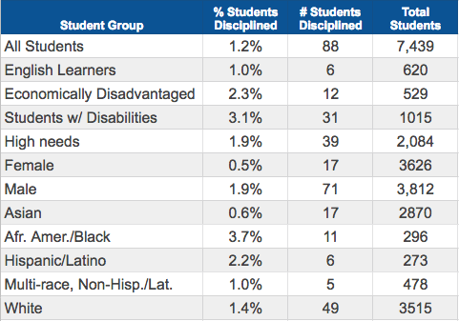
2017-18: 1 or More Suspensions By Subgroup (% of students)
How do suspension rates vary by subgroup?
Interpretive example:
In 2017-18, 88 students or 1.2%
of LPS students received one or more suspension.
Notes:
The next few slides we’ll share some highlights of the data we’ve been reviewing... this part of a review we did at administrative council; each school
This chart summarizes the latest suspensions from DESE, which takes us up to 2017-18 (note this is from last year)
Shows the % of students with one or more suspension, with each bar representing a particular subgroup.
Overall rates of this type of discipline continues to remain very low (note the vertical axis... only scaled up to 15%) - In 2017-18 1.2% or 88 LPS students received one or more suspension -
However, the overall number of suspensions was not and is not the issue, what was, was the facts that our rates vary by subgroups of students
Why proportionality is important - if all things being equal, we would expect to see the same rates of students grouped according to these different characteristics
Looking at the bar across the graph, .we see students with disabilities and African American/black students experienced higher rates of suspension than other groups.
Other groups of interest… differences between male & female...keeping an eye on economically disadvantaged & hispanic/latino

Slide 8
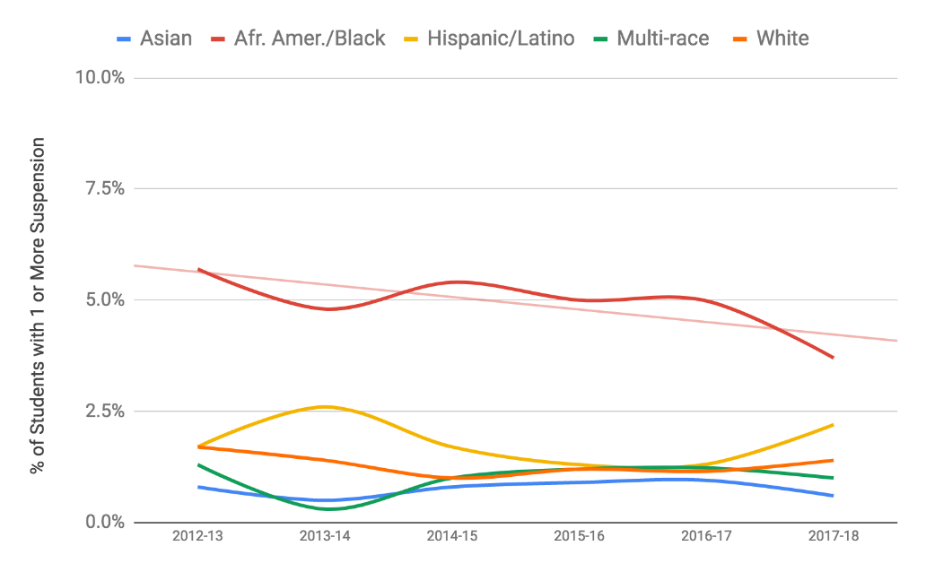
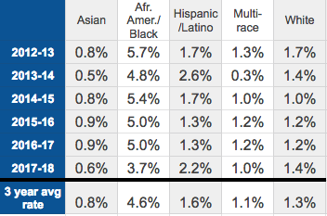
2013 to 2018: LPS % Students Disciplined By Race
How do suspension rates vary by race/ethnicity over time?
Notes:
We can verify this pattern, especially in the case of small group, by considering the picture over time
Each line represents a different racial/ethnic group..
Evident is the gap between African American/Black students -- shown by the red line above all others…
This existence of a gap has been consistent over the 6 years of this data set
We can also see this in the three year average
We do have signs of a downward trend…
Important to acknowledge that this isn’t necessarily consistent across the district; there were decreases for this group at the middle school, but not at the high school
But the gap still there and we need to continue our work
Additional Notes:
In the last published year 2017-18, African American students were 2.6 times more likely than white students… just over 6 times more likely than Asian students…
Last year this was a little more than 4 times more likely than white students to have one or more exclusionary discipline incident; Compared to our Asian students, who have consistently much lower percentages of students disciplined, African American students were over 13 times more likely than Asian students to have one or more exclusionary discipline incident)
Add note about small sample sizes

Slide 9
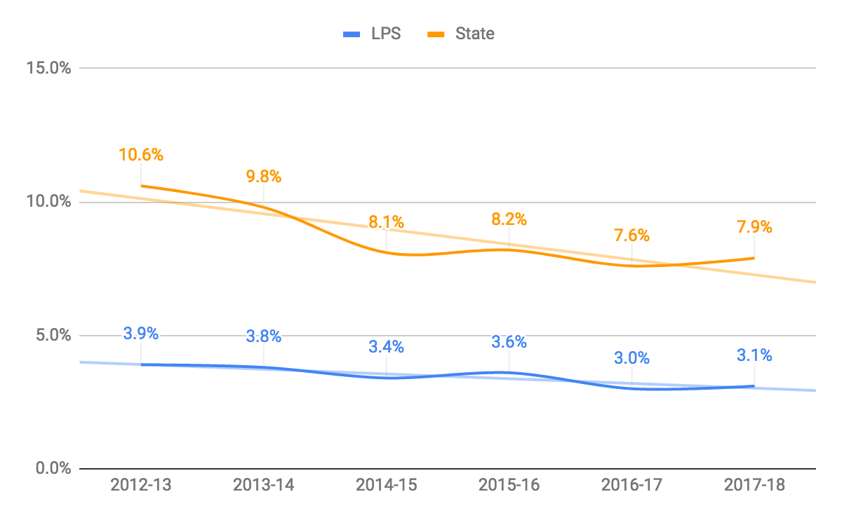
LPS vs. State: % of Special Education Students Disciplined
How do suspension rates for LPS students receiving special education services compare to the State?
 | 3 year Average
LPS | 3.2%
State | 7.9%
Notes:
Doing the same examination for special education students… rates over time, LPS in orange, state in blue
Our rates are much lower than the state.
We again see a downward trending at both the state and district level… these rates are still higher than the overall rates and rates for student
Note: Both these represent K- 12 rates and are not directly comparable to our school rates.

Slide 10
2018-19: 1 or More In- & Out-of-School Suspensions by Subgroup (Students)
Where do we stand so far this year? How do suspension rates vary by subgroup?
 | Total # of ISS = 22 | Total # of OSS = 50
 | # students with 1 or more in-school suspensions | # students with 1 or more out-of-School suspensions | # students with 1 or more suspension | Total enrollment as of 3/12/19 | % suspended (1 or more time this year)
All Students | 20 | 41 | 56 | 7312 | 0.8%
English Learners | 2 | 0 | 2 | 615 | 0.3%
Students w/ Disabilities | 6 | 18 | 21 | 934 | 2.3%
Free or Reduced Lunch | 5 | 5 | 8 | 420 | 1.9%
METCO | 2 | 1 | 3 | 215 | 1.4%
Female | 3 | 9 | 11 | 3577 | 0.3%
Male | 17 | 32 | 45 | 3734 | 1.2%
Asian | 4 | 9 | 11 | 2907 | 0.4%
Afr. Amer./Black | 3 | 5 | 8 | 292 | 2.7%
Hispanic/Latino | 0 | 2 | 2 | 297 | 0.7%
Multi-Race | 1 | 5 | 6 | 506 | 1.2%
White | 12 | 20 | 29 | 3496 | 0.8%
As of 3/19/19
Notes:
The next two will summarize where we stand this year…
At the time of our last review, which was March 19, we had 72 suspensions, 22 in-school and 50 out-of-schools
The Overall rates continues to be low, but still signs of disproportionality… still see rates highest for out students with disabilities & african american/black students
Notes:
Numbers not adding up:
1 student listed as non-binary; in terms of gender
9 - missing race
1 emergency removal

Slide 11
2018-19: In- and Out-of-School Suspensions (Incidents)
Where do we stand today? What are LPS students suspended for?
 | In-School Suspension (Total Incidents = 22) | Out-of-School Suspension (Total Incidents = 50) | All (Total = 72)
Drug use or possession (e.g. Marijuana) | 2 | 17 | 19
Weapon | 0 | 7 | 7
Tobacco | 3 | 4 | 7
Attendance violation - leaving the building | 4 | 2 | 6
Threat | 2 | 4 | 6
Theft | 2 | 3 | 5
Harassment of another student (non-sexual) | 1 | 3 | 4
Physical altercation - mutual | 3 | 0 | 3
Dishonesty (plagiarism) | 2 | 1 | 3
Physical altercation or attack | 1 | 2 | 3
Alcohol | 1 | 2 | 3
Violation of rules | 0 | 3 | 3
Harassment of another student (sexual) | 0 | 1 | 1
Unauthorized area (e.g. roof) | 1 | 0 | 1
Obscene behavior | 0 | 1 | 1
As of 3/19/19
Notes:
Here we have the reasons for students are suspended…
Most common reason for a suspension involved some kind of tobacco or drug use (reason these are co-mingled together...)
Notes:
Harassment of other student - incidents often had some kind of racial component (N-word, harassment of a muslim student)
Weapon (Knife, pepper spray, fake gun or olive pit - when asked why a student had it, said it was for protection)
Unauthorized area (student accessed the roof)
Violation of rules - this was cleaned up a bit, sometimes this included things that should be coded something else - attendance violations, weapon, violation of entry contract

Slide 12
LEXINGTON PUBLIC SCHOOLS - DEI PROMISING PRACTICES
Clear direction and support from School Committee (e.g., Supt./School Committee Norms and Beliefs include equity; Equity Audit; new DESS position; lots of great liaison work being done by SC members, etc.)
Director of Equity and Student Supports - (1) to provide professional learning; and (2) to act as a liaison for staff and community members
Shared Understanding, Alignment of Purpose, and Ownership of the Problem
DEI Goals for all administrators (levers for autonomy and innovation)
Curriculum Review with equity audit lens
Admin. Council Case Study Protocols
Engaging the Community in Solutions
Outreach in writing and in person to community members (i.e., the 25 Anticipated Reviewers mentioned in DEI paper)
Community Input Teams
Significant Professional Learning Opportunities (70+ high-quality PL sessions; EOC Affinity Group; Better Beginnings, etc.)
Student activism is increasing (e.g. IDEAS, student-led petitions, Lift Every Voice Challenge & Black National Anthem, etc.) Student-led petitions

Slide 13
Our Challenges
Communication. Two types of challenges: (a) Tricky Messaging - deciding what problem to solve inadvertently suggests that we aren’t interested in solving others; (b) the need for constant DEI updates (see Community Report).
Resist the quick-fixes. People are quick to offer their preferred solutions to the problems (add this curriculum, adopt that 10 point checklist, declare a moratorium on all types of suspension), but sometimes they are slow to understand the need for systemic change.
The initial tendency to talk about anything but race (e.g, socioeconomics).
We have made mistakes along the way and the work is hard, but you have to keep at it.

Slide 14
Next Steps
DEI: Our Call to Action paper revised and updated
DEI Community Input Teams up and running
Recruit and retain diverse staff
Expansion of inclusionary efforts
Cultural proficiency - more work on mandatory professional learning for all staff, as well as students and parents/caregivers
Incorporate DEI work into Lexington’s Strategic Plan
Continued effort and focus on addressing other areas of concern (e.g., LGBTQIA+ reports of bullying and harassment at school and online; suicidal ideation).

Slide 15
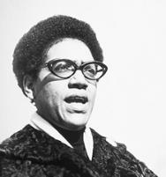
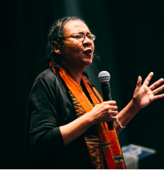
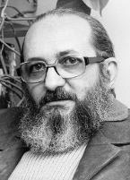
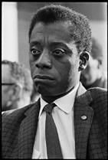
The Office of Equity, Diversity and Community Development
“Liberating education consists in acts of cognition, not transferals of information.”
Framingham Public Schools

Slide 16
Notes:
Prompting Question: What values and morals were instilled in you?
How do I identify?
Race? Gender? Ethnicity?

Slide 17
Assistant Superintendent
Equity, Diversity & Community Development
Joseph Corazzini
Executive Assistant
Najee Nunnally
Director
BLOCKS
Rosario Alvarez
Director
Community Resource Development
Tiffany Lillie
Early Childhood Alliance
Coordinator
Jane DeHaven
Director
Parent Information Center
Mikaele Neves
Director
Adult ESL
Kevin O’Connor
Early Education
Adult Learning
Equity
Family & Community Engagement
Diversity & Inclusion
Equity

Slide 18
Check Your Lens
Notes:
Check your bias. What does bias mean? Bias = Prejudice. Prejudice = preconceived opinion not based on fact or e

Slide 19
Terminology
Bias: Thoughts and feelings we have, and may not be aware of; implicit biases are preferences or aversions that permeate our world view without our conscious knowledge and become explicit when openly expressed (blonds have more fun).
People of color/ Children of color:include those identifying as African American/Black, Latino, Native American, Asian or Pacific Islander, and biracial. These identities constitute 30% of the US population and are among the fastest growing populations in the country. Any child in this category, born in the US, immigrant, refugee, or temporary resident is included in this category for this purpose.
Equity: Equity means promoting just and fair inclusion throughout FPS and creating the conditions in which everyone can participate, prosper and reach his or her full potential.

Slide 20
Terminology
Inclusion: A value and practice of ensuring that people feel they belong and that their input is valued by the whole (group, organization, society, system, etc.), particularly regarding decisions that affect their lives. (Adapted from Equity and Inclusion Campaign).
Prejudice: A pre-judgment or unjustifiable, and usually negative, attitude of one type of individual or groups toward another group and its members. (distaste, fear, repulsion, anger, frustration, pity, etc.)
Race: A socially constructed way of grouping people based on skin color and other apparent physical differences, which has no genetic or scientific basis. The concept of race was created and used to justify social and economic oppression of Blacks and other people of color by Whites. Highly dependent on phenotype, skin color, hair texture, and facial features. (From Race: The Power of an Illusion)
Racism: = Prejudice + Power

Slide 21
“We have to recognise that there cannot be relationships unless there is commitment, unless there is loyalty, unless there is love, patience, persistence.” “Never forget that justice is what love looks like in public.”
Cornell West

Slide 22
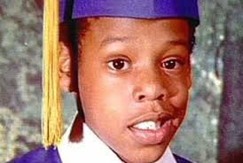
Sean Carter
“Now, all the teachers couldn't reach me
And my momma couldn't beat me
Hard enough to match the pain of my pops not seein' me
So, with that disdain in my membrane
Got on my pimp game; f*** the world, my defense came.”
Notes:
I love hip-hop because it has always been the stories of the oppressed wrapped poetically to a beat carrying the unheard struggles and dismissed conditions of Les Miserables.

Slide 23
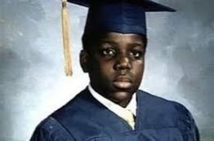
Christopher Wallace
“This is for all of the teachers who told me I’d never amount to nothing”
“Considered a fool 'cause I dropped out of high school. Stereotypes of a black male misunderstood And it's still all good”
“We used to fuss when the landlord dissed us No heat, wonder why Christmas missed us”

Slide 24
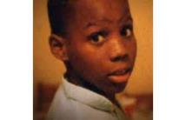
Earl Simmons
“Group homes and institutions, prepared my a** for jail They put me in a situation forcing me to be a man When I was just learning to stand without a helping hand Damn, was it my fault, something I did To make a father leave his first kid at seven doin my first bid”

Slide 32
Notes:
Who is right? Who is wrong?

Slide 33
Black Male
Conservative Christian
Queer Woman of Color
Documented Citizen
College Graduate
Able Bodied Individual
White Woman
Middle Class

Slide 34
As an educator, how are you working actively everyday to check the privileges you carry into the classroom?

Slide 35
The Audit
What it is and What its not…
Setting the Stage
Understanding the Issues
Defining Where You Want to go Deeper
Prep the Data
Establishing Your Goals
Aligning Your Goals and Needs to Your Budget
Partnering with Higher Ed Partners

Slide 36
Using Equity Audits to Improve Educational Opportunities
Doreen Cunningham
Assistant Superintendent for Diversity, Equity, and Human Resources
Amherst-Pelham Regional Public Schools
July 13, 2019

Slide 37
ARPS School Committee Policy ACB
AFFIRMATIVE ACTION ON CULTURAL DIVERSITY
The School Committees will provide students with (1) a school staffing environment in which such cultural diversity is clearly present, and (2) a selection of instructional programs which reflect the value of this cultural diversity.

Slide 38
POLICY GOALS
Obtain, retain, promote, qualified culturally diverse staff
Employ qualified staff which reflects the diversity of student body
Create partnerships to support the development of a diverse applicant pool
Implement instructional programs to create awareness
Provide informational and educational programs
Superintendent will develop implement and evaluate

Slide 39
SETF* GOALS
Eliminate racial disparities in discipline of students
Increase the percentage of people of color in each category of school district employees, annually, until it approximately equals the percentage of students of color
Broaden and deepen the learning of faculty, staff and administration about race and racism with special emphasis on systemic racism and unconscious bias and other equity issues
Increase the enrollment and success of students of color and low-income white students in Honors and AP classes
Create a Restorative Justice Program
*School Equity Task Force, a community subcommittee of the Regional School Committee

Slide 40
PROCESS
“First step toward change is awareness” -Nathaniel Branden
Reviewed previous policies:
Audit of licenses
Hiring process
Professional Development
Discipline Data
Course Offerings (staff, students)

Slide 41
PRIOR HIRING PROCESS
Choose a few candidates to interview
Share resumes with committee (SchoolSpring, hardcopy, PDF)
Discuss resumes with the committee (prior to or between candidates)
Interview
Discuss the interview and the candidates’ ability to answer the questions
Select a finalist or two to move forward
Superintendent meets candidate(s)
Search successful or failed

Slide 42
FINDINGS
FINDINGS
There is bias in the hiring process (implicit, affinity, confirmation)
We are working to reduce this bias through our training that is a prerequisite for all participants in the process
Exclusions - ‘not a good fit’ ‘hit the ground running’
Not enough candidates applying or moving forward
Hiring the same -per statistics
ADJUSTMENTS
Structural changes were needed:
Gather two diverse and distinct committees (screening, interview etc.)
Resumes will not be shared with interview committee
Continuous training (bias, culture)

Slide 43
EQUITY PROFESSIONAL DEVELOPMENT
(Who, What, When?)
FINDINGS
Professional development led primarily by outside consultants
Accountability limited
Topics generated without staff input
Pockets of individuals meeting to further their understanding of equity outside of the work day
ADJUSTMENT
Half day, district-wide professional development
Majority of workshops are teacher/student led
Topics generated via staff survey and committee
All staff in attendance (food service, clerical, maintenance, custodial, paraeducators, etc.)
Majority of staff choose 2 workshops

Slide 44
SAMPLE PD OFFERINGS
Gender and Sexual-Identity Inclusive Classrooms: Strategies that Build Community
Getting to know Restorative Justice
Teacher Dispositions for Culturally Responsive Instruction
Laying the Groundwork for Having Difficult Conversations About Race Part 2
Creating Gender-Inclusive Classrooms: Girls, Boys, Transgender Students, Non-Binary Students, and All of Us Deserve to Learn Here
Implicit Bias and The Process of "Unbiasing"
Informed practices to assist with de-escalation of challenging student behavior
The Myth of Colorblindness: Helping Educators Recognize the Role of Race in the PreK-12th Grade Classrooms
Diversifying Texts, Diversifying Reading

Slide 45
INFRACTIONS
Skipping/Out of bounds
Defiance/Insubordination/Non-Compliance
Disruption
Technology Violation
Inappropriate Language
Physical Contact/Aggression/fighting
Harassment (Non-Sexual)

Slide 46
DISCIPLINE DATA
Total # of referrals in Educators Handbook
2016 - 2017
740 total referrals
78 reporters
26 reporters with 10+
15 students with 10+
14 with an IEP or 504 plan (none are listed as English Language Learners)
2017 - 2018
789 total referrals
77 reporters
24 reporters with 10+
19 students with 10+
15 with an IEP or 504 plan (3 are also English Language Learners)

Slide 47
HIGH SCHOOL
Total # of referrals in Educators Handbook
2018 - 2019
493 total referrals (Both intervention/disciplinary)
79 reporters
15 reporters with 10+
10 students with 10+
7 of the 10+ with an IEP or 504 plan (none are listed as English Language Learners)

Slide 48
CAUSAL FACTORS?
District-wide professional development
Continuous teacher trainings (i.e. 1st & 2nd year teachers)
Questions/ RJ work incorporated at the end of every staff meeting
RJ program
Relationships being formed (staff/student, staff/parents)
Other (‘active and engaging approach to working with students’)

Slide 49
POSITIVES
School Committee (SC) and Superintendent
Shared Beliefs and Collective Values
Support and Collaboration
Constructive Feedback
Commitment to funding initiatives
Many members of SC willing to participate and understand (i.e. RJ practices)

Slide 50
PITFALLS

Slide 51
PITFALLS
Limited:
Time
Community understanding
Buy-in
Funding
Staff support

Slide 52
CunninghamD@ARPS.org
413-362-1803 Office 860-490-2719 Cell

Slide 53
QUESTIONS?

