Slide 1
70 on 70
+
minutes
Chapter
The Massachusetts landmark funding law as it stands
and as it stands to change

Slide 2
Tracy Novick, MASC Field Director
tnovick@masc.org
508-579-5472
@tracynovick

Slide 3
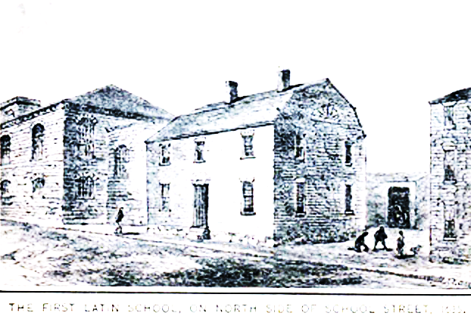
1620: English settlers in Plymouth
1628: English settlers in Boston
1635: Founding of Boston Latin
1636: Founding of Harvard College

Slide 4
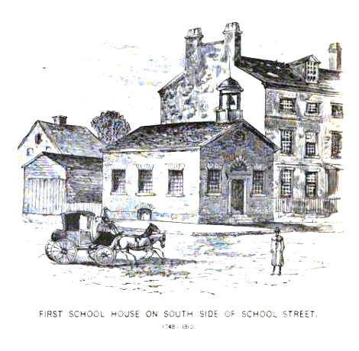
1646: Colony institutes taxes on “visible estate”
1647: Colony mandates creation and maintenance of
public schools

Slide 5
“It being one chief project of that old deluder, Satan, to keep men from the knowledge of the Scriptures…”
Required a school in every settlement of fifty families or more
Required a grammar school in every settlement of a hundred families or more
Paid for by parents or “by the inhabitants in general, by way of supply, as the major part of those that order the prudentials of the town shall appoint”
=schools for all paid for by local taxes
“Ye Old Deluder Satan” Act (1647)

Slide 6
What happens when education is locally funded?
Those that have fund more
Those that don’t have fund less
This Photo by Unknown Author is licensed under CC BY-SA
Plus communities with fewer resources
often have greater needs.

Slide 7
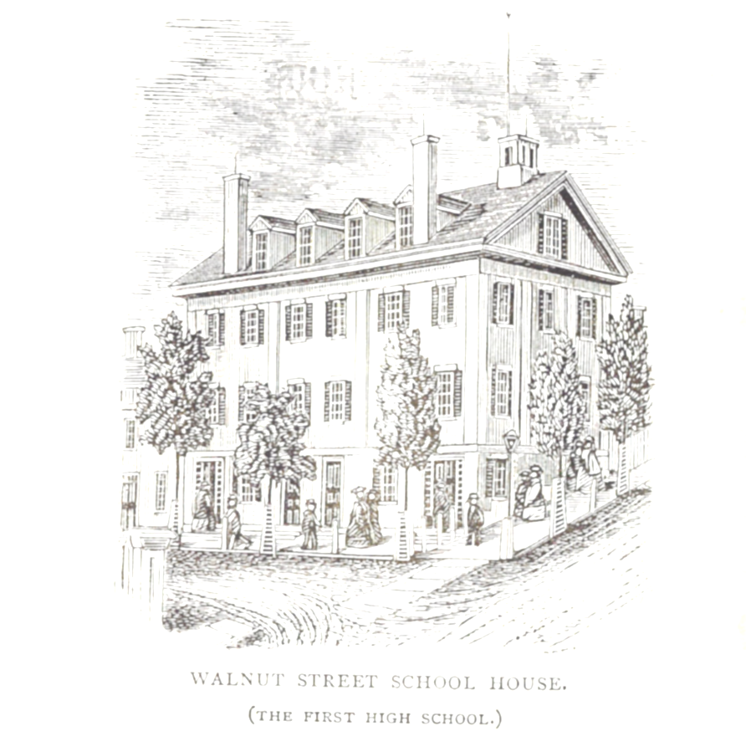
1779: Constitution of the Commonwealth
Wisdom, and knowledge, as well as virtue, diffused generally among the body of the people, being necessary for the preservation of their rights and liberties; and as these depend on spreading the opportunities and advantages of education in the various parts of the country, and among the different orders of the people, it shall be the duty of legislatures and magistrates, in all future periods of this commonwealth, to cherish the interests of literature and the sciences, and all seminaries of them; especially the university at Cambridge, public schools and grammar schools in the towns; to encourage private societies and public institutions, rewards and immunities, for the promotion of agriculture, arts, sciences, commerce, trades, manufactures, and a natural history of the country; to countenance and inculcate the principles of humanity and general benevolence, public and private charity, industry and frugality, honesty and punctuality in their dealings; sincerity, good humor, and all social affections, and generous sentiments among the people.

Slide 8
“…spreading the opportunities and advantages of education in the various parts of the country, and among the different orders of the people…”
“…it shall be the duty of legislatures and magistrates…”

Slide 9
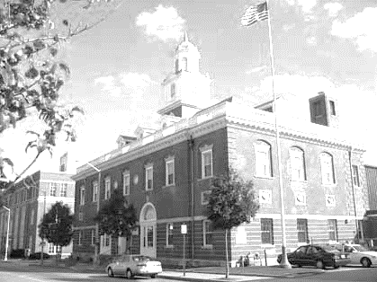
1993: McDuffy v. Secretary of the Executive Office of Education
“What emerges also is that the Commonwealth has a duty to provide an education for all its children, rich and poor, in every city and town of the Commonwealth at the public school level, and that this duty is designed not only to serve the interests of the children, but, more fundamentally, to prepare them to participate as free citizens of a free State to meet the needs and interests of a republican government, namely the Commonwealth of Massachusetts.”

Slide 10
The state thus is faced with two questions:
How much does it cost to educate a child in Massachusetts?
Who is going to pay for it?

Slide 11
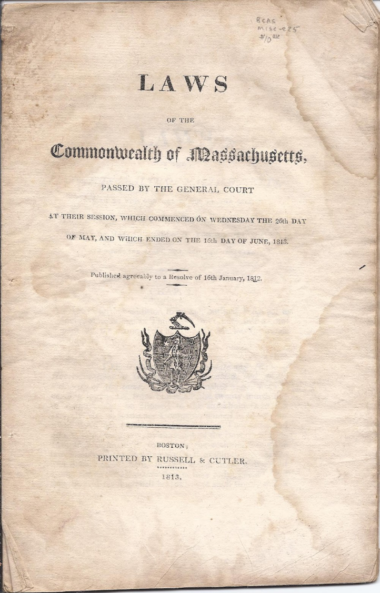
Massachusetts General Law Chapter 70, section 1
“It is the intention of the general court, subject to appropriation, to assure fair and adequate minimum per student funding for public schools in the commonwealth by defining a foundation budget and a standard of local funding effort applicable to every city and town in the commonwealth.”

Slide 12
“Chapter 70” thus is just shorthand for…
State funding for education

Slide 13
Chapter 70: SCHOOL FUNDS AND STATE AID FOR PUBLIC SCHOOLS
Section 1 Legislative intent
Section 2 Definitions
Section 3 Foundation budget; regulations; calculation of budget
Section 3A Data necessary to generate required minimum local contribution and state aid components; house and senate committees on ways and means; bi-monthly updates
Section 4 Foundation budget review commission; membership; recommendations
Section 5 Municipalities receiving overburden aid; reductions
Section 6 Contributions by municipalities for support of local schools and school district
Section 6A Recalculation of annual minimum required local contribution; appeal for adjustment; reduction; guidelines for implementation
Section 7 Reductions in amount appropriated
Section 8 Districts' methods for allocating appropriated funds; under-performing districts; restrictions
Section 9 Reports on amounts spent for certain expenses
Section 10 Aid paid to municipalities and districts; amounts
Section 11 Excess funds; application to following fiscal year
Section 12 Determination of amounts appropriated
Section 13 Allocation of funds
Section 14 Exemption of certain districts from chapter
Section 15 Applicability of chapter

Slide 14
“to assure fair and adequate minimum”
Teachers
Supplies
Professional development
Administrators
Principals
Facilities
Support for students
Benefits
out of district
preschool
kindergarten
elementary
special ed
middle
English learners
high
vocational

Slide 15
Important note:
As of this presentation, Massachusetts does not have a final FY20 budget.
The following, therefore, are NOT the final Chapter 70 calculations.

Slide 16
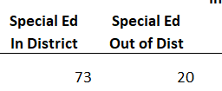
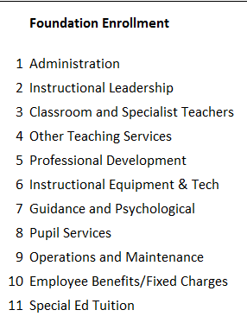
Calculating an adequate education: Greenfield

Slide 17
FY20 House Ways and Means Foundation budget rates

Slide 18
FY20 Senate Ways and Means Foundation budget rates

Slide 19
House Ways and Means Special education* rates
*assumed rate:
3.75% of enrollment for in-district
1% of enrollment for tuitioned-out

Slide 20
Senate Ways and Means Special education* rates
*assumed rate:
3.75% of enrollment for in-district
1% of enrollment for tuitioned-out

Slide 21
House Ways and Means English learners increment

Slide 22
Senate Ways and Means English learners increment
?

Slide 23
House Ways and Means economically disadvantaged by decile increment
• Supplemental Nutrition Assistance Program (SNAP)
• Transitional Assistance for Families with Dependent Children (TAFDC)
• Department of Children and Families' (DCF) foster care program
• MassHealth (Medicaid)

Slide 24
Senate Ways and Means economically disadvantaged by decile increment
• Supplemental Nutrition Assistance Program (SNAP)
• Transitional Assistance for Families with Dependent Children (TAFDC)
• Department of Children and Families' (DCF) foster care program
• MassHealth (Medicaid)

Slide 25
Inflation rate*
*Price Deflator Index for State and Local Governments

Slide 26
Your district foundation budget
Foundation budget amount per pupil
x enrollment in each category
+ increments above the base
= district foundation budget

Slide 27
Adding it up for Greenfield in FY20:
House Ways and Means
category | enrollment | Per pupil $ | total
Preschool | 68 | $4,029 | $274,002
Full day K | 157 | $8,059 | $1,265,262
Elementary | 832 | $8,106 | $6,744,166
Middle | 469 | $7,771 | $3,644,525
High | 495 | $9,538 | $4,721,562
Vocational | 2 | $14,383 | $28,765
In-district sped* | 73 | $27,168 | $1,983,256
Out-of-district sped* | 20 | $29,629 | $592,588
ELL PreK-5 | 63 | $2,177 | $137,162
ELL 6-8 | 17 | $2,721 | $46,265
ELL 9-12 | 24 | $3,266 | $78,378
Econ. Disadvantaged* | 953 | $4,144 | $3,948,975
Total | 1989* |  | $23,464,904
Increments above the base are in italics
Categories with zero students not included

Slide 28
Adding it up for Greenfield in FY20:
Senate Ways and Means
category | enrollment | Per pupil $ | total
Preschool | 68 | $4,023 | $273,574
Full day K | 157 | $8,046 | $1,263,290
Elementary | 832 | $8,093 | $6,733,712
Middle | 469 | $7,756 | $3,637,477
High | 495 | $9,526 | $4,715,317
Vocational | 2 | $14,372 | $28,744
In-district sped* | 73 | $27,167 | $2,010,387
Out-of-district sped* | 20 | $29,458 | $599,157
ELL PreK-5 | 63 | $2,276 | $143,379
ELL 6-8 | 17 | $2,381 | $40,469
ELL 9-12 | 24 | $1,858 | $44,596
Econ. Disadvantaged* | 953 | $4,390 | $4,278,703
Total | 1989* |  | $23,758,804
Increments above the base are in italics
Categories with zero students not included

Slide 29
Foundation budget fast facts:
Districts must spend no less than 95% of this amount each year.
They can (and most do!) spend more.
This does not include all funds spent on education in a district: transportation, some rental property, a few other items are not included. Grants are not included in this amount, nor is capital spending.
This is intended as a “fair and adequate minimum.”

Slide 30
Now who’s going to pay for it?
“it shall be the duty of
legislatures and magistrates”

Slide 31
Where do we get education funding?
*Note: does not include teacher pensions or Mass School Building Authority
Notes:
This is a rough chart showing funding sources for K-12 education in Massachusetts, based on FY17 reporting

Slide 32
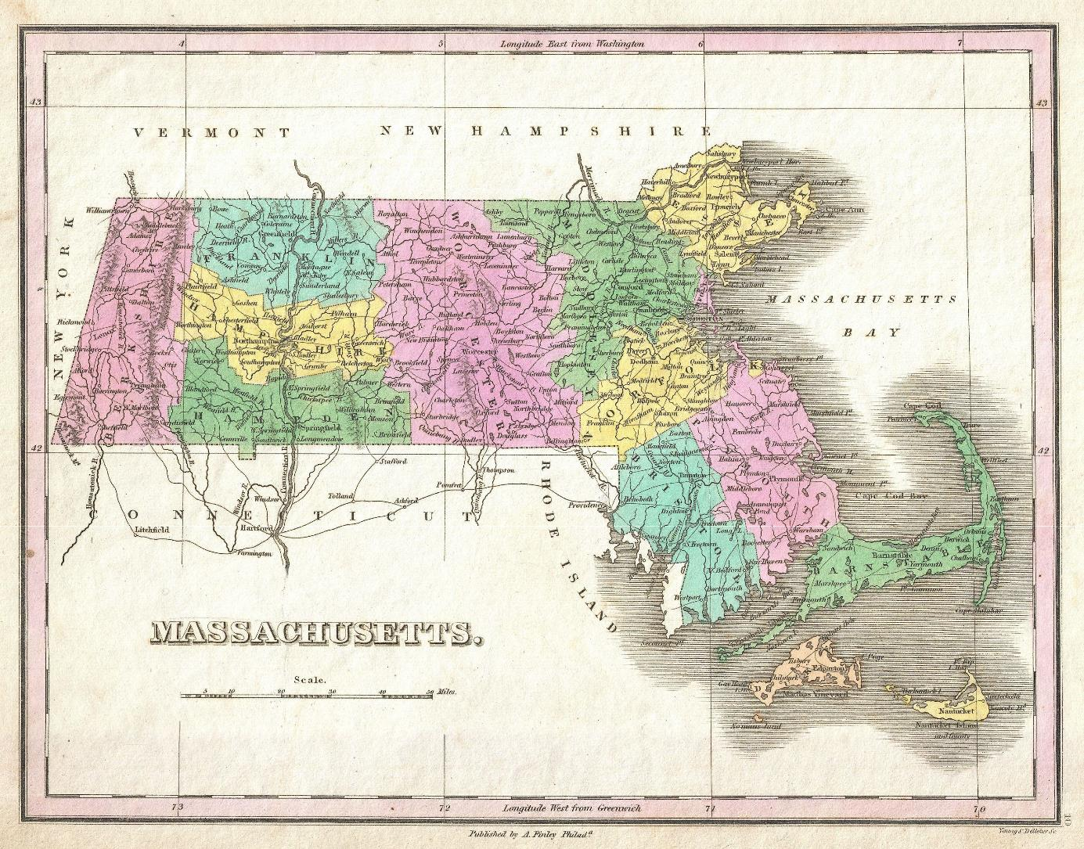
The foundation budget is intended to be funded with:
Little known fact:
59% local funding
41% state funding

Slide 33
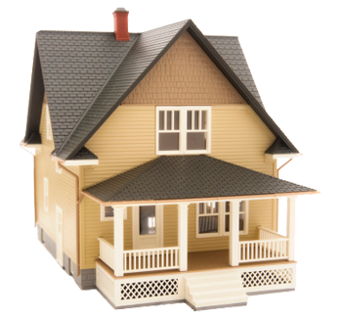
.3424
1.4845

Slide 34
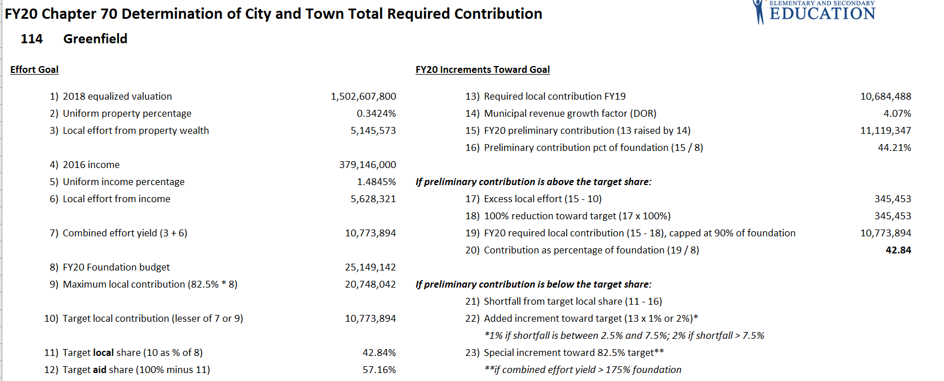
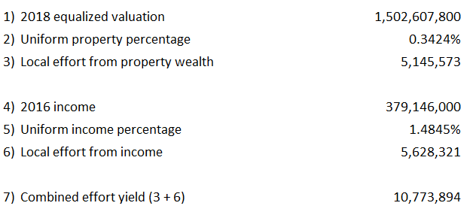
How Greenfield pays for foundation:
House Ways and Means
*
*includes Franklin County Regional assessment of $721,528

Slide 35
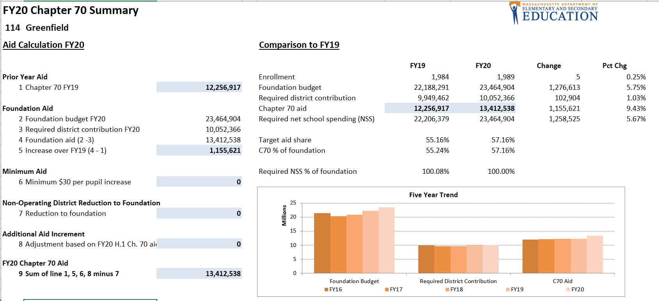
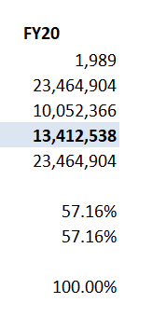
How Greenfield pays for foundation:
House Ways and Means

Slide 36
Remember:
that’s the FOUNDATION budget!

Slide 37
How Greenfield budgets for schools
$4,800,000
State and federal grants*
$3,000,000
Additional local contribution*
*based on past years; not actual

Slide 38
“How come they get more than we do?”

Slide 39
A tale of two districts
Waltham:
Student enrollment:
5605
Foundation budget FY20
$74,717,066
Fitchburg:
Student enrollment:
5798
Foundation budget FY20
$74,091,996
Notes:
Similar sized districts, similar sized foundation budgets.
However, the smaller district has the larger budget: how come?
Waltham: wage adjustment factor 9%; 2336 eco disad (decile 8); 349 voke; 1255 EL
Fitchburg: wage adjustment factor 0%; 3764 eco disad (decile 10); 2 voke; 818 EL
In this case, it’s largely the wage adjustment factor; stress student difference is usually way (in this case, voke and EL)

Slide 40
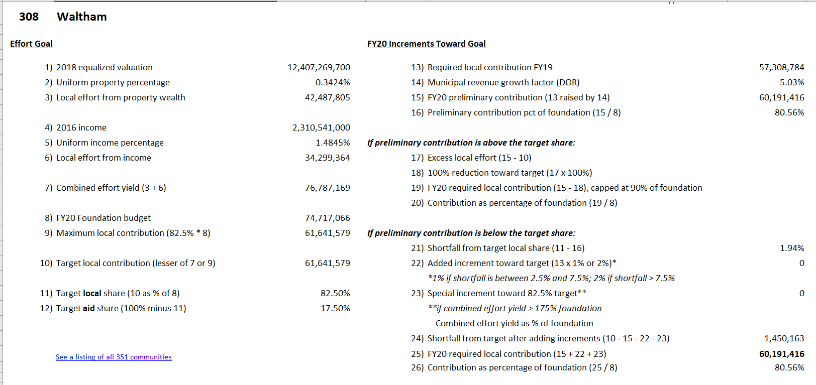
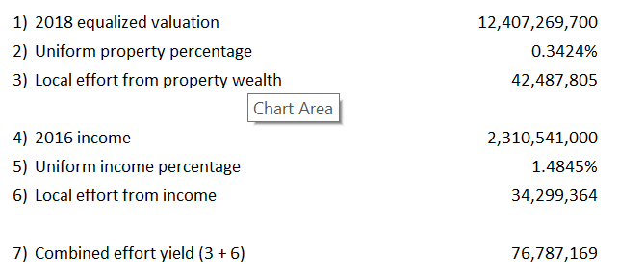
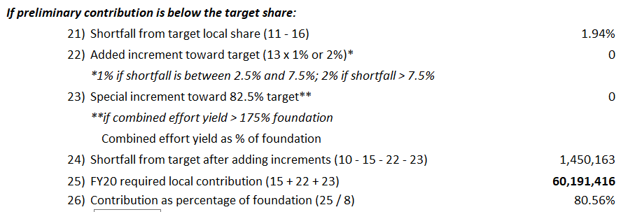
How does Waltham pay for schools?

Slide 41
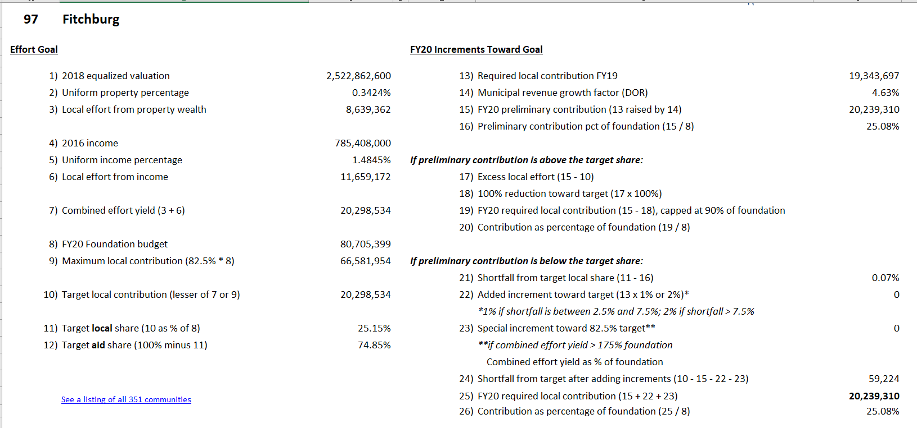
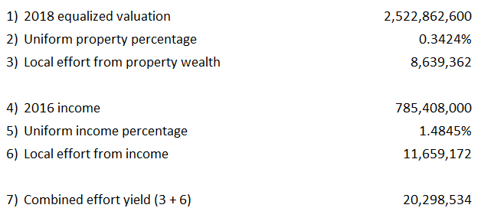
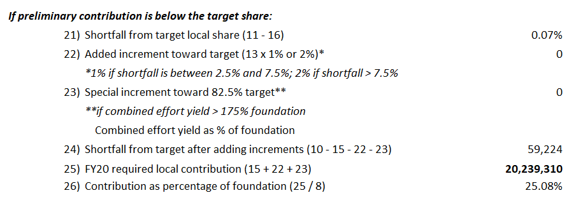
How does Fitchburg pay for schools?

Slide 42
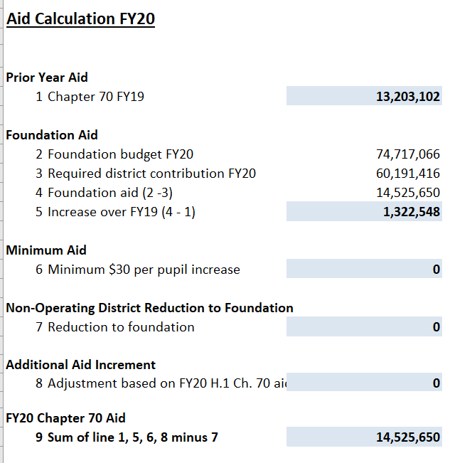
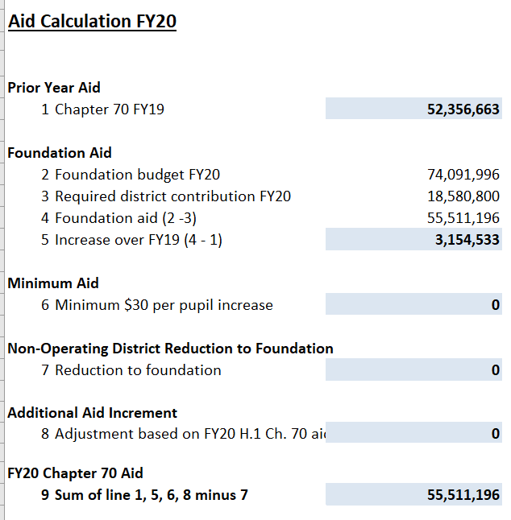
Chapter 70 aid
Waltham
Fitchburg

Slide 43
So hypothetically…
“The Steath Inequities of School Funding,” Bruce C. Baker and Sean Corcoran, The Center for American Progress, 2012.

Slide 44
Same foundation budget, Different aid levels, Different local contributions
BUT WE’RE NOT DONE…
*Actual for Waltham; estimate for Fitchburg

Slide 45
And why?
Waltham has the capacity to spend much more on its schools than Fitchburg, above and beyond the required contributions of the foundation budget.
Combined effort yield as a percent of foundation (FY20)

Slide 46
Same foundation budget, Different aid levels, Different local contributions
$16,881,261
$5,000,000
*Actual for Waltham; estimate for Fitchburg

Slide 47
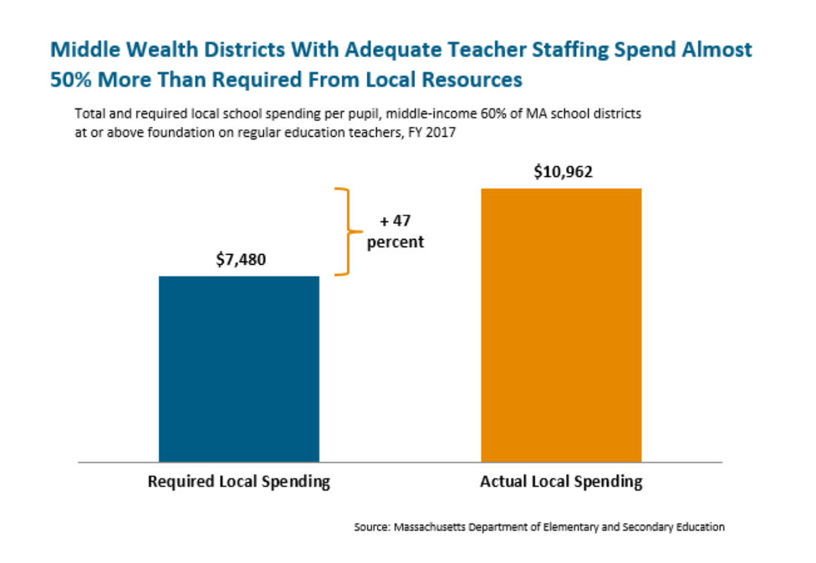
As is the case statewide:
Mass Budget and Policy Center, “Building an Education System that Works for Everyone,” July 2018

Slide 48
And so matters stood…

Slide 49
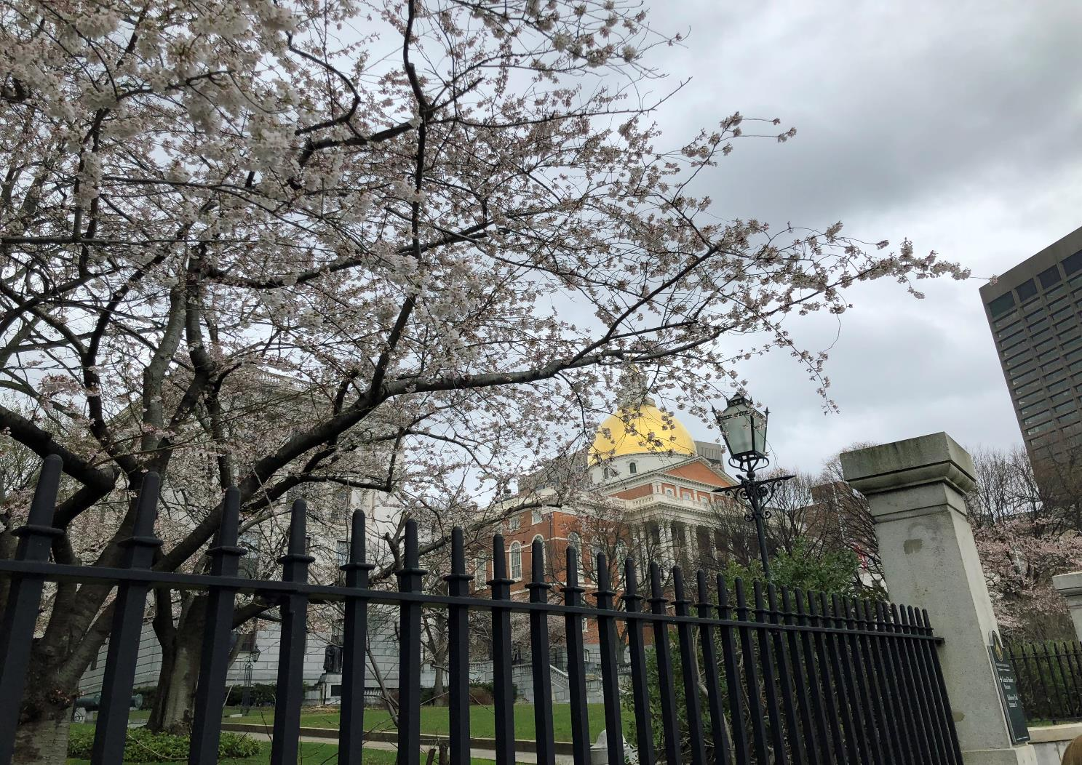
Foundation Budget Review Commission
Report issued October 2015 after months of hearings and research
Estimated that the cost of K-12 education in Massachusetts was undercalculated by at least $1 billion a year.

Slide 50
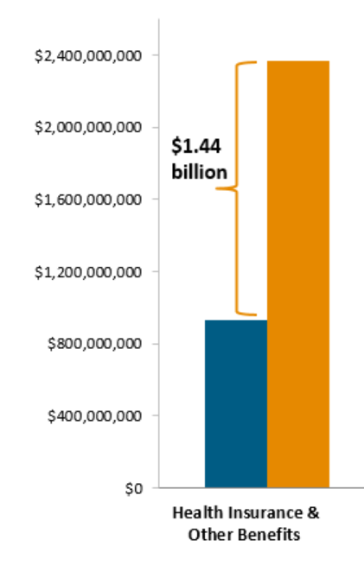
Foundation Budget Review Commission
Health insurance
adjust health insurance to be in line with average GIC rates
add retired health insurance to the foundation budget
calculate health insurance inflation separately from inflation of the rest of the budget
Mass Budget and Policy Center, “Building an Education System that Works for Everyone,” July 2018

Slide 51
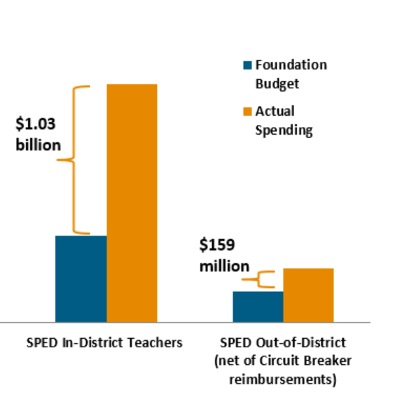
Foundation Budget Review Commission
Special education
change the assumed in-district special ed cost (from an assumed 15% of students to an assumed 16% of students
increase the out-of-district special ed cost rate to capture full cost before the circuit breaker is triggered
recognize "the growing use of inclusion as the preferred pedagogical model in the Commonwealth"
Mass Budget and Policy Center, “Building an Education System that Works for Everyone,” July 2018

Slide 52
Foundation Budget Review Commission
English Language Learners
make ELL an increment added to the base rate per pupil
include it for vocational students
make it the same rate at all levels, choosing the middle school level; this is to make up for the previous assumption that older kids required fewer services (or less funding), which has been found not to be the case.

Slide 53
Foundation Budget Review Commission
Low Income students
The Commission offers guidance that weighting should fall between 50-100% and cites the large number of programs --extended learning time, wraparound services, instructional improvement, class size reduction, early ed--that have been found to be successful with low income students, laying out some parameters on costs.
Note further that this includes districts posting a plan of what the district will do with additional dollars, but includes district flexibility to best meet student needs.

Slide 54
Foundation Budget Review Commission
It recommends establishment of a committee to improve data reporting, specifically around reporting of use of funding at a school level.
Additional recognitions (NOT RECOMMENDATIONS):
Early childhood education
Skipped inflation (year and quarter)

Slide 55
2016…
2017…
2018…
2019

Slide 56
2019 Legislative session
House 70, proposed by Governor Baker
House 576, proposed by Rep. Paul Tucker
House 586/Senate 238, proposed by Rep. Aaron Vega, Rep. Mary Keefe, and Senator Sonia Chang-Díaz
*
*”lacks sufficient detail to create a multi-year funding projection for comparison” per MassBudget

Slide 57
Health insurance
House 70 (Baker) | House 576 (Tucker) | House 586/Senate 238
Adjusted annually by employer costs in state GIC | Average active employee for previous three years for all GIC plans Weighted average for all retiree plans in GIC for previous three years | Adjusted annually by average annual rate for past three years of employer costs for all GIC plans

Slide 58
Special education
House 70 (Baker) | House 576 (Tucker) | House 586/Senate 238
Assumed 4%/4.75%* (voke) in-district Assumed 1% out-of-district (at 3x statewide average per pupil rate) | Assumed at 4%/5% (voke) in-district Assumed at 1% out-of-district (at 3x statewide average per pupil rate) | Assumed at 4%/5% (voke) in-district Assumed at 1% out-of-district (at 3x statewide average per pupil rate)
* Note: no change from current

Slide 59
Note:
Special education will still exceed actual spending by $700M/year per the Foundation Budget Review Commission.

Slide 60
English learners
House 70 (Baker) | House 576 (Tucker) | House 586/Senate 238
PreK-5 $2177 6-8 $2721 9-12 $3265 However, drops statewide count of EL students (includes only those who have not yet met or exceeded exit requirements) | PreK $1177 All others $2354 “bilingual” used in one section (not used since 2005) | $2537 for all grades

Slide 61
Low income (note: HWM sets Decile 10 at $4128)
House 70 (Baker) | House 576 (Tucker) | House 586/Senate 238
Decile 10 $4600 PLUS adds $181 “high needs” (decile 9 or 10 + EL) category | “not less than 50% of average per pupil expenditure” for decile 10 | Decile 10 ~$8251

Slide 62
House 70 also
Increases guidance/psychological support rate
Adds early college pathways category to foundation budget ($1050 over high school rate)
Creates study of tiered foundation budget for vocational programs
Switches charter reimbursement to 100/60/40 and only to increasing charter enrollment districts

Slide 63
House 586/Senate 238 also
Creates a floor for guaranteed state aid, net charter school costs
Allows district to choose to count low income through local form collection
Establishes a five-year cycle of foundation budget review

Slide 64
“What does this mean for me?”

Slide 65
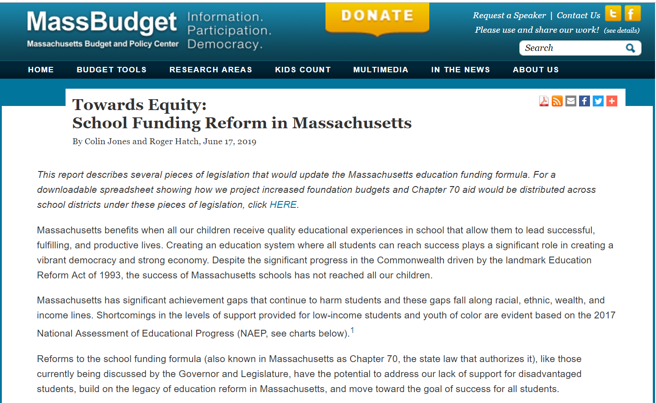

Slide 66
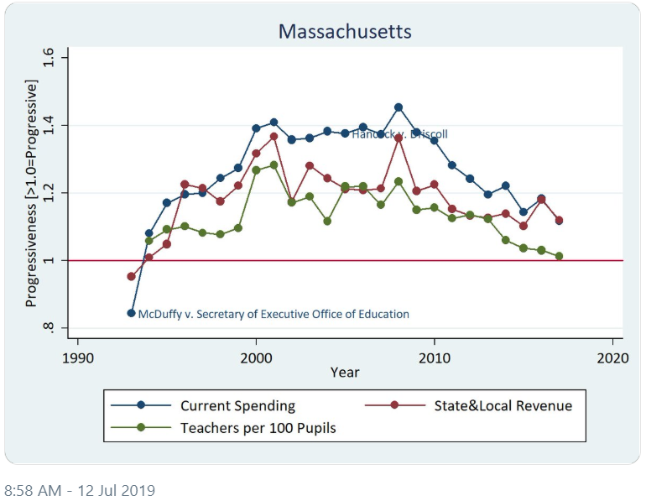
Adequacy and fairness are “largely the result of legislative choices.”
Professor Bruce Baker
Professor Bruce Baker (tweet 7/12/19)

Slide 67
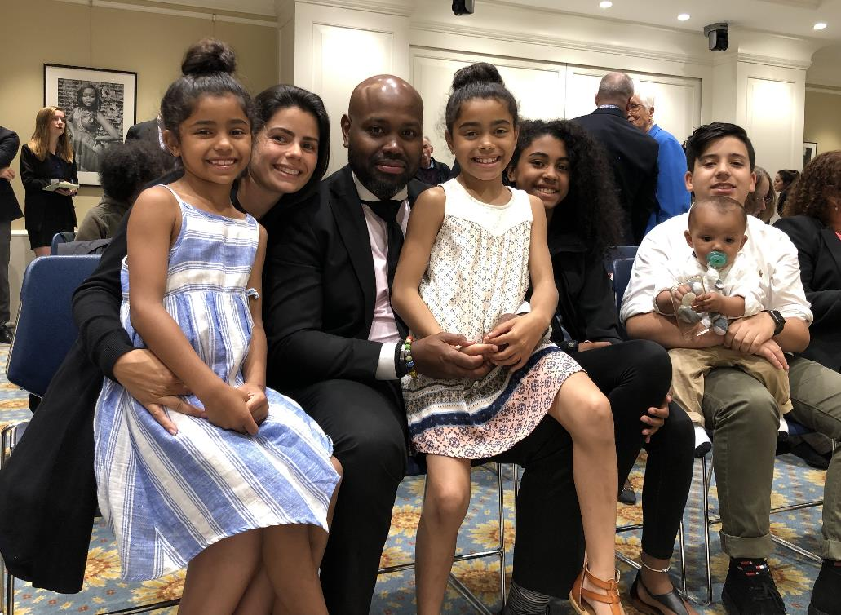
Mussotte v. Peyser

