Slide 1
Planning for Continuous Improvement: The importance of goal setting
Presenters:
Jim Hardy
Dorothy Presser

Slide 2
Your Primary Responsibility?

Slide 3
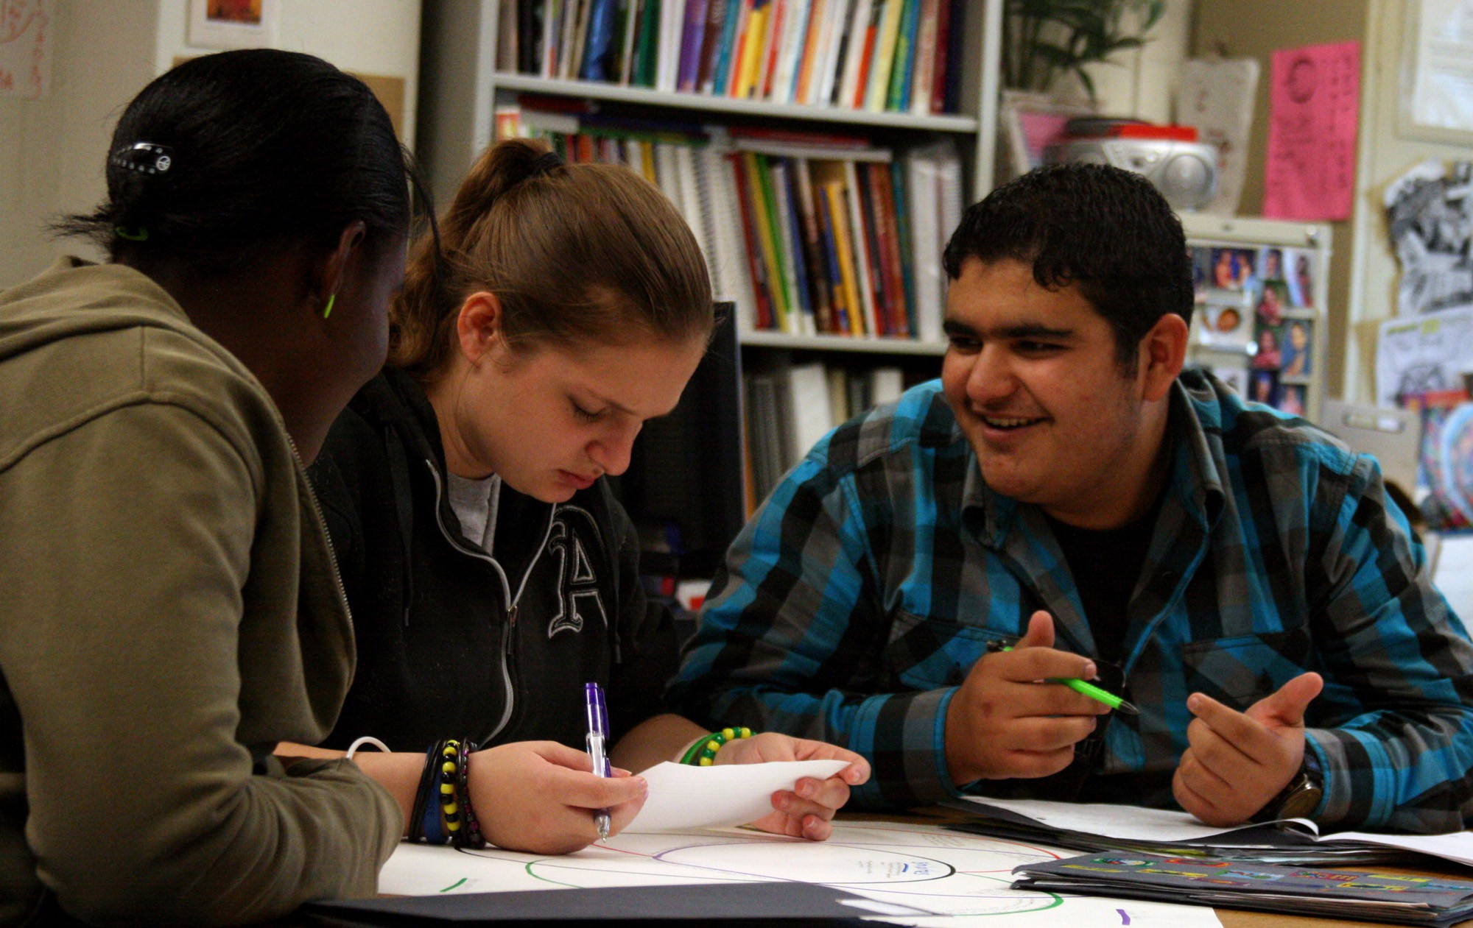
Continuous Improvement in Student Achievement

Slide 4
A Legal Responsibility
“The School Committee in each city and town and each regional school district shall….establish educational goals and policies for the schools in the district consistent with the requirements of the law and statewide goals and standards established by the board of education.” MGL 71:37

Slide 5
How Would You Rate Your Committee?
The district has no overarching goals for improving student outcomes
The SC has adopted overarching goals and the Superintendent and SC have agreed on annual goals, but they are not discussed that often
The SC and Superintendent have adopted overarching goals and agreed on annual goals. Once a year, they are used to evaluate the Superintendent
The SC had adopted annual goals and the Superintendent has used these in creating an improvement strategy for the district. The goals are a frequent topic of discussion and they often drive budget decisions and other policies
Notes:
Have participant hold up fingers, One number at a time. Spend some time discussing why. START WITH ZERO

Slide 6
Why does our organization exist?
What do we do?
For whom?
What’s the benefit?
The future we want to create
Where we want to be
Our North Star
Overarching Goals
A few carefully chosen, integrated initiatives that fulfill our mission and lead us to realize our vision.
Notes:
Dorothy

Slide 7
Our mission is to support and challenge all students to meet their full potential as individuals and citizens of the global community.
We will foster a culture of excellence in teaching and learning to create intellectually curious learners, broaden individual skills and talents and maximize each student’s potential.
Overarching Goals
Increase the professional learning of all staff and teacher leadership.
Strengthen social, emotional and behavioral health.
Improve curriculum, instruction, student support and assessment.
Improve communication across the district, with families and the community.
Notes:
JIM

Slide 8
Goal Alignment
Student Achievement
Teacher Goals
Administrator Goals
Superintendent Goals
School Committee Goals
School Improvement Plans
Overarching Goals
Notes:
DOROTHYresponsibility is ensuring alignment of goals throughout the district – from the overarching goals (District Improvement Plan, strategic plan) down to the classroom.

Slide 9
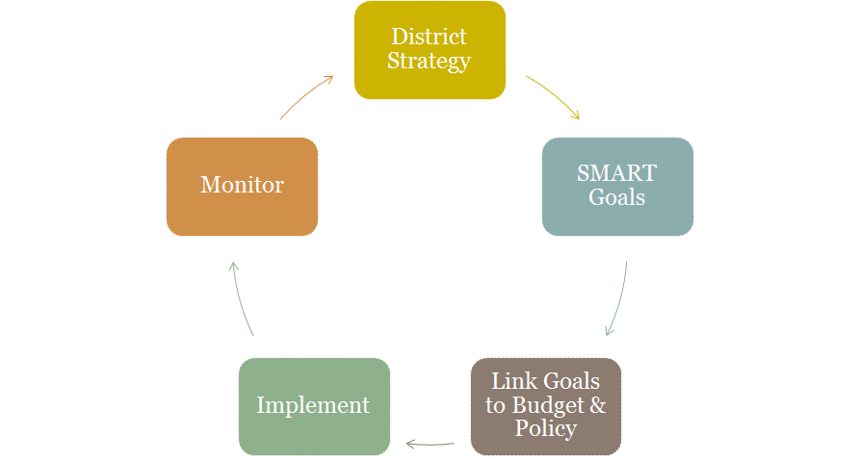
Continuous Improvement
Notes:
JIM

Slide 10
S.M.A.R.T. Goals
S = Specific and Strategic
M = Measurable
A = Action Oriented
R = Rigorous, Realistic, and Results Focused
T = Timed and Tracked
Notes:
Dorothy

Slide 11
Sample SC SMART Goal: Family and Community Engagement
Not a SMART Goal
We will communicate better with our stakeholders.
SMART Goal
By the end of the 2018-2019 school year, the School Committee will provide one article per quarter for the school newsletters and will provide copies of the articles to the local press. The SC will hold a public forum on the budget when it is introduced in January and another two weeks before Town Meeting. Success on this goal will be measured by inclusion of the articles in newsletters and by agendas for the public forums.
A
S
T
M
R
Notes:
JIM

Slide 12
How do you make sure it’s measurable?
Measuring progress and achievement
Outputs (Actions/process)
Outcomes (Results)
Benchmarks
Quantitative v Qualitative data
Notes:
DOROTHY

Slide 13
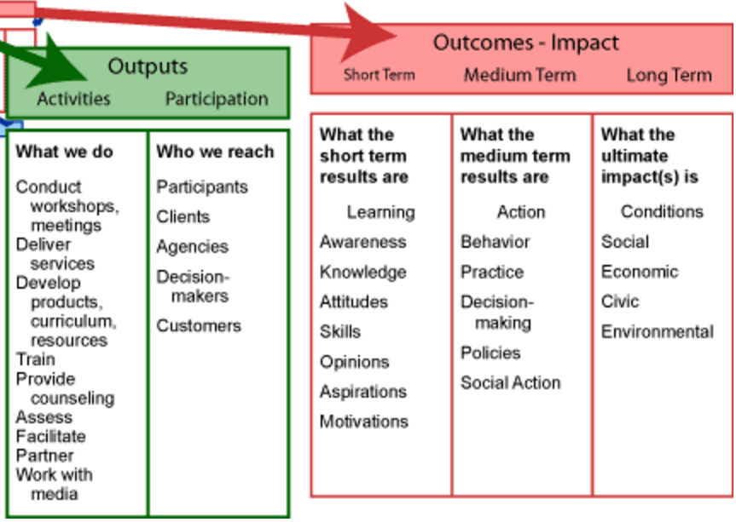
Outputs: Are the immediate results of the program activities included? Did we do what we said we would do? What evidence is there?
Outcomes: Did we articulate the impact the outputs have on our behavior, knowledge and skills, i.e., “Did we get the results we wanted?”
Notes:
DOROTHY

Slide 14
Sample Superintendent Goal: Instructional Leadership
Not a SMART Goal:
I will conduct 3 walk-throughs per month, covering each school at least twice during the school year.
SMART Goal:
I will conduct 3 instructional rounds per month, covering each school at least twice
during the year, with the school principal. The rounds will focus on observing the
implementation of differentiated instruction in classrooms. Success of this goal
will be measured by an increase in the number of classrooms using
differentiated learning strategies by the end of the school year.
Notes:
JIM Where do you see SMART

Slide 15
Time for you to construct your own SMART goals!

Slide 16
Topics You Might Choose:
Community Engagement
Budget Process
Policy
Professional Development
Any relevant topic

Slide 17
Discussion Prompts
Question | S | M | A | R | T
Why is this topic/focus important? | X Strategic |  |  | X Relevant
What/who will benefit and how? | X Specific |  |  | X Rigorous & Results- Focused
When will we achieve this goal? |  |  |  | X Realistic | X Timed
How will we know the goal has been achieved? |  | X Measurable
How will we demonstrate progress toward this goal? |  |  | X Action- Oriented |  | X Tracked
17

Slide 18
Goals Frame & Structure Work
Ensure Alignment
Monitor Progress
Budget Support
School Committee Goals

Slide 19
Governance
Management
Governance
Provide direction:
Mission
Vision
Review goals
Policy
Put plans in place to:
Accomplish goals
Implement policy
Monitor systems & procedures
Adjust to achieve desired results
Monitor accomplishment of goals & effectiveness of policy by:
Evaluate superintendent performance
Assess district results
Notes:
Dorothy: Who “owns” what work

Slide 20
Questions

