Slide 1
Open Meeting Law:
Balancing Government Transparency with Government Efficiency

Slide 2
Who the AGO Serves & How
Who:
The Commonwealth
How:
Four Major Ways this Work is Executed
Residents of the Commonwealth and their public interests
State departments, officers, and commissions
Groups of consumers
Investigation
Enforcement
Prevention
Policy
©2017 Office of Attorney General Maura Healey. Permission granted to reproduce for personal and educational use, only.

Slide 3
Public Protection & Advocacy Bureau
Description
Protecting students against predatory for-profit schools;
Ensuring that workers are paid the wages they are owed;
Combating discrimination by landlords and employers;
Keeping struggling homeowners in their homes through loan modifications; and
Fighting for consumers against scams and other deceptive business practices.
Divisions of the Public Protection & Advocacy Bureau
Civil Investigations
Consumer Protection
Fair Labor
Insurance and Financial Services
CARD/HomeCorps
Civil Rights
©2017 Office of Attorney General Maura Healey. Permission granted to reproduce for personal and educational use, only.
Notes:
We have many bureaus/divisions in the office…. PPAB handles issues that may be of more immediate interest to your every day life…

Slide 4

Where the AGO is located
Attorney General Maura Healey and her staff engage with every city and town of the Commonwealth. The Attorney General’s Office also runs a statewide Consumer Advocacy and Response Division and supports over thirty regional local consumer and face to face mediation programs, which you may choose to contact.
Central Massachusetts
10 Mechanic Street
Worcester
Boston
One Ashburton Place
and
100 Cambridge Street
Western Massachusetts
1350 Main Street
Springfield
Southeastern Massachusetts
105 William Street
New Bedford
©2017 Office of Attorney General Maura Healey. Permission granted to reproduce for personal and educational use, only.

Slide 5
Purpose of
Open Meeting Law (OML)
Government
Accountability
Government Efficiency
Ensures transparency by public bodies by requiring:
  Notice
  Open Deliberations
  Public Access
Allows government to efficiently manage operations by:
  Providing for certain
  deliberations in executive session
  Maintaining confidentiality of
  certain records of executive session
Notes:
Recognizes the necessary balance between government accountability and government efficiency.
Ensures transparency by public bodies by requiring:
Notice
Open Deliberations
Public Access
Allows government to efficiently and effectively manage its operations by:
Providing for certain deliberations to take place in executive session
Maintaining confidentiality of certain records of executive session

Slide 6
Attorney General’s Role
Division of Open Government
Educate public officials and public bodies
Promulgate regulations
Provide guidance on OML requirements
Make findings and bring enforcement actions
Investigate OML complaints
Notes:
Division of Open Government
Educate / train public officials and members of public bodies
Promulgate regulations
Provide guidance on OML requirements
Hotline / Email
Website
Address OML complaints
Make findings and bring enforcement actions

Slide 7
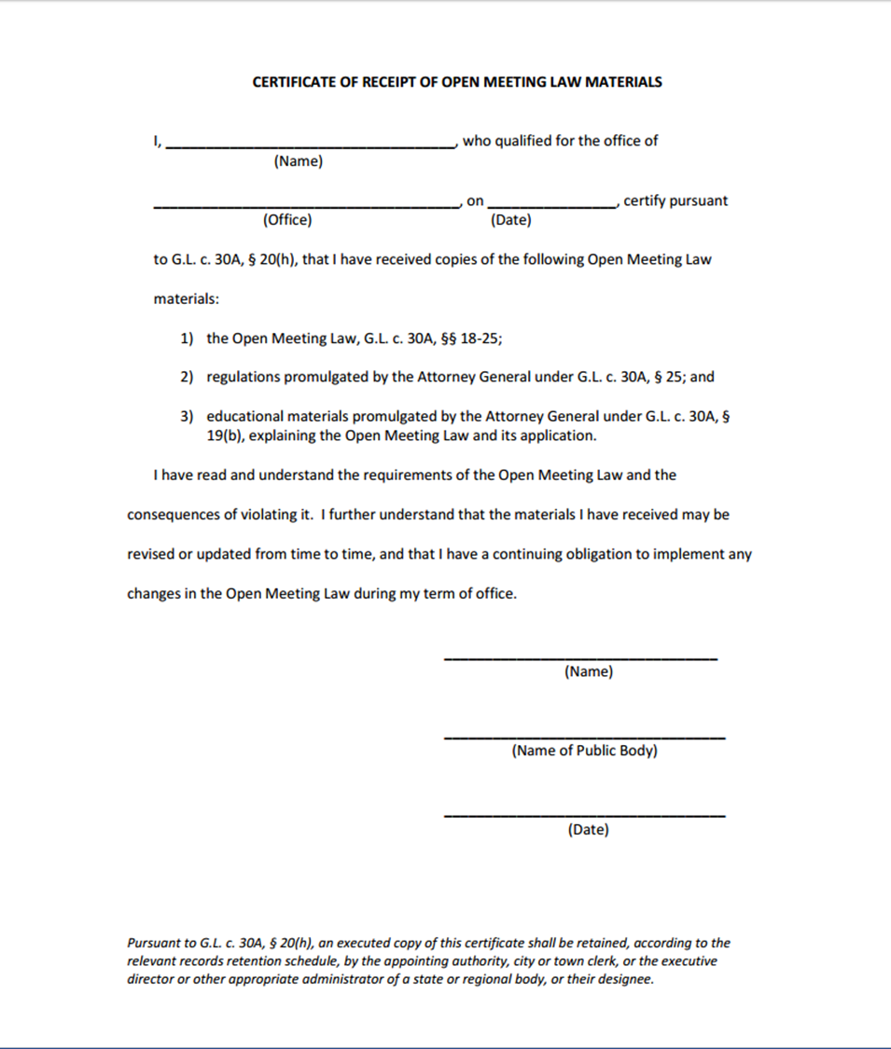
Certification
Members must sign certification within two weeks of receipt:
  Read and understand requirements of the law and consequences for violating it
  Educational Materials:
    OML Guide Book
    Last 5 Years of OML Determinations
©2017 Office of Attorney General Maura Healey. Permission granted to reproduce for personal and educational use, only.
Notes:
OML materials must be distributed to all public body members upon taking oath of office or, if none is required, before entering performance of office
Local Public Bodies: Municipal clerk
Regional, District, County or State Bodies: Appointing authority, executive director, or other administrator or designee
Members must sign certification within two weeks of receipt
Read and understand requirements of law and consequences for violating it
Person distributing materials also keeps certifications

Slide 8
Open Meeting Law Basics
Notice of meetings must be posted
Meetings must be open to the public
Minutes must be kept
Complaint process
Notes:
1) Notice must be posted for meetings
2) Meetings must be open to the public, unless the public body enters into executive session
3) Minutes must be kept for open and executive sessions
4) Public body member certification
5) Complaint process

Slide 9
Public Body
Definition
A multi-member board, commission, committee or sub-committee … however created, elected, appointed or otherwise constituted, established to serve a public purpose … subcommittee shall include any multiple-member body created to advise or make recommendations to a public body.
Connelly exception
Where a public official creates a group to advise that public official on a decision that he or she has sole responsibility for, the group is not subject to the Open Meeting Law. See Connelly v. School Committee of Hanover, 409 Mass. 232 (1991)
Notes:
Definition
A multi-member board, commission, committee or sub-committee … however created, elected, appointed or otherwise constituted, established to serve a public purpose … subcommittee shall include any multiple-member body created to advise or make recommendations to a public body.
Connelly exception: where a public official creates a group to advise that public official on a decision that he or she has sole responsibility for, the group is not subject to the Open Meeting Law

Slide 10
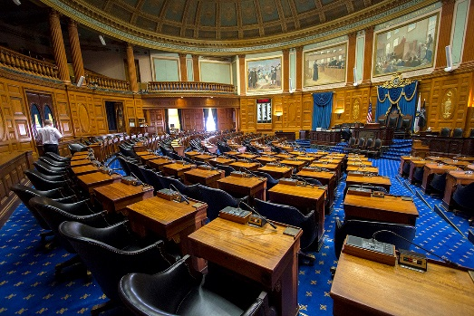
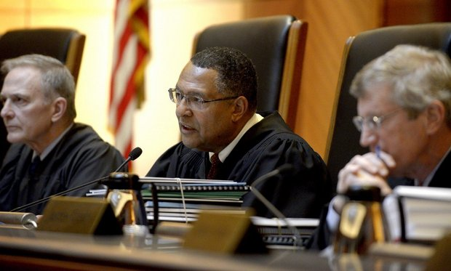




Exclusions
State Legislature
Judicial Branch
Not-for-Profit Organizations
The Greater Worcester Land Trust
Massachusetts House of Representatives
Massachusetts Supreme Judicial Court
    Focus Groups
    No Public Purpose
Constitutional Officers
Massachusetts Governor Charlie Baker
©2017 Office of Attorney General Maura Healey. Permission granted to reproduce for personal and educational use, only.
Notes:
Excludes:
Legislature and its committees
Bodies of Judicial branch
Bodies created by a constitutional officer solely to advise the constitutional officer
Bodies that do not serve a public purpose
Groups not established with the “jurisdiction” to make decisions or recommendations collectively

Slide 11
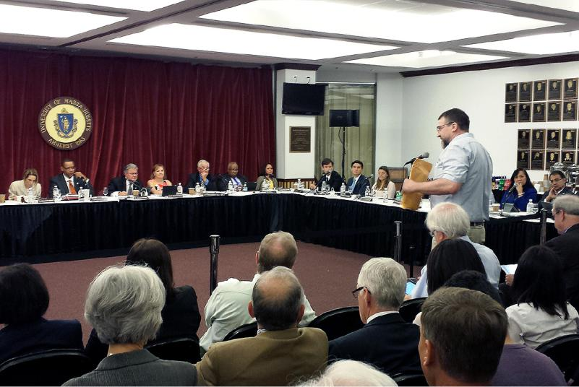
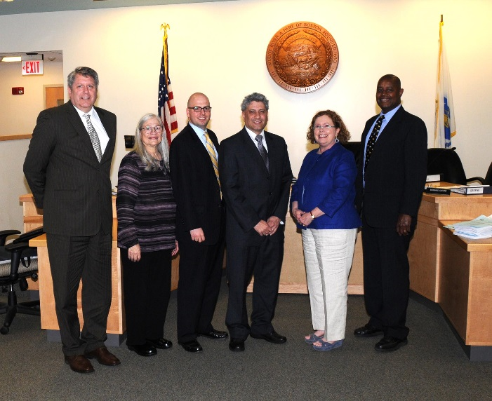
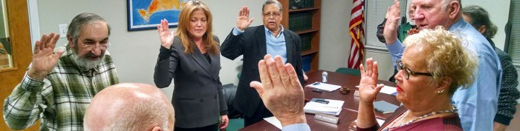
Examples: Public Bodies
State:
Local:
University of Massachusetts Board of Trustees
Regional:
Town of Brookline, MA Board of Selectmen
Martha’s Vineyard Airport Commission
Notes:
State: Open Meeting Law Advisory Commission; Massachusetts Gaming Commission; UMass Board of Trustees; Charter Schools
Local: Board of Selectmen; School Committee, Planning Board
Regional: Regional School Committee; Regional Water Commission; Regional Planning Commission
County: Board of County Commissioners; County Retirement Board; County Charter Review Commission

Slide 12
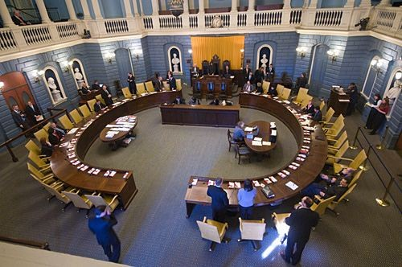




Examples: NOT Public Bodies
State:
Regional:
Local:
Algonquin Regional High School Boosters Club
Notes:
State: State Senate; House of Representatives; Judicial Nominating Commission; Massachusetts Municipal Association
Regional: Regional high school boosters club
Local: Neighborhood watch association; PTO; Republican/Democratic Town Committees

Slide 13
Quorum and Deliberation
  “An oral or written communication through any medium, including electronic mail, between or among a quorum of a public body on any public business within its jurisdiction.”
😐
😐
😐
😐
😐
Notes:
Definition of Deliberation
An oral or written communication through any medium, including electronic mail, between or among a quorum of a public body on any public business within its jurisdiction
Excludes:
Distribution of meeting agenda, scheduling or procedural information
Distribution of reports or documents to be discussed
Provided no opinion of a member of the public body is expressed
Subquorum, if not subcommittee, and no serial communication
Discussion of the recess or continuance of a Town Meeting, in the event of a weather-related or public safety emergency
Definition of Quorum
A simple majority of the members of a public body

Slide 14




Deliberation
Not deliberation:
    Agenda
    Reports or
    documents
    Scheduling
    Subquorum, but not subcommittee
    Recess a Town Meeting for emergency

Slide 15
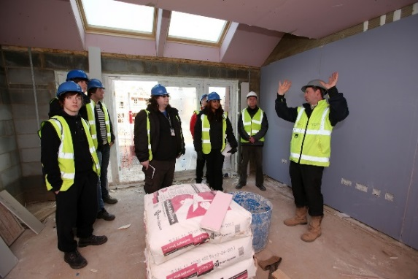

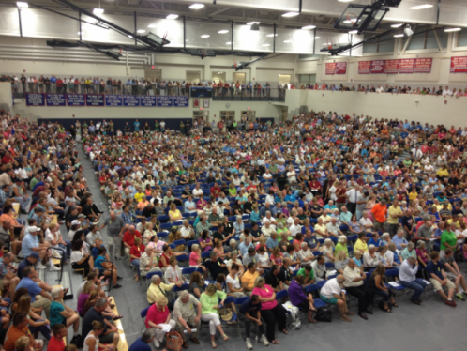


Meeting
Definition: Deliberation by public body with respect to any matter within the body’s jurisdiction
Excludes:
On-site Inspections
State Quasi-Judicial Boards
Town Meetings (Tewksbury Town Meeting)
Events
Attendance at Meetings of other Public Bodies
Notes:
Definition: Deliberation by public body with respect to any matter within the body’s jurisdiction
Excludes:
On-site inspection provided no deliberation
Attendance by a quorum at an event provided no deliberation
Attendance by a quorum at meeting of another public body provided no deliberation
Meeting of a state quasi-judicial board for sole purpose of making a decision in an adjudicatory proceeding
Town Meeting

Slide 16
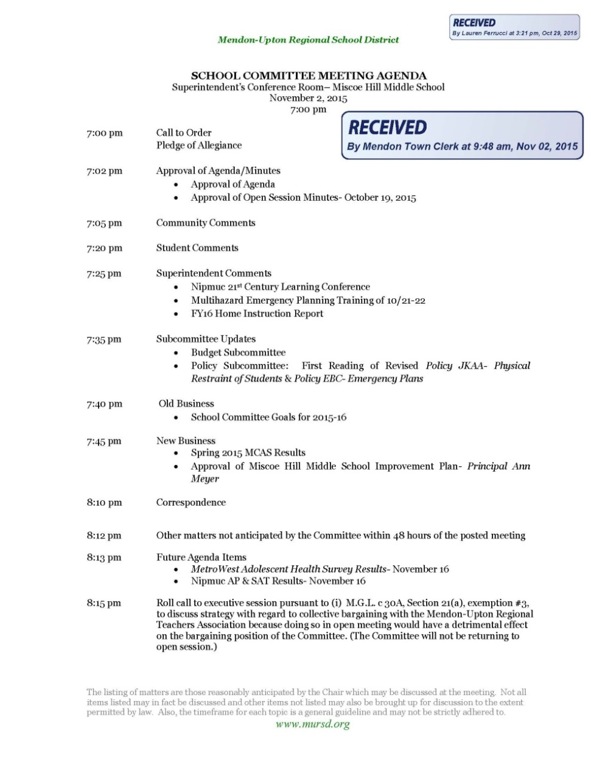
Meeting Notices
Date of meeting
Time of meeting
Place of meeting
List of topics reasonably anticipated
Date and time of notice posting
©2017 Office of Attorney General Maura Healey. Permission granted to reproduce for personal and educational use, only.
Notes:
Except in an emergency, a public body must post notice of meeting at least 48 hours in advance, excluding Saturdays, Sundays, and legal holidays
Notice must include:
Date of meeting
Time of meeting
Place of meeting
List of topics chair reasonably anticipates will be discussed at meeting
Topics should give enough specificity so that the public will understand what will be discussed.
Date and time notice was posted
If the notice is revised, the revised notice must record the date and time the original notice was posted, as well as the date and time of the revision

Slide 17
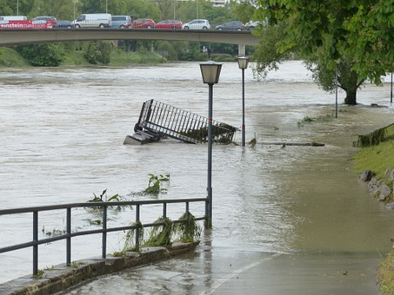
Meeting Notices
Emergency Meeting
Requires
immediate
action
Unexpected
©2017 Office of Attorney General Maura Healey. Permission granted to reproduce for personal and educational use, only.
Notes:
“Emergency” is a sudden, generally unexpected occurrence or set of circumstances demanding immediate action.
In an emergency, a public body shall post notice as soon as reasonably possible prior to a meeting

Slide 18
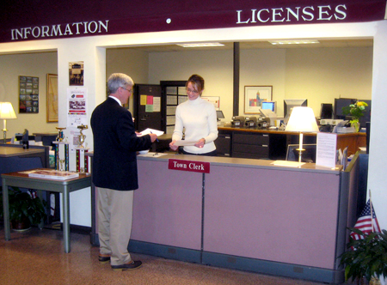
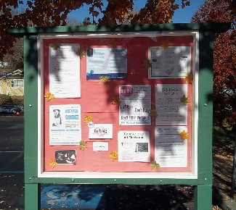

Meeting Notices:
Local Public Bodies
File with Municipal Clerk
Or
Bulletin Board
Municipal Website
©2017 Office of Attorney General Maura Healey. Permission granted to reproduce for personal and educational use, only.
Notes:
Local public body must file notice with municipal clerk
Notice must be posted in a manner conspicuously visible to the public, including persons with disabilities, at all hours in or on the municipal building where the clerk’s office is located
Alternate Posting options
Municipal website
Cable television/alternate municipal building open 24 hours
Newspaper/alternate municipal building open 24 hours
Monitor/electronic display where may be viewed 24 hours
Audio recording available 24 hours
Note that even if an alternative posting method has been adopted, meeting notices must still be available in or around the clerk’s office

Slide 19
Meeting Notices: County, District
and Regional Public Bodies
Hampshire Council Of Government Board Of Councilors
Plymouth Board of County Commissioners
Amherst-Pelham
Regional School
Committee
©2017 Office of Attorney General Maura Healey. Permission granted to reproduce for personal and educational use, only.
Notes:
Regional or district public bodies must post notice in each city or town within the region or district in the manner prescribed for local public bodies, or may post to a website
For a regional school district, the secretary of the regional school district is the clerk of the school district and shall file the notice with the clerk of each city or town in the district, or may post to a website
County public bodies must post notice with the office of the county commissioner and a copy of the notice posted in a manner conspicuously visible to the public at all hours in a place or places designated by the county commissioners, or may post to a website

Slide 20

Meeting Notices:
State Public Bodies
Post to the public body’s website or the website of its parent agency
Notify the Attorney General of the location of the website
Send a copy of the meeting notice to the Regulations Division of the Secretary of the Commonwealth’s Office
regs@sec.state.ma.us
Notes:
Post to the public body’s website or the website of its parent agency
Notify the Attorney General of the location of the website where meeting notices will be posted
Send a copy of the meeting notice to the Regulations Division of the Secretary of the Commonwealth’s Office
regs@sec.state.ma.us

Slide 21
Notice Posting:
Common Concerns
What if a new topic arises after notice is posted?
What if the clerk can’t post notice in time?
Cancelling a meeting?
Notes:
What if a new topic arises after notice is posted?
Public bodies are encouraged to update the notice when made aware of new topic within the 48 hour period before the meeting.
Chairs should not post notices so far in advance that there is a high likelihood that new topics will arise.
What if the clerk can’t post notice in time?
Chairs are encouraged to work with municipal clerks to enable sufficient time for posting.
Canceling a meeting?
Meeting cancellations do not require 48 hours notice.
Meetings that are continued, or cancelled and rescheduled, must comply with all notice requirements of the Open Meeting Law.
Other laws may apply (such as notice for public hearings)

Slide 22

Meeting Notices:
Websites
Finding notices
Notices should be easy to find on the website; listed either in a central page or at each public body’s page
Avoid posting in multiple locations unless linked to same document/page
Webpage outages
6 business hours to fix website, otherwise must cancel noticed meetings within 48 hours of outage

Slide 23
Accessibility
Reasonable efforts to accommodate crowds
Accessible to the disabled
Americans with Disabilities Act, federal Rehabilitation Act of 1973, state constitutional provisions
The Attorney General’s Civil Rights Division can assist -
Contact the Civil Rights Division at (617) 963-2939
Notes:
Reasonable efforts to accommodate crowds
Accessible to the disabled
Americans with Disabilities Act, federal Rehabilitation Act of 1973, state constitutional provisions
Civil Rights Division of the Attorney General’s Office can assist
Contact the Civil Rights Division at (617) 963-2939
Security policies

Slide 24
Remote Participation Authorization
Local Public Bodies
County Public Bodies
State/Regional Public Bodies
Mayor or board of selectmen approval
County commissioners must authorize
Simple majority vote
Dukes County Commissioners
Notes:
Must be adopted before members can use
Local Public Bodies: Chief Executive Officer must authorize for all public bodies in municipality
County Public Bodies: County Commissioners must authorize for all county public bodies in county
State/Regional Public Bodies: Simple majority vote to authorize for all future meetings
Minimum Requirements
Remote participants and all persons present at the meeting location must be clearly audible to each other
A quorum of the body, including the chair or, in the chair’s absence, the person authorized to chair the meeting, must be physically present at the meeting location
Members of public bodies who participate remotely may vote and shall not be deemed absent
Exception: Local Commissions in Disability

Slide 25
Remote Participation
Permissible reason for Remote Participation: physical attendance at the meeting must be unreasonably difficult.
☺
☺
☺
☺
☺
☺
Minimum Requirements:
  Clearly Audible
  Quorum Present
  Remote participants may vote
Notes:
Acceptable Methods
Telephone, internet, or satellite enabled audio or video conferencing
Any other technology that enables the remote participant and all persons present at the meeting location to be clearly audible to one another
Public body determines which method to use
Video technology
If used, remote participant must be clearly visible to all persons present at the meeting location
Chair decides how to address technical difficulties

Slide 26


Remote Participation
Procedures for Remote Participation
Notify chair
Technical difficulties
Announcement
Roll call votes
Documents
Technology
Executive session
declaration
Notes:
Procedures for Remote Participation
Public body member notifies chair
Announcement by chair of name of member participating remotely
All votes taken must be by roll call vote
Distribution of documents in advance of meeting
Member may participate in executive session but must state that no other person is present or able to hear discussion

Slide 27
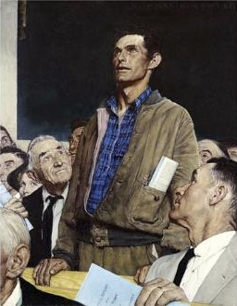
Public Participation
Public may attend open session
Addressing the public body
Recording/Informing
Removal
Notes:
Public may attend open session of meeting
Public may not address public body without permission of chair or otherwise disrupt meeting
Public may make audio or video recording of open session upon notification to chair and subject to reasonable requirements
Chair must inform other attendees of recording at beginning of meeting
If a person continues to disrupt a meeting after clear warning from the chair, the chair may order the person to leave the meeting. If the person does not leave, the chair may authorize a constable or other officer to remove that person.

Slide 28
Executive Session
Procedural requirements for entering executive session
Convene open session
State purpose
Take roll call vote
Reconvene?
Remote participants
All votes by roll call
Notes:
OML allows public bodies to conduct closed, or executive, meetings in certain circumstances
Public bodies must follow OML requirements for executive session:
Convene open session prior to going into executive session
State publicly the purpose(s) for the executive session
Conduct roll call vote to enter executive session and obtain a majority of members
Announce whether open session will reconvene after
Statement by remote participant(s) that no other person is present / able to hear discussion at remote location, unless approved by body
Maintain minutes of and documents from executive session
Discuss only matters for which executive session is lawfully called
Conduct roll call votes of all votes taken during executive session

Slide 29

Executive Session Purpose: 1
“To discuss the reputation, character, physical condition or mental health, rather than professional competence, of an individual, or to discuss the discipline or dismissal of, or complaints or charges brought against, a public officer, employee, staff member or individual.”
Notes:
“To discuss the reputation, character, physical condition or mental health, rather than professional competence, of an individual, or to discuss the discipline or dismissal of, or complaints or charges brought against, a public officer, employee, staff member or individual.”
If an executive session is held, such individual shall have the following rights:
Notified in writing at least 48 hours prior to the proposed executive session
Request that the session be open
To be present at such executive session during deliberations which involve that individual
To have counsel or a representative present and attending for the purpose of advising the individual and not for the purpose of active participation in the executive session
To speak on his own behalf
To cause an independent record to be created by audio-recording or transcription, at the individual’s expense

Slide 30
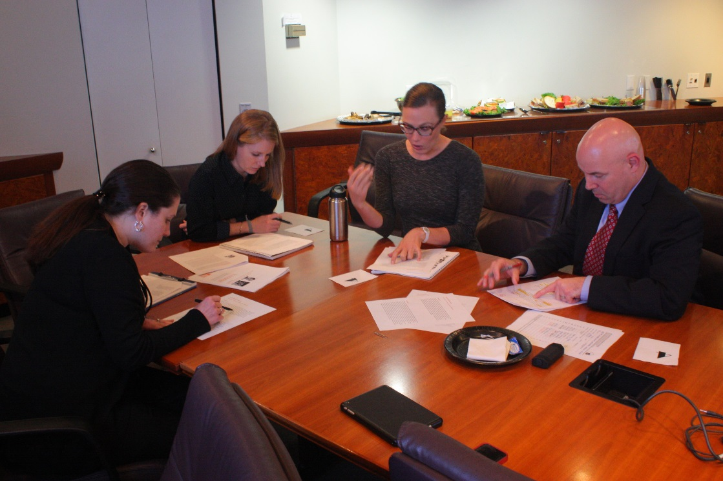
Executive Session Purpose: 2
“To conduct strategy sessions in preparation for negotiations with nonunion personnel or to conduct collective bargaining sessions or contract negotiations with nonunion personnel.”
Notes:
“To discuss strategy sessions in preparation for negotiations with nonunion personnel or to conduct collective bargaining sessions or contract negotiations with nonunion personnel.”
When discussing the contract of nonunion personnel, presumption that professional competence of the individual has already been discussed in open session
When negotiating a non-union contract in executive session, if the public body reaches an agreement, it must still vote to execute the agreement in open session following executive session
A public body should identify the specific nonunion personnel with whom it is negotiating before entering executive session, unless public disclosure of that information would compromise the purpose for secrecy
While we generally defer to the judgment of public bodies on this issue, a body must be able to demonstrate a reasonable basis for this claim if challenged

Slide 31

Executive Session Purpose: 3
“To discuss strategy with respect to collective bargaining or litigation if an open meeting may have a detrimental effect on the bargaining or litigating position of the public body and the chair so declares.”
Notes:
“To discuss strategy with respect to collective bargaining or litigation if an open meeting may have a detrimental effect on the bargaining or litigating position of the public body and the chair so declares.”
Chair must declare that deliberating during an open session would have a detrimental effect
Litigation must be pending or be imminently threatened
May approve final terms and execute a collective bargaining agreement in executive session
Should disclose in open session following execution
A public body should identify the specific collective bargaining unit or litigation matter before entering executive session, unless public disclosure of that information would compromise the purpose for secrecy
While we generally defer to the judgment of public bodies on this issue, a body must be able to demonstrate a reasonable basis for this claim if challenged

Slide 32


Executive Session Purpose: 4 & 5
4. Security personnel or devices
Criminal misconduct
Notes:
Executive Session Purpose 4: “To discuss the deployment of security personnel or devices, or strategies with respect thereto.”
Executive Session Purpose 5: “To investigate charges of criminal misconduct or to consider the filing of criminal complaints.”

Slide 33
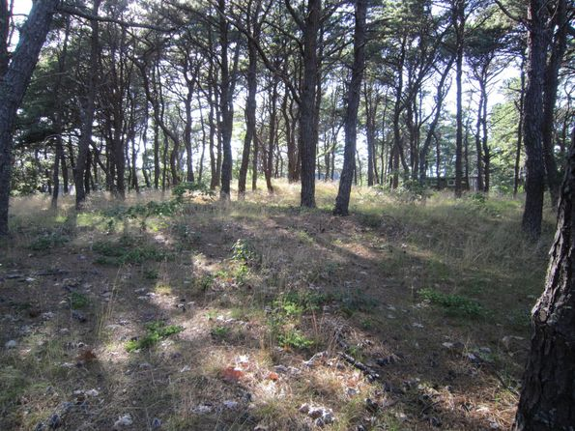
Executive Session Purpose: 6
“To consider the purchase, exchange, lease or value of real property if the chair declares that an open meeting may have a detrimental effect on the negotiating position of the public body.”
Wellfleet, MA
Notes:
“To consider the purchase, exchange, lease or value of real property if the chair declares that an open meeting may have a detrimental effect on the negotiating position of the public body.”
Must be to consider purchase, sale, lease or value of real property
Chair must declare that discussing during an open session would have a detrimental effect on negotiating position
Generally, the body should identify the specific piece of property it plans to discuss before entering executive session, unless disclosure of this information would compromise the purpose for secrecy
While we generally defer to the judgment of public bodies on this issue, a body must be able to demonstrate a reasonable basis for this claim if challenged

Slide 34

Executive Session Purpose: 7
“To comply with, or act under the authority of, any general or special law or federal grant-in-aid requirements.”
Notes:
“To comply with, or act under the authority of, any general or special law or federal grant-in-aid requirements.”
Must cite a statute which requires confidentiality or closed session
The body should disclose information unless public disclosure would compromise the purpose for secrecy
While we generally defer to the judgment of public bodies on this issue, a body must be able to demonstrate a reasonable basis for this claim if challenged

Slide 35

Executive Session Purpose: 8
“To consider or interview applicants for employment or appointment by preliminary screening committee if the chair declares that an open meeting will have a detrimental effect in obtaining qualified applicants; provided, however, that this clause shall not apply to any meeting, including meetings of a preliminary screening committee, to consider and interview applicants who have passed a prior preliminary screening.”
Notes:
“To consider or interview applicants for employment or appointment by preliminary screening committee if the chair declares that an open meeting will have a detrimental effect in obtaining qualified applicants; provided, however, that this clause shall not apply to any meeting, including meetings of a preliminary screening committee, to consider and interview applicants who have passed a prior preliminary screening.”
Preliminary screening committee can’t include a quorum of the public body; may include people who are not members of the public body
May only interview/screen candidates during a preliminary screening in executive session; once there are finalists, all additional screening must be conducted in open session
Chair must declare that an open meeting will have a detrimental effect in obtaining qualified applicants

Slide 36


Executive Session Purposes 9 & 10
9. Confer with mediator on litigation or decision
10. Trade secrets in the course of activities conducted by a public body as an energy supplier

Slide 37
Meeting Minutes
  Minutes must state the date, time, place of the meeting, and list of members present or absent
  Minutes must include:
    A summary of discussion of each topic
    Decisions made and actions taken, including a record of all votes - Secret ballots prohibited
    List of documents and other exhibits used by the body at the meeting, including by remote participants
©2017 Office of Attorney General Maura Healey. Permission granted to reproduce for personal and educational use, only.
Notes:
Minutes must state the date, time, place of the meeting, and list of members present or absent
Minutes must include:
A summary of discussion of each topic
Decisions made and actions taken, including a record of all votes
Secret ballots are explicitly prohibited
List of documents and other exhibits used by the body at the meeting, including by remote participants
Name(s) of any member who participated remotely.

Slide 38
Meeting Minutes
  Approving Minutes
Latest of 3 meetings or 30 days
  BUT whenever possible, approve at the next meeting
Documents and exhibits used by public body must be retained by the public body but do not need to be physically stored with the meeting minutes
Upon Request
Open session minutes provided within 10 days of request
  Whether in draft or approved form
For all other records – Consult Supervisor of Records in the Secretary of State’s Office

Slide 39
Executive Session Minutes
Minutes must be reviewed periodically by the chair or public body to determine if the purpose for executive session remains. The determination must be announced during the next meeting and be included in the minutes
Public body must respond within 10 days to request for executive session minutes
Review at next meeting or within 30 days, whichever comes first.
Provide minutes if no longer exempt from disclosure; or
Notes:
Minutes must be reviewed periodically by the chair or public body to determine if the purpose for executive session remains. The determination must be announced during the next meeting and be included in the minutes.
Public body must respond within 10 days to request for executive session minutes
Provide minutes if no longer exempt from disclosure; or
Undertake review at its next meeting or within 30 days, whichever comes first.

Slide 40
Document Used at a Meeting
Documents used by a public body during
an open meeting are public records!
But, the following materials are exempt from public disclosure:
Application materials, other than resumes
Performance evaluations NOT created by members of the public body
Notes:
The following materials are exempt from public disclosure:
Materials used in a performance evaluation of an individual bearing on his/her professional competence that were not created by members of the body for purposes of evaluation
Materials used in deliberations about employment or appointment of individuals, including applications and supporting materials but excluding resumes, which must be disclosed

Slide 41
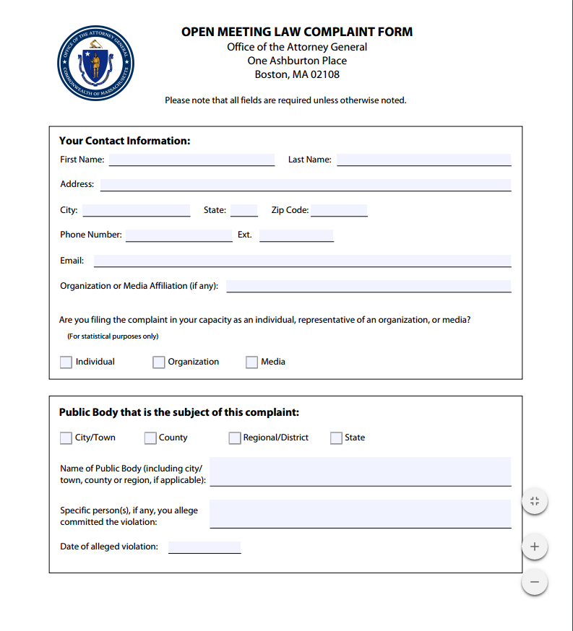
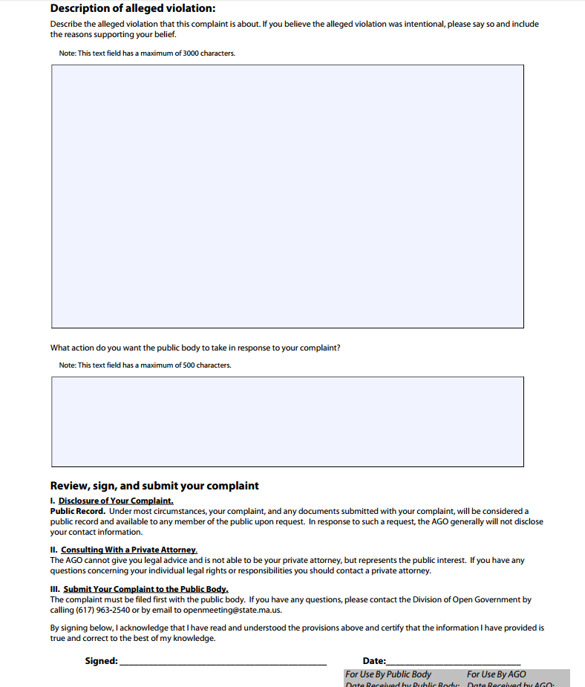
Complaint Process
  Step 1: The Complainant
Notes:
Complaint shall be filed in writing with the public body within 30 days of the alleged violation, or if it could not reasonably have been known at the time, then within 30 days of the date the complainant reasonably should have discovered the alleged violation
Complaint Form, found at the Division of Open Government website, completed and sent to chair of public body
For local public bodies, copy also filed with municipal clerk

Slide 42
Complaint Process
Step 2: The Public Body
Chair disseminates the complaint for response within 14 business days
May delegate responsibility for responding after public body review
Public body may request an extension of time to respond for good cause
Notes:
Chair must disseminate the complaint to the members of the public body. The public body has 14 business days in which to respond and inform Division of Open Government of remedial action taken
May delegate responsibility for responding after public body review
Public body may request from the Director an extension of time to respond for good cause

Slide 43
Complaint Process
Step 3: The Attorney General’s Office
If the complainant is not satisfied with the resolution of the complaint by the public body, he/she may file the complaint with the Division 30 days after the complaint is filed with the public body
Complaints must be filed with the AGO within 90 days of the date of the original alleged violation or reasonably discovery of violation
The AGO will not review allegations that were not raised in the initial complaint filed with the public body
Complaints filed with the Attorney General’s Office, and documents submitted with the complaint, are considered a public record
Notes:
If the complainant is not satisfied with the resolution of the complaint by the public body, he/she may file the complaint with the Division of Open Government 30 days after the complaint is filed with the public body.
To be considered timely, complaints must be filed with the AGO within 90 days of the date of the original alleged violation.
The Attorney General’s Office will not review allegations that were not raised in the initial complaint filed with the public body.
In most circumstances, complaints filed with the Attorney General’s Office, and documents submitted with the complaint, are considered a public record.

Slide 44
Complaint Process
The Division of Open Government
Review complaint
Conduct investigation
Finding
Appeal
Notes:
Step 4: Acknowledgment
Step 5: Request for documents and interviews
Step 6: Has there been a violation?
Step 7: Was the violation intentional?
Step 8: Was the action taken by the public body adequate?
Step 9: Resolution
Informal
Formal
Step 10: Public body appeal

Slide 45
Remedies
$1000 civil penalty
Compel attendance at training
Release minutes
Nullify action
Compel immediate and future compliance
Reinstate employee
Other appropriate relief
A public body found in violation of the OML must certify to the Attorney General its compliance with a remedial order.
Notes:
Compel immediate and future compliance
Compel attendance at training
Compel public release of minutes or other materials
Nullify any action taken in violation of the Open Meeting Law
Reinstate an employee and make whole
Impose a civil penalty of up to $1,000 on a public body for each intentional violation
Other appropriate relief

Slide 46
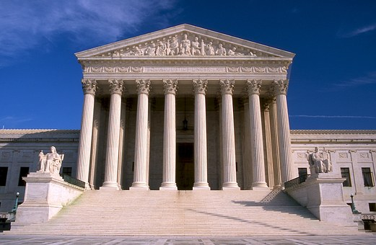
Judicial Complaint Process
Attorney General or 3 or more registered voters may initiate a civil action to enforce the Open Meeting Law
Notes:
Attorney General or 3 or more registered voters may initiate a civil action to enforce the Open Meeting Law
Must file in Suffolk Superior Court for state public bodies
For all other public bodies, must file in superior court in any county in which the public body acts or meets

Slide 47
Review
Notice must be posted for meetings
Meetings must be open to the public, unless public body enters executive session
Minutes must be kept for open and executive sessions
Complaint process
Public body member certification
Notes:
1) Notice must be posted for meetings
48 hours in advance, except for emergency
Include date, time, place, and sufficiently detailed list of topics chair reasonably anticipates will be discussed
2) Meetings must be open to the public, unless public body enters executive session
Discussion must fit within one of 10 purposes for executive session
3) Minutes must be kept for open and executive sessions
Must include summary of discussion for each topic
Must contain a list of documents & exhibits used at the meeting
4) Public body member certification
5) Complaint process
Must be filed with public body first
Alternative complaint process in Superior Court

Slide 48
Resources
Attorney General’s Open Meeting Law Website
http://www.mass.gov/ago/openmeeting
Open Meeting Law: G.L. c. 30A, §§ 18-25
Regulations: 940 CMR 29.00
Guide
FAQs
Checklists
Determination Letters

Slide 49
Contact Information
Office of Attorney General
Division of Open Government
One Ashburton Place
Boston, Massachusetts 02108
openmeeting@state.ma.us
(617) 963-2540

Slide 50

Contact Us
www.mass.gov/ago
617-727-2200
File a Complaint about an Unfair or Deceptive Trade Practice
617-727-8400
www.eform.ago.state.ma.us
©2017 Office of Attorney General Maura Healey. Permission granted to reproduce for personal and educational use, only.
Notes:
Say what PIAC does

Slide 51
Resources
Have a Complaint or Question?
General Assistance
Consumer Hotline: (617) 727-8400
E-Complaint form: www.eform.ago.state.ma.us
Specific Hotlines
HomeCorps (617) 573-5333
Elder Hotline (888) 243-5337
Fair Labor Division (617) 727-3465
Civil Rights Division (617) 727-2200
Medicaid Fraud Tipline (617) 963-2360
Insurance Fraud Tipline (617) 537- 5330
Insurance & Health Care Consumer Helpline (888) 830-6277
©2017 Office of Attorney General Maura Healey. Permission granted to reproduce for personal and educational use, only.
Notes:
Consumer Hotline
Answers a variety of general questions and providing awareness of consumer protection laws
Provides resources and referrals to other state and federal agencies

Slide 52
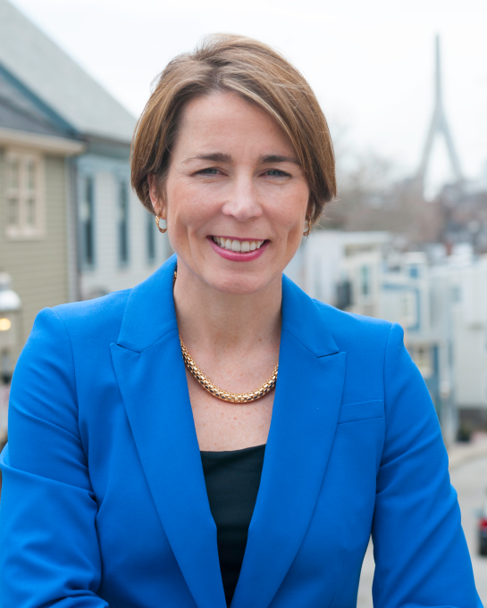
Thank You from the Attorney General
Attorney General
Maura Healey is the chief lawyer and law enforcement officer of the Commonwealth of Massachusetts.
©2017 Office of Attorney General Maura Healey. Permission granted to reproduce for personal and educational use, only.
Notes:
Chief law enforcement officer…

