Slide 1
Award-Winning Strategies for Cost Savings in Districts
Worcester Public Schools ▪ Sara Consalvo, Budget Director
Ashland Public Schools ▪ Jim Adams, Superintendent

Slide 2
Worcester Public Schools
Beginning FY12 – District Began Conversations to Start Building Internal Capacity to provide Applied Behavioral Analysis (ABA Services) Instead of Utilizing Third Party Vendors.
These Direct Services Provided Both Classroom Services, Along with Afterschool and Vacation Services to District Students.
Concerns:
Increasing Cost of Services
Quality & Consistency of Staff Being Provided
Tracking Student Data, Cost Per Student
Student’s IEP Language

Slide 3
Worcester Public Schools
 | FY10 | FY11 | FY12 | FY13 | FY14 | FY15 | FY16 | FY17
Vendor 1 | $2,000,000 | $2,400,000 | $2,600,000 | $3,300,000 | $2,900,000 | $250,000 | $0 | $0
Vendor 2 | $1,500,000 | $2,000,000 | $2,000,000 | $1,850,000 | $1,600,000 | $140,000 | $500,000 | $0
Total | $3,500,000 | $4,400,000 | $4,600,000 | $5,150,000 | $4,500,000 | $390,000 | $500,000 | $0

Slide 4
Worcester Public Schools
Analysis:
Determine Current & Prior Year Costs of Vendors
How many Students are Being Serviced?
What is the Rate Being Charged?
Determine Average Hours per Month?
Other Costs?
Specific Detail (Invoices, Student IEP, Current Staffing, Etc.*)

Slide 5
Worcester Public Schools
Determined Facts:
Vendor 1– Districtwide, Including Afterschool & Home Services (Vacations)
Direct Services, Clinical Services & Ph.D. Consultations
Vendor 2 – Afterschool & Certain Locations Only
Direct Services, Clinical Services
Category | Vendor 1 | Vendor 2
Students Serviced | 100 | 60
Direct Services Rate Per Hour | $27.50 | $27.00
Direct Services Average Hours Per Month | 8,000 | 3,000
Clinical Services Per Month | $65,000 | $55,000
Ph.D. Consultation Services Per Month | $6,300 | $0

Slide 6
Worcester Public Schools
Determined Costs:
Average Vendor Expenditures | Vendor 1 | Vendor 2 | Total Annual
Direct Services | $2,200,000 | $891,000 | $3,091,000
Clinical Services | $650,000 | $550,000 | $1,200,000
Ph.D. Consultation Services | $63,000 | $0 | $63,000
Total Average Vendor Costs | $2,913,000 | $1,441,000 | $4,354,000

Slide 7
Worcester Public Schools
Category | Vendor 1 | Vendor 2
Students Serviced | 100 | 60
Direct Services Rate Per Hour | $27.50 | $27.00
Direct Services Average Hours Per Month | 8,000 | 3,000
Clinical Services Per Month | $65,000 | $55,000
Ph.D. Consultation Services Per Month | $6,300 | $0
Average Vendor Expenditures | Vendor 1 | Vendor 2 | Total Annual
Direct Services | $2,200,000 | $891,000 | $3,091,000
Clinical Services | $650,000 | $550,000 | $1,200,000
Ph.D. Consultation Services | $63,000 | $0 | $63,000
Total Average Vendor Costs | $2,913,000 | $1,441,000 | $4,354,000
Methodology:
Average Vendor Expenditures | Methodology
Direct Services | Direct Service Rate x Hours Per Month x Months of Programming
Clinical Services | Clinical Service Rate x Months of Programming
Ph.D. Consultation Services | Ph.D. Consultation Rate x Months of Programming
Total Average Vendor Costs | $4,354,000

Slide 8
Worcester Public Schools
Implementation – Strategic Approach:
Developed Training and Began Providing to Current Staff
Addressed Student IEP Language (Vendor Specific)
Discussed Phase Out with Vendors
Began Parent Discussions Groups
Developed Short & Long Term Service Plans for Students
Phased In Trained Staff into Specific Locations (FY14)

Slide 9
Worcester Public Schools
Implementation – Strategic Approach:
FY15 Budget – Hired 50 additional ABA Instructional Assistant Positions & 5 Board Certified Behavior Analysts Positions
School Populations – Growth of Students that Needed Services
Preschool through Primary Grades, Families Moving into City
Developed Afterschool Model with Hourly Staffing
FY16 Budget – Hired 20 additional ABA Instructional Assistant Positions & 3 Board Certified Behavior Analysts Positions

Slide 10
Worcester Public Schools
Implementation – Strategic Approach:
FY15 Budget - Phased Out Vendor 1
Districtwide, Including Afterschool & Home Services (Vacations)
Direct Services, Clinical Services & Ph.D. Consultations
FY16 Budget - Phased Out Vendor 2*
Transitioned Into Providing Afterschool & Home Services Only until District Completely Equipped to Provide All Services to All Students.
Budget 101 – Keep Some Funding Available in 1st Year for Emergency Issues… Don’t Over Cut & Monitor Expenditures…

Slide 11
Worcester Public Schools
Worcester Public School | Total Annual
Instructional Assistants (70 Positions) | $1,960,000
Additional Home Services Provided (Hourly) | $101,250
Board Certified Behavior Analysts (8 Positions) | $576,000
Health Insurance Costs (Avg 70% Participation) | $491,400
Supplies & Material Costs | $50,000
Staff Development | $50,000
Total District Costs | $3,228,650
Total (Average) Vendor Costs | $4,354,000
Program Cost Savings | -$1,125,350
District Costs:
Savings:
Savings Allowed for the Reallocation of Resources to Other Instructional Services (Teachers, Textbooks, Etc.)

Slide 12
ASHLand Public Schools
Key Cost-Saving Measures
Change in Mindset – Budgeting Based on Blueprint for Continuous Student Improvement
Solar Panel Implementation
Ashland High School and Ashland Middle School
Net Metering Agreements
Consolidation of District with Town
Technology
Facilities
Green Community Grants and Energy Efficient Upgrades
Electric Vehicles
Elementary Boilers
Light Sensors, Automatic Computer Shut-Down, LED Lights
Special Education Savings
Developed Internal Programs

Slide 13
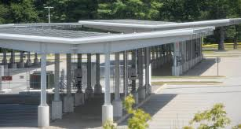
Solar Panel Car Port Implementation
Electricity Costs Savings of about $32,000 annually
4 Net Metering Agreements – Account for $20,000 in revenue

Slide 14
Consolidation of District and Town Departments
Consolidated IT and Facilities/Maintenance Departments
IT Director now is Director for the Town and Schools – Savings of $90,000 Town Wide
Facilities/Maintenance allows us to bid on joint projects and share cost of Director
Increased working relationship with General Government and Schools

Slide 15
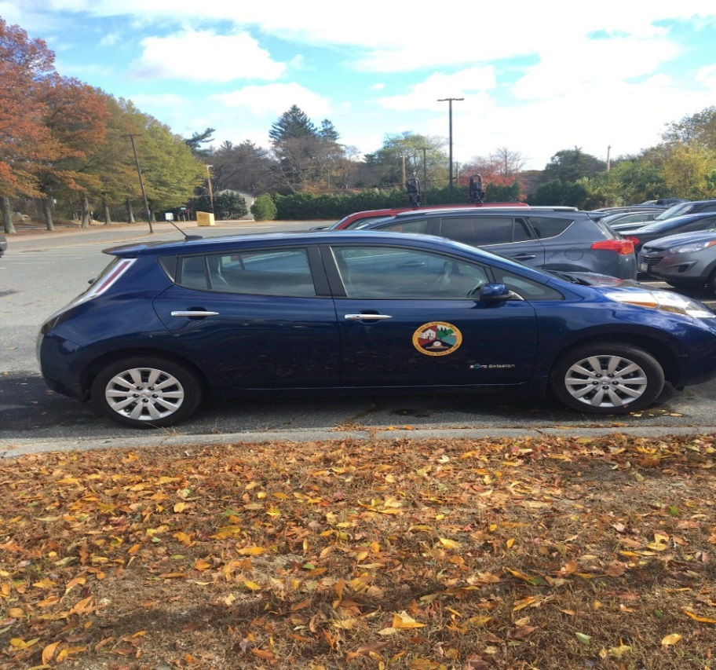
Green Community Grants
Charging stations and lease payments for 3 electric cars for 3 years.
Reduction in mileage reimbursement for administration and special education – savings of $5,000 per year.
Grant for boiler of $225,000

Slide 16
Special Education Program Development
Developed 3 SPED Programs in-house
Out-of-District SPED costs remained flat for 3 years – Prior 17% increase per year
Tuition Students into program at Ashland High School, which offset teacher cost
Savings in Out-of-District tuition and transportation:
5 students in house saved $164,000 in Year 1…..(5 Students/Transportation = $295,000 Program Cost was $131,000 (1 Teacher and 3 ESPs/ABA)

