Slide 1

Addiction, Opioids, Cannabis, and Youth
John F. Kelly, Ph.D.
MASC/MASS STATE CONVENTION, NOV 2017

Slide 2
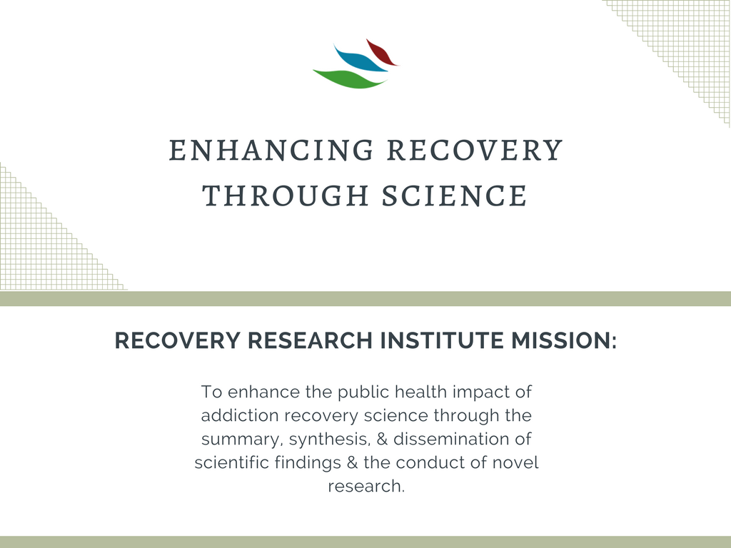


Slide 3

“Public Health Emergency”

Slide 4
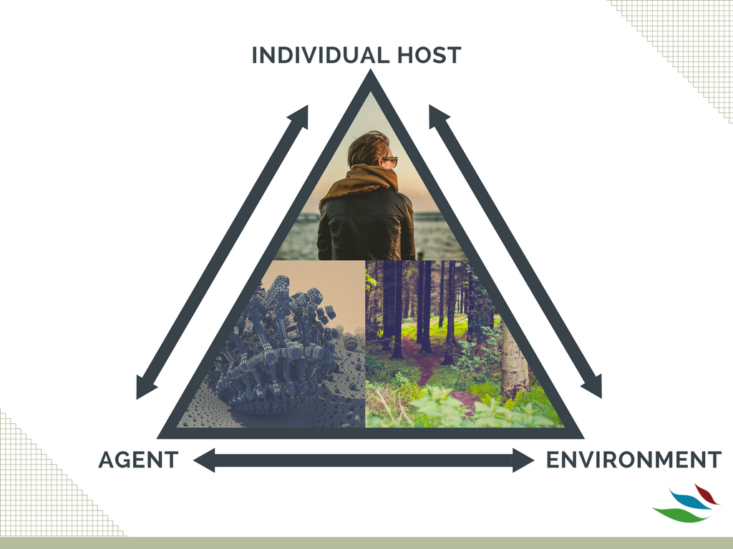
PUBLIC
HEALTH
MODEL
Notes:
Public health model
Individual/Host: age, attitudes toward drug use, genetics, dual diagnosis, etc.
Agent: Type and strength of drugs
Environment: treatment and recovery services, policy and laws, employment opportunities, drug availability, friends and family use

Slide 5
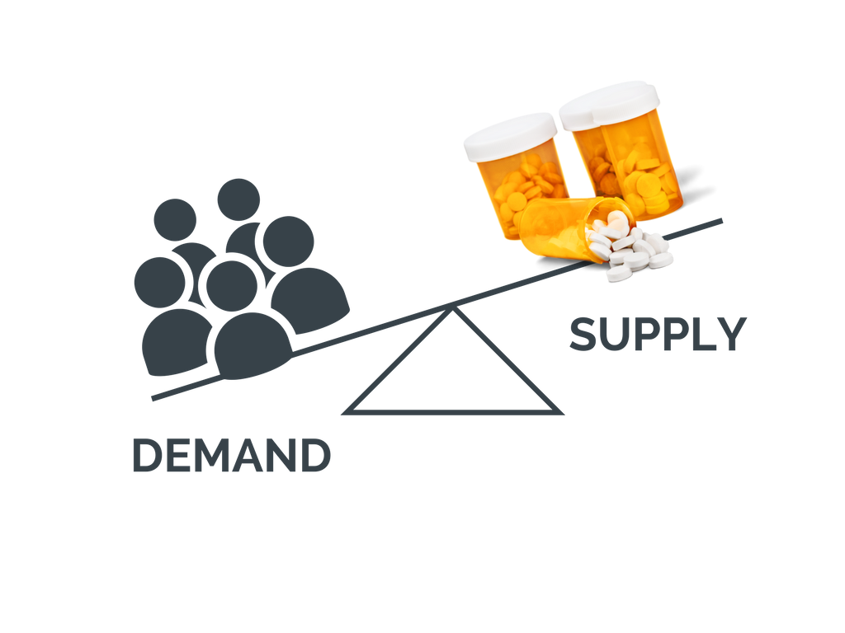

ETIOLOGY: HOW DID WE GET HERE?
SUPPLY & DEMAND
Desirability
Availability
Accessibility
Low Stigma
Legal Status
Cost
availability, accessibility, and price
prevention and treatment intervention

Slide 6
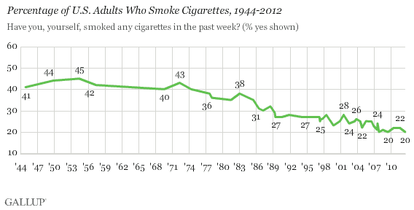
ETIOLOGY: HOW DID WE GET HERE?
This is what we’ve seen with tobacco use…

Slide 7
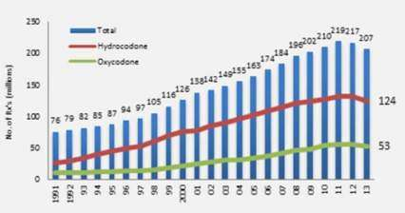
United States biggest consumer globally of opioids, accounting for almost 100% of world total for hydrocodone (e.g., Vicodin) and 81% for oxycodone (e.g., Percocet).
Number of prescriptions for opioids (like hydrocodone and oxycodone products) escalated from 76 million in 1991 to 207 million in 2013
International Narcotics Control Board Report 2008.External link, please review our disclaimer.. United Nations Pubns. 2009. p. 20

Slide 8
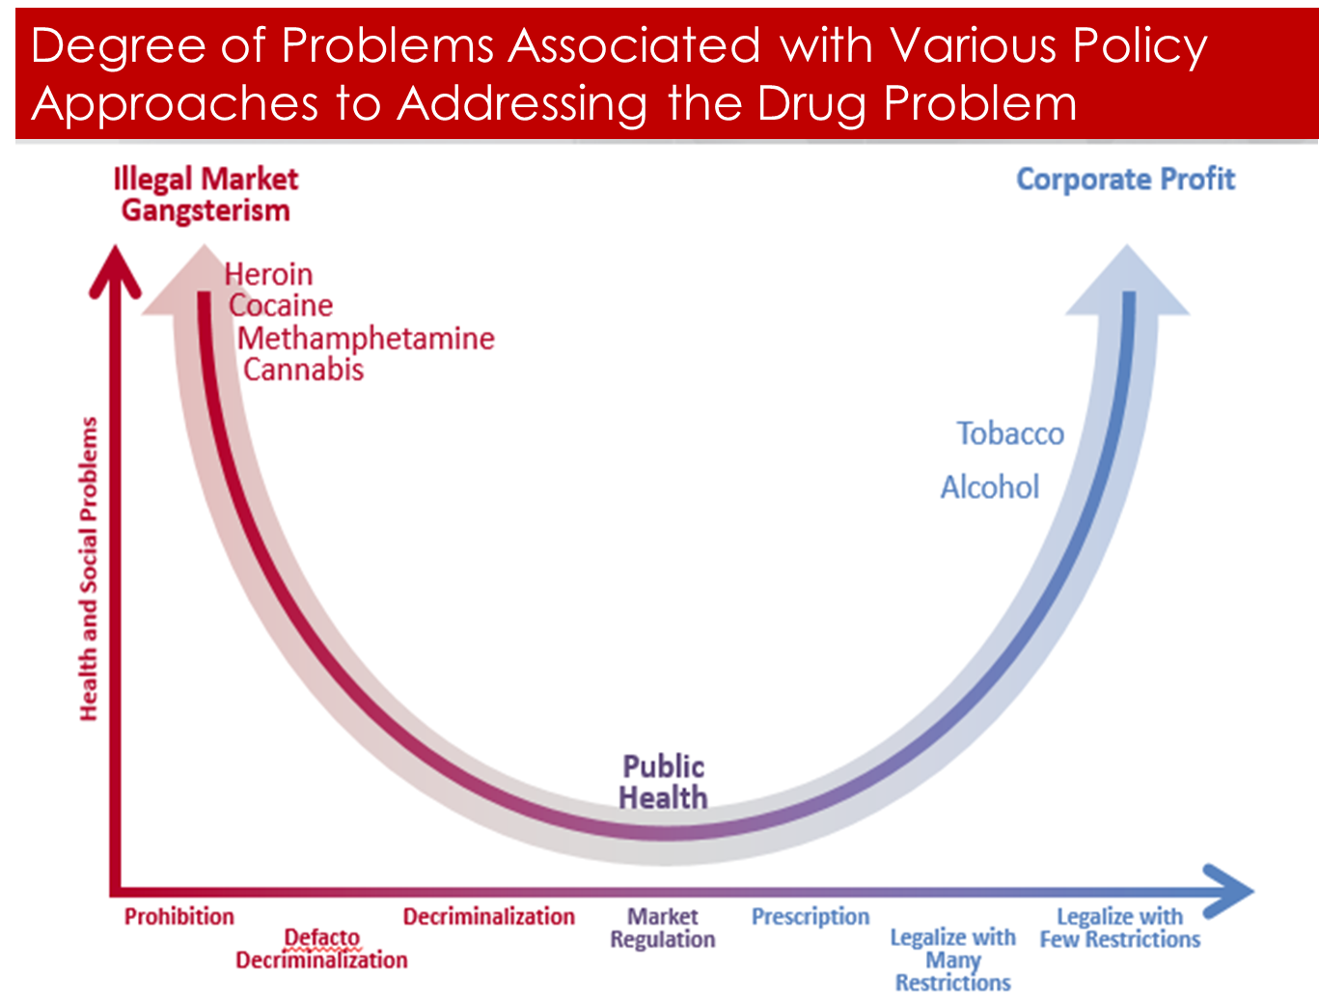
ETIOLOGY: HOW DID WE GET HERE?
There are many different policy positions and strategies that one can take to address drugs in the population…

Slide 9
ETIOLOGY: HOW DID WE GET HERE?
There are many different policy positions and strategies that one can take to address drugs in the population…
Ironically, from a drug policy perspective, prescriptions are supposed to be safe conferring among the lowest levels of health and social threat…

Slide 10
ETIOLOGY: HOW DID WE GET HERE?
Overprescribing: The 5th Vital Sign
  Unrelieved pain major, yet an avoidable, public health problem.
  1997, collaborative project initiated to integrate pain assessment and management into standards
  2001, all patient care organizations accredited by JCAHO - Pain Management becomes the 5th vital sign.
  Prescription opioids purported and perceived to be “safe” “non-addicting” …

Slide 11

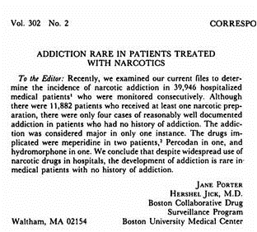
“I was sort
of amazed. None of
the companies came to
talk to me about the letter
or the use as an ad.”
-Hershel Jick, NPR Interview, 2017
NPR: http://www.npr.org/sections/health-shots/2017/06/16/533060031/doctor-who-wrote-1980-letter-on-painkillers-regrets-that-it-fed-the-opioid-crisi
NEJM: http://www.nejm.org/doi/pdf/10.1056/NEJM198001103020221
Notes:
ORIGINAL LETTER: http://www.nejm.org/doi/pdf/10.1056/NEJM198001103020221
NPR INTERVIEW: http://www.npr.org/sections/health-shots/2017/06/16/533060031/doctor-who-wrote-1980-letter-on-painkillers-regrets-that-it-fed-the-opioid-crisi

Slide 12

How did we get here?
A perfect storm…
Powerfully seductive, addictive, legal, potentially lethal opioid medications, became too widely prescribed/ and available, easily accessible, promoted as “non-addictive” and safe, in an effort to treat the new “5th vital sign” (pain) with systematic encouragement and performance monitoring

Slide 13
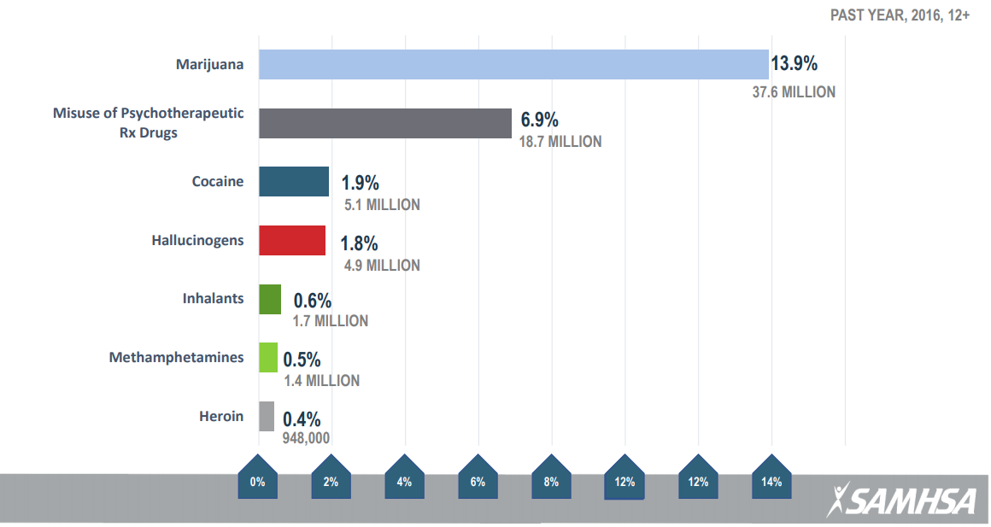
EPIDEMIOLOGY & TRENDS: US
NATIONAL TRENDS IN SUBSTANCE USE
Of all misused drugs (besides alcohol), prescription drugs are 2nd most common
Of all opioids, prescription pain relievers were the most commonly misused; heroin 0.4%
NSDUH: https://www.samhsa.gov/sites/default/files/topics/data_outcomes_quality/nsduh-ppt-09-2017.pdf

Slide 14
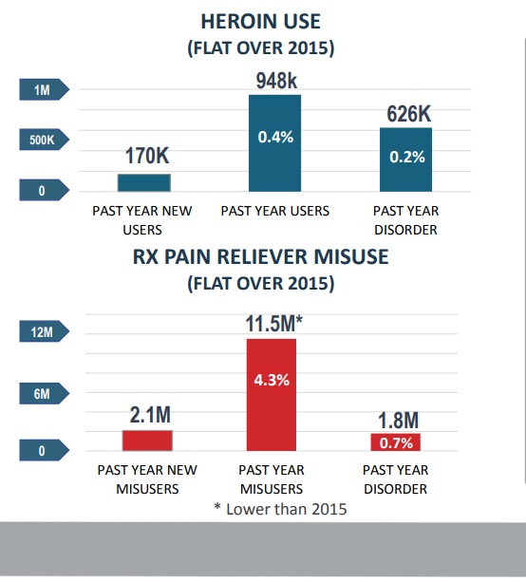
EPIDEMIOLOGY & TRENDS: US
Rate of OD death 10x higher among individuals addicted to heroin compared to prescription opioids but prescription opioid use is 10x higher than heroin suggesting an equal need to reach and intervene with both groups assertively.
Rose’s Theorem (prevention paradox): A large number of people exposed to a small risk can generate many more cases than a small number of people exposed to high risk (Rose, 1992).
NATIONAL TRENDS
And we’re still seeing lots of new misuse…
NSDUH: https://www.samhsa.gov/sites/default/files/topics/data_outcomes_quality/nsduh-ppt-09-2017.pdf

Slide 15
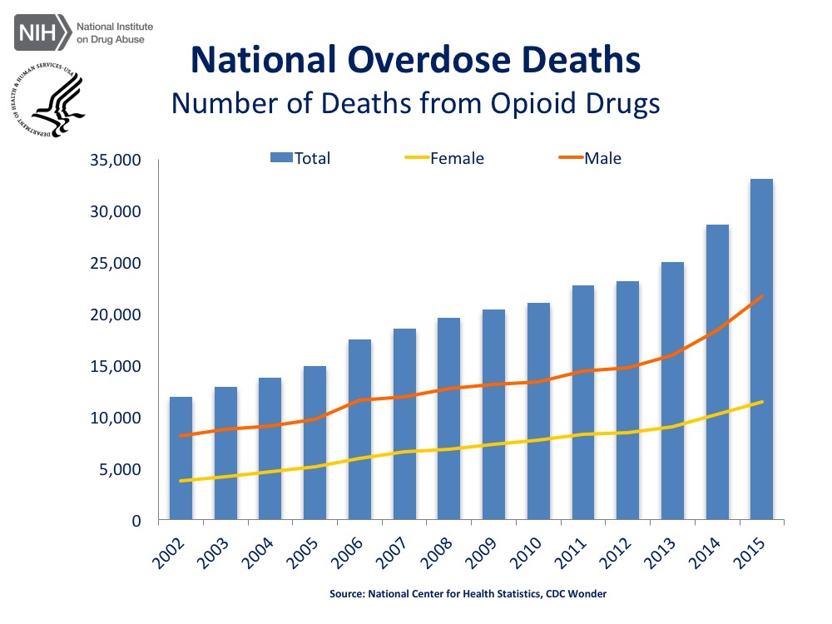
EPIDEMIOLOGY & TRENDS: US
NATIONAL OPIOID OD DEATHS: BY SEX
Almost a tripling in total number of OD deaths from ANY opioid drugs between 2002 and 2015
OPIOID OD represents about 62% of all OD deaths (excluding alcohol)
*Includes heroin, illicit synthetic opioids, and opioid analgesics
NIDA: https://www.drugabuse.gov/related-topics/trends-statistics/overdose-death-rates
Notes:
Other drugs that peopled OD’d on were: cocaine/meth, and benzos…

Slide 16
Addiction is not the only pathway to harm….
Toxicity, Intoxication, and Addiction
Patterns of use
Average volume
intoxication
Toxic Effects
Addiction
Chronic Disease
Accidents/injuries (acute disease)
Acute social problems
Chronic Social problems
Source: Babor et al, 2010

Slide 17
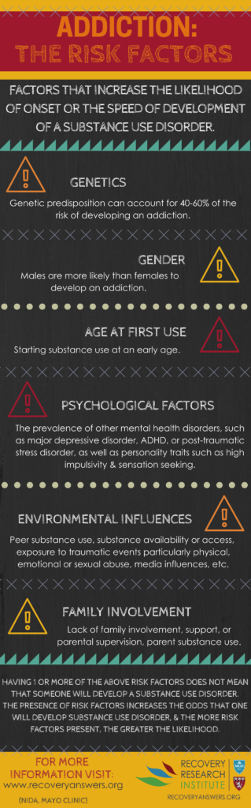
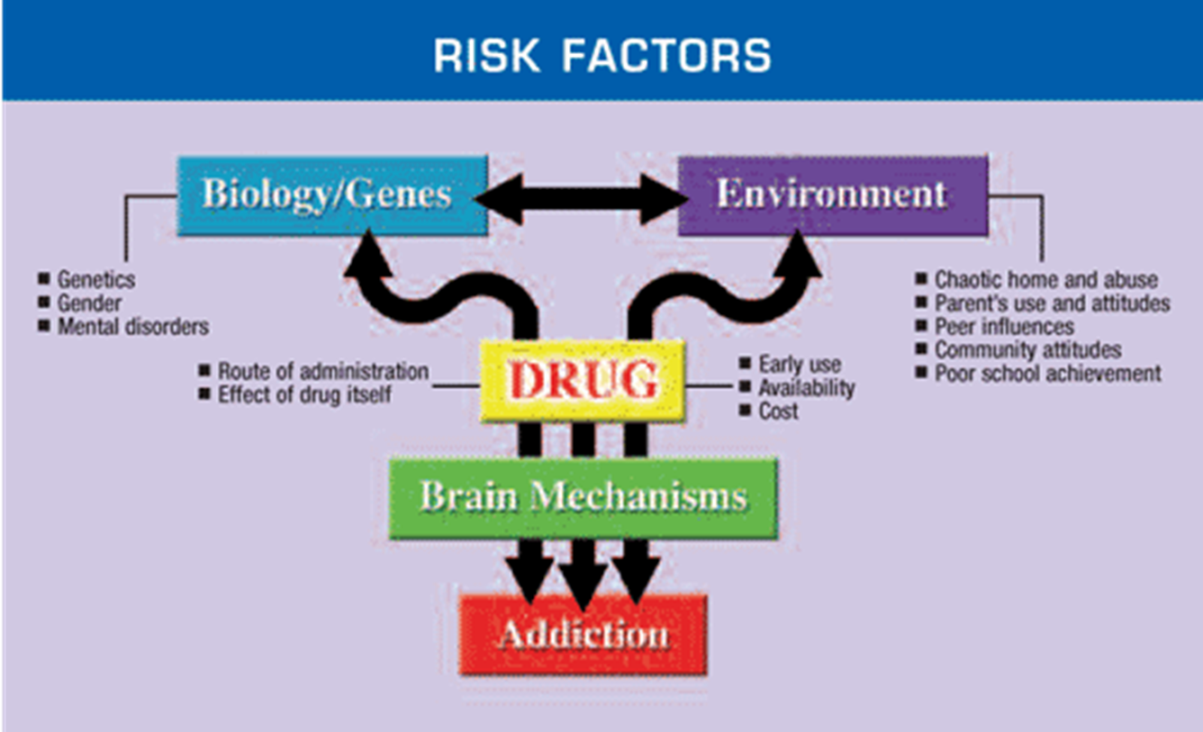
Addiction is a complex multi-factorially determined illness…

Slide 18
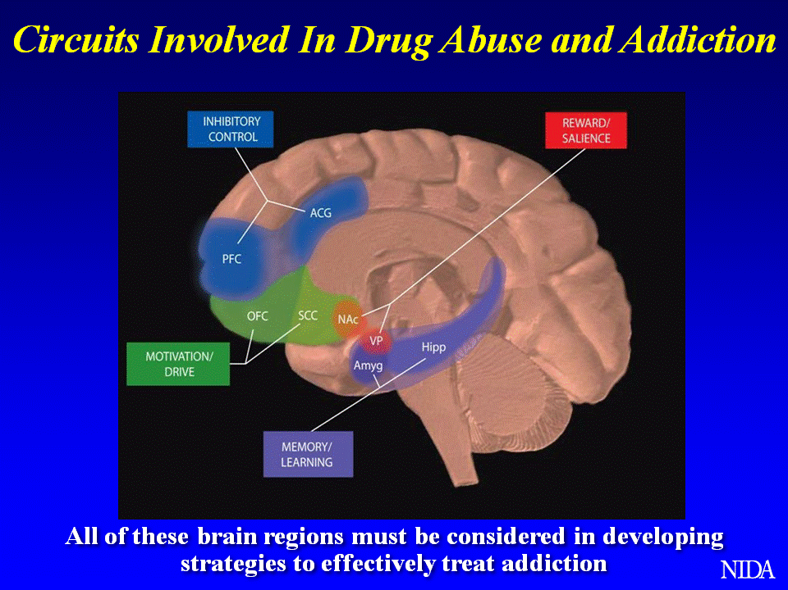
Addiction is a result of neurological changes …
Key:
PFC – prefrontal cortex;
ACG – anterior cingulate gyrus;
OFC – orbitofrontal cortex;
SCC – subcallosal cortex;
NAc – nucleus accumbens;
VP – ventral pallidum;
Hipp – hippocampus;
Amyg – amygdala.
Notes:
Key:
PFC – prefrontal cortex;
ACG – anterior cingulate gyrus;
OFC – orbitofrontal cortex;
SCC – subcallosal cortex;
NAc – nucleus accumbens;
VP – ventral pallidum;
Hipp – hippocampus;
Amyg – amygdala.

Slide 19
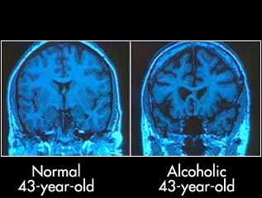
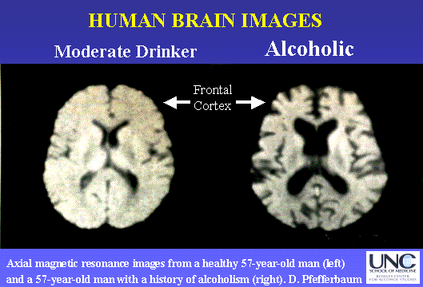

Slide 20
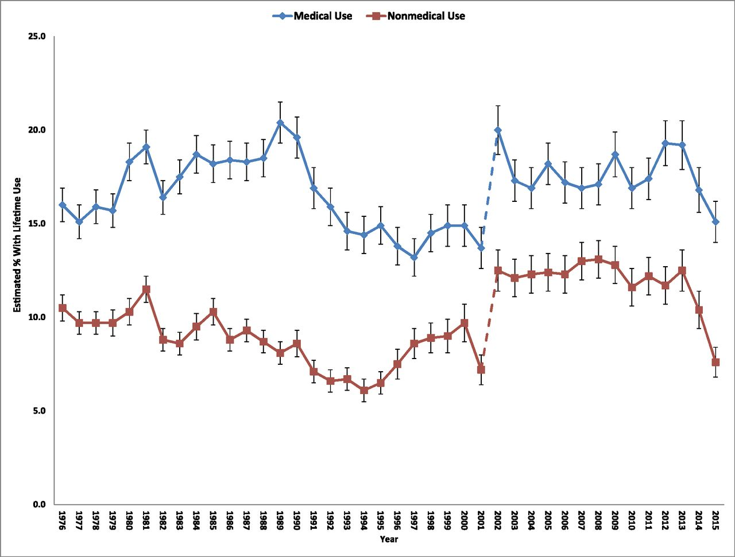

Trends in lifetime medical and nonmedical use of prescription opioids among high school seniors, 1976–2015.
About 10-15% of
HS seniors misuse
Prescription opioids
(General adult population =5%)
Non-medical
Use has largely
Followed trends in medical
Use.
Sean Esteban McCabe et al. Pediatrics doi:10.1542/peds.2016-2387
Joint Commission requirement
to address pain
©2017 by American Academy of Pediatrics
Notes:
Trends in lifetime medical and nonmedical use of prescription opioids among high school seniors, 1976–2015. The dotted line reflects the fact that the list of examples of prescription opioids was updated in 2002, which probably contributed to an increase in medical and nonmedical use of prescription opioids in 2002 (see the Measures section for details of the updates).

Slide 21
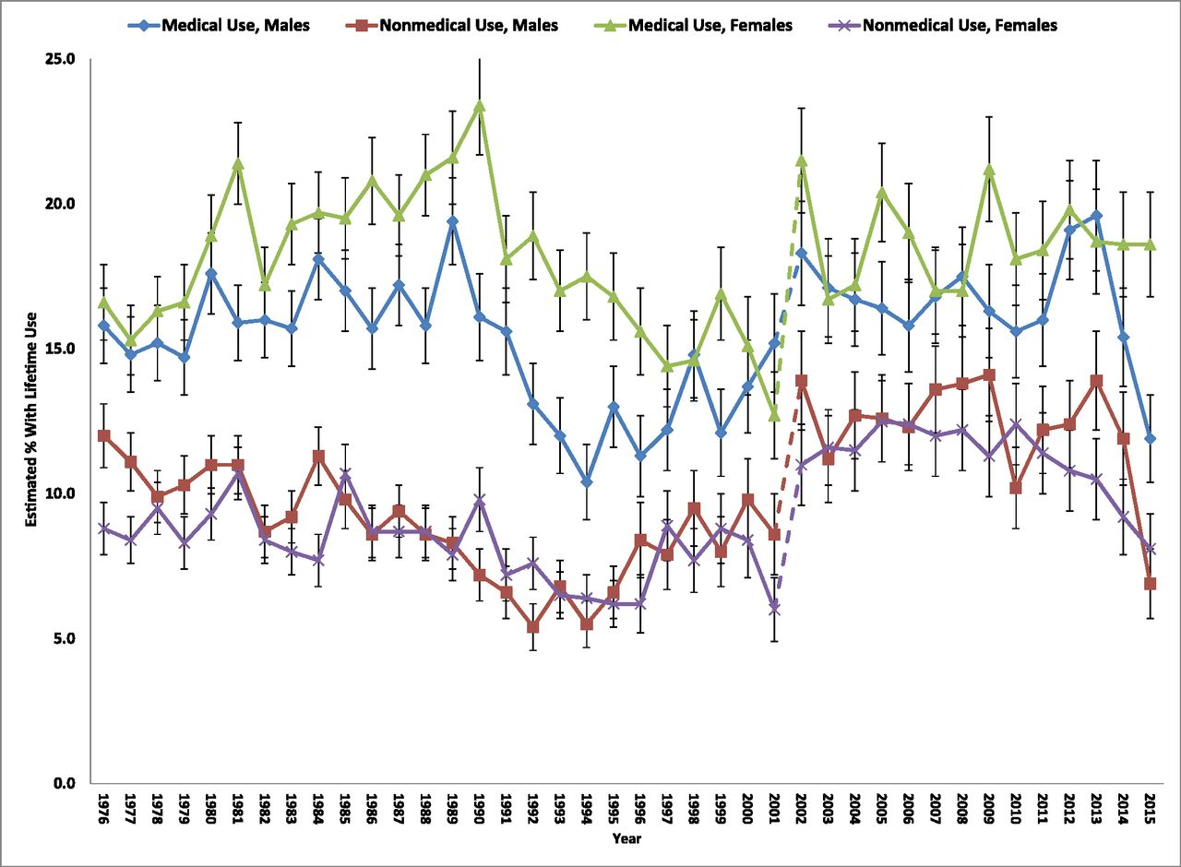
Trends in lifetime medical and nonmedical use of prescription opioids among high school seniors by sex, 1976–2015.
Boys and Girls show similar trends in prevalence of use with boys slightly higher in recent years
Sean Esteban McCabe et al. Pediatrics doi:10.1542/peds.2016-2387
©2017 by American Academy of Pediatrics
Notes:
Trends in lifetime medical and nonmedical use of prescription opioids among high school seniors by sex, 1976–2015. The dotted line reflects the fact that the list of examples of prescription opioids was updated in 2002, which probably contributed to an increase in medical and nonmedical use of prescription opioids in 2002 (see the Measures section for details of the updates).

Slide 22
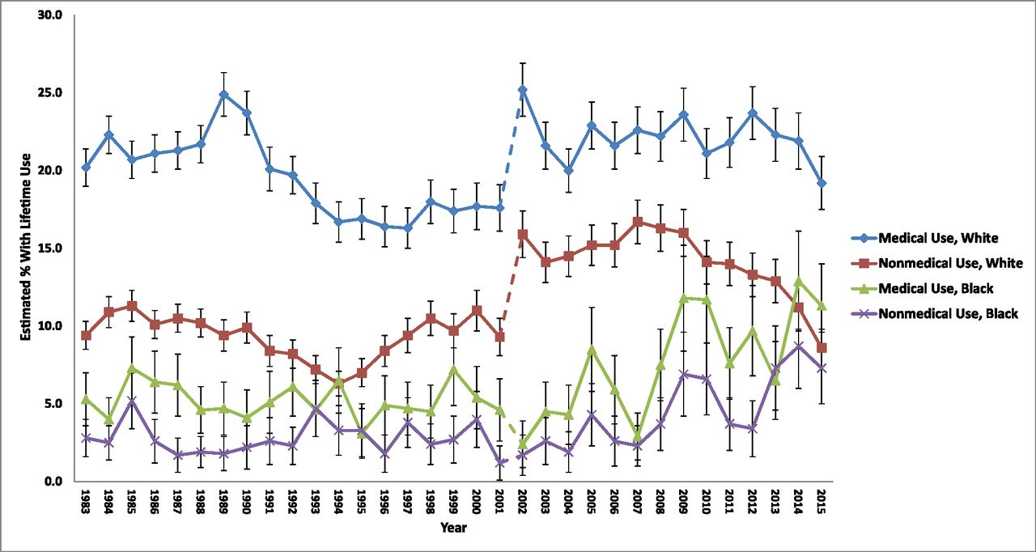
Trends in lifetime medical and nonmedical use of prescription opioids among US high school seniors by race, 1983–2015.
Rates of medical use and nonmedical use substantially higher among White than Black individuals
Sean Esteban McCabe et al. Pediatrics doi:10.1542/peds.2016-2387
©2017 by American Academy of Pediatrics
Notes:
Trends in lifetime medical and nonmedical use of prescription opioids among US high school seniors by race, 1983–2015. Based on changes in the response options to the race question between early cohort years (1976–1982) and more recent cohort years (1983–2015), we examined race trends starting in 1983 to have consistent race categories over time. The dotted line reflects the fact that the list of examples of prescription opioids was updated in 2002, which probably contributed to an increase in medical and nonmedical use of prescription opioids in 2002 (see the Measures section for details of the updates).

Slide 23
EPIDEMIOLOGY & TRENDS: US
NATIONAL TRENDS IN SUBSTANCE USE
NSDUH: https://www.samhsa.gov/sites/default/files/topics/data_outcomes_quality/nsduh-ppt-09-2017.pdf

Slide 24


Slide 25
Addictiveness of marijuana
“Adolescents, especially troubled ones, and people with psychiatric disorders (including substance abuse) appear more likely than the general population to become dependent on marijuana… ”
-- Institute of Medicine
Anthony, J.; Warner, L.A.; and Kessler, R.C. Comparative epidemiology of dependence on tobacco, alcohol, controlled substances, and inhalants: Basic findings from the National Comorbidity Survey. Exp Clin Psychopharmacol 2:244–268, 1994;
Hall, W.; and Degenhardt, L. Adverse health effects of non-medical cannabis use. Lancet 374:1383–1391, 2009;
Hall, W. The adverse health effects of cannabis use: What are they, and what are their implications for policy? Int J of Drug Policy 20:458–466, 2009

Slide 26
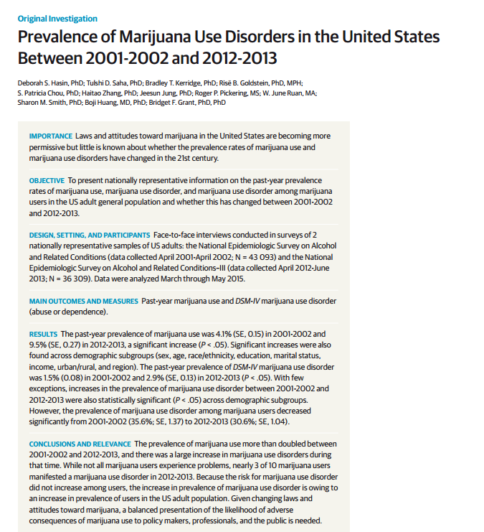

Slide 27
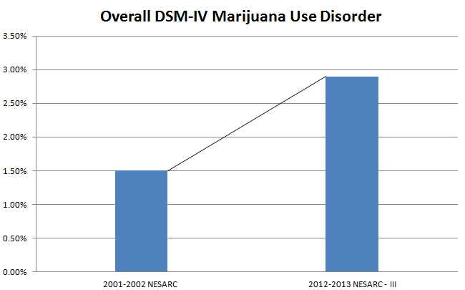
Past Year DSM-IV Marijuana Use Disorder
Notes:
Prevalence of DSM-IV marijuana use disorder nearly doubled between 2001-2002 and 2012-2013.

Slide 28


Slide 29

1. First Analysis (k=33)
Results: Neurocognitive deficits in most domains of functioning present early during abstinence
2. Second Sub-Analysis (k-13)
Results: Not present after 25 or more days of abstinence
3. … but what about among youth?
Notes:
e.g., learning, memory, processing speed, reaction time etc.

Slide 30
A Life Course Perspective
Fetus
Child
Adolescent
Young Adult
Middle Age
Senior
The life course perspective has the advantage of recognizing developmental stages as factors facilitating or inhibiting change and continuity, and/or protective and risk factors, that may differ across the life span (Hser & Anglin, 2008).

Slide 31
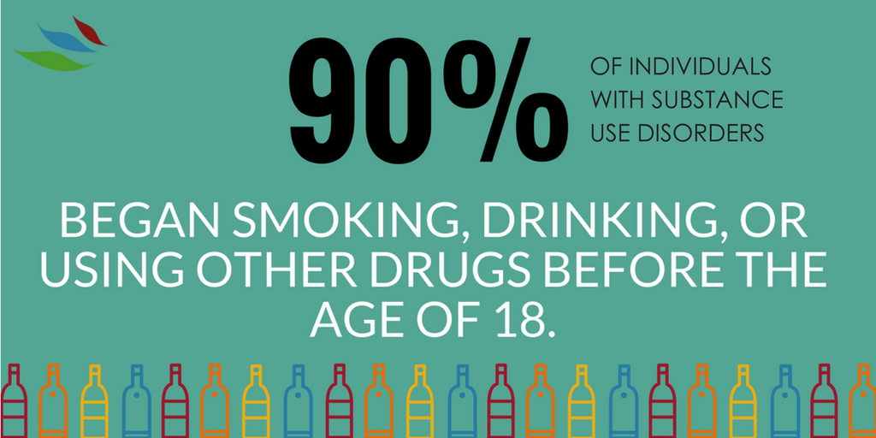

Slide 32
Clinician’s Illusion vs Epidemiologist’s Illusion
Age Groups
100
Severity Category
90
80
No Alcohol or Drug Use
70
Light Alcohol Use Only
60
Any Infrequent Drug Use
50
40
Regular AOD Use
30
Abuse
20
10
Dependence
0
12-13
14-15
16-17
18-20
21-29
30-34
35-49
50-64
65+
NSDUH and Dennis & Scott
Notes:
This figure shows how the prevalence of these past year severity categories vary by age.
1- Substance use disorders typically on set during adolescents and young adult hood. In fact, 90% of all adults with dependence started using under the age of 18, half under the age of 15.
2- After several decades, the rates of abuse and dependence do decrease as people go into remission, incarceration or die. Epidemiological studies of people with lifetime substance dependence suggest that 58% eventually enter sustained recovery (i.e., no symptoms for the past year) -- a rate that is considerably better than the 39% average rate of recovery across psychiatric disorders (Kessler, 1994; see also Dawson, 1996; Robins & Regier, 1991).
3 – Notice how the rates of no use go up with age.
Thus substance use disorders on set early and last for many years, but do get better over time.

Slide 33
Earlier Intervention Lessens Impact and Duration of SUD
1.0
Years to 1st Tx
.9
Cumulative Survival
.8
.7
Years from first use to 1+ years abstinence
20+
.6
.5
.4
.3
.2
10-19*
.1
0.0
0-9*
0
5
10
15
20
25
30
* p<.05 (different from 20+)
Source: Dennis et al., 2005
33
Notes:
33
But the good news is the sooner you get tx the better…

Slide 34
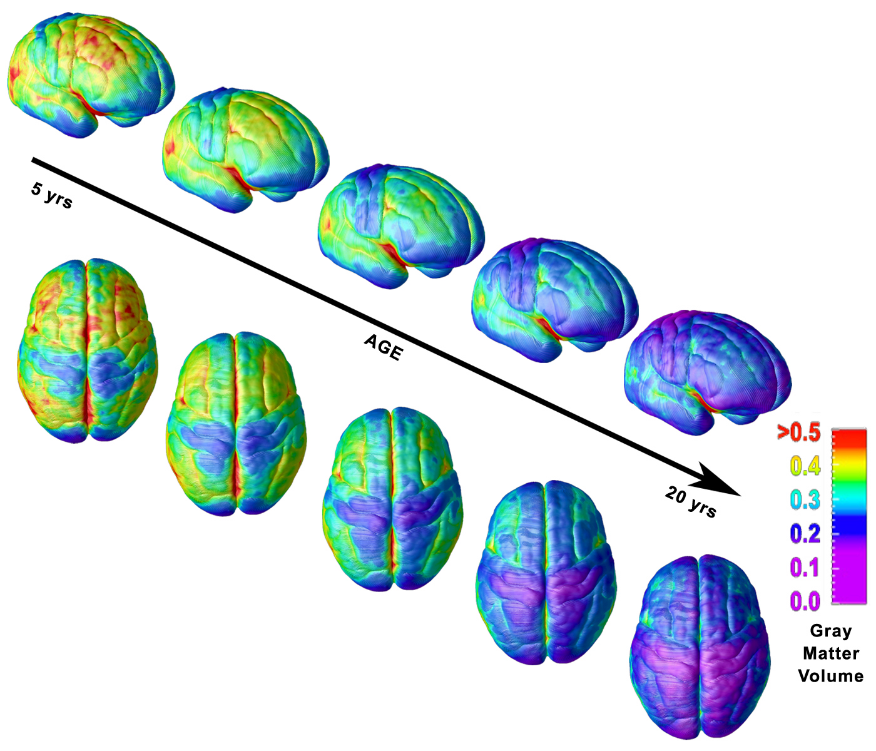
Pre-frontal cortex associated with weighing pros/cons, impulse control, judgment, abstract reasoning, planning last to develop…
There are “critical” periods in brain development wherein substances can have more profound developmental effects…

Slide 36
MJ use during adolescence may affect
neuromaturational processes through two pathways:
Alters synaptic pruning (via disrupting glutamate
Transmission) leading to greater disinhibition in prefrontal
regions leading to psychotic symptoms
2. Decreased myelination altering development of white matter
leading to cognitive-emotional impairments
Notes:
White matter is composed of bundles of myelinated nerve cell projections (or axons), which connect various gray matter areas (the locations of nerve cell bodies) of the brain to each other, and carry nerve impulses between neurons. Myelin acts as an insulator, increasing the speed of transmission of all nerve signals. MJ may interrupt communication and informataion exchange as well as speed of communication among neurons and regions involved in executive funx

Slide 37
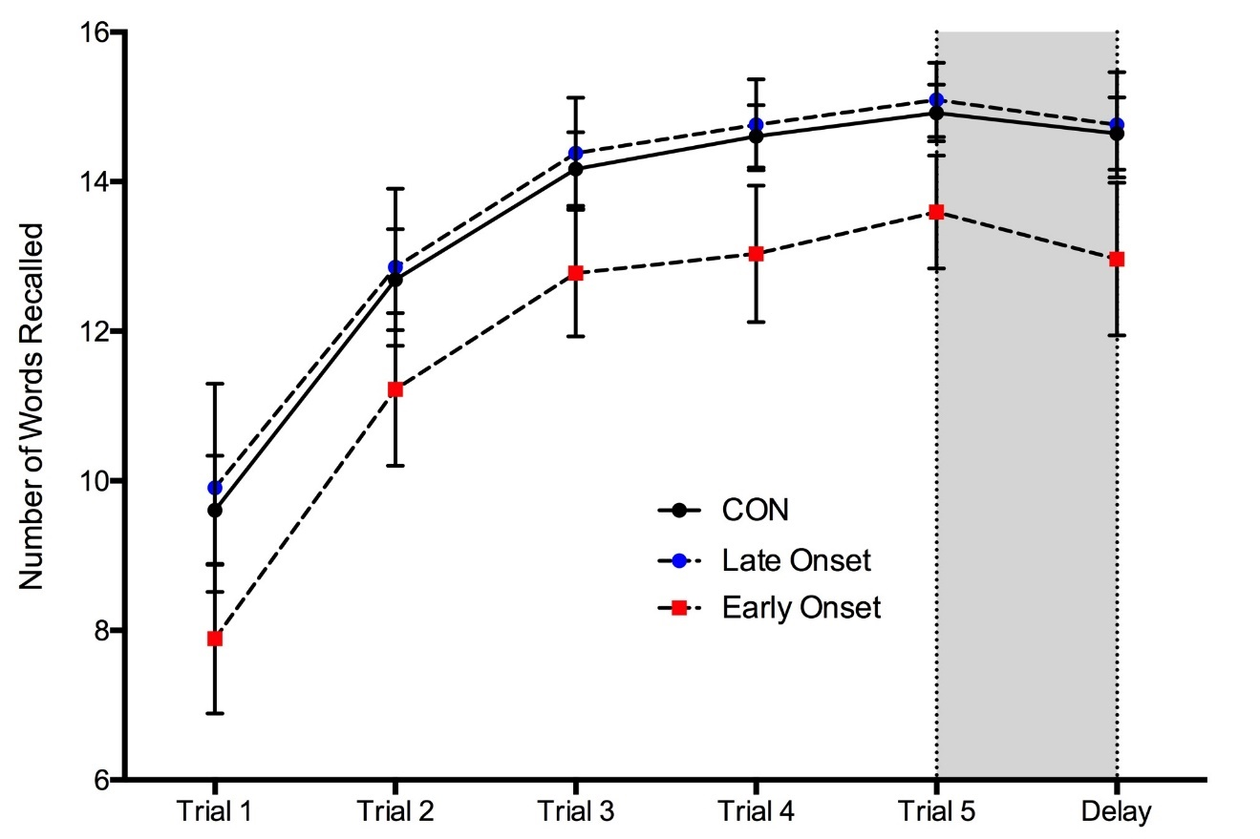
Potential impact on academic achievement: Marijuana Users Show Worse Performance on a Memory Test
Early onset MJ users (<16), show impaired learning compared to non-users
Could mean students using MJ regularly could have difficulty attending to and learning new information
Schuster et al., 2016

Slide 38
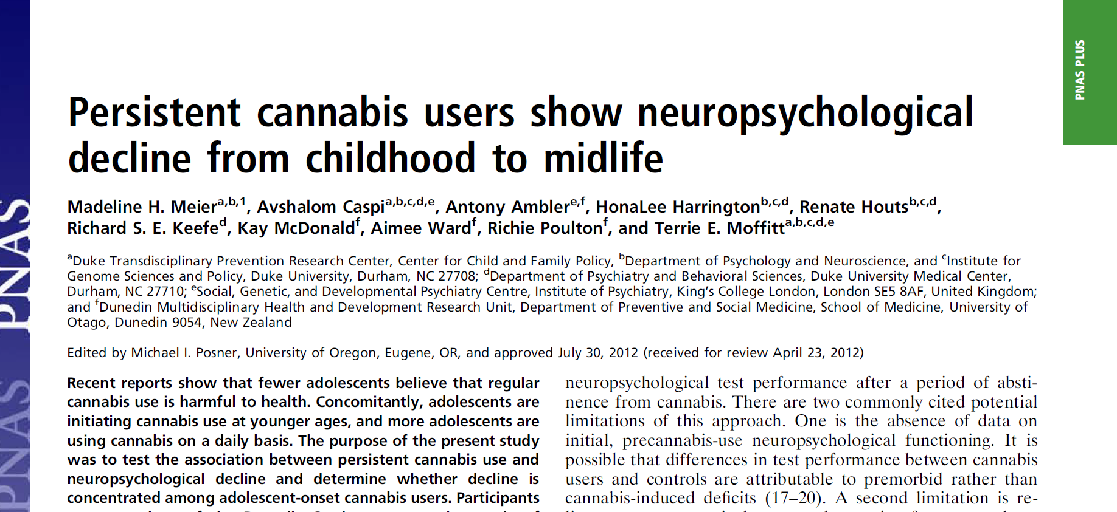

Slide 39
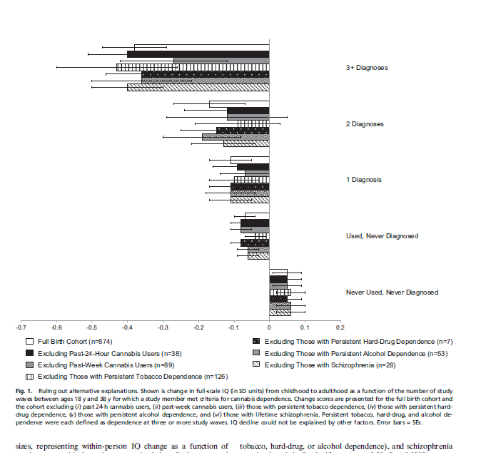
Even when recent MJ use was taken into account along with other confounds heavy use during teen years was associated with an 8 point drop in IQ

Slide 40
5 outcomes from longitudinal Meier et al (2012)
prospective design over 20 yrs assessing neuropsych function
1. Findings not due to premorbid neuropsych deficits
2. impairment was global, detectable across 5 domains of neuropsych functioning. Still present after other drug use accounted for
3. neuropsych decline did not occur solely because MJ users had less education.
4. impairment was apparent to third-party informants and persistent MJ use interfered with everyday cognitive functioning.
5. among adolescent onset former persistent MJ users, impairment was still evident after cessation of use for 1 y or more.
Collectively, findings consistent with speculation that cannabis use in adolescence, when the brain is undergoing critical development, may have neurotoxic effects.

Slide 41
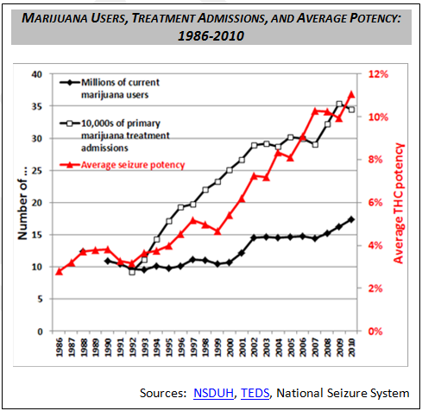
What will be the effects of higher potency MJ?
That study was done when MJ potency was lower…. Increased potency in past 20 years

Slide 42
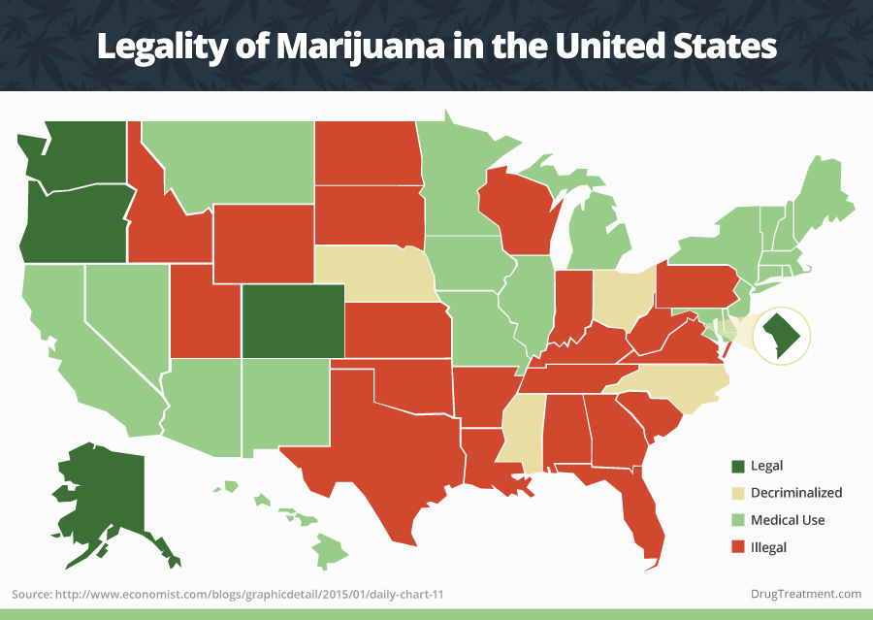
Will legalization
lead to Increased
consumption of
MJ?

Slide 43
Positive moderate-strong correlation
across states, between less perceived harm and legalization and “medicalization” of MJ
Positive moderate to strong correlation
across states, between higher rates of teenage use
and legalization and “medicalization” of MJ

Slide 44
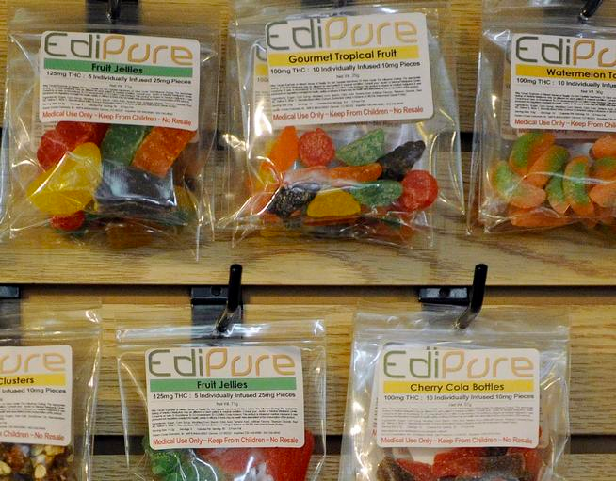
Impact of Edibles?

Slide 45


