Slide 1
Department of Developmental Services 2017 MASC/MASS Joint Conference November 3, 2017
Turning 22: Challenges and Strategies
Victor Hernandez, Ed. M.
Deputy Assistant Commissioner

Slide 2
Parental Concerns
Transition is a word that has a unique meaning to families with a son or daughter aging out of the entitlement of education.
Fear, anxiety and dread are just a few words that come to mind around this anticipated change.
As parents, they felt fairly competent with the educational terminology.
Now they must learn a new lingo: Ch. 688, ITP, ISP, Prioritization, Waiver, Self-Direction, Shared Living????
Also, transportation takes on a whole new meaning when the bus doesn’t stop at their house any more.
Parents ask: When do we start? Who is involved? What are our options? Where do we go for help? We don’t even know all of the questions we need to ask!!!

Slide 4
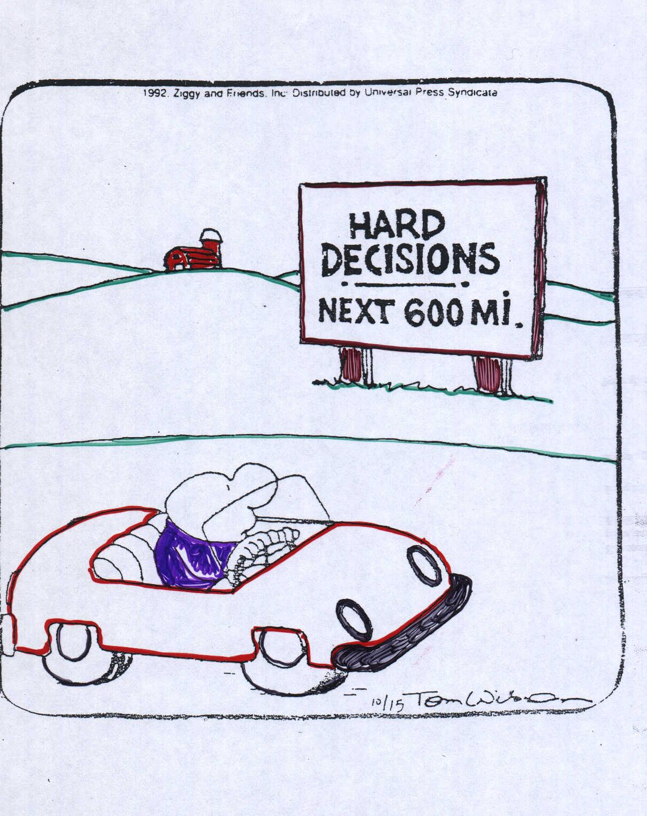
Transition

Slide 5
Developing A Vision for a Good Life
High Expectations & Expanding Possibilities!
Consider the following areas:
Work/career
Housing
Social relationships
Recreation/fun
Family connections
Community Connections
Spiritual Life
Transportation

Slide 6
The School and Transition
There are two laws that provide two very different types of
transition requirements for youth with disabilities.
They can be confusing because although they both are
called “transition” (and they involve many of the same
players), but the two transition processes do very different
things.

Slide 7
IDEA: The School and Transition
IDEA--- The federal special education law, Individuals with Disabilities
Education Act (IDEA) contains a number of requirements related to
transition, which focus on the school district’s obligation to provide
transition services before a young adult graduates or turns 22 and
exits SPED.
The school and related services are designed to meet the student’s unique needs and help to prepare them for further education, employment, and independent living.
What supports and services will be necessary for the student to make progress towards achieving his/her postsecondary goals?
How can the student develop self-determination skills and be prepared both academically and functionally transition to post-school activities to achieve his/her post-secondary vision.

Slide 8
Massachusetts Chapter 688
Chapter 688, a MA state law, establishes a process which helps to determine which state human service agency will be responsible for adult services and begins the transition process when they graduate or turns 22.
A law to highlight the needs of students who will lose their SPED entitlement
Provides a two year planning process
A process for accessing appropriate the adult service agency for student after SPED
Transitional Agency will develop an Individual Transition Plan (ITP)
Is not a continuation of SPED services nor is an entitlement for services after SPED

Slide 9
Who is Eligible for Chapter 688?
To be eligible for Chapter 688 services, a person must:
Be receiving special education paid for by the Commonwealth of Massachusetts;
Need continuing habilitative services at the time of turning 22 or graduating from special education; and
Be unable to work competitively (without specialized supports) for more than 20 hours per week at the time of leaving school.
Note: An individual is automatically eligible for Chapter 688 if receiving SSI, receiving SSDI, or registered with the Massachusetts Commission for the Blind.

Slide 10
How is a Chapter 688 Referral made?
Only the local school district (LEA) can make a 688 referral.
The referral must be made while the student is still in school.
DDS prefers referrals sooner- around age 18
The student’s IEP team selects the adult services agency that provides the services and expertise that most closely resemble the student’s areas of need, and sends the 688 referral to that agency.
The receiving agency then becomes the “Transitional” Agency.
Listing of Eligible Chapter 688 State Agencies:
Department of Children and Families (DCF)
Department of Developmental Services (DDS)
Department of Mental Health (DMH)
Department of Youth Services (DYS)
Massachusetts Commission for the Blind (MCB)
Massachusetts Commission for the Deaf and Hard of Hearing (MCDHH)
Massachusetts Rehabilitation Commission (MRC)

Slide 11
New Chapter 688 Referral Process
Beginning September 1, 2017, the Bureau of Transitional Planning (BTP) is no longer accepting paper Chapter 688 referrals on behalf of students with disabilities.
This includes submissions directly to human service agencies as well as to the BTP.
All referrals should be submitted using the new electronic T22/Chapter 688 referral application which is accessed through the EOHHS Virtual Gateway.

Slide 12
The Role of the Parent/Student
The 688 referral should be discussed at the IEP Team meeting and
submitted before the student is 18.
The parent/ student may want to consider applying for Supplemental
Security Income (SSI) and to MassHealth.
Utilize Transition Timelines
Student’s Role in transition: self-advocacy & responsibility
Families Role: Ways to promote independence & responsibility at home and in community
Maximize educational services to promote learning opportunities that support goals for life after school

Slide 13
DDS Transition Coordinator (688TC)
The DDS Transition Coordinator (688TC) is the case manager who
works at the local DDS Area Office.
The 688 TC is the student’s primary link to assistance from DDS during
the transition from special education to adult life.
The 688 TC visits the student’s programs and attends IEP meetings as
needed in preparation for the Individual Transition Plan (ITP)
development.
The 688 TC will work with the individual and their family from less
restrictive alternatives to a court appointed guardian.

Slide 14
The ITP
The Individual Transition Plan (ITP) specifies what kinds of support the
student/family is requesting upon leaving special education
The ITP meeting is normally held about one year before the student is
ready to leave school
The purpose of an ITP meeting is to develop a plan that includes the
interests, skills and needs of the person
The ITP does not contain specific goals and objectives, or identify
specific provider agencies
Supports identified in the ITP are not guaranteed or create an
entitlement; they are subject to prioritization, appropriation and
availability.

Slide 15
Benefits of the 688 Process
The 688 process ensures that the student is working with the
appropriate adult human service agency before exiting SPED
entitlement
Provides very specific timelines for planning and transition to the new
agency.
The ITP enables the adult agency to understand the students’ needs
and to begin programmatic and fiscal planning
By specifying an individual’s needs before exiting SPED, the family and
agency can plan and advocate as appropriate.
Any student is free to apply directly to an adult agency outside of the
688 process, but going through the process ensures that the agencies
have enough time to set up a transition.

Slide 16
Key Points to Remember Regarding the 688 Process
Not a continuation of special education services-adult services are subject to funding and availability
DDS receives specialized funding each fiscal year for students transitioning within that year
A 688 referral is not the same as the DDS adult eligibility
A 688 referral is still needed if known to DDS as a child or already determined adult eligible
DDS Transition Coordinator plays key role in planning

Slide 17
DDS Eligibility

Slide 18
DDS Eligibility
In order to receive supports from DDS, eligibility must be determined
Determination occurs through one of the 4 Regional Teams (Springfield, Waltham, Danvers, and Middleboro)
Criteria for Eligibility is the same throughout the state
All eligibility determinations are made by a DDS Licensed Psychologist
When thinking about transition and DDS adult supports
ELIGIBILITY FOR ADULT SERVICES IS KEY!

Slide 19
DDS Eligibility 115 CMR 2.01
Intellectual Disability means, consistent with the standard contained in
the Definition, Classification and Systems of Supports of the11th edition
(2010) of the American Association of Intellectual Disabilities:
significantly sub-average intellectual functioning existing concurrently with and related to
significant limitations in adaptive functioning. Intellectual Disability originates before age 18.
A person with intellectual disability may be considered to be mentally ill
as defined in 104 CMR (Department of Mental Health), provided that no
person with intellectual disability shall be considered to be mentally ill
solely by reason of his or her intellectual disability.

Slide 20
DDS Eligibility 115 CMR 2.01 (cont.)
Significant Limitations in Adaptive Functioning means an overall composite adaptive functioning limitation that is approximately two standard deviations below the mean or approximately two standard deviations below the mean in one of the three domains of the appropriate norming sample determined from the findings of assessment using a comprehensive, standardized measure of adaptive behavior, interpreted by a qualified practitioner.
The domains of adaptive functioning that are assessed shall be:
(a) areas of independent living/practical skills;
(b) cognitive, communication, and academic/conceptual skills; and
(c) social competence/social skills

Slide 21
DDS Eligibility 115 CMR 2.01 (cont.)
Significantly Sub-average Intellectual Functioning means an intelligence test score that is indicated by a score of approximately 70 or below as determined from the findings of assessment using valid and
comprehensive, individual measures of intelligence that are administered in standardized formats and interpreted by qualified practitioners.

Slide 22
Eligibility Update
Have a primary diagnosis of Autism Spectrum Disorder (“ASD”), based on the most recent addition of the Diagnostic and Statistical Manual (DSM V).
Have a primary diagnosis of Prader‐Willi Syndrome, based on medical evidence which includes genetic testing results.
Have a primary diagnosis of Smith‐Magenis Syndrome, based on medical evidence which includes genetic testing results.
Have substantial functional impairment in three or more areas of the seven areas of major life activities. The seven areas are selfcare, expressive communication, receptive communication, learning, mobility, capacity for selfdirection, economic self‐sufficiency.
IQ is not a relevant determinative factor.
Maintains IQ and Functional limitations criteria for those with an ID diagnosis
Changes the age of adult eligibility from its current 18 years of age to 22 years of age

Slide 23
DDS Prioritization

Slide 24
MASSCAP
MASSCAP stands for the Massachusetts Comprehensive Assessment
Process
DDS created the MASSCAP for adults in order to determine what
types of services the person needs
It addresses the question of “Who needs DDS funded residential
supports, defined as 24/7 out-of-home, 24 hour, 7 days a week?”
MASSCAP also addresses the question that if an individual does not
need 24/7, out-of-home residential supports, what other types of
supports would meet the person’s need
The MASSCAP assists the Area Office in making prioritization
decisions

Slide 25
MASSCAP
The MASSCAP assesses:
The functional limitations of an individual
What resources are currently available to support the individual
Specific characteristics of the individual, such as unique medical,
mental health or forensic issues
Caregiver capacity to provide care, since an individual’s need for 24/7
out-of-home residential support is an interaction between the person’s
needs and the ability of the caregiver(s) to provide care

Slide 26
MASSCAP
The MASSCAP is not
Used to determine general DDS eligibility for services
Involved in who is the most appropriate person for a particular opening
Used to proscribe the specific service and provider of the service
needed for the individual.

Slide 27
Medicaid Home and Community-Based Services Waiver

Slide 28
Medicaid Home and Community-Based Services
An arrangement between the state and the federal Medicaid program
Waives some Medicaid rules to create more choice about services received and how they are provided
Individual must have MassHealth in order to apply for one of the Waiver programs
Massachusetts is reimbursed from the federal government for part of the cost of providing DDS services in the community (about 50%).
DDS is required under law to "maximize" its federal reimbursement so that it can help to serve individuals with the funding it receives.

Slide 29
Medicaid Home and Community-Based Services
In addition to helping fund services, participation in the Waiver Program provides participants with important rights, including choice in providers and protection from a reduction or change in services being provided to individuals.
Individual waiver participants have a right to needed services, and appeal rights in the event of a decrease in the amount or type of service that individuals receive.
Individuals not enrolled in the Waiver Program do not have the same appeal rights, and risk having services impacted in the event of budget reductions.

Slide 30
DDS Adult Services

Slide 31
DDS Adult Services
Traditional
A provider agency is selected to deliver supports and they assume the full responsibility for the hiring, screening, training, supervising and managing of the employees.
Self-Direction
A self directed model means that the individual/family/guardian and friends can develop and manage the services.
They recruit, hire, and supervise the staff.
The control and responsibility for services shifts to individual and people chosen to support them.
Many people have found that managing their own services makes a difference because it helps them determine the course of their lives.

Slide 32
DDS Adult Services
Agency with Choice
When you choose an Agency with Choice you are entering into an agreement with the provider agency to share those responsibilities.
You as the individual/family are responsible for selecting the employee, setting the work hours, and daily management of the employee.
You share responsibility for evaluation and training.
In both types of agencies you do not have the authority to terminate the employees, but in the Agency with Choice model, you have the right to dismiss an employee from working for you.

Slide 33
DDS Adult Services - Residential
24-HOUR COMMUNITY RESIDENCE
Extensive on-going services and supports provided to individuals who need daily intervention with care, supervision, and skills training in activities of daily living, home management, and community integration.
These individuals live in a certified or licensed home with 24 hour paid support.
Residential supports are not available to individuals who live with their immediate family (grandparent, parent, sibling, or spouse) unless the immediate family member lives in the licensed or certified home and is also eligible for DDS supports.

Slide 34
DDS Adult Services - Residential
SHARED LIVING
Shared living is a residential support in which a person
resides with a non-family member (host family) in their
home.
Provider agencies who offer shared living services recruit
host families and work to match a person with an optimal
living situation that offers an appropriate level of support
and supervision.
These agencies are responsible for providing oversight,
training, and assistance to the host families.

Slide 35
DDS Adult Services - Residential
INDIVIDUAL/COMMUNITY SUPPORTS
On-going services and supports by paid staff designed to assist individuals to acquire, maintain or improve the skills necessary to live in a non-institutional setting.
Individual/Community Supports are provided to individuals who require less than 24 hours per day of assistance by paid staff.
This service provides supports necessary for individuals to develop the skills that enable them to become more independent, integrated, and productive in their communities.
The service enables adults to retain or improve skills related to personal finance, health, shopping, use of community resources, community safety, and other adaptive skills needed to live in the community.

Slide 36
DDS Adult Services – Day/Employment
Community Based Day Supports
Provide opportunities for individuals who may choose to have work take a less important role in their lives to develop, enhance, and maintain competency in personal, social and community activities during the workday hours in center-based programs with a strong focus on community involvement and integration.
Individual Supported Employment
Services and supports to assist individuals whose goal is to work less than 20 hours/week to obtain and maintain paid employment in a work place where individuals without disabilities are employed. The services may involve: assisting the participant to locate a job, developing a job on behalf of the participant, or providing customized employment, e.g. assisting participants to establish their own business.
Group Supported Employment
Provide employment services to small groups of individuals, (typically 2 to 8), often working as employees of a provider agency in the community under the supervision of a provider agency. Emphasis is on work in an integrated environment, with the opportunity for individuals to have contact with co-workers, customers, supervisors, and others without disabilities.

Slide 37
DDS Adult Services - Support
Family Support
Services for Children ~ up to age 22
Children’s Service Coordinator at local Area Office
Family Support Services consist of supplemental supports that help a family to care for their family member at home.
Types of family support services include individual and/or family education and training, support groups, family support coordination, supports planning, supports for community participation, outreach and education, and respite.
Respite
Respite provides short term out of home care for the individual with intellectual disability.
It allows parents and other primary caregivers to handle personal matters, emergencies, or take a break.

Slide 38
DDS Adult Services - Support
FAMILY SUPPORT CENTERS
Family Support Centers act as a hub for offering a wide range of general family support services and activities to families of children and adults who are eligible for DDS services.
Family Support Centers conduct broad outreach and provide services to families from diverse cultural, ethnic and linguistic communities in the geographic area they are serving.
This may involve creating partnerships with community organizations and other resources in order to provide culturally responsive services.
The Center staff are expected to be experts in generic resources and services in their respective areas and work with families to maximize natural supports.
The Center is expected to encourage active family involvement and consultation to identify interests and needs in developing activities and service options.

Slide 39
Autism Support Centers
There are seven Autism Support Centers throughout the state that provide an array of information and referral services, resources, and supports to children and young adults with autism spectrum disorders.
These Centers conduct broad outreach and provide services to families from diverse cultural, ethnic and linguistic communities in the geographic area they are serving and may create partnerships with community organizations and other resources in order to provide culturally responsive services.
The array of services and supports to families includes:
Information and Referral
Family Clinics
Support Groups
Access to the latest information on autism
Family Trainings
Parent Networking and Mentoring, and
Social/recreational events, among other activities

Slide 40
Referral Process
Opportunities provided to visit and explore different agency program services- word of mouth from other families can be helpful
Referral for services is made by DDS to the agency that provides the model of DDS funded support the individual will benefit from
Adult provider agencies have their own process/timelines for completing an intake & assessing needs
Provider agency may accept individual for services, or determine that their needs cannot be well met in their model

Slide 41
What are the bumps in the road?
Adult services are is not an entitlement service
Resources can be limited and an area often will rely on existing
resources to meet someone’s needs
Families are frustrated and disappointed that DDS cannot address their
needs and wants.

Slide 42
What do we hope to achieve?
Families have access to information that includes critical timelines,
essential contacts, and a summary of the transition planning process
A choice/array of service opportunities
Positive and constructive working relationships (long term)
A successful transition !

Slide 43
Who was that guy???

