Slide 1
Marlborough Public Schools STEM Early College High School Program
“In times of drastic change it is the learners who inherit the future. The learned usually find themselves beautifully equipped to live in a world that no longer exists.” - Eric Hoffer

Slide 2
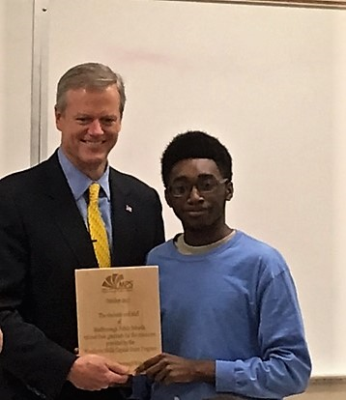
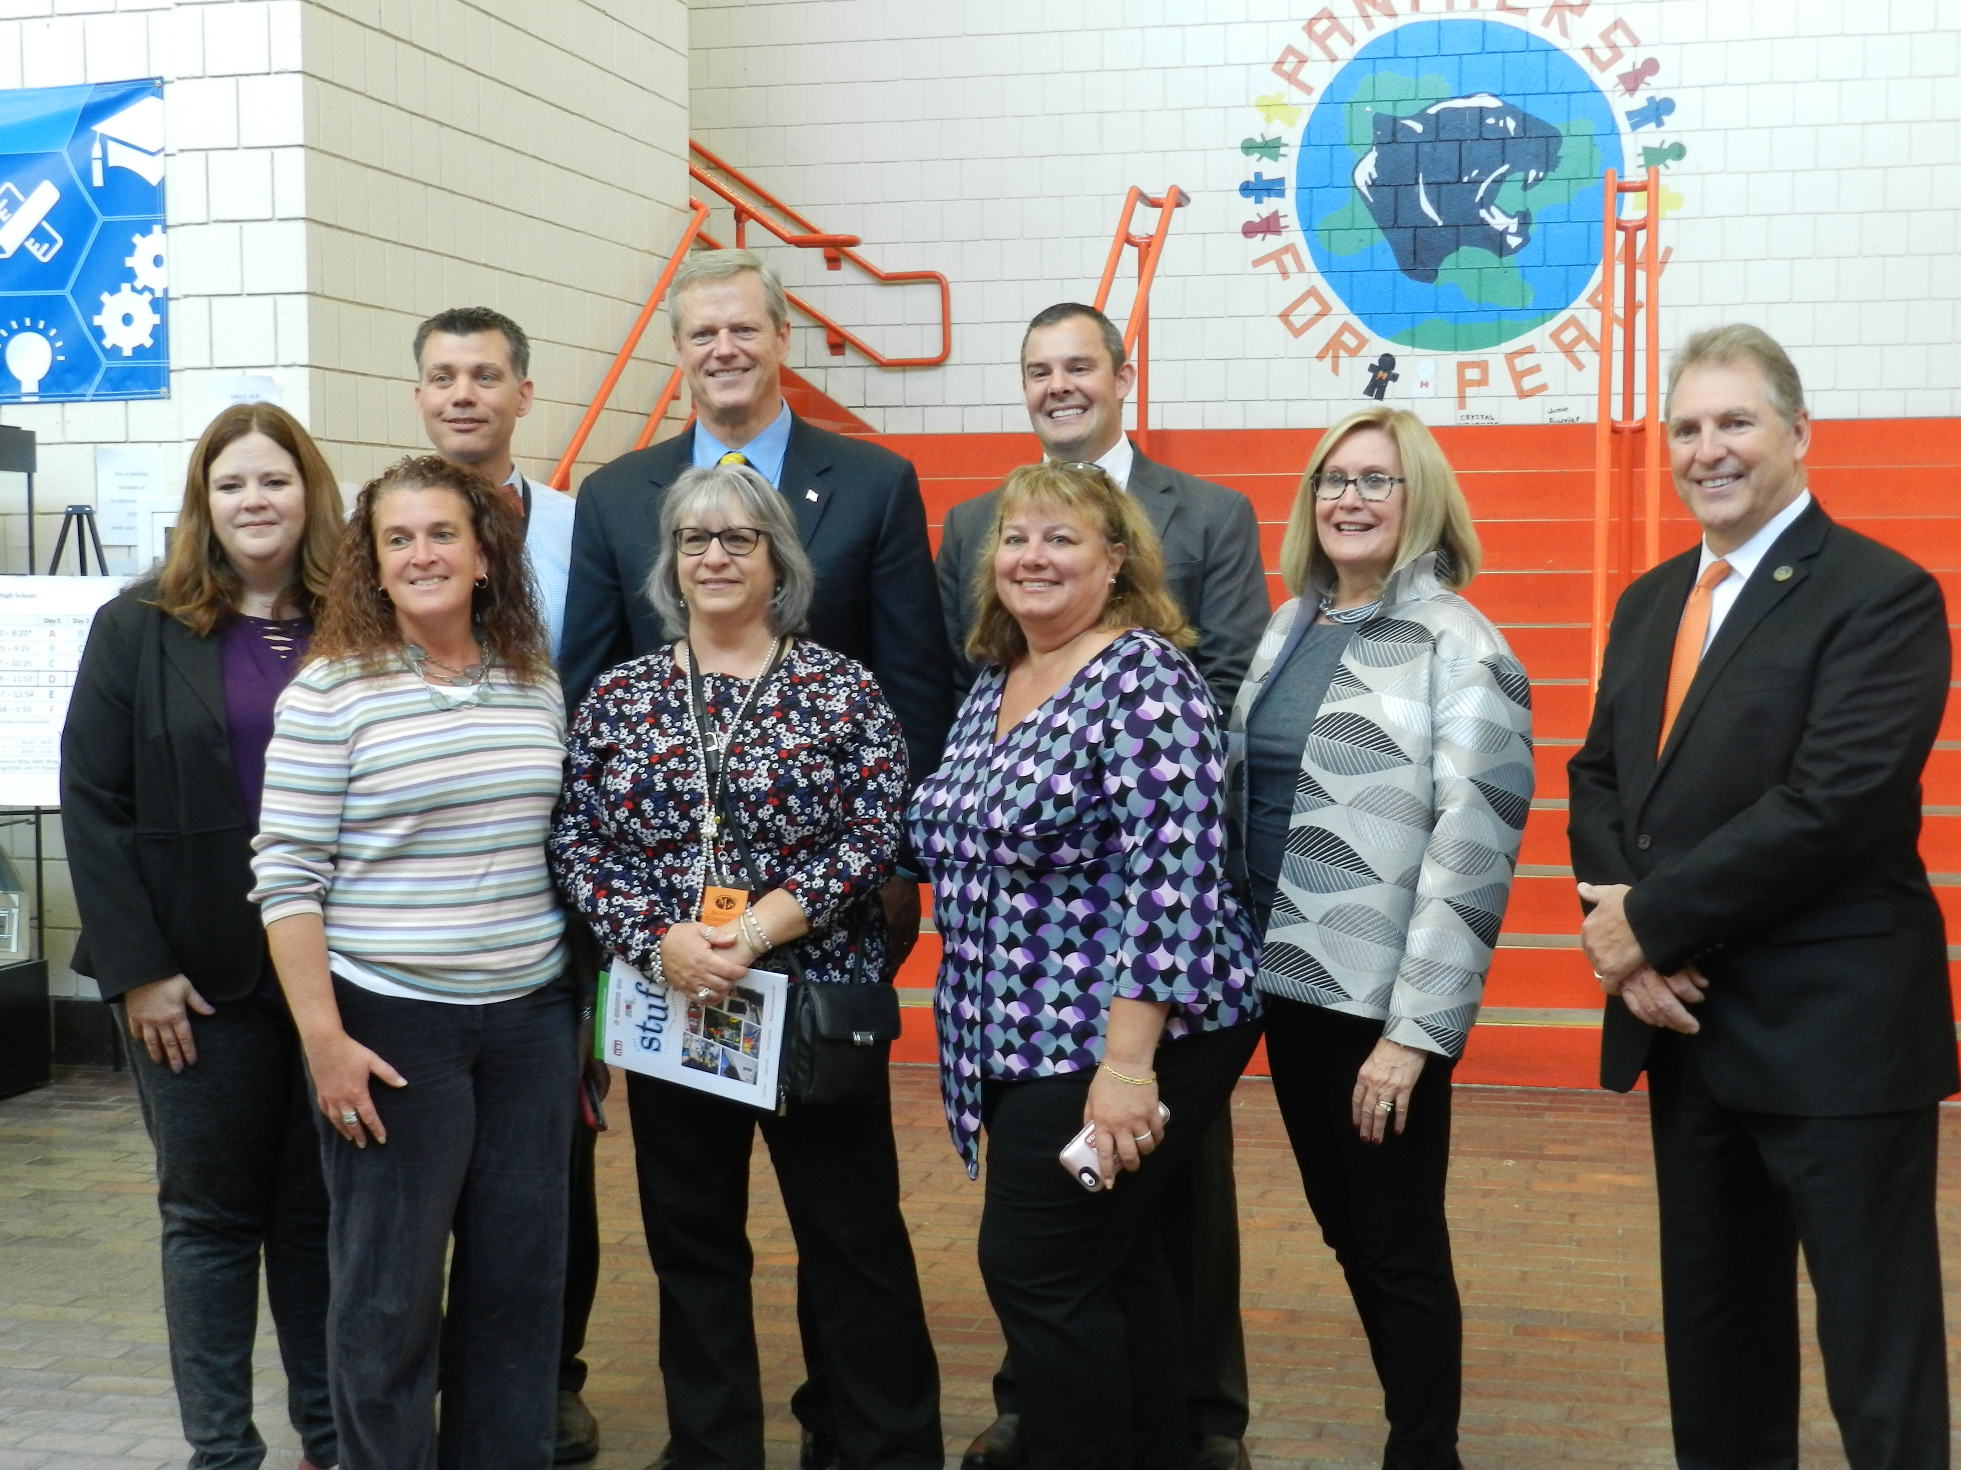
Recent Awards and Visit from Governor Baker

Slide 3
Breakdown of STEM Student Population
Category | Total | Percent of Total | MHS
Total Enrolled (Grades 9 – 12) | 292 | 27.8% | 1051 students
Male | 153 | 52.7% | 51%
Female | 138 | 47.3% | 49%
Hispanic/Latino | 93 | 31.8% | 49%
African American | 14 | 4.8% | 3%
Special Education | 15 | 5.1% | 14%
English Language Learner | 10 | 3.4% | 16%
Low Income | 116 | 39.7% | 54%
Program Attendance Rate | N/A | 97.7% | 93%
Program Retention Rate | N/A | 91% | N/A
STEM Student Population Data extracted from October 2017 YCC Participant Tracking System Quarterly Report

Slide 4
What Are the Key Ingredients That ALL Students Need?
Interdisciplinary
Learning
Work-Based Learning
High-Level Curriculum Framework
Early College Opportunities
Small Learning Communities
Professional Development

Slide 5
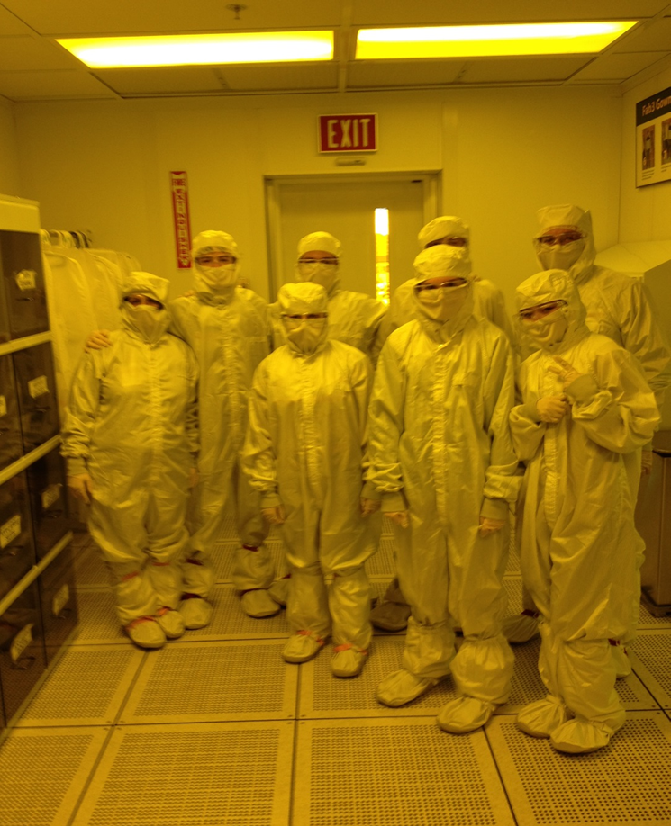
Foundation is Extremely Important
Integrated STEAM model 5 – 8
PLC across three areas
Work-based Learning Model
Explore
Mentor
On-site
Individual Development Plans
Reflect
Predict
Vision

Slide 6
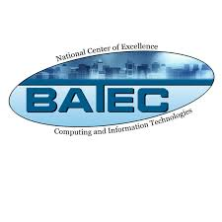
Leadership Steering Committee

Slide 7
Evolution of MPS Early College Design
FSU Writing Courses (2013-2015)
Taught by visiting lecturer
Offered twice per week for 15 weeks
100% Completion Rate
Deltas:
Too much downtime for students
Course occupied two periods per day
Students need a full year of English each year of high school
Cost
QCC Online Course (2015 Spring & Fall)
Offered through Blackboard
Variety of offerings in core-readiness and CTE areas
Deltas:
Coursework is above and beyond student’s schedule
50% Completion Rate
New QCC Model (Fall 2016)
Some courses taught by approved MHS teachers
Training program for selected high school faculty
MHS college courses offered throughout 15-week college calendar every school day
Variety of offerings in core-readiness and CTE areas
Pathways linked to MassTransfer/Associate’s Programs
Reduced Tuition Cost

Slide 8
Early College Pathways Launched in 2016
11th Grade | 12th Grade
Composition l (Fall) | College Mathematics I: Pre-Calculus (Fall)
Composition II (Spring) | College Mathematics II: Trigonometry (Spring)
AP Computer Science Principles | AP Computer Science A
Composition l (Fall) | College Mathematics I: Pre-Calculus (Fall)
Composition II (Spring) | College Mathematics II: Trigonometry (Spring)
AP Biology | Biotechnology
Composition l (Fall) | Introduction to Psychology (Fall)
Composition II (Spring) | Introductory Sociology – Principles (Spring)
AP Biology | Anatomy & Physiology I & II
Composition l (Fall) | College Mathematics I: Pre-Calculus (Fall)
Composition II (Spring) | College Mathematics II: Trigonometry (Spring)
Engineering Course | Engineering Course
Computer Science
Engineering
Healthcare (Nursing)
Biotechnology

Slide 9
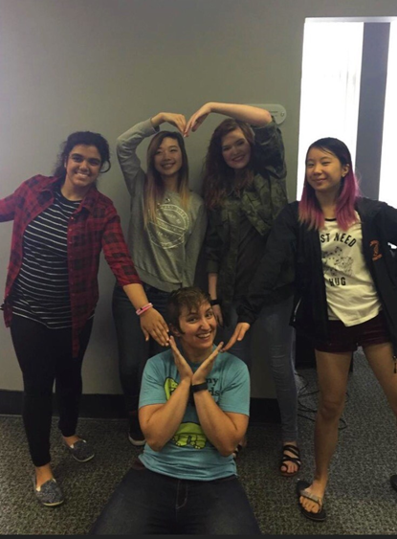
2017 IT Help Desk Certificate Program – Senior Year
Fall Semester | Spring Semester
Mobile Operating Systems (CompTIA’s Mobility+) | Computer Hardware and Support (CompTIA’s A+)
Windows Client Operating Systems (Microsoft Solutions Associate) | Network Technology (CompTIA’s Network+)
IT Help Desk Concepts (Online) | Cooperative Work Experience & Seminar

Slide 10
2018 Associate’s Degree in Computer Systems Engineering Technology – Computer Support Option
Summer 1 | 11th Grade | Summer 2 | 12th Grade
Intro to Microcomputer Applications (Waiver Exam) | Composition I (Fall) | Advanced Microcomputer Applications | Introductory Sociology (Principles)
IT Help Desk Concepts | Composition II (Spring) |  | Introduction to Psychology
 | College Algebra (Fall) |  | Speech Communication Skills
 | Introduction to Programming with C++ (Spring) |  | Technical and Workplace Writing
 | Mobile Operating Systems |  | IT Security Foundations
 | Windows Client Operating Systems |  | Computer Hardware and Support
 | Networking Technologies |  | Windows Server Operating Systems
 | Internetworking Principals and Protocols |  | Unix Operating Systems
 |  |  | Cooperative Work Experience & Seminar

Slide 11
Proficient/Advanced MCAS Outcomes
Year | 2015 |  | 2016 |  | 2017
SUBJECT | STEM | Non-STEM | STEM | Non-STEM | STEM | Non-STEM
Math | 95% | 72% | 92% | 57% | 97% | 63%
ELA | 100% | 88% | 100% | 79% | 100% | 79%
Science (Grade 9) | 93% | 67% | 84% | 64% | 88% | 65%
MCAS Data provided by Massachusetts Department of Elementary and Secondary Education

Slide 12
College Readiness Data
Year | 2016 |  | 2017
 | STEM | Non-STEM | STEM | Non-STEM
Graduation Rate | 100% | 89% | 100% | 96% (only for this year)
Post-secondary Matriculation Rate | 97% | 86% | 100% | 85%
52% of graduating students in 2015 matriculate into post-secondary STEM pathways
63% of graduating students in 2016 matriculate into post-secondary STEM pathways
67% of graduating students in 2017 matriculate into post-secondary STEM pathways

