Slide 1
Creating Inclusive Schools through High Impact Relational Home Visits

Slide 2
An Inclusive School is one where parents feel invited to partner with educators in fulfilling their hopes and dreams for their children.

Slide 3
What is the PTHVP model?
What does the research tell us about the benefit to:
Parents and Students
Educators
Districts
What’s happening in Springfield and Framingham?

Slide 4
Mission:
To increase student and school success by building and sustaining a national network of partners who implement and advance our relationship-building home visit model of family and teacher engagement in public schools across the U.S.

Slide 5
Vision:
The PTHV model will be implemented with fidelity at scale, leading to increased academic and social success for students. The growing body of evidence of effectiveness will drive demand for the model.

Slide 6
History: A Collaborative Effort
Began in SCUSD in 1997 as a community organizing strategy with Sacramento ACT
2 years of focus groups
Launched pilot project in 1998 with 8 Sacramento schools
Notes:
The key behind our model’s success and growth from 8 schools in a a single community to hundreds of communities throughout the country has been the power of this 3-part collaboration: union, district, and community. It has propelled us from a grassroots organization to a national movement.

Slide 7
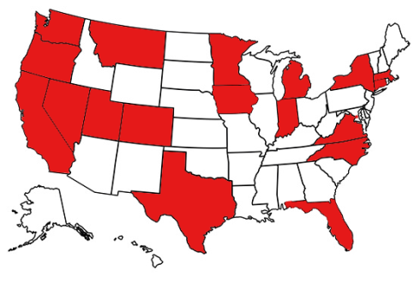
From Grassroots to National Model
2015-2016 School Year
PTHV National Network trained 7,054 staff members
We expanded to over 600 participating schools in
19 states and Washington, D.C.
Together, we conducted over 51,468 relationship-building home visits
1,500 of these visits were conducted in Massachusetts:
In Boston, Springfield, Lawrence, and Salem
And now in Framingham

Slide 8
PreK – 12th Grade

Slide 9
Home Visit Impact: A Critical Link to Learning
Teachers use the knowledge and relationships gained in visits as a foundation on which to build curricular and teaching strategies that best serve each student.

Slide 10
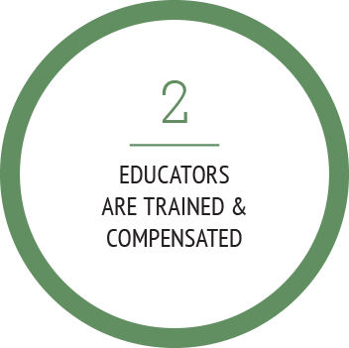
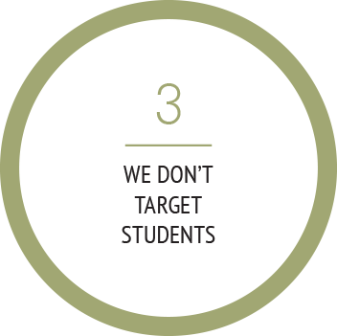
Non-Negotiable Core Practices

Slide 11
Training: Introduction to Home Visits
The core of our 3-hour training program prepares and certifies educators for Parent Teacher Home Visits, including:
Building skills, knowledge, and confidence to conduct relational home visits
Providing rehearsal/practice in engaging families
Discussing potential fears (time, safety, mandated reporting)
Examining culture and cross-cultural connection
Taking it back to the classroom

Slide 12
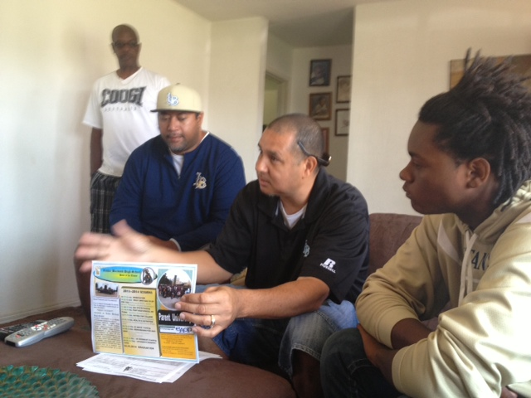
Research-Based Participation Outcomes
Notes:
We are currently in the midst of a national evaluation of our work studying four locations where parent teacher home visits are in process: Reno, DC, Sacramento, and Denver – to study shifts in parent and teacher mindsets, best practices of our model, and student outcomes – including academic, social, and emotional. Results of the mindset study will be available at the PTHVP National Conference in October.

Slide 13
Benefits for Students:
2015 Johns Hopkins University Study
Students who received a home visit--
Had 24% fewer absences in school
Were more likely to read at or above grade level
Had more positive attitudes toward school
Decreased suspensions
Increased applications to 2 & 4 year colleges

Slide 14
Benefits for Parents:
2014 Landscape Evaluation of PTHVP Model Across the US Hueling M. Lee, ED. L.D.
Home Visits:
Increase parent involvement
Facilitate use of culturally responsive strategies
Bridge teacher-parent relationships, contact and communication as co-educators
Promote trust and sense of self-efficacy for teachers, parents and students

Slide 15
Benefits for Teachers:
2014 Goff, Pejsa & Associates
Teachers who conducted home visits reported:
Increased job satisfaction
Renewed energy for the profession
Deeper connections with colleagues
Increased capacity to better engage students in academics

Slide 16
Benefits for the District
Helps ensure success of subsequent interventions to close achievement gaps
Provides an opportunity for teachers to increase evidence for DESE Standard III: family and community engagement
Promotes cultural proficiency between schools and the communities they serve
Strengthens positive parent engagement and advocacy

Slide 17
High Impact Family Engagement Dr. Karen Mapp, Harvard
USDOE Framework: Family Engagement Should Be Relational, Build Capacity Of Families and Staff, and Be Linked to Learning
Lower Impact
Higher Impact
Celebrations
Parent help on administrative tasks
Parent training events
Goal-setting talks
Weekly data-sharing folders
Parent resource rooms
Regular, personalized communication
Fundraisers
Back to school night
Home visits
Family support services
Parent-teacher conferences
Positive phone calls home
Modeling of learning support strategies
Potlucks
Performances and showcases
Generic school newsletters
Interactive homework
Classroom observations
Parent help on learning projects
Notes:
This Slide and Next: 8:40-8:50; 11:55-12:05
Kelly = Point them to Page 5 of their manuals. Ask them to pair up. Give them a specific time limit to discuss.
Ask: What do you notice about the activities on the higher impact side of the chart? What do they have in common?
(Prompt if they don’t say: 1) teacher-led; 2) learning-focused; 3) individualized; 4) they either build relationships or support academic partnering; 5) most of them don’t require the family to come to the school
For More on Research and evaluation resources, point them to pthvp.org website.
The family engagement activities that schools often engage in are school-wide, not learning-focused, and require families to come to the school. “Numbers of participants” is what gets recognized – rather than the increase in a parent’s ability to play the five roles. If families are being asked repeatedly to come to school but are not getting anything that will help them with what they most care about – educating their individual child, then schools often see the undesired effect of families choosing NOT to attend school events because they feel like their time is wasted.
“High impact” family engagement activities may or may not bring families to your buildings, because many of the highest impact family engagement happens at home. When families do need to come to the school, proactively encourage their continued participation by only inviting them to high quality/high impact offerings.

Slide 18
PTHVP Framingham Team

Slide 19
Francedy Rodriguez, Framingham Parent
“My 8th grade daughter has changed since our home visit from Mr. Marin. She’s talking about college and how to build her resume. I want to involve more immigrant families in the program and I’m sure the ‘Voice of the Community’ could be a huge bridge between us and the families.”

Slide 20
How Can I?
Implement effective parent engagement that supports my district’s strategic plan and school improvement plans?
Involve parents who use their voice to partner for their children and for my schools?
Reinvigorate teachers with better and stronger connections to the families and communities they serve?
Utilize relational strategies that support student achievement?

Slide 21
Our Statewide Partners Boston City Councilor at Large Boston Public Schools Boston Teachers Union Framingham Teachers Association Framingham Public Schools Jobs with Justice-Massachusetts Pioneer Valley Project 1647 Springfield Education Association Springfield Federation of Paraprofessionals Springfield Public Schools Westfield State University Teacher/Parent Representatives

Slide 22
Our National Partners
National Education Association American Federation of Teachers Scholastic Institute for Educational Leadership National Association for Family, School, and Community Engagement

Slide 23
Thank You!
Stay In Touch…
www.pthvp.org
roberta@pthvp.org
(202) 669-4870
@pthvp
/pthvp

