Slide 1
WORKING WITH YOUR SCHOOL RESOURCE Officer to Support Student Well-Being
The L.E.A.P. Program Model
Detective Michelle Palladini

Slide 2
The SRO
IS A:
Mentor
Friend
Teacher
Advisor
Law enforcer
Informal Counselor
Coach
Advocate
IS NOT A:
Disciplinarian
Heavy hand
Formal Counselor
Internal Affairs & Personnel Investigator

Slide 3
BACKGROUND
& HISTORY OF L.E.A.P.

Slide 4
The L.E.A.P. Model

Slide 5
Direct Service
Classroom Instruction (L.E.A.P. Core Curriculum)
Training & Policy
SRO & Schools
School-wide Initiatives (L.E.A.P. Warriors, In 4 Words)
Afterschool/Summer Programs (L.E.A.P. Cadets, Crown and Shield Club
L.E.A.P. Attendance Program
MOU Development
Legislative Advocacy
Advocacy
Models For Excellence in School-Based Policing – CLUES Model, Building an Effective SRO Position, Trauma Informed Approaches, Mental Health, Brain Development, Holistic Approaches
Developing an Effective SRO Position and Police Partnership

Slide 6
SRO
Safety
Community
Outreach
Climate

Slide 7
Safety: Physical AND Emotional
No child will be able to succeed in school if they don’t feel seen, safe and secure.

Slide 8
Safety Initiatives: The SRO is critical to plan’s effectiveness
PHYSICAL
EMOTIONAL
Emergency Protocols
Policy
Procedure
Practice
Reporting Mechanisms
Staff
Students
Crisis Management
Plan
Implement
Respond
Risk Assessment
Safe and Supportive Schools

Slide 9
Community Outreach - #buildvillages

Slide 11
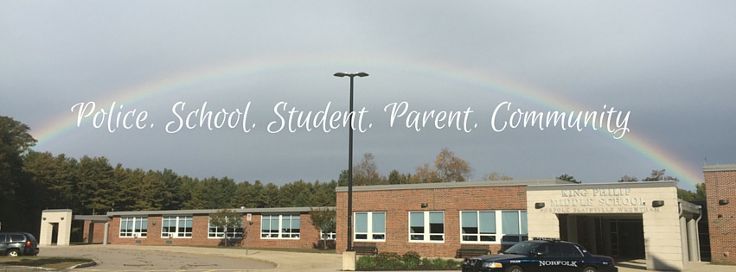
Systematic change
can not be achieved
without the energy of
community.

Slide 12
Social/Emotional Learning & Community
CASEL
LEAP

Slide 13
Use Your SRO!
Coffee Chats
Live Video
Facebook Group
Attendance at Open House/Curriculum Night/Conferences
Attendance at sports/clubs/events
Attendance at staff meetings, and PD days

Slide 14
Climate:
What types of relationships are you building?
How do you foster a safe and supportive environment?
Does your SRO participate in supporting positive school climate? How?

Slide 15
Climate: Your SRO can….
Address Risky Behaviors
Offer Awareness & Solutions
Bullying/Harassment
Drugs & Alcohol
Depression/Anxiety
School Disruption
Negativity
Curriculum Programs
1:1 Educational Meetings
Restorative Justice Practices
Informal Counseling
Mentoring
Liaison to other agencies
Promote positivity
Build Relationships

Slide 16
Building Relationships Building Skills

Slide 18
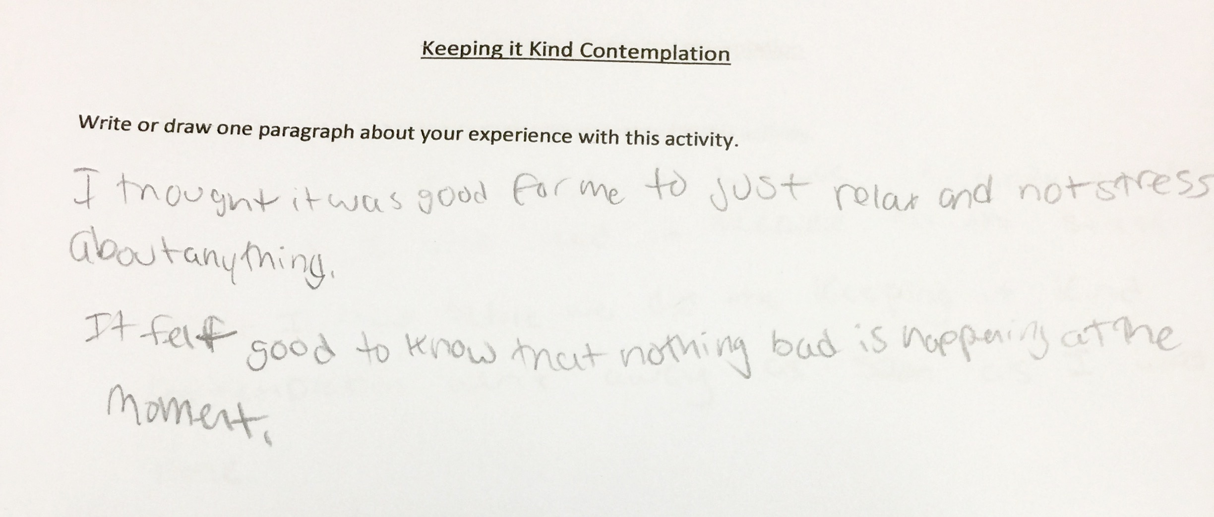

Slide 19
Training, Training, Training!

Slide 20
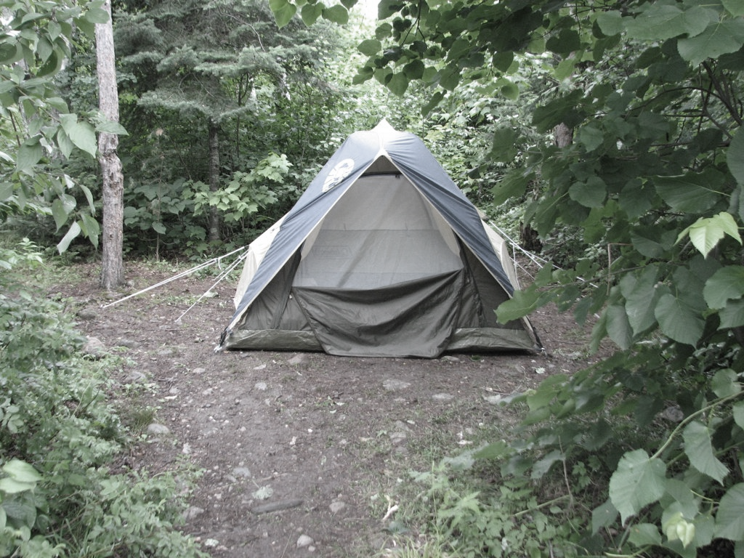
the grown-ups
failed me.

Slide 21
Risky behaviors are reduced when integrated methods are used.
School
Police
Parent
Community
Student
Notes:
Your SRO should have a method for working with each to help students succeed.

Slide 23
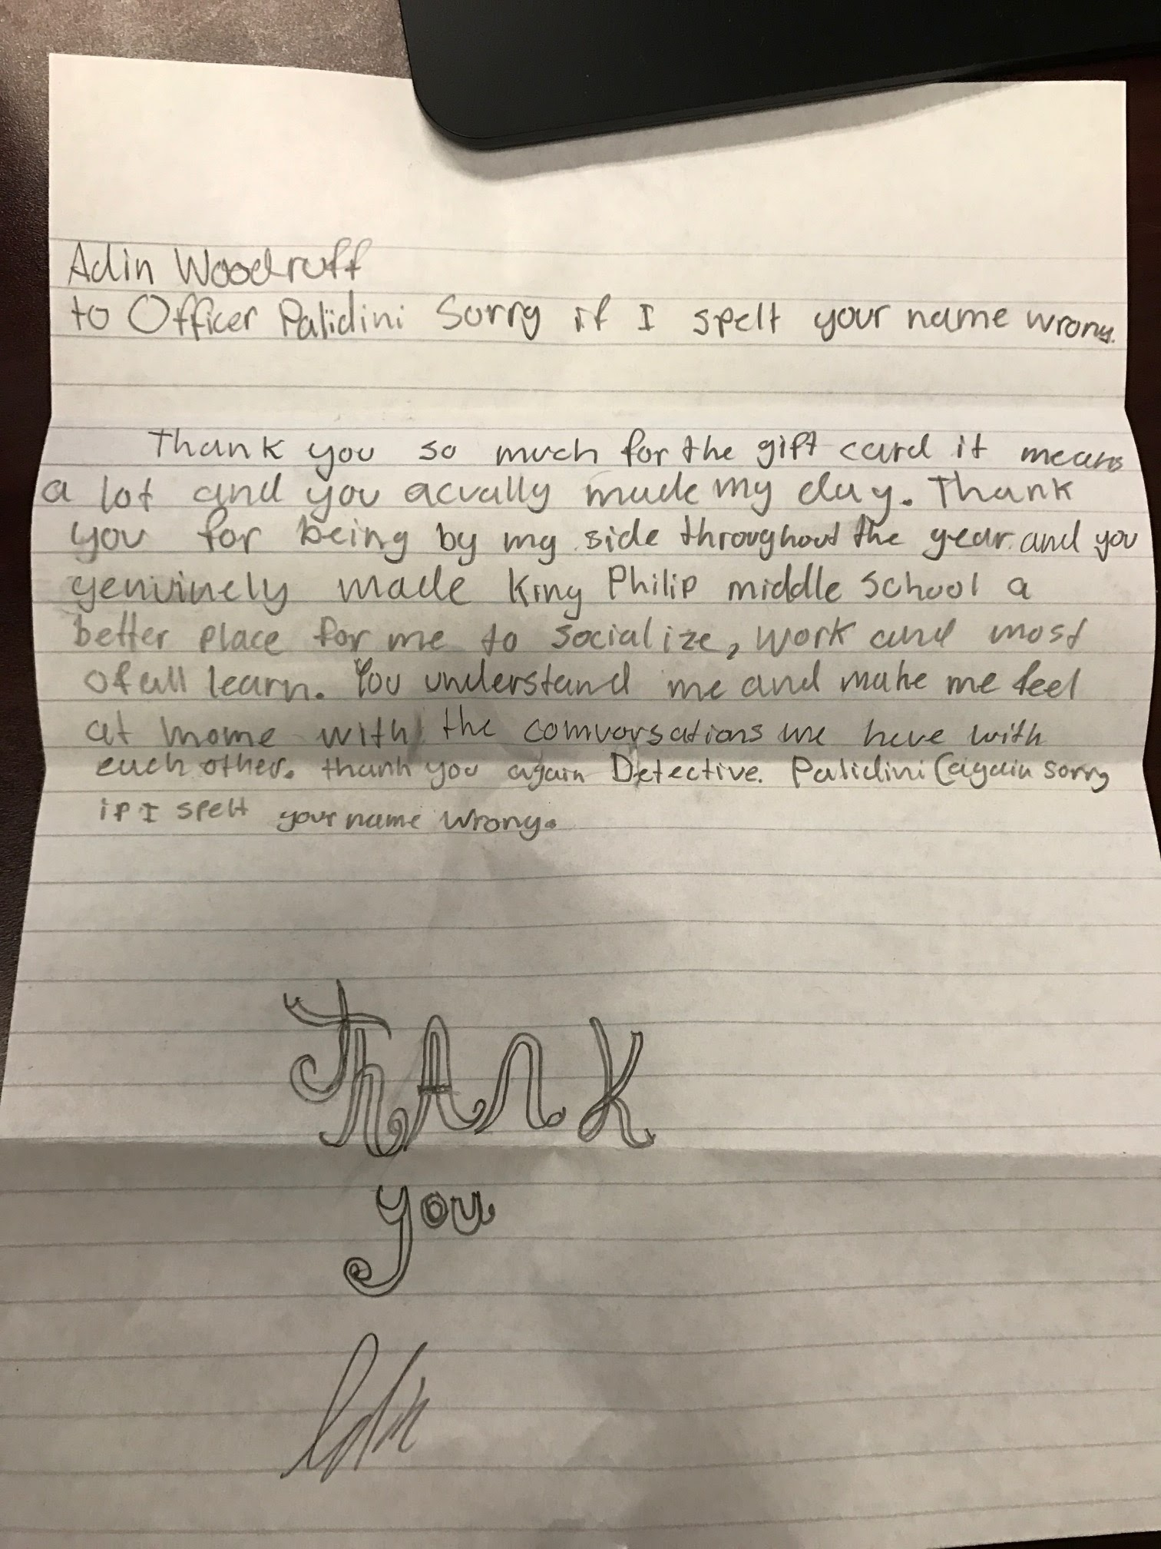

Slide 24
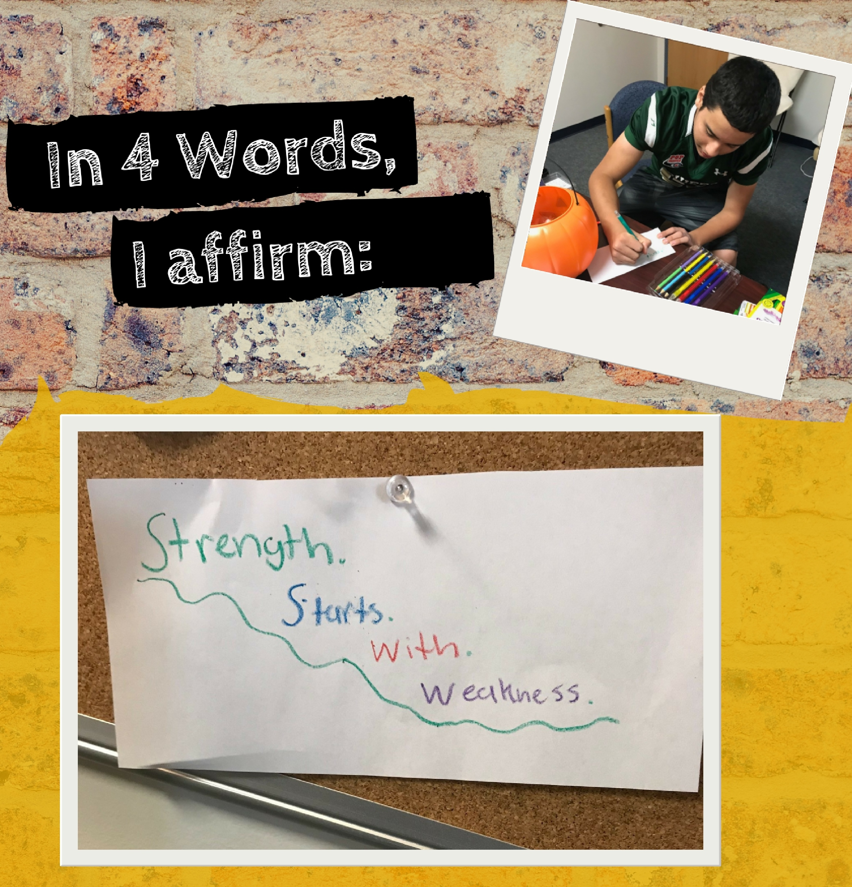
“Strength Starts
With Weakness”
Where are your weaknesses?
How can you grow?

Slide 25
Find me on social!
Facebook:
@michellepalladinileap
@leapprograms
Twitter:
@leapprograms
Linked In:
Michelle Palladini
BLOG:
www.leapprogram.net/blog

