Slide 1
Looking for a Leader: Superintendent Searching
Presenter: James Hardy, Field Director-Training & Development
2016 MASC/MASS Joint Conference

Slide 2
SUPERINTENDENT SEARCH
Preliminary Meeting and Process Determination
Conducting an Assessment of District Priorities
Advertising
Screening of Candidates

Slide 3
SUPERINTENDENT SEARCH
Interviews
Site Visits
Selection/Appointment
Follow-up Program

Slide 4
SUPERINTENDENT SEARCH
Preliminary Meeting
Define the scope of the search
Determine the qualifications of the new Superintendent
Establish a timetable
Determine the process to be used to develop the profile
Determine the extent of community involvement
Gather district information
Establish a calendar of events within the timetable

Slide 5
SUPERINTENDENT SEARCH
Assessment of District Priorities
Meetings with groups or individuals representing the:
Community
Parents
Staff
Administration
Local government officials
Meet with school committee to develop profile
Present a report that reflects the group meetings

Slide 6
90% of the game is half mental Where do we look for candidates? What are we looking for in a candidates application packet?

Slide 7
SUPERINTENDENT SEARCH
Advertising
Determine the extent of “paid” advertising
Take advantage of “in-kind” postings
Direct mailings
Distribution of informational brochure

Slide 8
SUPERINTENDENT SEARCH
Screening of Candidates
Three-member screening team
Predetermined number of semifinalists
Based solely upon criteria adopted

Slide 9
SUPERINTENDENT SEARCH
Interviews
Prepare the interview schedule
Meet with semifinalist interview committee
Work with committee in developing questions
Attend every interview
Facilitate discussion and selection

Slide 10
SUPERINTENDENT SEARCH
Site Visits
Schedule visits for the candidates and school committee
Work with candidates in preparing their visit
Work with committee preparing visit agenda
Discuss questions the committee can ask teams
Review site visit reports prior to final interviews

Slide 11
SUPERINTENDENT SEARCH
Selection/Appointment
Schedule each interview
Meet with school committee to review interviewing guidelines
Work with committee in developing questions
Attend every interview
Facilitate discussion and selection/appointment

Slide 12
SUPERINTENDENT SEARCH
Follow-up Program
60-90 days after new superintendent is on the job
Review school committee policies
Develop a communications model
Discuss the superintendent evaluation process
Develop a mutual understanding of the district’s goals and objectives

Slide 13
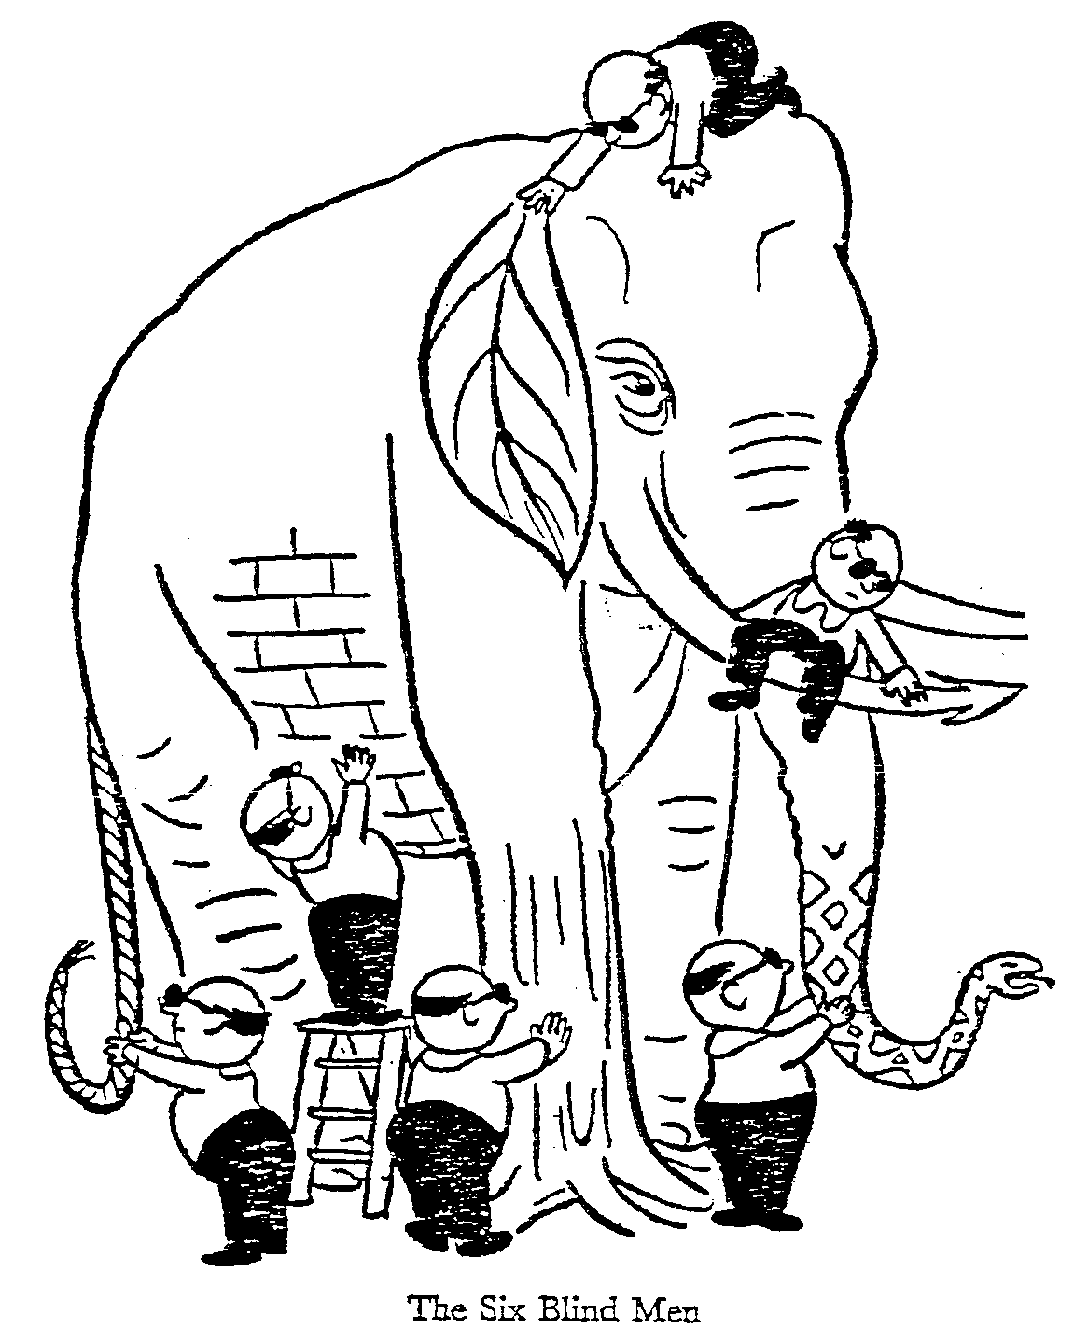

Slide 14
OR

Slide 15
Background A Leadership Crisis in Public Education in MA?
Approx 30 Superintendent openings; 19 current Interim Superintendents
Some Districts have experienced multiple leadership transitions over a relatively short time
In some cases, Educational results are being threatened
Quality of Superintendent applicant pool sometimes unsatisfactory
Costs of Turnover are High

Slide 16
Background A Leadership Crisis in Public Education in MA?
School Committee Members serve an average of one term, providing little continuity
These trends could become even more pronounced in the coming years
Leadership transitions bring a complex set of challenges and opportunities
MASS, MASC, and DESE are designing support mechanisms for Districts (DGSP)
School Committees and Administrations can, by taking a proactive stance, manage transitions as a strategic opportunities

Slide 17
Change as a Leadership Challenge
Conversation:
What can you, as leaders in the District, do to most effectively lead the District through the change and transition?

Slide 18
Change as a Leadership Challenge
Managing Change
Many view it as a straightforward process:
Lay out what needs to be done, when, and by whom.
Implement the plan
“Just do it!”*
What often happens?
the change that seemed so obviously necessary has languished like last week's flowers.*
Develop a succession plan.
Ask yourselves…..If person A leaves, who will fill in?

Slide 19
Change as a Leadership Challenge
→Plan for the change and implement your plan
→Do so in a way that addresses both
External change issues
Internal transition issues
Ignoring either set of issues can, and often does, result in a stagnated process

Slide 20
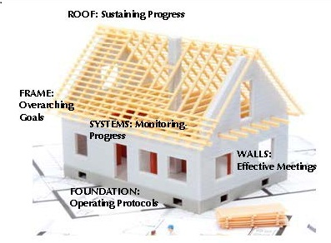
The Jefferson Memorial
A Study in Root Cause Analysis

Slide 21
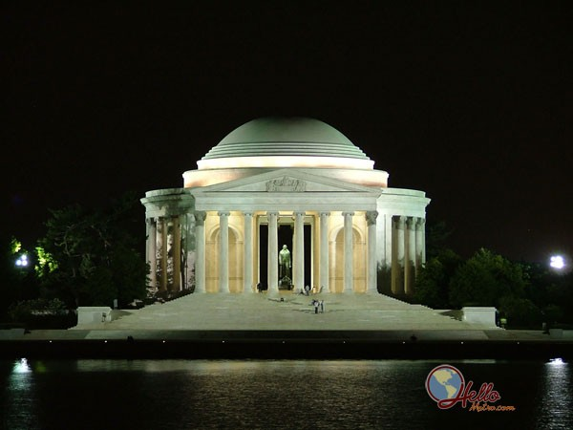
The Jefferson Memorial

Slide 22
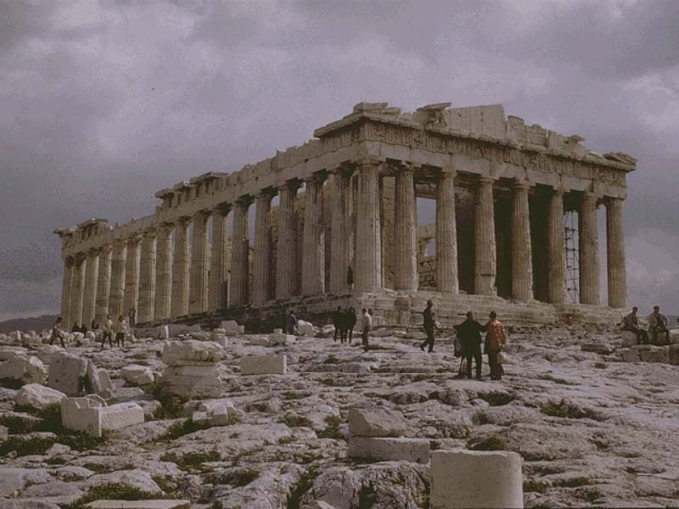
The Jefferson Memorial
Notes:
I fully admit that while the basis of this story is true, it has been greatly embellished for pure entertainment value and to help make a point.
It was noted that the granite of the Jefferson Memorial was decaying at a rate far greater than any other monument in Washington.

Slide 23
The Jefferson Memorial
Why is it Decaying?
Notes:
So they asked Brilliant Question #1: Why is it decaying so rapidly?

Slide 24
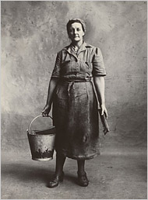
The Jefferson Memorial
Notes:
In typical Washington fashion, they decided to study the issue and found that it was decaying because it was being washed more than other memorials in the city. So, they studied soaps, what types of bristles were being used on the brushes, the soaps they were using and the use of Power Washers, etc (which actually seemed to cause a greater decay in the granite), until at some point (and numerous taxpayer dollars later) someone asked…

Slide 25
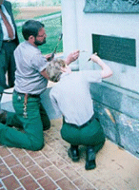
The Jefferson Memorial

Slide 26
The Jefferson Memorial

Slide 27
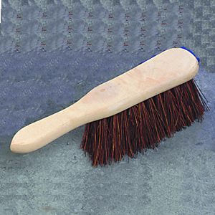
The Jefferson Memorial

Slide 28
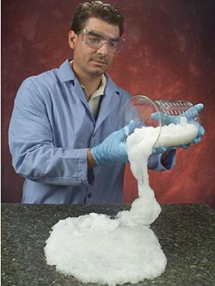
The Jefferson Memorial

Slide 29
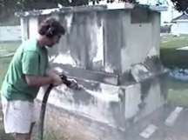
The Jefferson Memorial

Slide 30
The Jefferson Memorial
Why is it so Dirty?
Notes:
Brilliant question #2: “Why is it so dirty?”

Slide 31
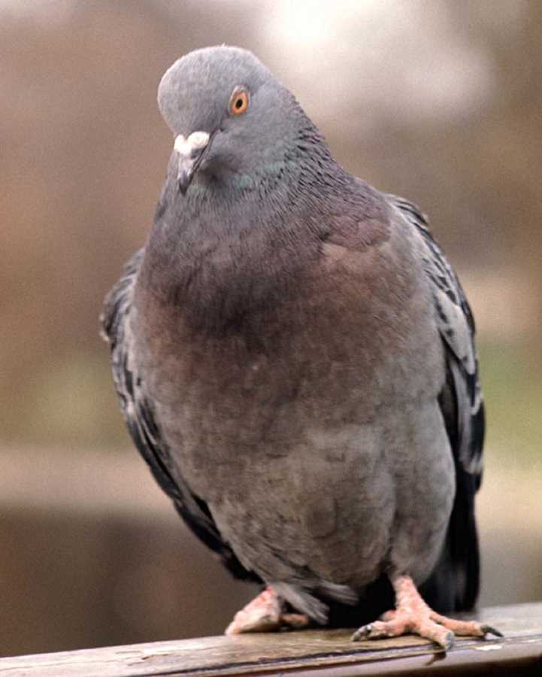
The Jefferson Memorial
Notes:
Answer: birds

Slide 32
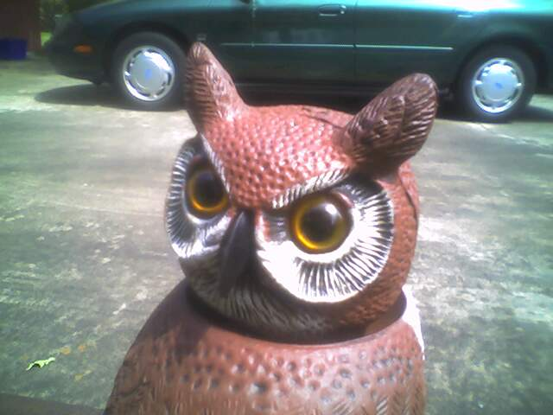
The Jefferson Memorial
Notes:
So, they broke out the plastic owls, fake coyotes, etc..

Slide 33
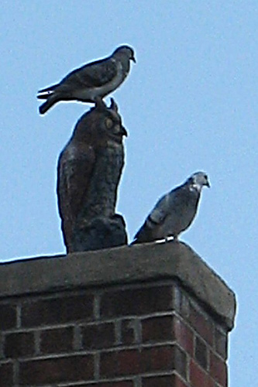
The Jefferson Memorial
Notes:
The results were NOT stellar…

Slide 34
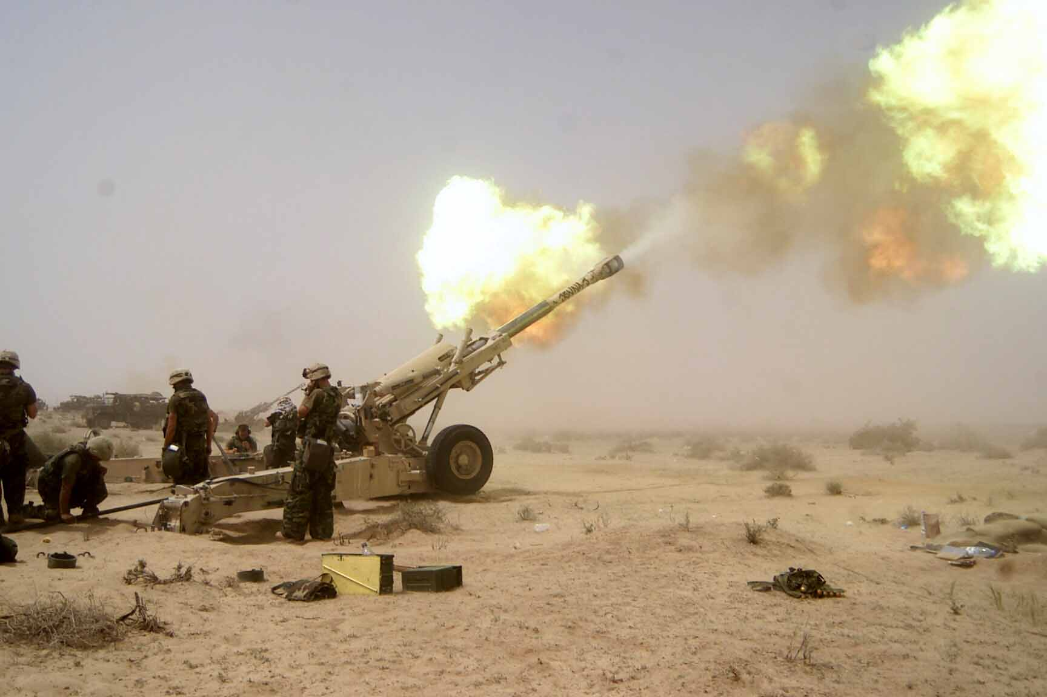
The Jefferson Memorial
Notes:
I even seem to remember reading in an old National Geographic that they actually tried firing a cannon to scare the birds away….

Slide 35
The Jefferson Memorial
Why so many birds?
Notes:
Again, after numerous unsuccessful attempts to remove the birds, Brilliant Question #3 arose: “Why are there so many birds?”

Slide 36
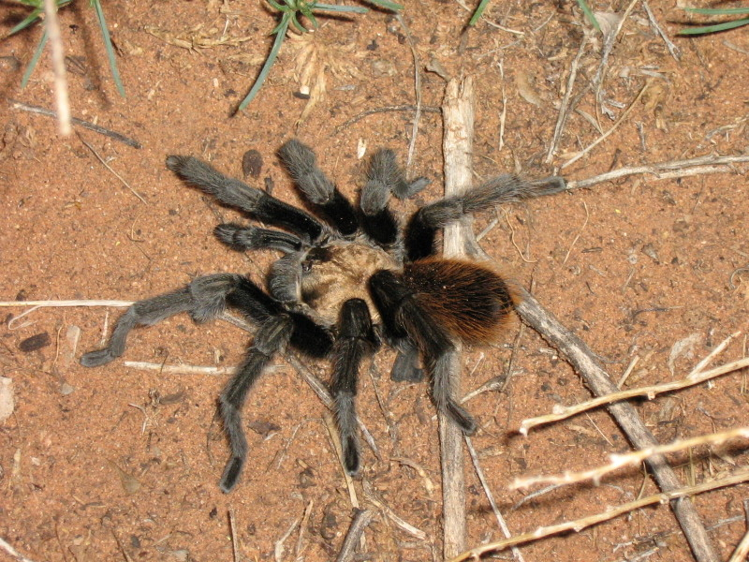
The Jefferson Memorial
Notes:
Answer: Spiders

Slide 37
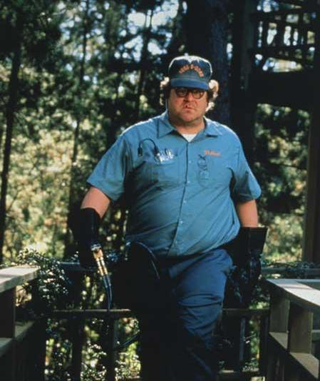
The Jefferson Memorial
Notes:
Bring in the Arachnimoligists (My made-up word - Spider experts) and study how to get rid of spiders….

Slide 38
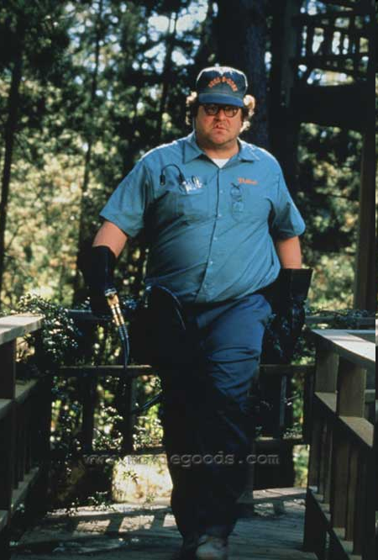
The Jefferson Memorial
Why so many Spiders?
Notes:
After a long unsuccessful campaign to rid the Jefferson Memorial of the demon spiders: Brilliant Question #4: “Why are there so many Spiders?”

Slide 39
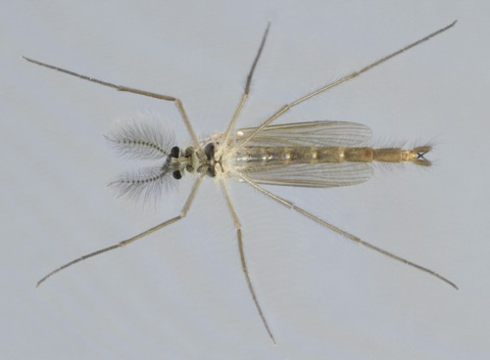
The Jefferson Memorial
Notes:
Answer: Flying insects.

Slide 40
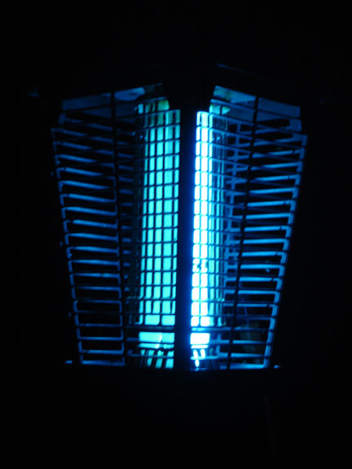
The Jefferson Memorial
Notes:
So, they studied flying insects, broke out bug zappers and tried to solve the problem of decaying granite by killing off as many flying insects as they could. I imagine that any pesticides they would use would actually cause more decaying granite, but that is just a supposition.

Slide 41
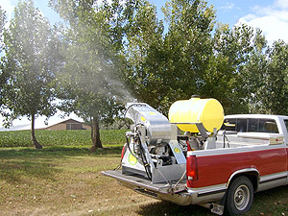
The Jefferson Memorial

Slide 42
The Jefferson Memorial
Why so many flying insects?
Notes:
When that failed to work, someone finally hit upon Brilliant Question #5: “Why are there so many flying insects?”

Slide 43
The Jefferson Memorial
Notes:
I did not choose this picture of a flying insect by accident. Those of you who do any fly fishing have seen this insect. It is called a Midge, which is termed an emergent because they come out at dawn and dusk.

Slide 44
The Jefferson Memorial
Notes:
. In fact, the lighting at the memorial replicated that dawn/dusk lighting so those little critters were emerging at all hours of the day and night.

Slide 45
The Jefferson Memorial

Slide 46
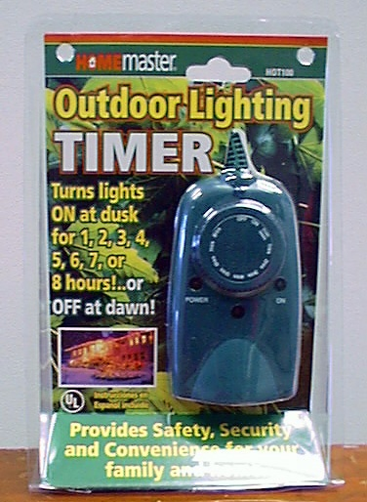
The Jefferson Memorial
Notes:
By changing the lighting and putting timers on the memorial, the midges stopped emerging, the spiders left, the birds stopped doing their thing, the building stayed cleaner and the granite stopped decaying…

Slide 47
The Jefferson Memorial
Notes:
How many times has your board spent time arguing over the wrong question?
By focusing on drilling down to the root cause – the “real” problem that needs fixing, you will generally argue less and solve more. Dr. Philip Boyle (University of North Carolina) once said that if there are nine board members at the board table there may be nine people fighting that their solution is the best, but what few boards do is come to consensus on what it is they are really trying to fix – and fix it. The challenge to Superintendents and board members is to refocus attention on what is the real issue, and work on solving that!

Slide 48
As you prepare for a Superintendent Search, make sure you ask the right questions so you get the information you need to make the right choice.

