Slide 1
The Achievement Gap Initiative At Harvard University
Toward Excellence with Equity
Joint Conference of the Massachusetts Association of School Committees
and the Massachusetts Association of School Superintendents
Questions School Committees Can Ask
in Pursuit of Excellence with Equity
and Development of the Whole Child
Ronald F. Ferguson, PhD
Harvard Kennedy School
and Tripod Education Partners
November 4, 2016
Email: Ronald_Ferguson@HKS.Harvard.ed
Websites: www.agi.harvard.edu www.bostonbasics.org tripoded.com

Slide 2
I’m now a seventh grader
And the focus of my life
Is to figure out just who I am
Which way to find the light.
Latent potential
waiting to
be harvested.

Slide 3
Sure as Sunlight
There is a child here in your caring
who may someday cure all cancer
but you’ve got to lay the groundwork
so that it can come to pass.
She is a child who has not blossomed
so you cannot see her brilliance
but as sure as there is sunlight
she is here now in your class.
I cannot tell you what her name is
nor her height, nor weight, nor color,
only that she is potentially
a history-making lass.
Latent potential
waiting to
be harvested.

Slide 4
Every School has Two Curricula:
What Teachers Teach

Slide 5
Every School has Two Curricula:
What Teachers Teach
What Students Teach

Slide 6
Every School has Two Curricula:
What Teachers Teach
What Students Teach
Both
matter
a lot!

Slide 7
Considering both, how can we track:

Slide 8
Considering both, how can we track:
What children experience in school through interactions with adults and other students?

Slide 9
Considering both, how can we track:
What children experience in school through interactions with adults and other students?
How it makes them feel?

Slide 10
Considering both, how can we track:
What children experience in school through interactions with adults and other students?
How it makes them feel?
What they think and learn?

Slide 11
Considering both, how can we track:
What children experience in school through interactions with adults and other students?
How it makes them feel?
What they think and learn?
How these affect their choices, behaviors, and goals?

Slide 12
Considering both, how can we track:
What children experience in school through interactions with adults and other students?
How it makes them feel?
What they think and learn?
How these affect their choices, behaviors, and goals?
Would if matter if we knew these things?

Slide 13
We want our children to:
Interact with peers and teachers: empathetically, respectfully, responsibly, cooperatively
Feel: welcomed, valued, happy, successful
Think and learn: ambitiously, confidently, unselfconsciously, cooperatively, successfully

Slide 14
How can we help children develop more holistically—emotionally, socially, cognitively, and academically?

Slide 15
To achieve these things most effectively, we need to develop The Whole Child.

Slide 16
The Whole Child
COGNITIVE
(Thinking)

Slide 17
The Whole Child
COGNITIVE
EMOTIONAL
(Feeling)

Slide 18
The Whole Child
COGNITIVE
EMOTIONAL
SOCIAL

Slide 19
The Whole Child
COGNITIVE
EMOTIONAL
ACADEMIC
AGENCY
SOCIAL

Slide 20
ALL AGES AND STAGES ARE IMPORTANT!

Slide 21
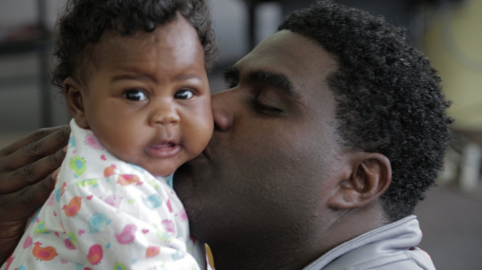
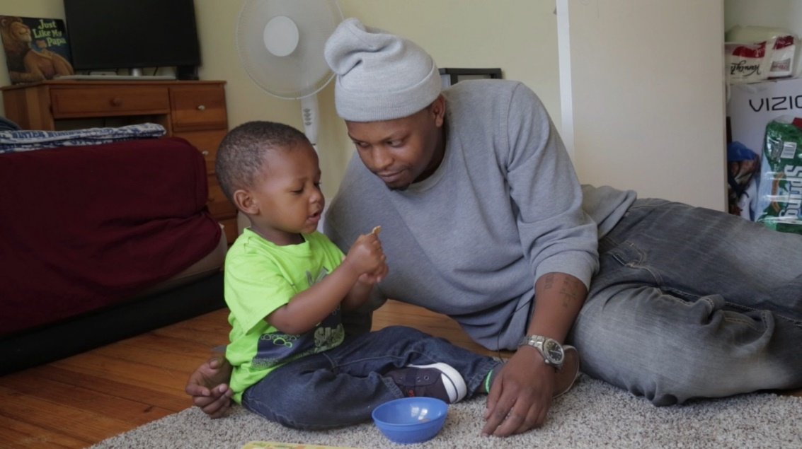
Birth to 3: 80% of brain development!

Slide 22
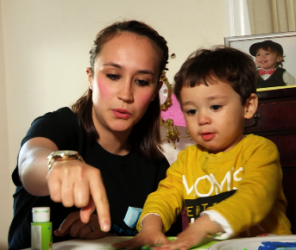
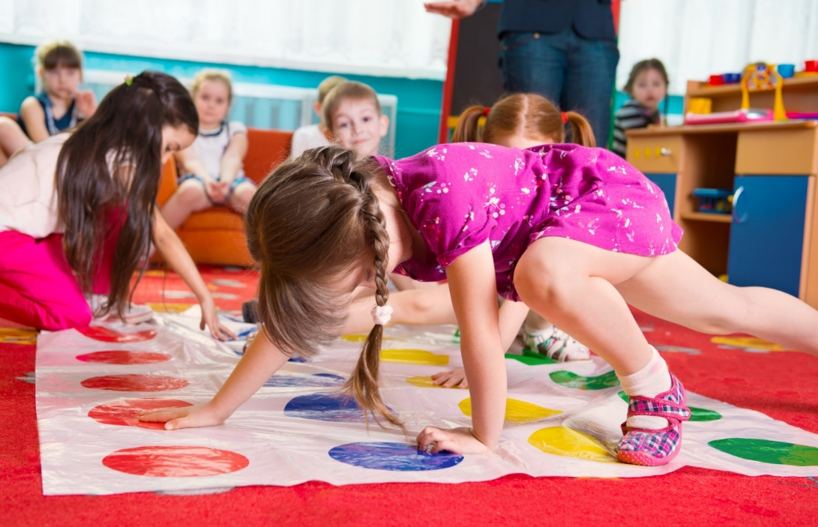
Ages 3 to 5: pre-school socialization and school-readiness skills

Slide 23
Ages 5 to 9: school socialization, learning to read and do basic arithmetic

Slide 24
Ages 9 to 14: reading to learn; trying on identities and imagining possible future selves

Slide 25
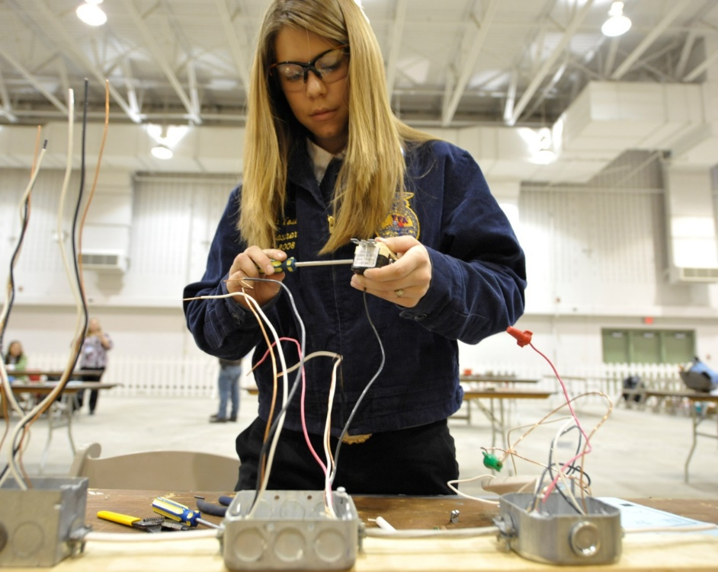
14 to 18: settling on an academic and pre-career pathway

Slide 26
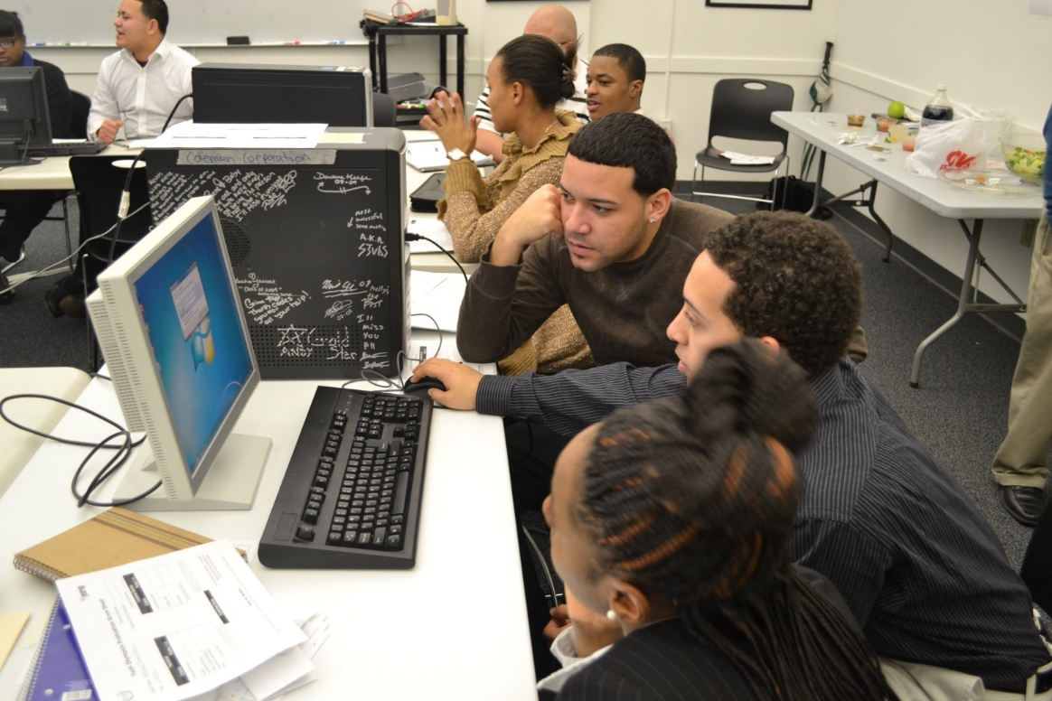
18 to 22: transitioning from adolescence into the adult world

Slide 27
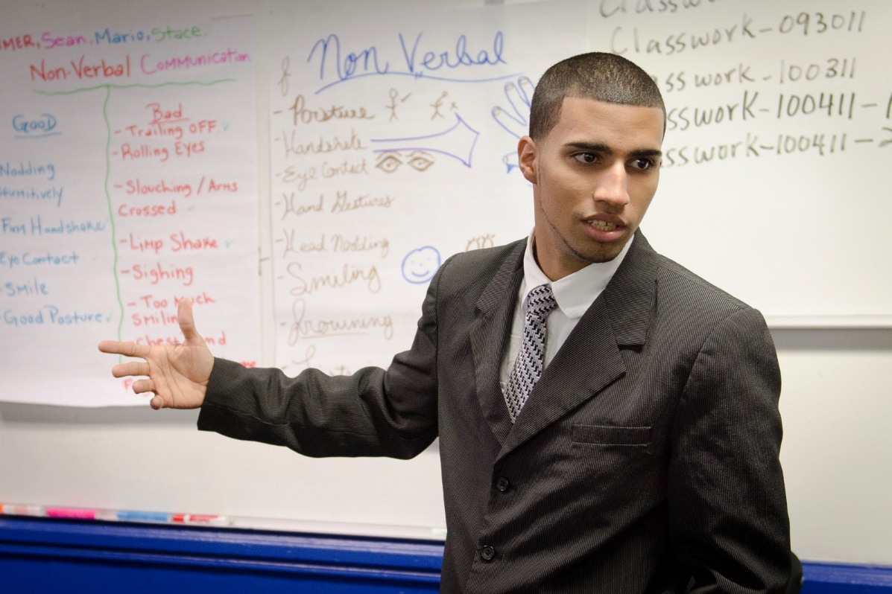
22 to 30: finding a career track, adult routines and separating from parents

Slide 28
What are the skills and qualities we want children from all backgrounds to have equitable opportunities to learn and develop?

Slide 29
Whole-Child Skills and Qualities
that Help Foster AGENCY
Future Awareness
Goals (for School, Work, and Life)
Purposeful Planning
Optimism

Slide 30
Whole-Child Skills and Qualities
that Help Foster AGENCY
Growth Mindset
Conscientiousness
Persistence and Grit
Executive Function Skills

Slide 31
Whole-Child Skills and Qualities
that Help Foster AGENCY
Identifying Emotions
Managing Emotions
Navigating Social Norms

Slide 32
Whole-Child Skills and Qualities
that Help Foster AGENCY
Oral Communication
Written Communication
Information Search Capabilities

Slide 33
Disadvantaged students, students of color, and especially males of color, can face special challenges having their “whole child” developed effectively. This is true for both the teacher-taught and student-taught curricula.

Slide 34
The Predicament
Entangled in Cycles of Negative Reinforcement from Day One
INSIDE SCHOOLS
A
Racial, Ethnic, and Social Class Differences in how Children from Different Backgrounds Experience PARENTING and Preparation for School & Learning
From: Ronald F. Ferguson (2016) Aiming Higher Together: Strategizing Better Educational Outcomes for Boys and Young Men of Color. Washington DC: The Urban Institute. May 2016.

Slide 35
The Predicament
Entangled in Cycles of Negative Reinforcement from Day One
INSIDE SCHOOLS
Past & Current POWER & RESOURCE INEQUITIES & Concentrated Disadvantage
B
A
Racial, Ethnic, and Social Class Differences in how Children from Different Backgrounds Experience PARENTING and Preparation for School & Learning
From: Ronald F. Ferguson (2016) Aiming Higher Together: Strategizing Better Educational Outcomes for Boys and Young Men of Color. Washington DC: The Urban Institute. May 2016.

Slide 36
The Predicament
Entangled in Cycles of Negative Reinforcement from Day One
INSIDE SCHOOLS
Societal STEREOTYPES & Stigmas
C
Past & Current POWER & RESOURCE INEQUITIES & Concentrated Disadvantage
B
A
Racial, Ethnic, and Social Class Differences in how Children from Different Backgrounds Experience PARENTING and Preparation for School & Learning
From: Ronald F. Ferguson (2016) Aiming Higher Together: Strategizing Better Educational Outcomes for Boys and Young Men of Color. Washington DC: The Urban Institute. May 2016.

Slide 37
The Predicament
Entangled in Cycles of Negative Reinforcement from Day One
INSIDE SCHOOLS
Societal STEREOTYPES & Stigmas
BIASED IDENTITY SCRIPTS
C
Dispropor-tionalities in DISCIPLINE PRACTICES and PRIVILEGES
SKILL & BEHAVIOR GAPS & Destructive PEER DYNAMICS
Past & Current POWER & RESOURCE INEQUITIES & Concentrated Disadvantage
Inequity in Provision of High Quality TEACHING & LEARNING
C’
B
B’
A
Racial, Ethnic, and Social Class Differences in how Children from Different Backgrounds Experience PARENTING and Preparation for School & Learning
From: Ronald F. Ferguson (2016) Aiming Higher Together: Strategizing Better Educational Outcomes for Boys and Young Men of Color. Washington DC: The Urban Institute. May 2016.

Slide 38
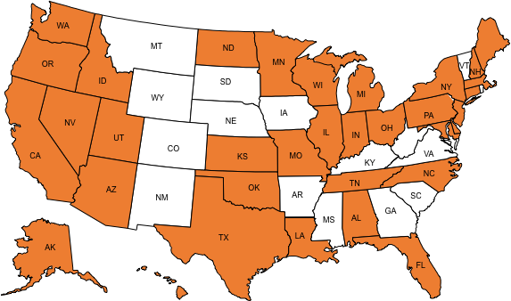
Tripod Surveys Are Used Across the Country
States: 37
Schools: 9,500
Classrooms: 227,000
Responses: 4,580,300

Slide 39
Sample Survey Items – Secondary
Care
Confer
Captivate
Clarify
Consolidate
Challenge
Classroom Management
My teacher wants us to share our thoughts.
Students speak up and share their ideas about class work.

Slide 40
Sample Survey Items – Upper Elementary
Care
Confer
Captivate
Clarify
Consolidate
Challenge
Classroom Management
My teacher takes the time to summarize what we learn each day.
My teacher takes time to help us remember what we learn.

Slide 41
Some Facts from Tripod Survey Data
Disparity in access to orderly classrooms may be the greatest form of racial inequity in opportunity to learn.
Higher quality instruction reduces behavior problems in all types of classrooms, no matter what the racial composition is.

Slide 42
Vertical Axis: Percentage
responding “Yes, mostly” or “Yes, always,”
that student behavior in the class slows down learning.

Slide 43
Misbehaviors that may interfere with achievement are not necessarily signs of bad intentions. Kids just want to fit in! They need assistance achieving the peer cultures and school climates that they would most prefer to experience.

Slide 45
Five Strategic Components to Help More Children
Achieve Person-Environment Fit and School Success
1. PARENTAL PREPARATION
PARENTS know (or learn) how to lay early foundations at home.
2. BIRTH-TO-FIVE CHILD PREPARATION
Children arrive at formal schooling prepared to fit academically.
3. K-12 EDUCATOR PREPARATION
EDUCATORS are willing and able to teach all types of students effectively.
4. K-12 ORGANIZATIONAL PREPARATION
The SCHOOL OFFICIALS nurture & discipline students responsively.
5. COMMUNITY PREPARATION
The COMMUNITY mobilizes resources for in- and out-of-school supports and shares responsibility for caregiving.

Slide 46
Schools & Classrooms that Nurture the Whole Child: Tripod 7Cs Questions
1. CARE: | Do our students believe the adults care?
2. CONFER: | Do the adults seek and respect student perspectives?
3. CAPTIVATE: | Are lessons interesting?
4. CLARIFY: | Is instruction clear?
5. CONSOLIDATE: | Is the curriculum coherent?
6. CHALLENGE: | Are students challenged?
7. CLASSROOM MANAGEMENT: | Are classes orderly and on task?

Slide 47
Regarding the Other Curriculum:
Is the norm in the school for students to treat peers with respect, not bully them?
Is there peer support for learning, so that students feel free to strive openly and express high academic ambitions?
Is it untrue that being ready to fight is a perpetual natural state-of-mind at the school?
Do classroom and social environments make students feel welcome to seek help for problems that they can’t solve on their own?

Slide 48
Does it matter? Yes!
Our research shows that if the answers to these questions are mostly yes, our schools will be effective whole-child development institutions.

Slide 49
Does it matter? Yes!
Let’s find the answers and then work to make all of them “Yes.”

Slide 50
Does it matter? Yes!
Let’s fulfill our collective responsibility to harvest the tremendous unharvested potential in our children.

