Slide 1
The Role and Responsibilities of the School Committee Chair
Massachusetts Association of School Committees, Inc.
2016 MASC/MASS JOINT CONFERENCE

Slide 2
Servant of the Assembly
Description in Roberts Rules of Order
Not the Master
Defined Responsibilities
First among Equals

Slide 3
Chair Responsibilities
Ensure access to the work and actions of the Committee
Includes not at the meeting table
Ensure public access

Slide 4
Effective Governance
Select a good leader
Establish and clarify the mission, vision, goals and objectives
Establish policies
Delegate responsibilities and authority
Build community relationships

Slide 5
Chair and the Superintendent
Chair and Superintendent can mentor each other
Chair can assist the Superintendent in building relationships
Set the communication tone

Slide 6
The Chair and Legal Counsel
Legal Counsel is indispensible to the Superintendent
The School Committee is the client
Exceptions:
Matters related to confidential student info
Matters related to personnel, including termination hearings
Management has been delegated to Supt.

Slide 7
Meeting Management
Start with the agenda
Chair and Supt meet to develop
School Committee can set a calendar for the year with topics
Timed or not?

Slide 8
Tips to remember
Stick with the procedures
Follow the agenda
Try to declare consensus
Avoid dead air time

Slide 9
Public participation
Schedule presentations, then publish the schedule
Establish guidelines for public comment sessions
Public hearings are not meetings

Slide 10
Parliamentary Procedures
Rules of Order
Efficiency
Fairness
Publish local exceptions

Slide 11
Selecting the Chair
Local tradition
City or Town Charter
Who presides?
Oh NO….a tie vote!

Slide 12
Convening the Meeting
Was the meeting posted correctly?
Quorum present?
Executive sessions
Adjournment

Slide 13
Motions
Roberts Rules
Main motions
Amendments
Majority or 2/3’s required

Slide 14
Additional references
Roberts Rules of Order, Newly Revised
Selected General Laws
Parliamentary Procedures at a Glance
District Policy Manual

Slide 15
Cowboy Words of Wisdom
“Life is simpler when you plough around the stump.”
“Words that soak into your ears are whispered, not yelled.”
“Forgive your enemies. It messes with their minds.”
“Don’t corner something meaner than you.”
“Remember, silence is sometimes the best answer.”

Slide 16
Attitude
Life is 10% what happens to me and 90% how I react to it!

Slide 17
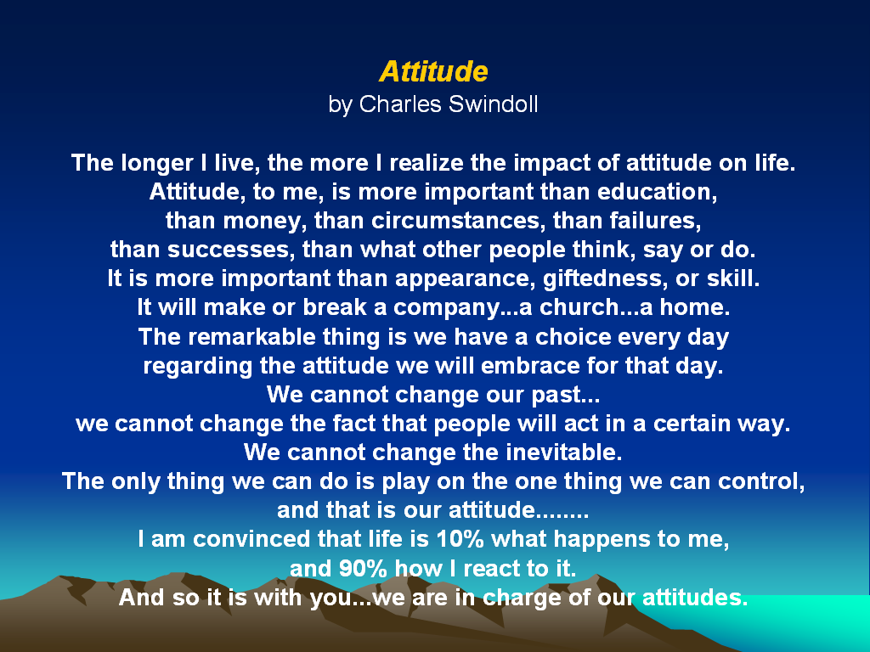

Slide 18


Slide 19

James Hardy - Field Director
Massachusetts Association of School Committees
One McKinley Square
Boston, MA 02109
617-523-8454
jhardy@masc.org
www.masc.org

