Slide 1
Multigenerational Community Engagement
Telling Your Story

Slide 2
Workshop Goals
Increase knowledge and understanding of the six generations
Enhance comprehension of how generational differences affect you
Promote skills for effective intergenerational communication
Expand capacity to manage diverse working styles across the generations

Slide 3
Is the Generation Gap Back?
Generational communication differences represent a critical new aspect to community engagement.
How you view generational differences is based on your generational perspective.

Slide 4
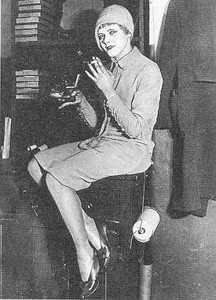
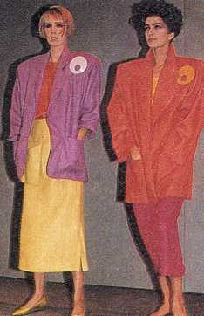
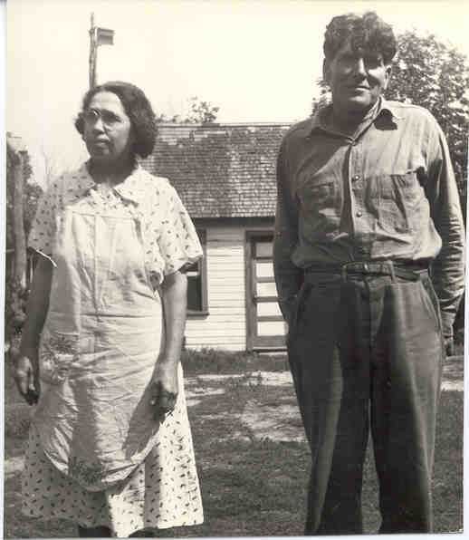
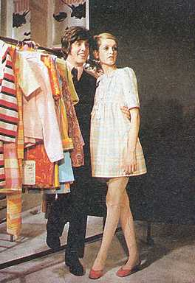
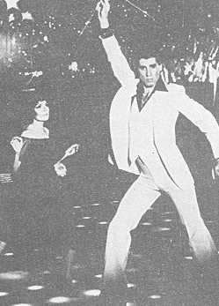
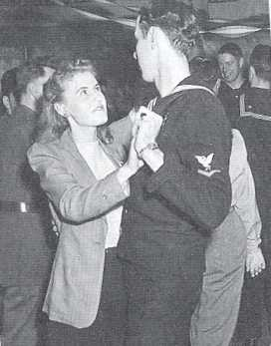
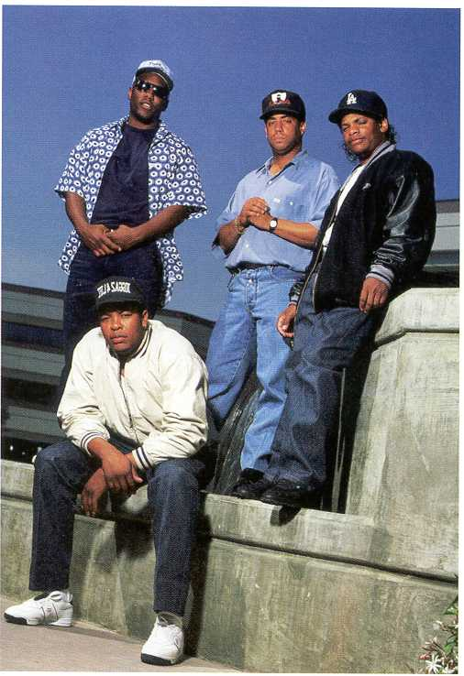
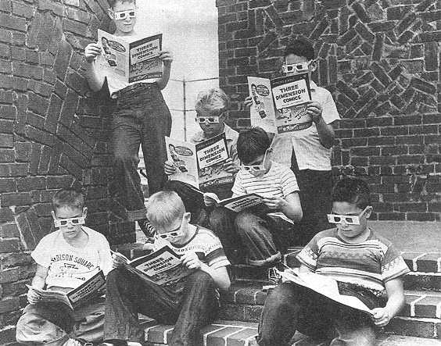
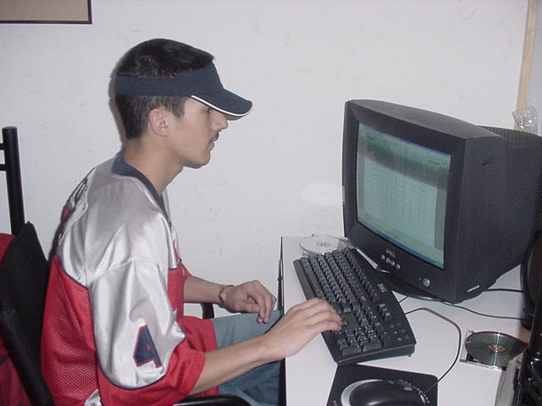

Slide 5
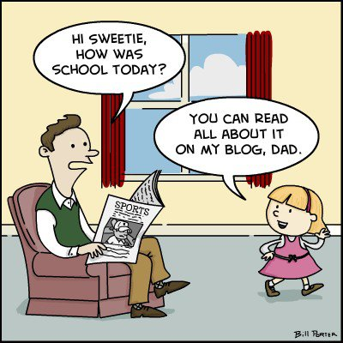

Slide 6
The Six Generations
The G.I. Generation 1901-1924
The Silent Generation 1925-1945
The Baby Boomers 1946-1964
Baby Busters 1965-1980
MTV Generation/Boomerang 1975-1985
Generation Y/Millennials 1978-1990
Notes:
GI Generation and Silent generation make up “The Greatest Generation”
Baby Busters and MTV/Boomerangs make up “Generation X”

Slide 7
The Six Generations
Generation Z 1995-2007
    New Silent Generation
The Next Generation after 2007
Source: MarketingTeacher.com

Slide 8
Greatest Generation
Born between 1901-1945
Are now 70 years old +
GI Generation 91+
Silent Generation 70-90
Represent 9.875% of the population
Their Depression was The Great One, their war was The Big One; their prosperity was the legendary Happy Days
Peace! Jobs! Suburbs! Television! Rock n Roll! Cars! Civil Rights movement began
Notes:
GI Generation- Experienced WWII in adulthood. Some of those who survived the war then went on to build and rebuild United States industries in the years following the war
Born 1901-1926.
Children of the WWI generation & fighters in WWII & young in the Great Depression…all leading to strong models of teamwork to overcome and progress.
Their Depression was The Great One; their war was The Big One; their prosperity was the legendary Happy Days.
They saved the world and then built a nation.
They are the assertive and energetic do’ers.
Excellent team players.
Community-minded.
Strongly interested in personal morality and near-absolute standards of right and wrong.
Strong sense of personal civic duty, which means they vote.
Marriage is for life, divorce and having children out of wedlock were not accepted.
Strong loyalty to jobs, groups, schools, etc.
There was no “retirement” you worked until your died or couldn’t work anymore.
The labor-union-spawning generation.
“Use it up, fix it up, make it do, or do without.”
Avoid debt…save and buy with cash.
Age of radio and air flight; they were the generation that remembers life without airplanes, radio, and TV.
Most of them grew up without modern conveniences like refrigerators, electricity and air conditioning.
Sometimes called The Greatest Generation.
Silent Generation – Experienced WWII in childhood, Civil Rights movement. Born between the two World Wars. Many had fathers who served during World war I
Born 1927- 1945.
Went through their formative years during an era of suffocating conformity, but also during the postwar happiness: Peace! Jobs! Suburbs! Television! Rock ‘n Roll! Cars! Playboy Magazine!
Korean and Vietnam War generation.
The First Hopeful Drumbeats of Civil Rights!
Pre-feminism women; women stayed home generally to raise children, if they worked it was only certain jobs like teacher, nurse or secretary.
Men pledged loyalty to the corporation, once you got a job, you generally kept it for life.
The richest, most free-spending retirees in history.
Marriage is for life, divorce and having children out of wedlock were not accepted.
In grade school, the gravest teacher complaints were about passing notes and chewing gum in class.
They are avid readers, especially newspapers.
“Retirement” means to sit in a rocking chair and live your final days in peace.
The Big-Band/Swing music generation.
Strong sense of trans-generational common values and near-absolute truths.
Disciplined, self-sacrificing, & cautious.

Slide 9
The Baby Boomers
Born between 1946-1964
Now between the ages of 51 and 69
79 million strong (24.7 % of population)
Also known as:
Hippies (60’s and 70’s)
Yuppies (70’s/80’s)
Notes:
Hippies – save-the-world revolutionaries
Yuppies – party-hardy career climbers of the 70’s/80’s
Born between 1946 and 1964. Two sub-sets:
1. the save-the-world revolutionaries of the ’60s and ’70s;
and 2. the party-hardy career climbers (Yuppies) of the ’70s/’80s.
The “me” generation.
“Rock and roll” music generation.
Ushered in the free love and societal “non-violent” protests which triggered violence.
Self righteous & self-centered.
Buy it now and use credit.
Too busy for much neighborly involvement yet strong desires to reset or change the common values for the good of all.
Even though their mothers were generally housewives, responsible for all child rearing, women of this generation began working outside the home in record numbers, thereby changing the entire nation as this was the first generation to have their own children raised in a two-income household where mom was not omnipresent.
The first TV generation.
The first divorce generation, where divorce was beginning to be accepted as a tolerable reality.
Began accepting homosexuals.
Optimistic, driven, team-oriented.
Envision technology and innovation as requiring a learning process.
Tend to be more positive about authority, hierarchal structure and tradition.
One of the largest generations in history with 77 million people.
Their aging will change America almost incomprehensibly; they are the first generation to use the word “retirement” to mean being able to enjoy life after the children have left home. Instead of sitting in a rocking chair, they go skydiving, exercise and take up hobbies, which increases their longevity.
The American Youth Culture that began with them is now ending with them and their activism is beginning to re-emerge.

Slide 10
The Generation X’ers
Born between 1965-1985
Currently 30-50 years of age
83 Million (25.8% of the population)
Also known as: Original “Latch-Key kids”, the Baby Busters, MTV Generation
Experienced Vietnam War/Cold War
Later-Rise of Mass Media/Falling
of the Berlin Wall
Notes:
Born between 1965 and 1985*
The “latch-key kids” grew up street-smart but isolated, often with divorced or career-driven parents. Latch-Key came from the house key kids wore around their neck, because they would go home from school to an empty house.
Entrepreneurial.
Very individualistic.
Government and big business mean little to them.
Want to save the neighborhood, not the world
Feel misunderstood by other generations
Cynical of many major institutions, which failed their parents, or them, during their formative years and are therefore eager to make marriage work and “be there” for their children
Don’t “feel” like a generation, but they are
Raised in the transition phase of written based knowledge to digital knowledge archives; most remember being in school without computers and then after the introduction of computers in middle school or high school
Desire a chance to learn, explore and make a contribution
Tend to commit to self rather than an organization or specific career. This generation averages 7 career changes in their lifetime, it was not normal to work for a company for life, unlike previous generations.
Society and thus individuals are envisioned as disposable.
AIDS begins to spread and is first lethal infectious disease in the history of any culture on earth which was not subjected to any quarantine.
Beginning obsession of individual rights prevailing over the common good, especially if it is applicable to any type of minority group.
Raised by the career and money conscious Boomers amidst the societal disappointment over governmental authority and the Vietnam war.
School problems were about drugs.
Late to marry (after cohabitation) and quick to divorce…many single parents.
Into labels and brand names.
Want what they want and want it now but struggling to buy, and most are deeply in credit card debt.
It is has been researched that they may be conversationally shallow because relating consists of shared time watching video movies, instead of previous generations.
Short on loyalty & wary of commitment; all values are relative…must tolerate all peoples.
Self-absorbed and suspicious of all organization.
Survivors as individuals.
Cautious, skeptical, unimpressed with authority, self-reliant.

Slide 11
The Generation Y’s or Millennials
Born between 1978 and 1990
Between 25-37 years of age
54 Million Strong (16.9%)
Saw the rise of the Information Age/Internet/War on Terror/Iraq War/Rising Gas and Food Prices
Notes:
Most born mid 1980’s
Share some characteristics of Gen X
Have a consumer mentality re: education
Grew up with structured social interactions, i.e., daycare, camp, after school programs
Technically savvy
Value instant communication
Want work to be “fun” and “meaningful.”
Born between 1980* and 2000*.
Aka “The 9/11 Generation” “Echo Boomers” America’s next great generation brings a sharp departure from Generation X.
They are nurtured by omnipresent parents, optimistic, and focused.
Respect authority.
Falling crime rates. Falling teen pregnancy rates. But with school safety problems; they have to live with the thought that they could be shot at school, they learned early that the world is not a safe place.
They schedule everything.
They feel enormous academic pressure.
They feel like a generation and have great expectations for themselves.
Prefer digital literacy as they grew up in a digital environment. Have never known a world without computers! They get all their information and most of their socialization from the Internet.
Prefer to work in teams.
With unlimited access to information tend to be assertive with strong views.
Envision the world as a 24/7 place; want fast and immediate processing.
They have been told over and over again that they are special, and they expect the world to treat them that way.
They do not live to work, they prefer a more relaxed work environment with a lot of hand holding and accolades.

Slide 12
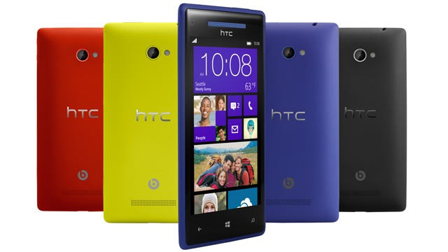
Generation “Z”
Born between 1990 and 2007
Between 8 and 25 years of age
55 million strong (17.1 % of population)
Internet/Smart Phone/ dot com bubble/Google
Digital Globalization
Notes:
Born after 1990*
In 2006 there were a record number of births in the US and 49% of those born were Hispanic, this will change the American melting pot in terms of behavior and culture. The number of births in 2006 far outnumbered the start of the baby boom generation, and they will easily be a larger generation.
Since the early 1700’s the most common last name in the US was ‘Smith’ but not anymore, now it is Rodriguez.
There are two age groups right now:
(a) Tweens.
(a1) Age 8-12 years old.
(a2) There will be an estimated 29 million tweens by 2009.
(a3) $51 billion is spent by tweens every year with an additional $170 billion spent by their parents and family members directly for them.
(b)Toddler/Elementary school age.
61 percent of children 8-17 have televisions in their rooms.
35 percent have video games.
14 percent have a DVD player.
4 million will have their own cell phones. They have never known a world without computers and cell phones.
Have Eco-fatigue: they are actually tired of hearing about the environment and the many ways we have to save it.
With the advent of computers and web based learning, children leave behind toys at younger and younger age. It’s called KGOY-kids growing older younger, and many companies have suffered because of it, most recognizable is Mattel, the maker of Barbie dolls. In the 1990’s the average age of a child in their target market was 10 years old, and in 2000 it dropped to 3 years old. As children reach the age of four and five, old enough to play on the computer, they become less interested in toys and begin to desire electronics such as cell phones and video games.

Slide 13
The “Next” Generation
Born after 2007
Less than 8 years old
Over 35 million strong
Approx. 1 million more boys
Have just started or will be starting school

Slide 14
How Their Times Shaped Them

Slide 15
Greatest Generation: Defining Events
The Great Depression & Dust Bowl
The New Deal
Social Security Established
Golden Age of Radio
Pearl Harbor Attacked
WW II and Korean War
Patriotism
Rise of Labor Unions

Slide 16
Greatest Generation: Heroes
Superman
MacArthur, Patton, Halsey,
Montgomery, Eisenhower
FDR
Winston Churchill
Audie Murphy
Babe Ruth
Joe DiMaggio

Slide 17
Boomers: Defining Events
Economic Prosperity
Expansion of Suburbia
Focus on Children
Television
Vietnam
Assassinations
Civil Rights Movement
Cold War/McCarthy Hearings
Space Race/Moon Landing

Slide 18

Baby Boomers: Heroes
Ghandi
Martin Luther King Jr.
John and Jacqueline Kennedy
John Glenn
Feminist Movement
  Billie Jean King – Bobby Riggs

Slide 19
Gen X’ers: Defining Events
Watergate, Nixon resigns
Challenger Disaster
Computers
Latchkey Kids
MTV
AIDS
Harsh economic conditions
Persian Gulf

Slide 20
Gen X’ers: Heroes ?
Oprah Winfrey
Bill Gates & Steve Jobs
Michael Jackson
Michael Jordan
Things, animation…
George Lucas
Sally Ride
Nelson Mandela

Slide 21
Millenials: Defining Events
Technology
TV Talk Shows
Multiculturalism
Desert Storm
Clinton Scandals
School safety
Oklahoma City Bombing
9/11
Columbia tragedy
First Black President

Slide 22
Millenials: Heroes ?
Steve Jobs
Princess Diana
Mother Teresa
Tiger Woods
Lance Armstrong
Jon Stewart
Mark Zuckerburg
Venus and Serena Williams
Notes:
Steve Jobs – portability of music (ipod)

Slide 23
Greatest Generation Values
Dedication/sacrifice
Law and order
Strong work ethic
Risk averse
Respect for authority
Patience
Delayed reward
Duty, honor, country
Loyalty to the organization

Slide 24
Greatest Generation: Training & Development
Training
Take plenty of time
Give them the “big picture”
Emphasize long-term goals
Let them share their experience
Developing
Technology
Don’t stereotype as technophobes
Use formality and order
Don’t rush it

Slide 25
Messages that Motivate Greatest Generation
“Your experience is respected here.”
“It’s important for the rest of us to hear what has, and hasn’t, worked in the past.”
“Your perseverance is valued and will be rewarded.”

Slide 26
Boomer Values
Optimism
Team work
Personal gratification
Health and wellness
Promotion and recognition
Youth
Work
Volunteerism

Slide 27
Boomers:
Training & Development
Training
Focus on the near future
Focus on challenges
Focus on their role
Development
Meetings and team team building
Provide develop-mental experiences
Use business books and training tapes

Slide 28
Messages that Motivate Boomers
“You are important to our success.
“We recognize your unique and important contribution to our team.”
What is your vision for this project?”
“You are valued.”

Slide 29
Gen X Values
Diversity
Thinking globally
Balance in life
Computer literacy
Personal development
Fun
Informality
Independence
Initiative

Slide 30
Gen X’ers: Training & Development
Training
Focus on balance
Offer them access to many different kinds of information
Provide resource lists
Development
Electronic support
Keep materials brief – bullets/checklists
Help them train for another job

Slide 31
Messages that Motivate Gen X’ers
“Do it your way.”
“We’ve got the latest computer technology.”
“There aren’t a lot of rules here.”
“We’re not very corporate.”

Slide 32
Millennial Values
Optimism
Civic duty
Confidence
Ambition/
achievement
Tradition
Education
Idealism
Fun
Diversity

Slide 33
Millennials: Training & Development
Training
Take plenty of time
Let them know what they do matters
Communicate expectations
Development
Focus on customer service and interpersonal skills
Model the behavior you want to see
Large teams with strong leadership
Notes:
Well written job descriptions
Clear performance expectations
Effective interview process
Structured, thorough orientation
Established training plan
Performance support systems (mentors, resources, feedback, on-going training, etc.)
Focus on the staff’s professional developmment whenever possible
Ask for input on policy and procedural decisions, this will allow the staff to create “buy in” to their positions
Help them to understand the “process” that goes into all decision making.

Slide 34
Messages that Motivate Millennials
“We provide equal opportunities here.”
“Your mentor is in his/her sixties.”
“You are making a positive difference to our company.”
“You handled that situation well.”
Notes:
Clear expectations
Ask for input
Give responsibility
Increase personal interaction
Meaningful balanced feedback
Positive work environment
Lead by example
Recognize effort
Reward outcome
What doesn’t work
Threats, anger and other parental responses
Micro management
Isolation, ignoring
Belittling or minimizing contribution
Extending chance after chance after chance

Slide 35
How They Communicate
Greatest Generation
  Relies on print media or television news
  Reads books
  Write letters/send cards
  Face-to-face conversation

Slide 36
How They Communicate
Baby Boomers
  Very comfortable with face to face conversation
  Feel strongly about procedure and chain of command
  Expect more formality in communication

Slide 37
How They Communicate
Generation “X”
  Last generation that was taught cursive
  Wants to know the source of the information and always expects you to have back-up plans
  Very good at email (they mainstreamed it)
  Tech savvy

Slide 38
How They Communicate
Generation Y/Millennials
  Fastest growing and most diverse population in the workplace
  Communication is less formal…text messages, social media, IM, Twitter, SnapChat.
  Visual generation, think in pictures and images
  Best to start with outcomes
  Source: Bridging the Gap at Work – Nora Zelevansky
Notes:
Example: Daily Show with Jon Stewart – news with a saterical comic edge

Slide 39

Engaging Your Community
What is Your Promise to the Public?

Slide 40
Public Participation Spectrum
Purpose | Inform | Consult | Involve | Collaborate
OBJECTIVE | Provide the public with information | Obtain public feedback | Work directly with the public throughout the process | Partner with the public in decision-making

Slide 41
Public Participation Spectrum
PURPOSE | INFORM | CONSULT | INVOLVE | COLLABORATE
OBJECTIVE | Provide the public with information | Obtain public feedback | Work directly with the public throughout the process | Partner with the public in decision-making
PROMISE TO THE PUBLIC | We will keep you informed | Provide feedback on how public input influenced the decision | Ensure public concerns & issues are reflected in the alternatives | Incorporate public advice & recommendations into the decision

Slide 42
Public Participation Spectrum
PURPOSE | INFORM | CONSULT | INVOLVE | COLLABORATE
OBJECTIVE | Provide the public with information | Obtain public feedback | Work directly with the public throughout the process | Partner with the public in decision-making
PROMISE TO THE PUBLIC | We will keep you informed | Provide feedback on how public input influenced the decision | Ensure public concerns & issues are reflected in the alternatives | Incorporate public advice & recommendations into the decision
EXAMPLE TOOLS | Fact sheets Websites Open Houses | Public Comment Focus Groups Surveys Public Meetings | Workshops Deliberative polling | Citizen Advisory Committees Synergy-building Participatory decision-making

Slide 43

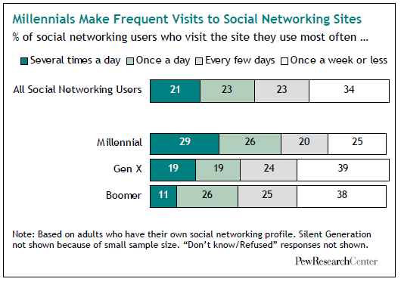
Social Networking - Millenials
Source: Pew Internet & American Life Project. “MILLENNIALS
A Portrait of Generation Next. Confident. Connected. Open to Change.” February 2010.

Slide 44
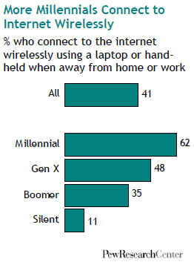
Wireless Internet Usage
Source: Pew Internet & American Life Project. “MILLENNIALS
A Portrait of Generation Next. Confident. Connected. Open to Change.” February 2010.

Slide 45
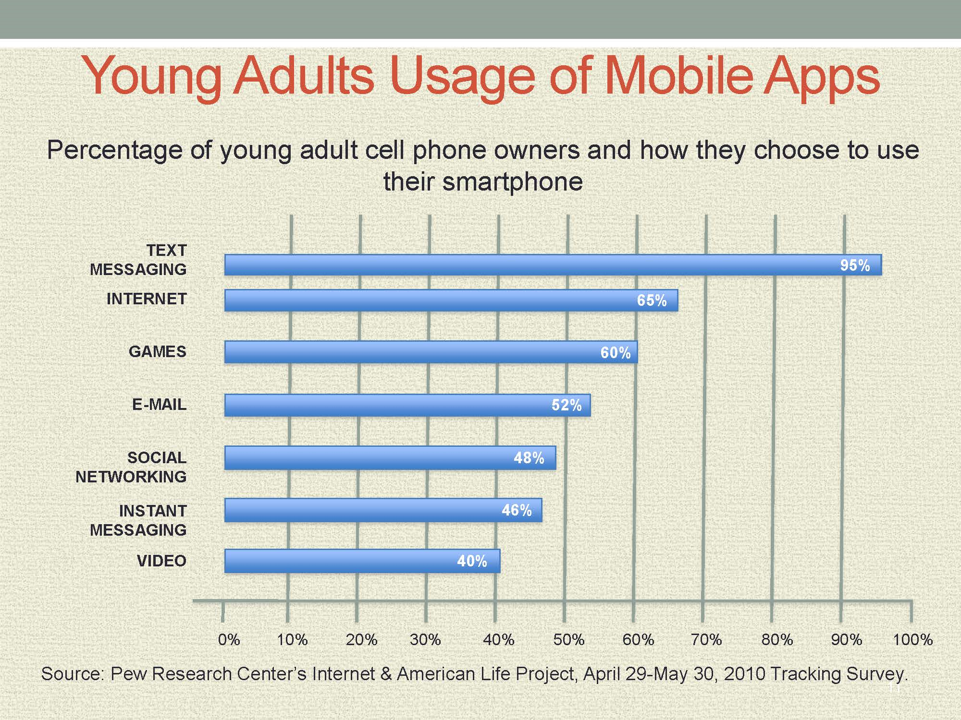

Slide 46

Your Impression and Comments…

Slide 47

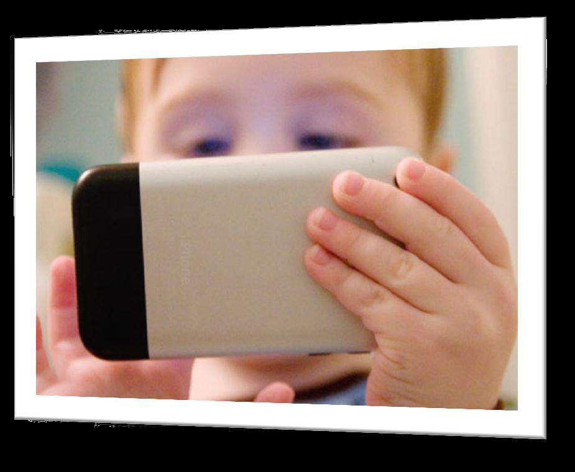
Questions

