Slide 1
Building an Effective SRO Position
Michelle Palladini | Norfolk Police Department l
King Philip Middle School Resource Officer

Slide 2
School Resource Officer
Notes:
How many have them?
What does that position look like?
How many don’t have them?
What does the position look like to you?
I know the stories (examples). Acc to 2013/2014 National Center for Education Statistics 43,000 Officers and 39,000 security guards working in our public schools.
So how can an SRO be an asset to your school? This presentation will discuss that.

Slide 3
SRO
How can we prepare children for the future?
What does that future look like?
What do children need to know to navigate that future?
Goals
Standards (MOU or SOP)
Personal Mission

Slide 4
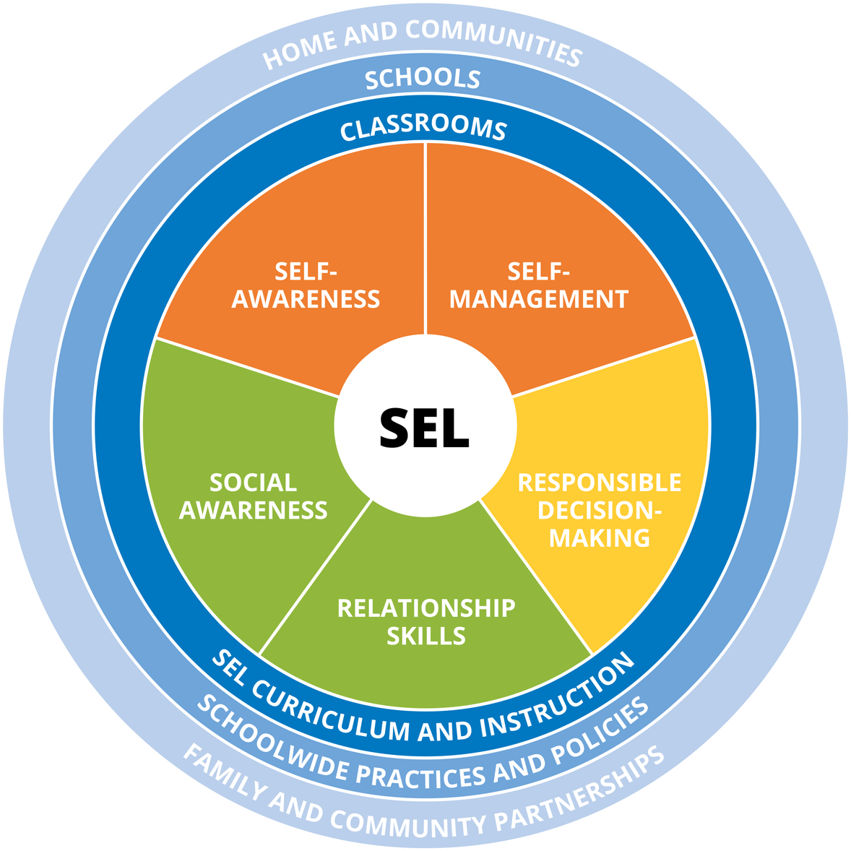
Why L.E.A.P.?

Slide 5
Risky behaviors are reduced when integrated methods are utilized to develop these skills.
School
Police
Parent
Community
Student
Notes:
Your SRO should have a method for working with each to help students succeed.

Slide 6
“Luck is what happens when preparation meets opportunity.”
Notes:
Thank you’s and credit to NPD & KPMS

Slide 7
“
Governor Deval Patrick, Jan. 16, 2014
“No child will be able to succeed academically if they don’t first feel safe in school. No teacher will be able to teach at their best if they aren’t confident there’s a plan in place to ensure their school is well prepared for an emergency”
Governor Duval Patrick, January, 2014

Slide 8
At the secondary level, every school in the Commonwealth should have a School Resource Officer (SRO) who is appointed jointly by he Superintendent and Police Chief At the elementary level, all schools should have an appropriate program that provides both police presence and public safety education Recommendation made by the 2014 MA School Safety and Security Task Force

Slide 9
Preparing the District to Support the Position
Reallocating Existing Fiscal Resources
Attendance Officer
Existing Programs (Health- Guest Speakers)
Anti-Bullying Education Programs/Resources
Safety Training Programs

Slide 10
Essential Qualities of an SRO
Encourages the development of good citizenship in students
Builds positive relationships
Supports students and parents and handles well
the duality of the position (School/Police)
Able to be on duty when needed, has strong follow through, and
attention to detail
Commands respect and is a model of integrity

Slide 11
Launching and Embedding the SRO program in School
Communication and Visibility
(Staff, Students, Parents, Community)
Proximity to School Leadership and Guidance
Student and Parent Access
Sustainability of Programming- Safety and Security, Student Education, Parent and Community Education, and Teacher Education

Slide 12
Resilience
Leadership
Health
Awareness
Safety
Protection
Happiness
Empowerment
Notes:
Goal of student success: but success how?

Slide 13
Integrated Methods

Slide 14
Core Program - L.E.A.P.
What does the world look like?
How can we prepare them for success?
Program dosage is high
No scare tactics
Mindfulness in each class
Notes:
It’s not going to feed kids, or put a roof over their heads, but it can mitigate the circumstances that contribute to a child from making poor decisions.

Slide 15
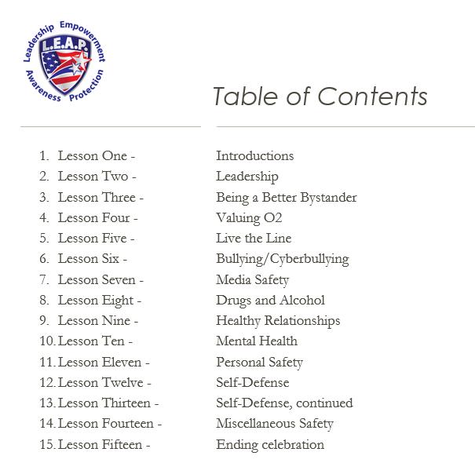
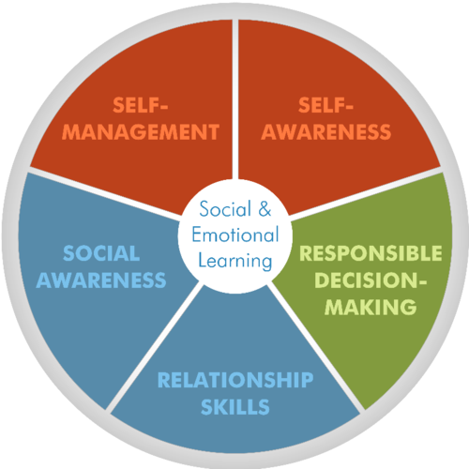
L.E.A.P. and SEL
A Snapshot
Notes:
Skills are critical to being a good citizen

Slide 16
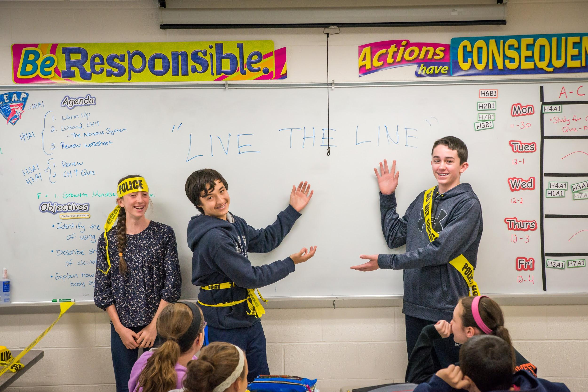
Notes:
Explain live the line

Slide 18
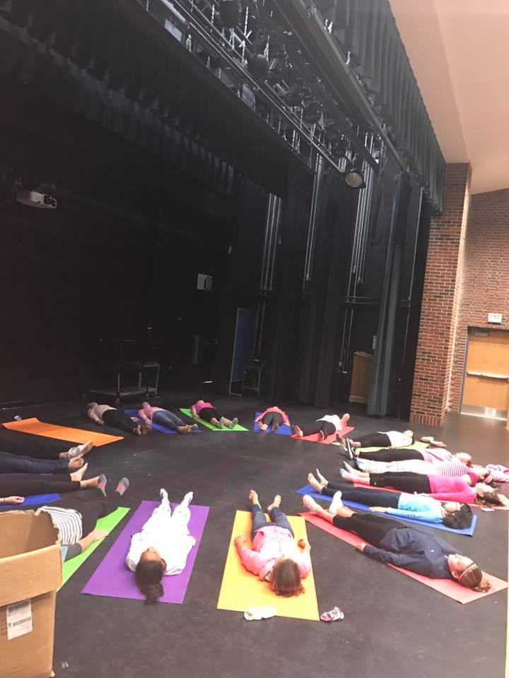
Self-Defense
Healthy Relationships
Body Image
Mindfulness
Empowerment

Slide 19
L.E.A.P. Method: Connection. Mindful, compassionate communication. Understanding adolescent brain development

Slide 20
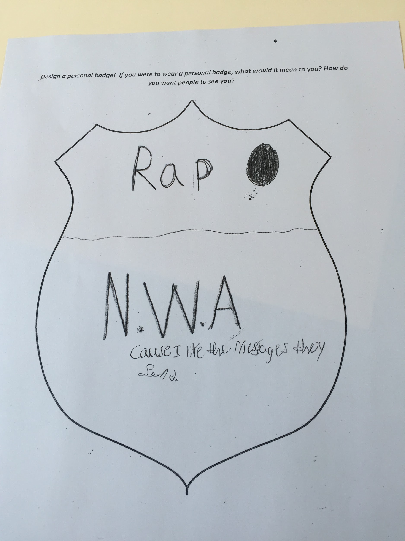
Connection with ALL children.
#cluesnotcuffs
Notes:
Case Study
Band known for explicit lyrics that are disrespectrul of women, and glorify drugs and crime. Furthermore, group is known for deep hatred of police system.

Slide 21
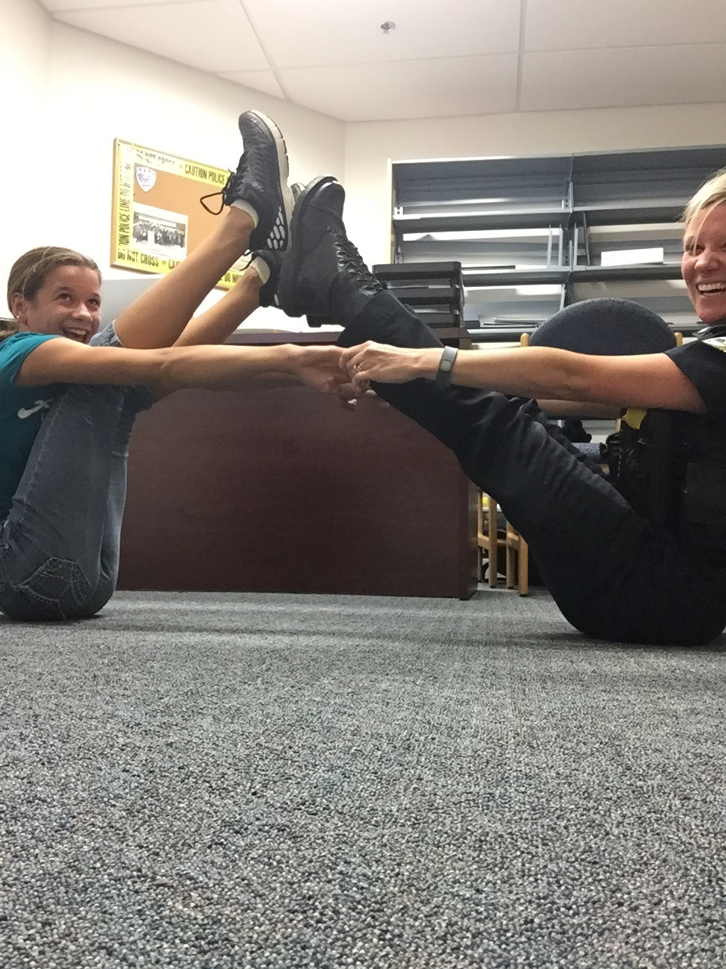
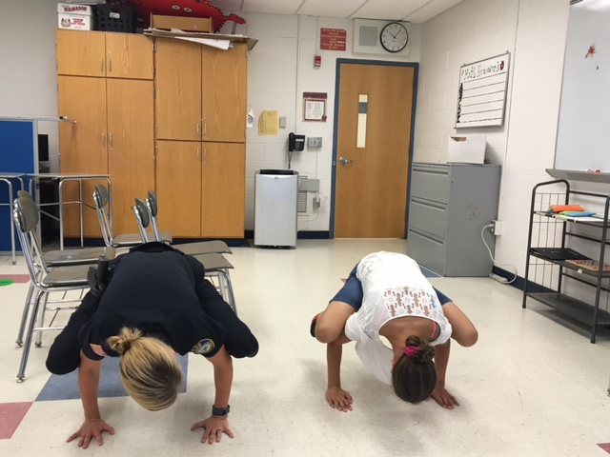
Attendance, Discipline, Students with Special Needs…oh my!
Notes:
Case Study

Slide 22
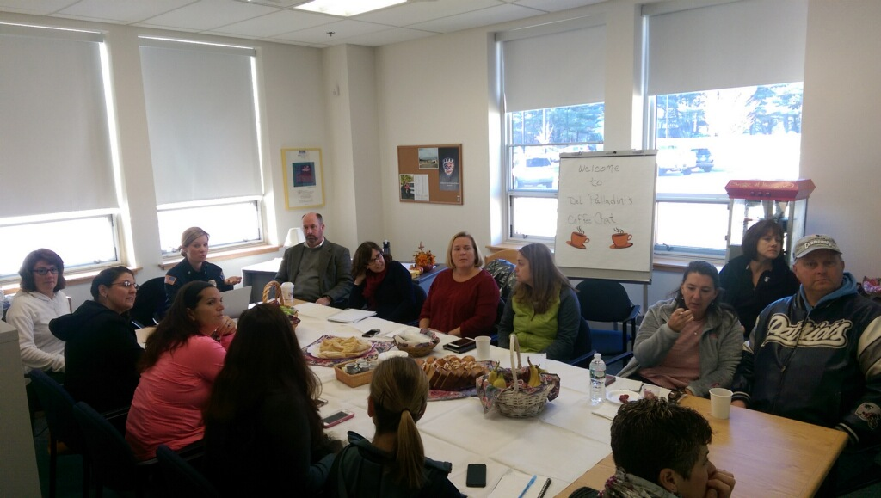
Parents/Community
Notes:
How can we help parents prepare their children for the future? How can we support them? Seth story. Social Media Story. Villages.

Slide 23
“It takes a village to raise a child
..and a community to keep the parents sane!”
Notes:
We need to work together to keep kids safe as the typical adolescent works to push against what is known, safe and familiar.
Teenagers natural inclination is to push against the parents when they are the only close adult in their life.

Slide 24
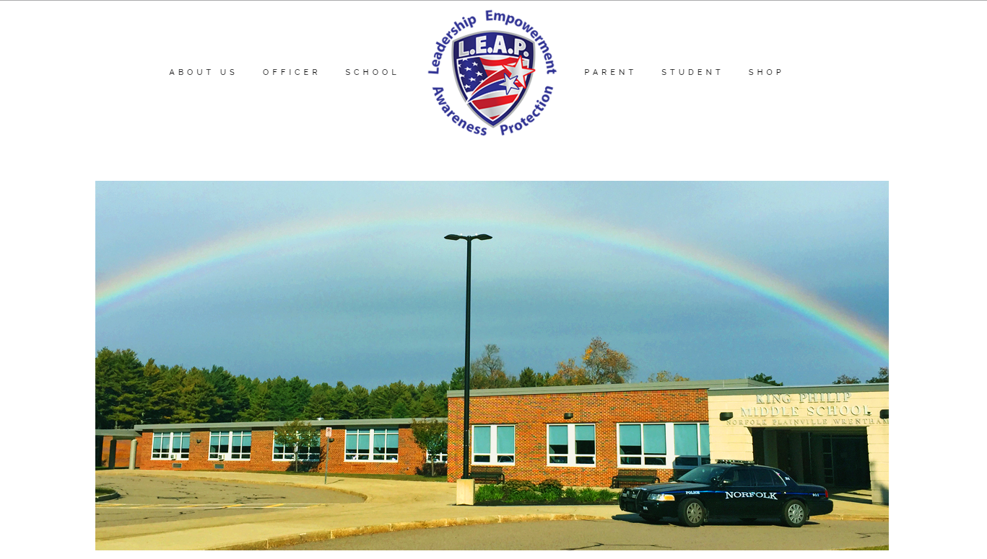
Michelle Palladini
mpalladini@norfolk.ma.us
info@leapprogram.net
508-509-0285 (Cell)
Facebook: Michelle Palladini & LEAP PROGRAM
Twitter: @leapprograms
www.leapprogram.net

