Slide 1
Natick’s Start-Time Odyssey

Slide 2
Start Times ARE a policy decision
If the following tenets are true for the majority of adolescents:
Students between 14 and 21 years old cannot fall asleep before 11:00 PM
These students need 8.5 to 9.5 hours of sleep nightly to perform optimally
Then it is a school committee’s responsibility to structure a school day - with an appropriate start time - that reflect these factors.

Slide 3
Structuring a school day that reflects the extensive and unequivocal research about adolescent sleep requirements
is the single most impactful decision a school committee can make
to support the social-emotional wellness and student achievement of the students it has pledged to support

Slide 4
8/27/2012
“Whereas research has shown that adequate sleep increases teenagers’ retention of information, increases their overall immunity, and helps lower physical stress, and
Recognizing that the Natick parental community took a strong interest in the movie “Race to Nowhere” and in its subsequent recommendations,
A motion is put forth to request that the Natick School Administration study the various options available to the district to move out the start time of Natick High school by 1 hour (at least), and that these options be presented to the School Committee during the 2012-13 school year,
And secondly, that such options be designed to minimize cost,
And thirdly, following receipt of these options, the Natick School Committee initiate at least 3 public hearings on the topic to assess whether the community would support pursing one of these options as soon as possible and whether these benefits outweigh the potential costs.”

Slide 6
The superintendent and the high-school principal need to be committed to the change - from the beginning.
Focus on outreach. Actively share the research.
Engage with all stakeholders before you present a change proposal.

Slide 7
Leadership
The superintendent is the educational leader of the district and the high-school principal of the demographic with the most to gain from a start-time change.
Given that start-time changes do create logistical challenges, the educational leaders need to signal to the community – staff, students, and parents - that the benefits outweigh the “costs.”
There will be negative feedback from some stakeholders. You cannot overcome the negative if your educational leaders are actively against the change or unwilling to lead the community through the issues.

Slide 8
The Start-Time Challenge

Slide 9
The research about the benefits of achieving appropriate sleep for adolescents is unequivocal.
However, work on the premise that your stakeholders have not and will not avail themselves of the research on their own.
Actively educate stakeholders – staff, students, and parents
* speakers
* forums to discuss the research
* share the many articles on adolescent sleep
* communicate regularly
Build awareness for the benefits to create buy-in that the logistical changes are worthwhile.

Slide 10
Research
Examining the Impact of Later High School Start Times on the Health and Academic Performance of High School Students: A Multi-Site Study
file:///C:/Users/Amy/AppData/Local/Temp/final_version_3-11-14_start_time_report.pdf
School Start Time Change : An In-Depth Examination of School Districts in the United States.
file:///C:/Users/Amy/AppData/Local/Temp/schoolstarttimechange_mbe_owensdrobnichlewinbaylor_2014.pdf
School Start Time for Adolescents: American Academy of Pediatrics
file:///C:/Users/Amy/AppData/Local/Temp/Pediatrics-2014--642-9.pdf
School Start Times and Student Outcomes: Hanover Research
file:///C:/Users/Amy/AppData/Local/Temp/School%20Start%20Times%20and%20Student%20Outcomes%20-%20Hanover%20Research.pdf

Slide 11
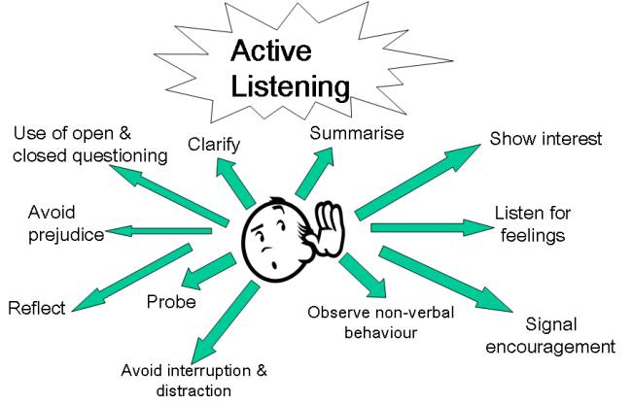
Do not start with a change proposal.
Focus on sharing information and listening to your stakeholders first.
After sharing the research and listening to the concerns of the stakeholders, follow with a thoughtful proposal that incorporates the benefits of the research and the values and concerns of your community.

Slide 12
87% of high school students report they do not get the required amount of sleep
71% of parents are unaware of their child’s sleep deficit.

Slide 13
“The results from this three-year research study, conducted with over 9,000 students in eight public high schools in three states, reveal that high schools that start at 8:30 AM or later allow for more than 60% of students to obtain at least eight hours of sleep per school night.”
Examining the Impact of Later High School Start Times on the Health and Academic Performance of High School Students: A Multi-Site Study
Wahlstrom, Kyla; Dretzke, Beverly; Gordon, Molly; Peterson, Kristin; Edwards, Katherine; Gdula, Julie (2014)
Charged
and ready to learn

