Slide 1
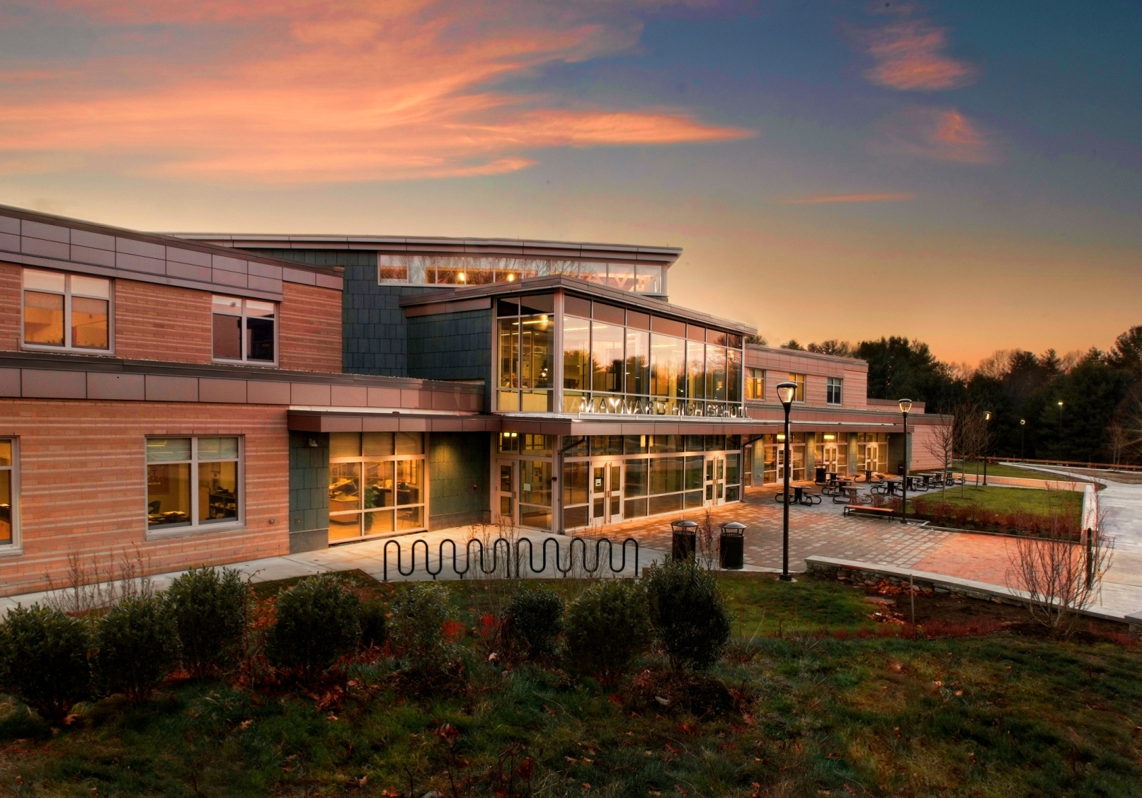
Maynard Public Schools
Foreign Exchange Case Study
1
Notes:
This is a picture of the beautiful new Maynard High School that was taken by our local photographer Bruce Lucier of Marqee Photo. This new building was opened in September 2013. The design of this school was by a very special architect, Brooke Trivas, currently from the international firm of Perkins+Will. Even the contractors commented that this project did not look like a typical high school but more like the corporate offices or college campuses that they have worked on.
Maynard High School, the Fowler Intermediate School, and Green Meadow Elementary school are located on one 200 acre campus with sports fields and wooded areas for nature based studies. The school system serves approximately 1,500 students with approximately 300 staff. The Maynard Schools offer a broad array of programming excellence including:
A rigorous course of study at MHS with a capstone graduation requirement
Championship interscholastic sports offerings
Award winning Band, Chorus, and Drama activities
A state of the art TV/Radio production facility and 50 years of broadcasting WAVM as an afterschool club
Regular international travel experiences for Maynard resident students
A robust foreign exchange program that has included visiting students from over 20 different nations during the last 15 years
Computer science curricula starting in 4th grade & Latin in 6th grade
NAEYC accredited Preschool and Kindergarten

Slide 2

Maynard Public Schools
Foreign Exchange Case Study
2
Notes:
Recently the Boston Globe identified that many communities want to be the next Somerville. We believe Maynard is the next suburban Somerville based on the following facts:
-Maynard is 22 miles from Boston with reasonable housing pricing in the region
-Maynard’s downtown has charm and character through its restaurants, arts, and theater
-Maynard has a rich history of innovation dating back to the industrial revolution including:
1. A textile mill that provided woolen goods for revolutionary soldiers.
2. The international headquarters for Digital Equipment Corporation in the 80’s
3. The headquarters for Monster.Com in the new millennium
4. An area that Saracen Properties is currently converting into a multipurpose property
-The most amazing fact is that the greater community is so supportive of the schools
1. The community voted overwhelmingly to build the new high school
2. Over the last 5 years the average increase in the school budget has been 4.55%
3. The logo concept and wording was created through a visioning process with all stakeholders
4. The logo was designed by a resident graphic artist, Christopher O Brien.
5. The logo represent the Maynard Public School’s core values
“We are a Kind&Empathetic, Safe&Healthy, Creative&Curious Maynard Community”

Slide 3
Foreign Exchange Primer
MASSC/MASS Presentation – November 2, 2016
3
Monitoring Agency Hierarchy
  Department of Homeland Security
  US Immigrations and Customs Enforcement (ICE)
  Student Exchange Visitor Program (SEVP)
Student Exchange Visitor Information System (SEVIS)
  Tracks and monitors schools, programs, F,M, & J Visa’s
Notes:
There is a hierarchy of government agencies that monitor the foreign exchange programs in participating schools.
The Department of Homeland security is the top agency that monitors
The US Immigrations and Customs Enforcement (ICE) that monitors
The Student Exchange Visitor program.
The Student Exchange Visitor Program SEVP monitors local foreign exchange programs including the schools and Visa Process.
3

Slide 4
Foreign Exchange Definitions
MASSC/MASS Presentation – November 2, 2016
4
Important Definitions
  F-1 Visa – for a foreign student in the U.S. to pursue a full course of academic study
  M-1 Visa – for a foreign student in the U.S. to pursue a full course of study at a vocational or other non academic school
  J - 1 Visa – for a foreign student participating in programs that promote cultural exchange
Notes:
Much like the Department of Education the federal government uses lots of acronyms and abbreviations. I would like to take a minute to define some of the important ones in regard to the students.
4

Slide 5
Foreign Exchange Definitions
MASSC/MASS Presentation – November 2, 2016
5
Important Definitions
  DSO (Designated School Official) –
    A member of the school who keep records in SEVIS and provide resources for the visa students
  PDSO (Principal Designated School Official)
    Each district can only have one PDSO
    The PDSO is the main point of contact for SEVP
    PDSO’s must make updates to DSO information in SEVIS
    PDSO’s must file for recertification
Notes:
Bob-
More Definitions on the school side.
5

Slide 6
History of Maynard’s
Foreign Exchange Certification
MASC/MASS Presentation – November 2 2016
6
Maynard became SEVIS Certified in 2001
  1 to 2 students for the first 10 years
  Recertification required every 5 years
  Miscommunication in Superintendent transitions (almost lost certification in 2012)
  Online and phone process for recertification
Current Support Improved
  Field representatives now provided
Notes:
Bob-
Maynard had a great history in regard to hosting foreign exchange students
For 10 years before I came to Maynard we had a parent who had been bringing 1 or 2 foreiegn exchange students to Maynard High School on J – 1 Cultural exchange Visa’s. The community valued this experience and wanted the school system to expand global learning initiatives and the foreign exchange program.
Recertification is required every 5 years and there was a miscommunication between my predecessor and I which almost resulted in the termination of our certification. We paid a late registration fee and filled out reams of forms and ultimately recertified our high school without a break in service. At that time all support was done electronically through a federal SEVP help desk.
Current Support has improved in the last two years and they now provide a liaison who visits the school district annually.
6

Slide 7
History of Maynard’s
Foreign Exchange Vendor Selection
MASC/MASS Presentation – November 2, 2016
7
Initial vendor
Second vendor interest
RFP process
  Resulted in 3 venders
  Resulted in a greater understanding of what different venders offer
Notes:
The School Committee was looking to expand the foreign exchange program. Initially, I met Steve Jenkins of Eductious International at a NEASS conference. Our first year we signed a memorandum of Expectations (MOE) which will be an important distinction from an MOA, MOU, or a contract. Our first year we only had one additional student but that was because of school level decisions we made.
7

Slide 8
History of Maynard’s
Foreign Exchange Program
MASC/MASS Presentation – November 2 2016
8
Maynard program development
Screening processes
Community decisions (policies)
  Adding staff or just filling empty seats
  Eligibility for diploma
  Eligibility for Valedictorian and salutatorian
  District Eligibility for Interscholastic participation
  MIIA Eligibility for Interscholastic participation
Notes:
Our first year we didn’t know what the market wanted and as such we did not get many students. We learned by the second year that many foreign exchange students want to attend an American University. Attending their senior year in an American High School helps them improve their English skills for a year and getting an American High School Diploma is seen as helping them in the application process for an American University. Once we changed our program to include a Maynard High School Diploma we went from one foreign exchange student to 20 foreign exchange students.
In our first year we did not screen students as well as we could have. We have developed our screening process with increased English test scores requirements and a Skype interview.
Community concerns arise when you provide a diploma to foreign exchange students. Some districts create school committee policies on these issues and others create high school protocols depending on the community concern level.
8

Slide 9
Foreign Exchange Tuition
MASC/MASS Presentation – November 2, 2016
9
Funds kept in revolving account
  Some funds used for foreign exchange and resident students to participate in cultural travel experiences in our region.
  Some funds used for seed money for innovative program expansion benefiting all students
    Added online course offerings
    Added dual enrollment opportunities
  Scholarship money set aside for resident student learning through travel experiences.
Notes:
The tuition funds are kept in a revolving account similar to school choice.
We have chosen to use the money as seed money to provide services for the foreign exchange students that also benefit Maynard students like increasing online course offerings and Dual enrollment programs.
We just set aside $110,000 for Maynard resident students scholarship money to support learning leadership and service through foreign travel which can be also used by our students as their senior project theme.
9

Slide 10
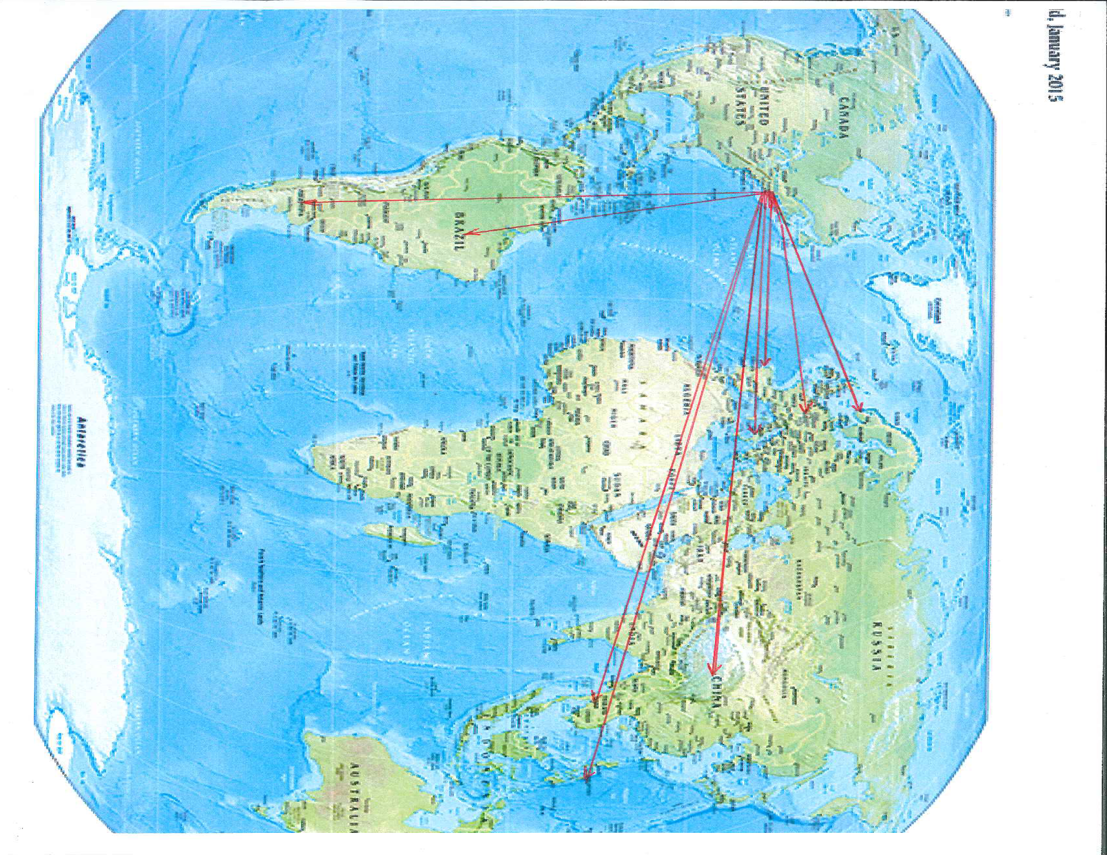
Maynard Public Schools
Foreign Exchange Case Study
10
Notes:
Hopefully you can see the red lines on this map that point toward the countries we have had foreign exchange students visit from. Symbolically, those arrows are pointing toward those countries as we grow our resident student travel experiences and global learning opportunities for Maynard resident students using the foreign exchange scholarship funding.

