Slide 1
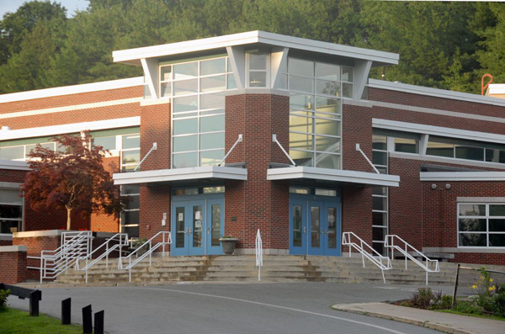
Georgetown Will Starting School Later Work?
GMHS

Slide 2
Start School Later Volunteer Committee Members
Teresa Frost – Parent
Paula Hooper – Parent
Carol Jacobs – Superintendent
Barbie Linares – School Committee Chair
Mary Lyon – Teacher
Suzanne MacDonald – School Committee
Margaret Maher – Penn Brook Principal
Heidi Mongeau – GMHS Administrator
Christine Orvis – Parent
Heather Torrey – District Food Service Director
Donald Valentine – Community Member
Mark Winer – Parent

Slide 3
Timeline
9/2015 Parent approached SC regarding a later start time at GMHS
10/2015 School Committee approved a committee to research later start times
Committee meets regularly since established
12/2015 Started a local chapter of Start School Later/Facebook page
Met with union leadership, Athletic Director, Music Department, After School Program Director, School Staff
5/2016 Conducted a community forum in partnership with the PTA
6/2016 Administered a survey to community members, school staff and students
Published survey results

Slide 4
Collaborate
The committee believes in the importance of aligning with other local districts. Newburyport plans on changing their start times in Fall 2017, Masconomet Regional School District is on pace with Georgetown, Lynnfield is actively pursuing a change while Hamilton-Wenham is interested but no formal committee has been established.

Slide 5
Information Gathered from Data and Forums
Largest challenges in Georgetown are elementary school hours changing, athletic schedules and transportation.
Proposed changes at GMHS will be a start time of 8:00 a.m. instead of 7:30 a.m. Penn Brook Elementary will change from 8:40 a.m. to 9:10 a.m.
43% of students at GMHS say they are most alert and attentive between 9:00 a.m. – 11:00 a.m.
22% of students at GMHS say that are most alert between 7:30 a.m. – 9:00 a.m.
15% of students at GMHS believe they get 8 hours or more of sleep each night
33% of students at GMHS believe they get between 6-7 hours of sleep each night
27% of parents support a later school start time with an additional 22% in support if all logistics can be worked out
Most opposition comes from teachers and staff

Slide 6
Did You Know?
Since the 1990’s roughly 1,000 schools have changed their start times
The average school start time in Massachusetts is 7:53 a.m.
60% start school before 8:00 a.m.
In 2014 the American Academy of Pediatrics recommended that all middle and high schools start after 8:30 a.m.
Waking a teen at 7:00 a.m. is comparable to waking an adult at 4:00 a.m.
Most districts face similar challenges: cost, athletics, childcare for younger siblings, transportation, safety issues if a flipped schedule is required and after school employment
CHALLENGES CAN BE MET!

Slide 7
What the experts are saying…
“Given that the primary focus of education is to maximize human potential, then a new task before us is to ensure that the conditions in which learning takes place addresses the very biology of our learners.” Dr. Mary Carskadon, Brown University School of Medicine
“Fifty years ago we learned that hungry children don’t do well in school. Now we know that sleepy children do not do well in school. Now it is time for us to do something about it.” Dr. Joseph Buckhalt, Auburn University
“Almost all teenagers as they reach puberty, become walking zombies because they are getting far too little sleep. A teacher can be delivering the most stimulating, interesting lecture to sleep deprived kids whose overwhelming drive to sleep replaces any chance of alertness, memory or understanding.” Dr. James Maas, Department of Psychology, Cornell University

Slide 8
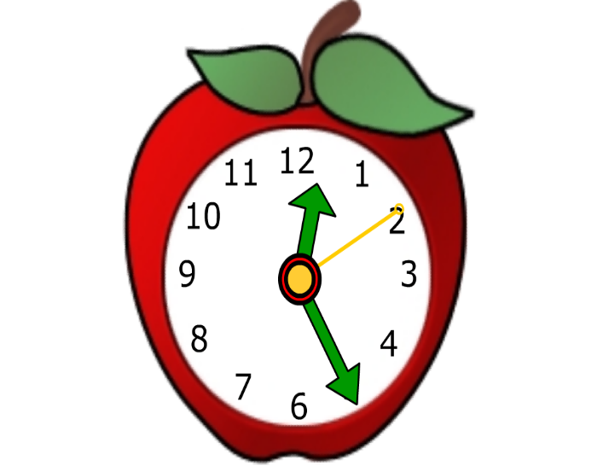
Next Steps
Start School Later committee to present at a School Committee meeting early 2017
Second community forum scheduled for March 2017 with guest speaker Dr. Judith Owens – other communities will be welcome
Committee has reached a consensus for a change in the 2018-2019 school year – as long as logistics can be worked out
Second survey will be administered to staff, students and community in April 2017

