Slide 1
Establishing a Positive Behavioral Support Model and code of conduct
M.A.S.S. Executive Institute, 2016

Slide 2

Who we are
Judy Paolucci Tina Boss
Superintendent Principal
Ashley Niggl Laura Stuart (not available)
School Psychologist BCBA
Paul McCarthy
School Committee Chairman
Notes:
When we introduce each other we will focus on the role we have.
Superintendent - leader, ultimately responsible for safety, effectiveness, and finances of the school dept.
Principal - responsible for the safety of the children in the school
School psychologist - refer to sheet in folder to explain role.
BCBA - refer to sheet in folder to explain role…. Ashley can explain this.
SC - Responsible for policies and budget in support of the school department.

Slide 3
Our focus for today
Leicester’s Story
Traditional Discipline / Massachusetts Laws
New Solutions
  A New Paradigm for Discipline
  Overcoming Challenges
    Staffing
    Programs
    Space
    Training
Communication, communication, communication
Notes:
Judy

Slide 4

What’s Leicester’s Story?
1
Increasing behavior issues, especially at lower grades
Growing student disengagement
Need to adjust practice due to new laws
Parental discontent reaches tipping point
Notes:
Tina

Slide 5
“Leicester Elementary School not Punishing Savage kids”
Turtle Boy Blog, March 2016
Notes:
tina

Slide 6
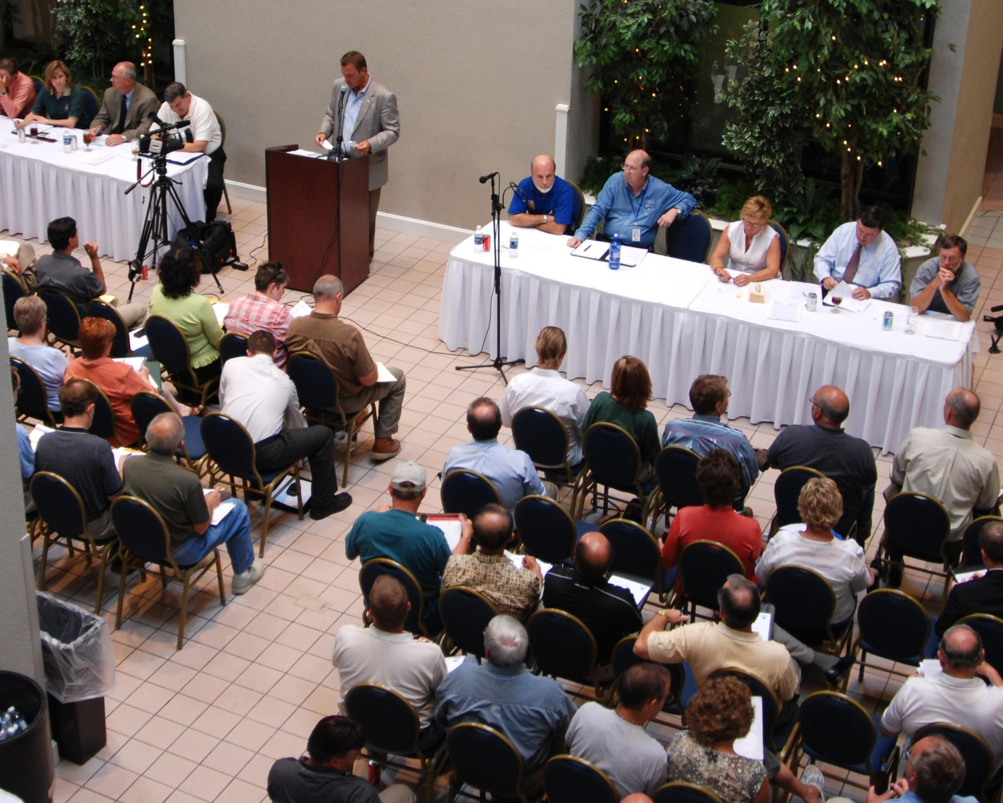
Leicester School Committee Meeting, February 2016
Notes:
Paul will discuss what happened at the SC meeting, highlighting the following point:
There is a Public Comment Period at our SC meetings, however, the chair ultimately has the right to call on anyone they want. Mistake - belief that everyone has a right to be heard.

Slide 7
Hindsight
Next Steps
Articulate clear rules for public comment period
Who can speak
Chair role
SC articulate next steps
Amend policy for public comment period & Code of Conduct
Budget adjustments to support staffing needed for school
Notes:
Paul

Slide 8
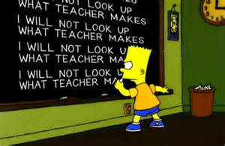
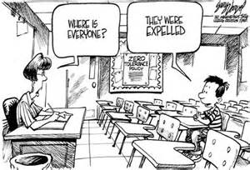
2.
Traditional discipline
And Massachusetts Law
Understanding why what we grew up with doesn’t work very well anymore.
Notes:
Judy

Slide 9
Traditional
Paradigm
Wrongdoings are violations against the rules: what rules have been broken?
Blame must be apportioned: who did it?
Punishment must be imposed: what do they deserve?
Notes:
Judy

Slide 10
School discipline statistics
Students suspended or expelled are nearly 3 times more likely to be in contact with the juvenile justice system the following year. (Community Matters)
Harsh discipline contributes to a sense of disconnect in the school environment, resulting, in turn, to an INCREASE in bad behaviors (Blum, McNeeley & Rinehart, 2002)
If our goal is to DECREASE bad behaviors, we need to do something different.
Notes:
Judy

Slide 11
Discipline laws and regulations
Massachusetts Statutes
  M.G.L. c.71, §37H
  M.G.L. c.71, §37H ½
  M.G.L. c.71, §37H ¾ (as of 7/1/14)
  M.G.L. c.76, §17
  M.G.L. c.76, §16
  M.G.L. c.76, §21(as of 7/1/14)
Massachusetts Regulations
  603 CMR 53.00
Federal Statutes
  The Individuals with Disabilities Education Act (IDEA)
  Section 504 of the Rehabilitation Act of 1973
Federal Regulations
  34 CFR §300.530-537
Notes:
Judy (refer to handout in folders)

Slide 12
Reducing or Eliminating suspensions without providing alternates
Recipe for disaster
=
Notes:
Judy

Slide 13
3.
Investigating & implementing new solutions: PBIS
Working with the May Institute
Staff and community buy-in
Visits to PBIS Schools
Notes:
Tina

Slide 14
New discipline
Paradigm
Behavior, like academics, must be taught.
Positive behavior should be acknowledged.
A positive school culture must be actively nurtured.
Wrongdoings are violations of people and relationships.
Harm and relationships must be repaired.
Notes:
Tina

Slide 15
Key ideas of new discipline paradigm
(whether it is focused on restorative practices, responsive classroom, engaging schools, or PBIS)
Proactively work on creating a positive school climate
Take deliberate steps to nurture strong relationships among and between students and staff
Recognize good behavior
Develop students social/emotional & conflict resolution skills
As part of discipline, restore relationships and engagement.
Provide individualized support for identified students.
Notes:
Tina

Slide 16
Positive behavioral interventions and supports
Supported by training from the May Institute
Process for teaching children appropriate behavior & providing the supports to sustain that behavior
Proactive, positive, & consistent across all settings
Improves academic achievement & social competence
Data is collected and used
System of interventions applied, similar to academics
Notes:
Ashley

Slide 17
School discipline processes bring people back into relationship with the school community rather than cause further separation
Notes:
Ashley

Slide 18
“If a child doesn’t know how to read, we teach.”
“If a child doesn’t know how to swim, we teach.”
“If a child doesn’t know how to multiply, we teach.”
“If a child doesn’t know how to drive, we teach.”
“If a child doesn’t know how to behave, we… …teach? …punish?”
“Why can’t we finish the last sentence as automatically as we do the others?”
(Herner, 1998)
Notes:
Ashley

Slide 19



Designing School-Wide Systems for Student Success
Intensive, Individual Interventions
Individual Students
Assessment-based
High Intensity
Intensive, Individual Interventions
Individual Students
Assessment-based
Intense, durable procedures
Targeted Group Interventions
Some students (at-risk)
High efficiency
Rapid response
Targeted Group Interventions
Some students (at-risk)
High efficiency
Rapid response
Universal Interventions
All students
Preventive, proactive
Universal Interventions
All settings, all students
Preventive, proactive
Academic Systems
Behavioral Systems
Notes:
Ashley

Slide 20
Expectations Matrix
Memorial School Behavioral Expectations:
https://docs.google.com/a/lpsma.net/spreadsheets/d/1gRWZ09vaxErgW0WW3yIqlKqK8H-JCNOCfYq8rvtARi0/edit?usp=sharing
Primary School Behavioral Expectations:
https://docs.google.com/document/d/1BQmgs2DsKL1LEn6EmUCMoH1QxfgDcMC3ODJQt491ioM/edit?usp=sharing
Notes:
Tina

Slide 21
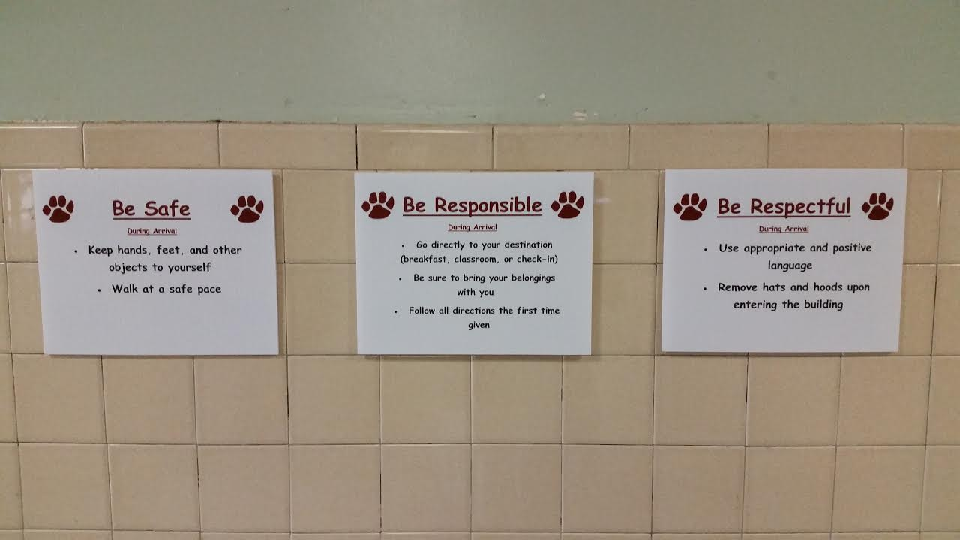
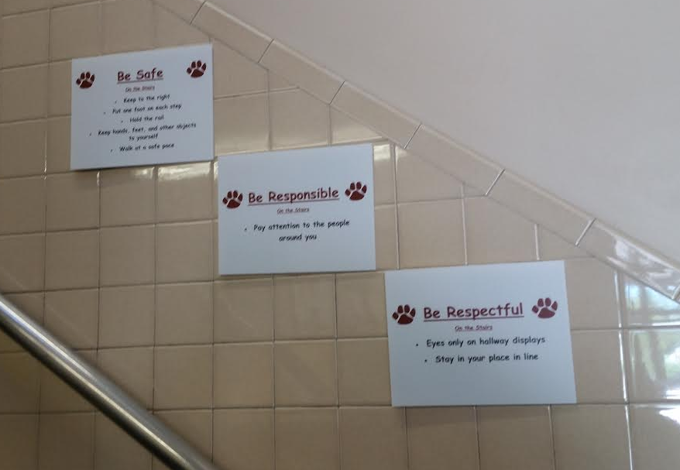
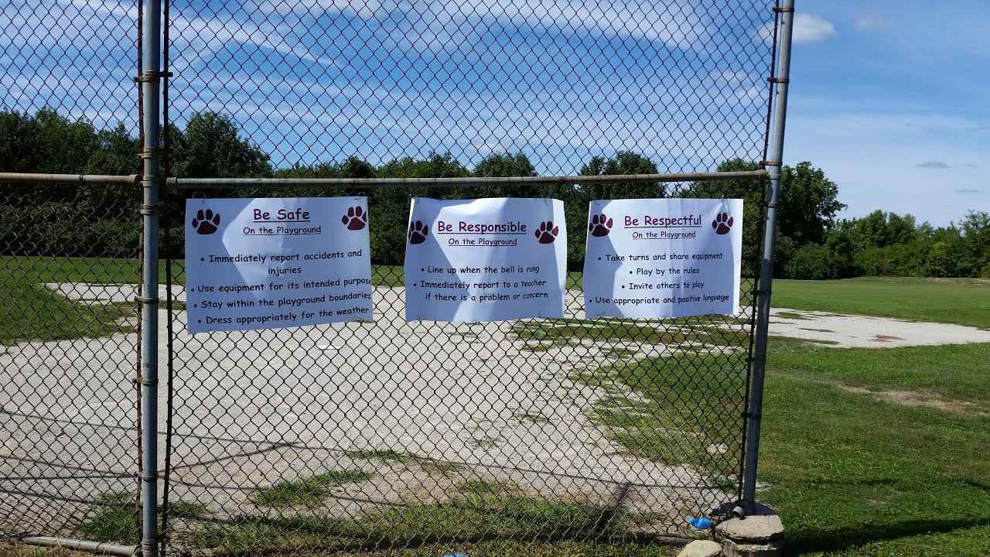
Expectations posted in all school areas
Notes:
Tina

Slide 22
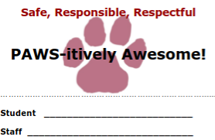
Acknowledging & recognizing good behaviors
Verbal Praise
  Based on specific behavior
Nonverbal Praise
  Done immediately after behavior
Public Acknowledgement
Notes:
Tina

Slide 23
Failure (punishment)
Success (reinforcement)
5
4 : 1
Notes:
Tina

Slide 24
4.
Ensuring success
Space needs
Communication
Staffing
Communication
Policies
Changes in staffing, training, space, and thinking
Training
Thinking
Communication
Notes:
Judy

Slide 25
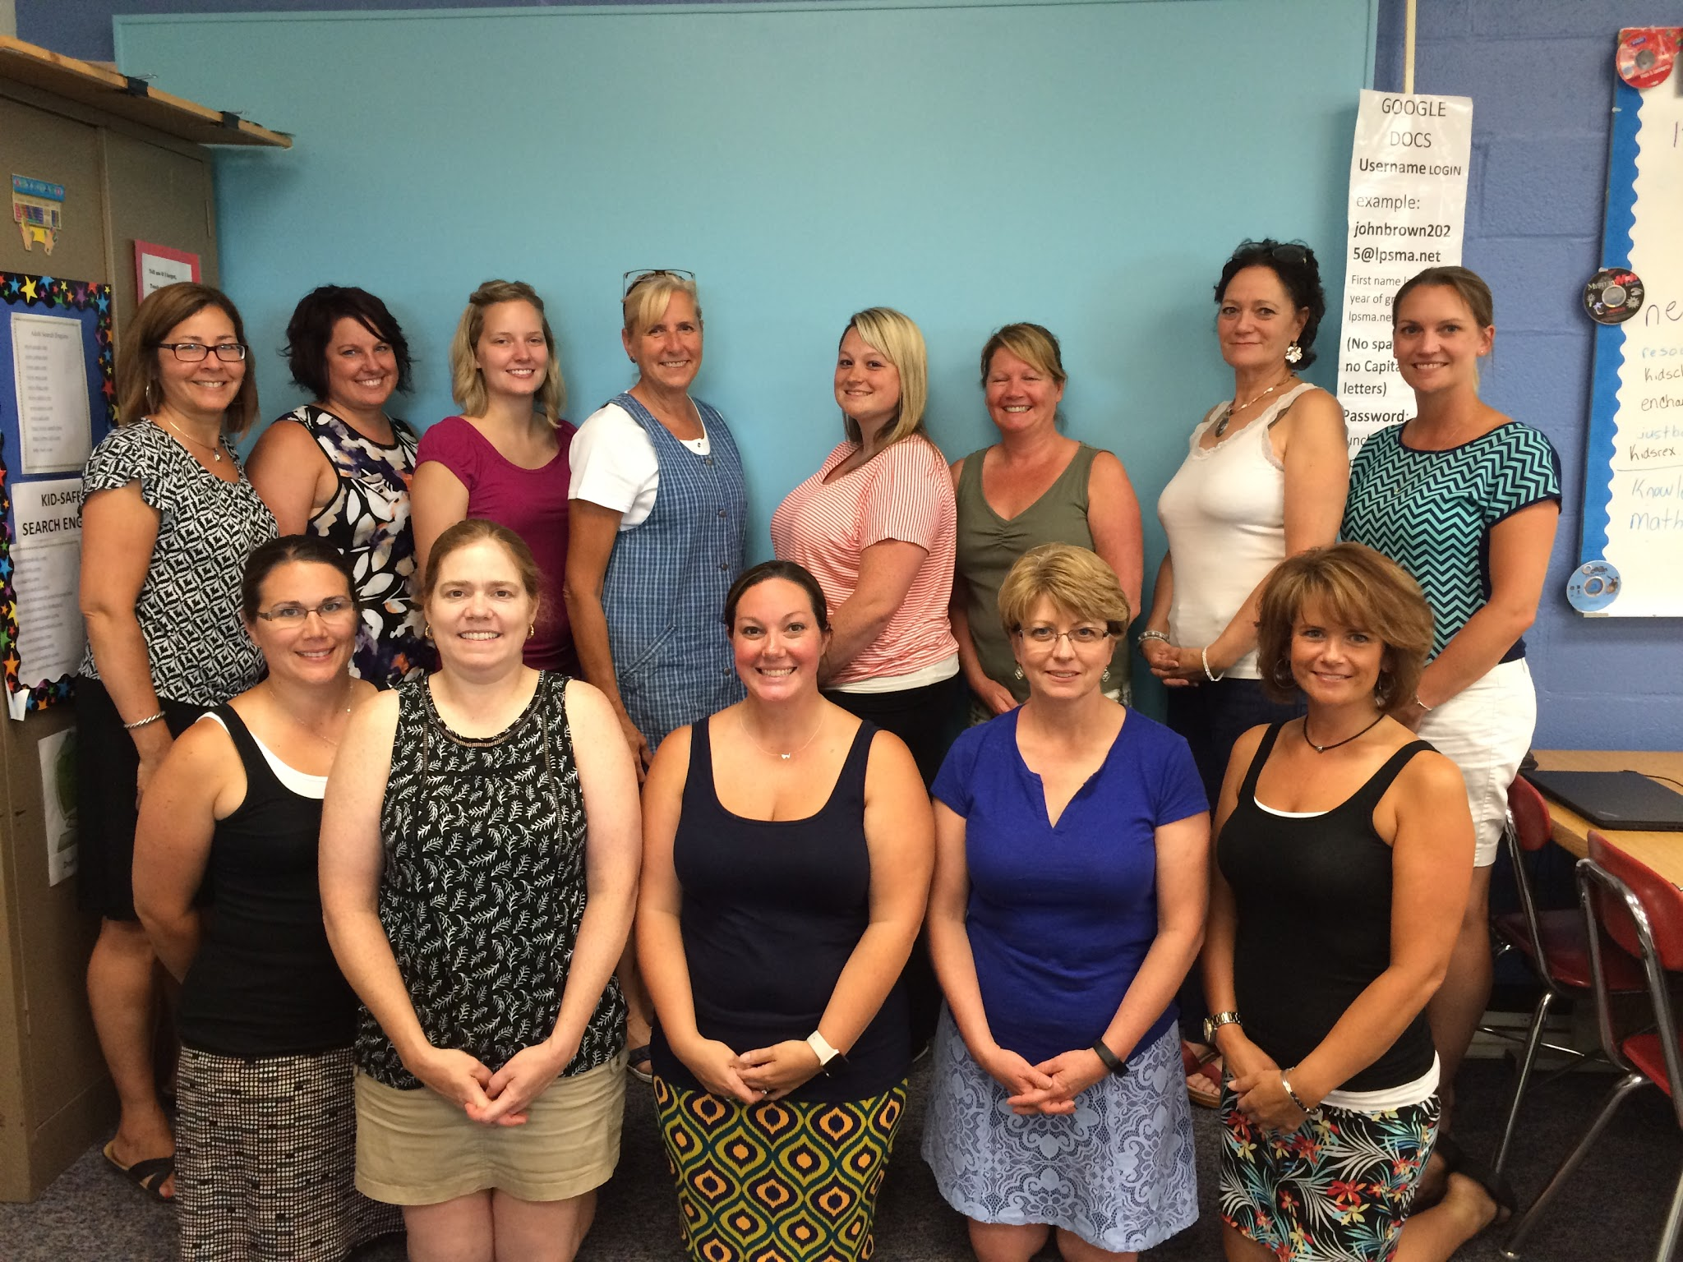

Our Team - A Key for success
Notes:
Judy

Slide 26
Maintaining a consistent focus
Build Community
Support Academic and Professional Goals
Promote Social Emotional Learning
Respond to Conflict or Issues
Notes:
Judy

Slide 27
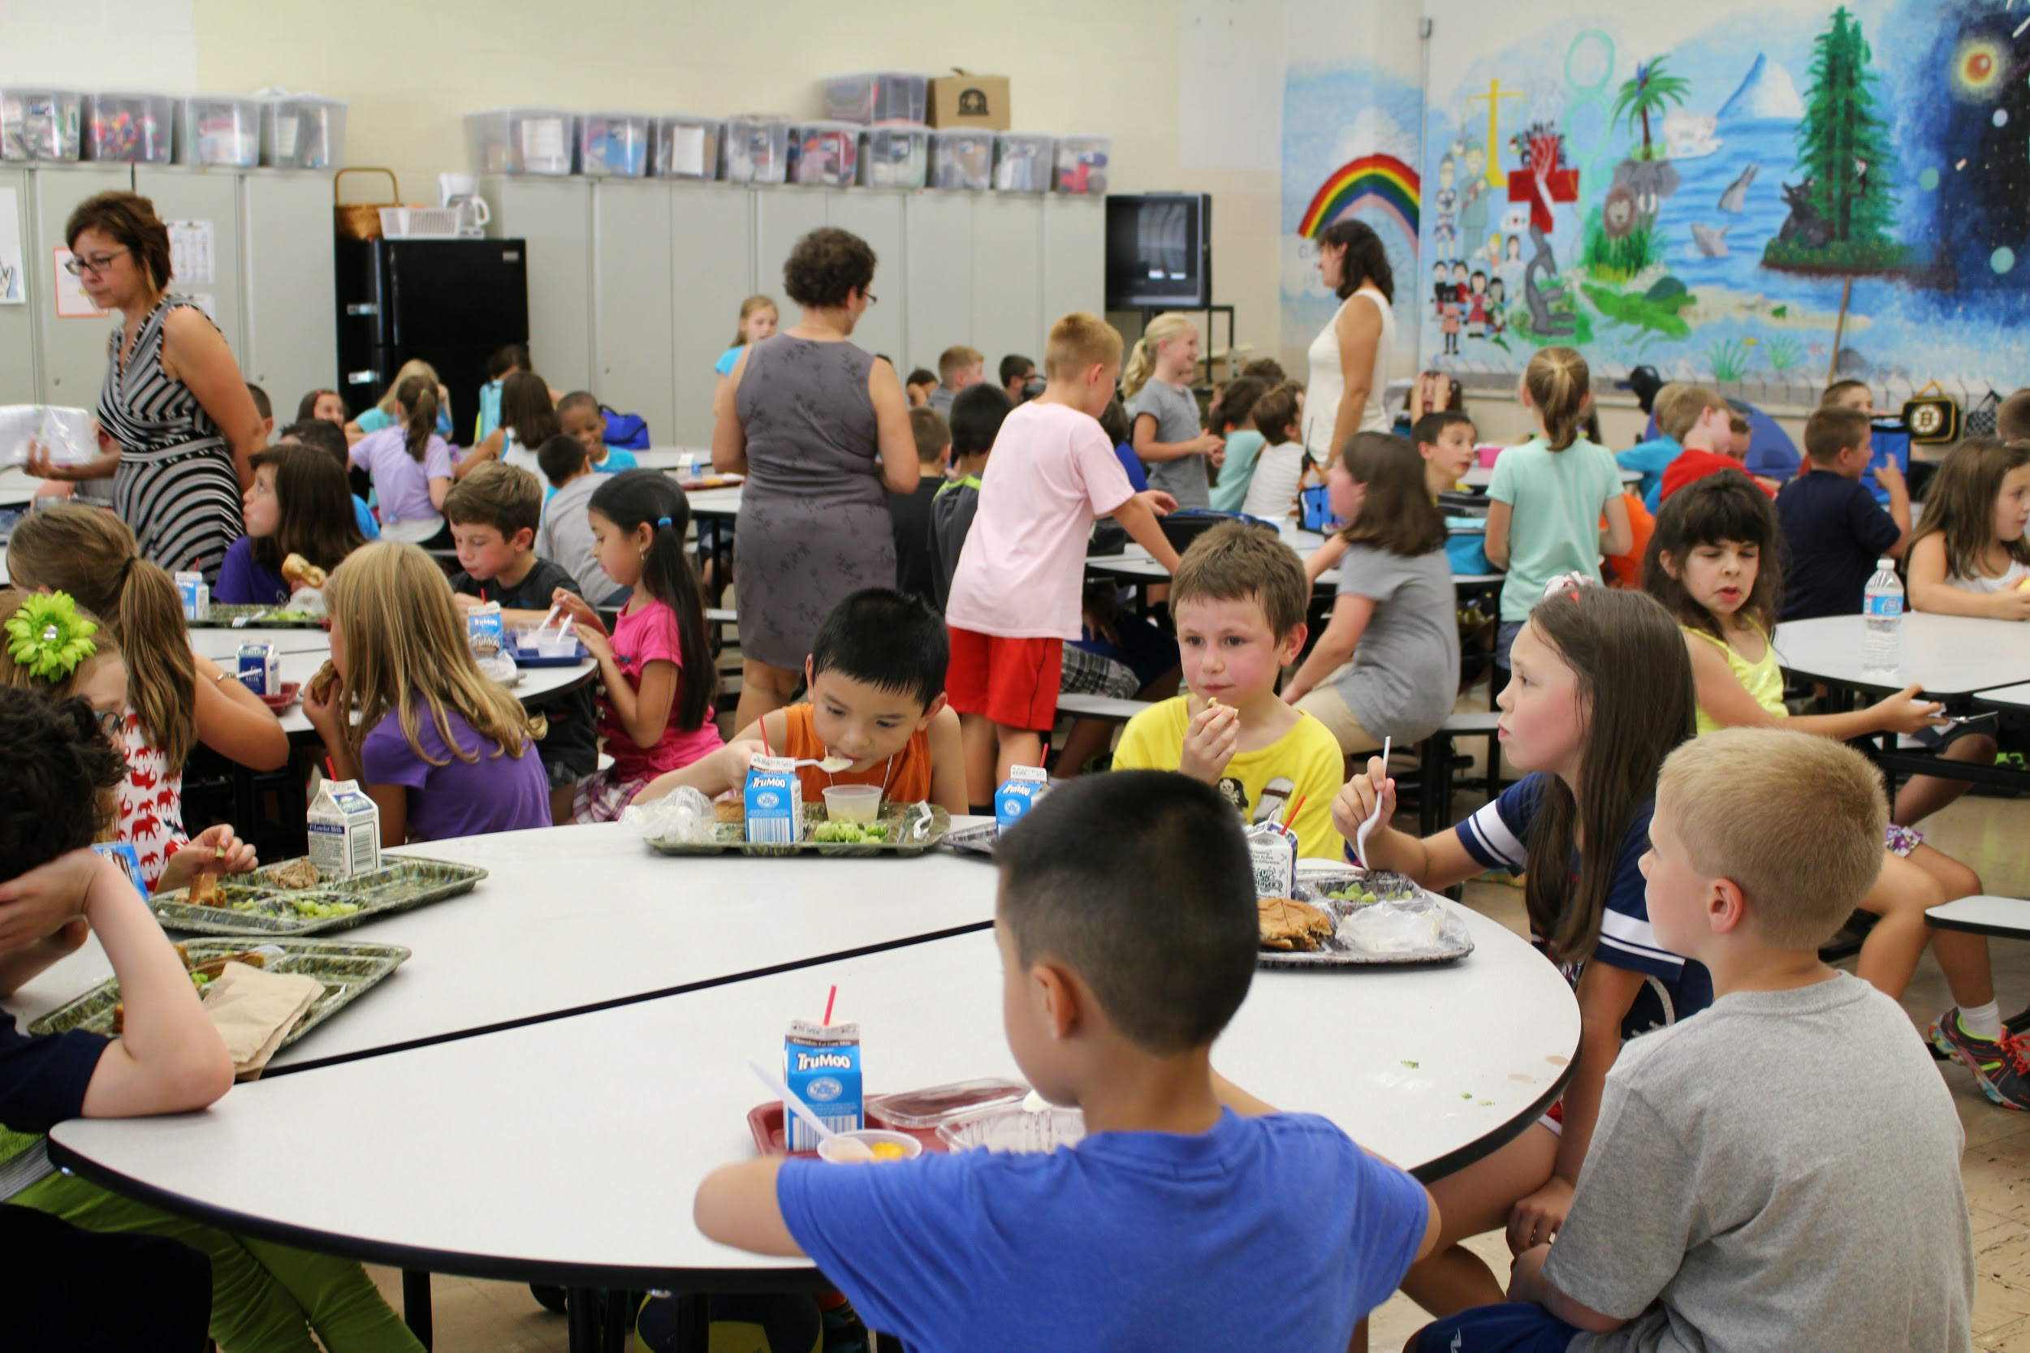
Building community and social connectedness
Notes:
Judy

Slide 28
Code of conduct task force
Policies
Models
Syracuse (developed with help from Engaging Classrooms)
Duval County, FL
Members
Superintendent
Director of Curriculum
School Principals (4)
School Assistant Principals (3)
Teachers (2)
Parents (4)
2 School Committee Members
Process
Meetings twice a month
Sharing models, laws, goals
Dividing into 2 groups, sharing, SC approval
Notes:
Paul

Slide 29
Adequate resources for staffing
Team Chair, shared between Primary & Memorial Schools allows school psychologist to focus on social emotional learning and support
Board Certified Behavioral Analyst (BCBA), develops behavior plans & helps teachers improve response to behavior
School Psychologist, to focus on social emotional learning and support
Notes:
Paul

Slide 30

Communication
Communication
Notes:
Judy

Slide 31
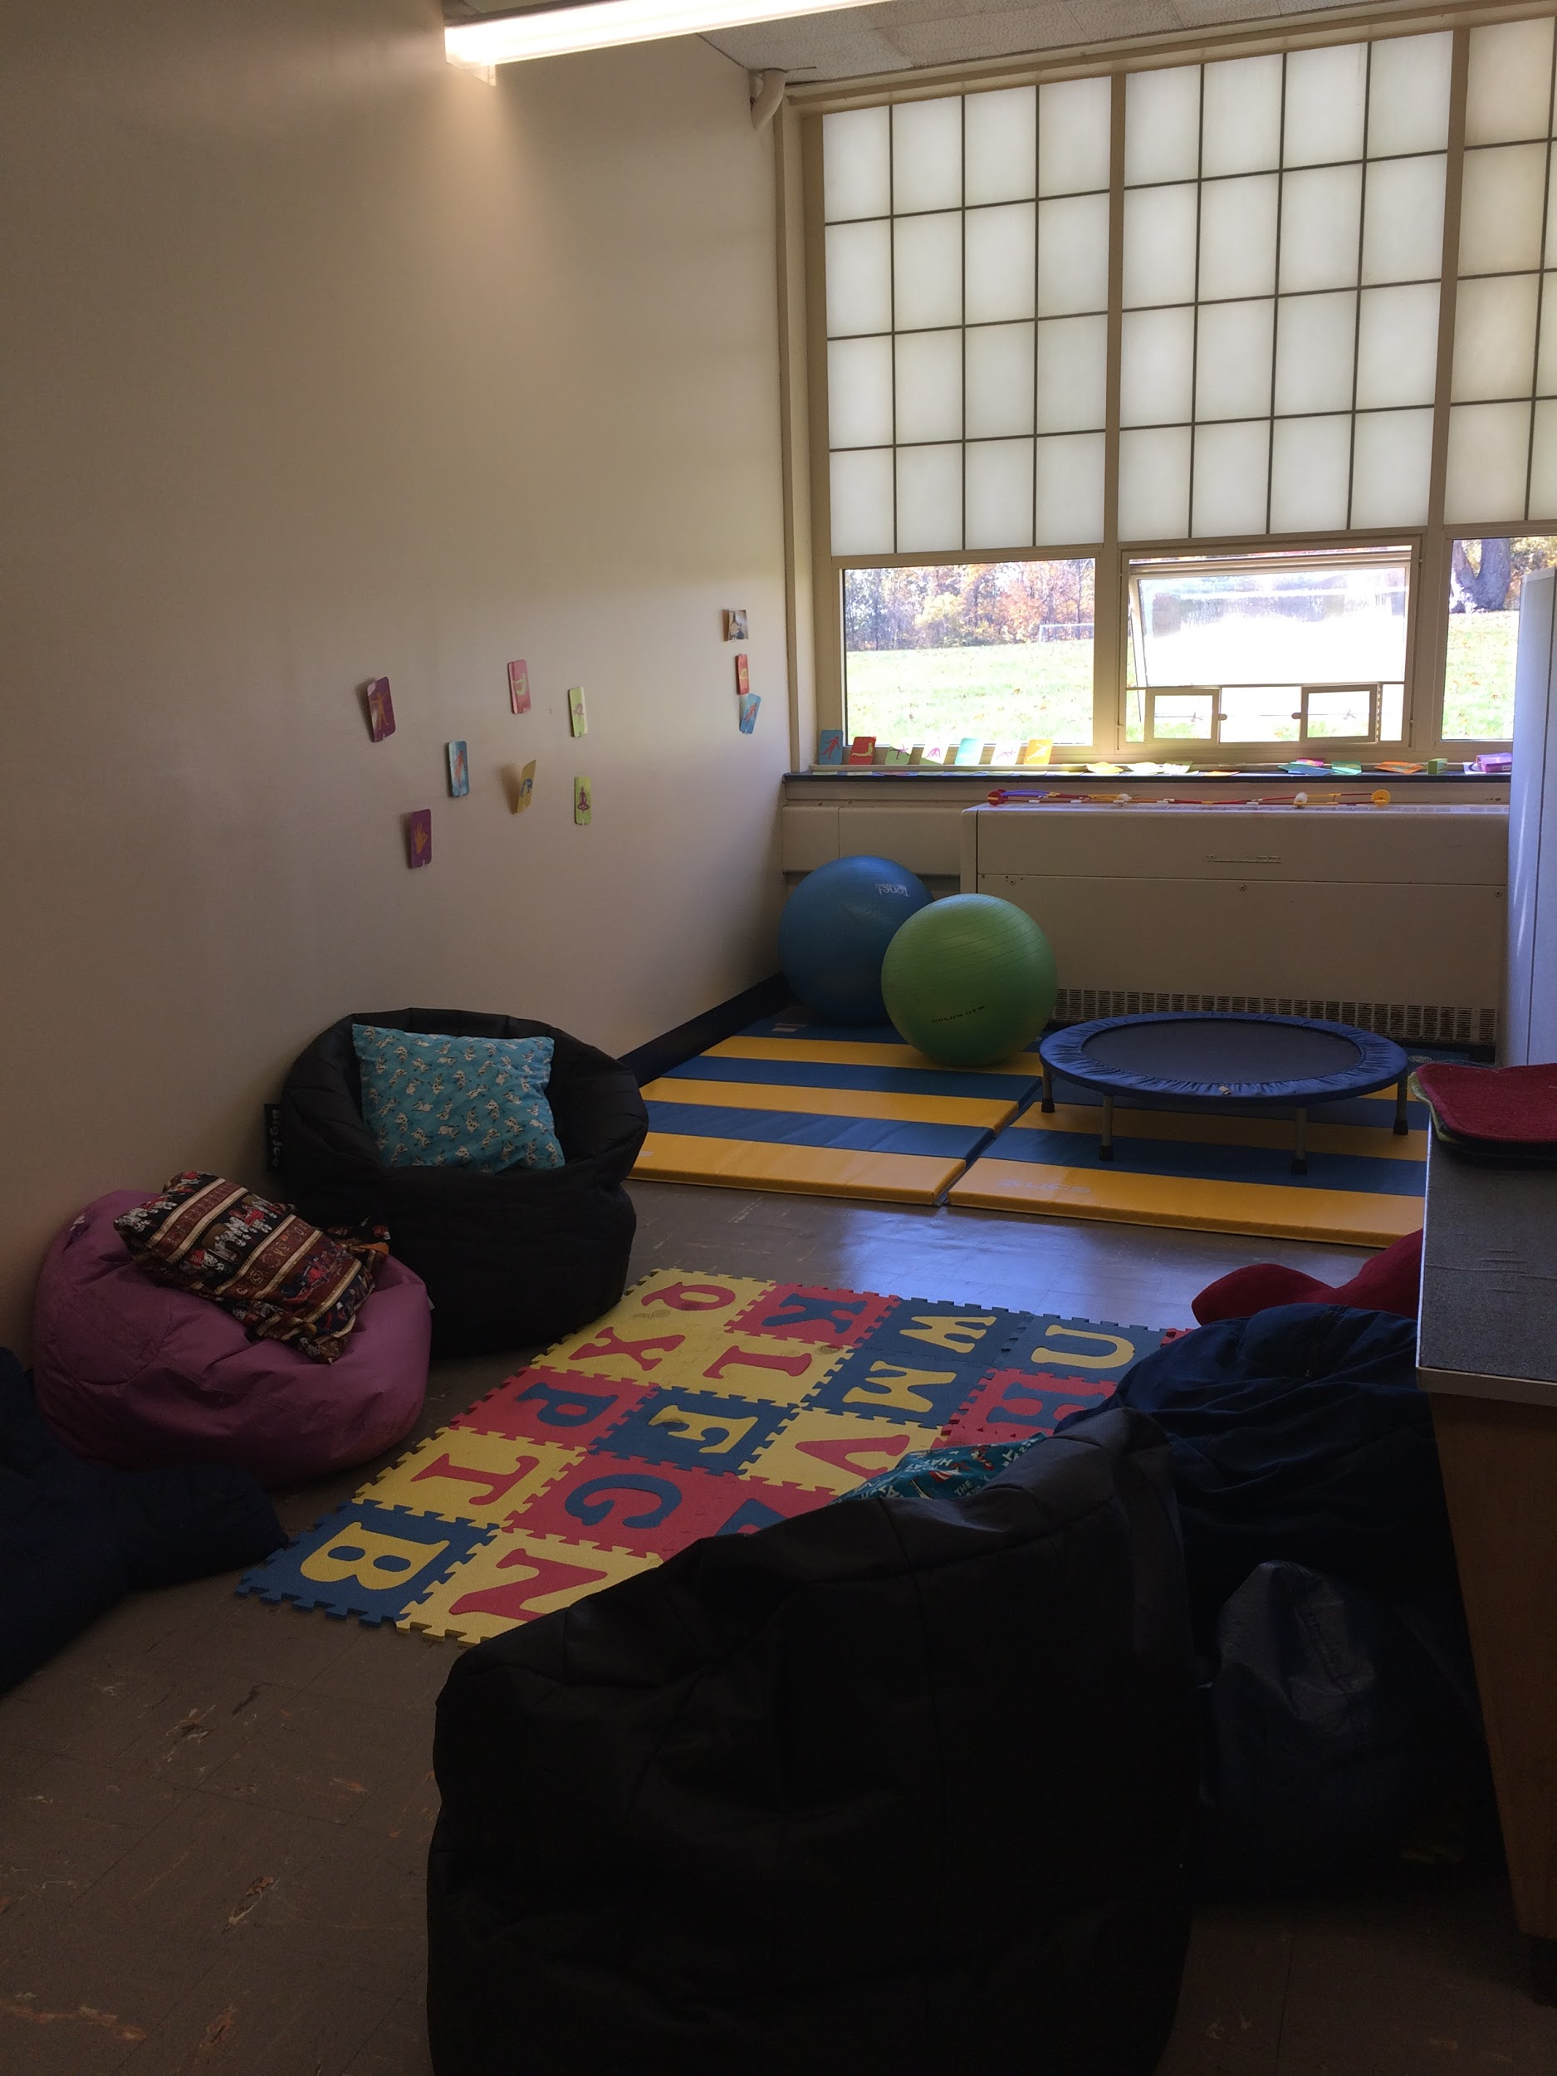
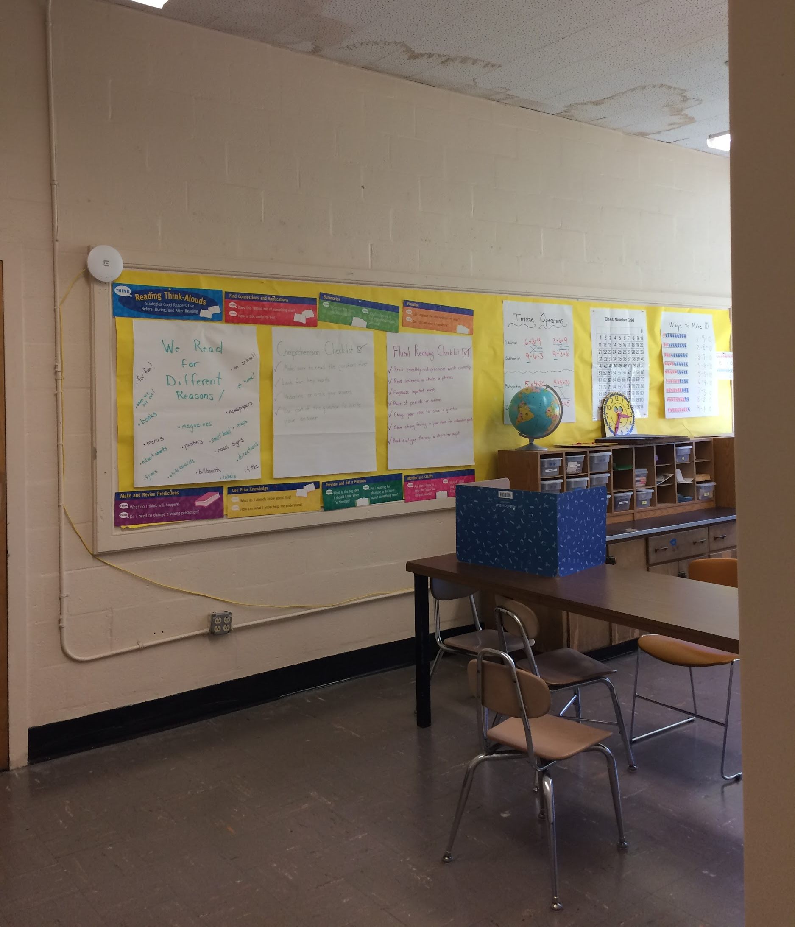
Ensuring Appropriate Space Should Not Be Overlooked!
Notes:
Ashley

Slide 32
Support
Low → High
Changing thinking about discipline
Place your screenshot here
To (Authorative) | With (Restorative)
Not (Negligent) | For (Permissive)
Control/Expectations
Low → High
Notes:
Tina

Slide 33
5.
Connections to the work of our secondary schools
Notes:
Judy

Slide 34
NESDEC-Sponsored Workshop with Community Matters
Strategies for Successful Implementation of Restorative Practices: Leading the Change
19 Middle or High Schools
Full day Workshop on Restorative Practices Basics
Concept - If we can establish a cohort of schools employing these methods, we increase our collective likelihood of success.
Notes:
Judy

Slide 35

Follow-up with engaging Schools for LMS
Local
23 Garden Street Cambridge, MA 02138
Notes:
Judy

Slide 36
Help is just a click away
www.pbis.org
www.pbisworld.com/
https://www.responsiveclassroom.org
http://engagingschools.org
http://community-matters.org
www.Casel.org
www.leicester.k12.ma.us
http://lpspolicies.wikispaces.com/home
Notes:
Judy

