Slide 1
Improving Early Education for All Students
Massachusetts Association of School Committees/ Massachusetts Association of School Superintendents Joint Conference
November 5, 2015

Slide 2
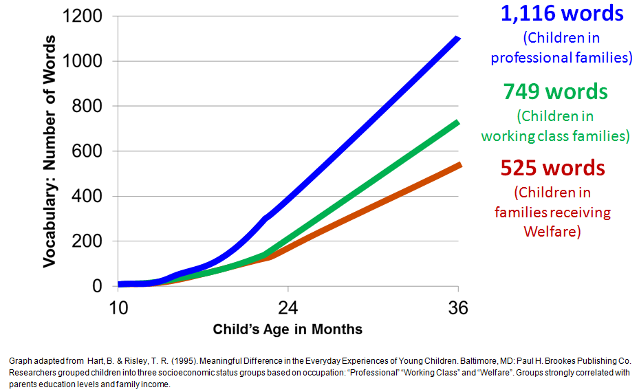
Why Early Education Matters
Massachusetts students continue to lead their peers on national and international measures of student achievement.
However, there are still persistent achievement gaps that disproportionally affect students in lower-income communities, English language learners, students with disabilities and students of color.
Vocabulary gaps by household occupational status can be seen early:
Third grade literacy proficiency is an important predictor of a child’s future academic success.
Providing access to high-quality early education programs is a vital component of addressing the achievement gap.
Notes:
Data show that 3/4 of children who struggle with reading in 3rd Grade will continue to struggle academically through their educational careers.

Slide 3
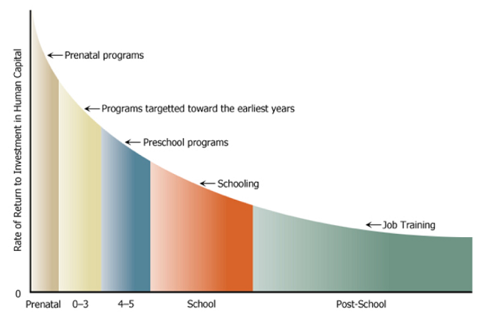
Investing Early Makes Economic Sense
Research suggests greater ROI the earlier the investment
Investment in early ed yields positive return in savings on education, crime and welfare spending; increased taxes on earnings*
Investment of $15K/child returned total public benefit of $195K/child*
Graph Source: Heckman, James (2008) “Schools, Skills, and Synapses” Available online at: https://heckman.uchicago.edu/sites/heckman2013.uchicago.edu/files/uploads/Heckman_2008_Schools%20skills%20and%20synapses.pdf
*From “Lifetime Effects: The High/Scope Perry Preschool Study Through Age 40 (pp. 194–215), by Lawrence J. Schweinhart, Jeanne Montie, Zongping Xiang, W. Steven Barnett, Clive R. Belfield, & Milagros Nores, 2005, Ypsilanti, MI: High/Scope Press. © 2005 by High/Scope ® Educational Research Foundation. Available at: http://www.highscope.org/file/Research/PerryProject/specialsummary_rev2011_02_2.pdf
Notes:
The earliest years of a child's life are the most formative in terms of their overall growth and development making it an opportune time for supporting their learning.
It's much harder and more costly to play a game of catch up later.

Slide 4
EEC State Budget History
Total amounts are adjusted for PACs.

Slide 5
FY16 EEC Budget

Slide 6
Children Served By EEC
EEC subsidizes approximately 18K preschool age children per month.
Current preschool waitlist is approximately 6,000 children.

Slide 7
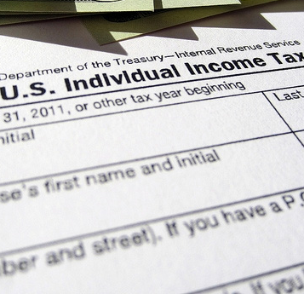
EEC Subsidy Funding Types
Department of Children and Families (DCF) Child Care
Families are referred based on open protective service cases
Type: Contracted slots
Served: Approx. 7K monthly
Department of Transitional Assistance (DTA) Child Care
Families must participate in Employment Services Program
Type: Vouchers
Served: Approx. 14.5K monthly
Immediate Access
Income-Eligible Child Care
Financial assistance for low-income families with a service need. First come/first served.
Type: Vouchers & Contracted slots
Served: Approx. 35K monthly

Slide 8
Subsidy Caseload Over Time*
Transitional Child Care (subsidies for DTA involved families) decreased from 15,847 in FY10 to 14,534 in FY15.
Supportive Child Care (subsidies for DCF involved families) increased from 6,158 in FY10 to 7,132 in FY15.
Income Eligible Child Care (subsidies for low-income families) increased from 29,118 in FY10 to 33,454 in FY15.
In addition, EEC served 2,617 new children in FY14 and 2,105 new children in FY15 through $30M waitlist remediation funding ($15M per fiscal year). EEC expects to serve an additional 2,000 with $12M in FY16.
*Figures are average number of children served monthly.

Slide 9
Additional Federal Support
We have also sought federal funding to help our programs attain and maintain high quality levels, and to help families in need to access these programs.
$23.97 million CCDF discretionary obligation through the American Recovery and Reinvestment Act of 2009 (ARRA)
Funds served additional children and families as well as new families, and supported program quality improvements
$50M Early Learning Challenge grant to strengthen the state’s comprehensive early childhood system (2012-15)
Grant is supporting program quality improvements
Goal is to ensure that all children, especially those who are high needs, have a solid foundation for school and life success
$30M over two years through the federal Preschool Expansion Grant program (potential for $60M total over four years)
Increase the quality of preschool programs and related services, and their effectiveness in terms of child outcomes
Increase number of 4 year-olds enrolled in high quality preschool

Slide 10
Federal Preschool Expansion Grant
The Preschool Expansion Grant (PEG) supports Massachusetts' efforts to increase families' access to high-quality preschool and achieve improved outcomes for children.
Public schools are partnering with community-based early education and care programs licensed by EEC to increase each community's capacity to provide high-quality preschool opportunities to four year olds in their respective communities.
The partnerships focus on collaborating in key areas that support the delivery of high quality programs and services for children and families, including:
Smaller class size and teacher/child ratios
Inclusive instruction and settings
Attaining/maintaining NAEYC program accreditation and/or QRIS Level 3 or higher
Educator professional development including coaching, mentoring, and professional learning communities
Teacher compensation aligned with public school salaries
Data and assessments to inform strategic planning and measure benefits to children
Family engagement
Comprehensive services
Transition to preschool and Kindergarten; alignment with birth to 3rd grade systems
PEG goal: Develop replicable and sustainable model for other districts. EEC is conducting a longitudinal study that assesses the impact of the PEG on children.
EEC is reviewing research bids to evaluate PEG implementation, impacts and costs, and to provide formative feedback to grantees to support on-going quality improvement.

Slide 11
Workforce Compensation
Current compensation structure for family/center-based early educators does not match that for public (preK) school educators.
Family child care provider median salary: $25,001 - $27,500*
Center-based educator median salary: $22,501 - $25,000*
Public school educator avg. starting salary in MA: $40,462**
An estimated 30% of the family/center-based early educator workforce attrits annually.***
Salaries and benefits are the most significant operation costs for programs
*The Massachusetts Career Ladder and Early Educator Compensation Reform, May 2013. The Bessie Tart Wilson Initiative for Children.
**2011-2012 Average Starting Teacher Salaries by State. National Education Association. http://www.nea.org/home/2011-2012-average-starting-teacher-salary.html
Preparing the Early Education and Care Workforce: The Capacity of Massachusetts’ Intuitions of Higher Education, 2005. The Wellesley Centers for Women. http://www.wcwonline.org/pdf/capacityexecsum.pdf
Notes:
Legislative Commission findings and recommendations:
EEC doesn’t have data on the true cost of child care
Consideration for options for supplemental incentives for early educators, including increased support for higher education should be explored.
The potential of developing a formula for determining early educators’ salaries that would directly tie quality to higher compensation should also be explored.
Consideration of the median salary for educators in public preschool programs as benchmarks in the development of recommended compensation levels associated with Massachusetts' career ladder and QRIS professional qualification standards, both of which are intended to move educators to comparable levels of higher education.

Slide 12
Commonwealth Preschool Partnership
Preschool Expansion Planning Grants
EEC received FY16 state funding for a new planning grant opportunity for communities to develop local partnership models for expanding preschool to children ages 2.9 through Kindergarten entry from low-income families.
EEC intends to award ten grants of up to $50,000 per community.
Applications must represent a partnership between a public school district (LEA) and at least two EEC-licensed early learning providers.
Eligible applicants are cities, towns, regional school districts or educational collaboratives currently providing pre-kindergarten or preschool opportunities.
The grant funds must be used to implement a strategic planning process to identify leadership, program design and resources needed to develop a preschool expansion partnership model based on the design of the U. S. Department of Education's Preschool Expansion Grant program.

