Slide 1
Help is on the way!
Help is on the way!
Improving Students, Teachers and Administrators’
IT Experience through Managed Services
Bob Murphy
Business Development Executive
rmurphy@eplus.com
781-615-1308

Slide 2
Today’s Agenda
Technology in Today’s World of Education
Challenges supporting today’s technology requirements
Managed Services: Just what is it?
Benefits of Managed Services
What to look for in a Managed Services Provider
Who’s using it
Summary
Notes:
Use this slide to set the tone/pace of your meeting. Lead with an exploration of the customer’s needs and business situation so you can customize the presentation to address their specific challenges.
Ask about their focus areas of business results and desired outcomes.
Discuss major industry trends and emerging technology potential, if applicable.
Make sure to itemize the key elements you intend to cover, that specifically map to the customer/prospect opportunity.
DO NOT LEAVE THIS SLIDE BLANK OR DELETE.

Slide 3
Today’s World
Technology is a requirement not an option
Technology is integrated into all aspects of education from classroom to administration
Technology is a foundation of the learning process
Today’s students have grown up in a connected world

Slide 4
Challenges Supporting Technology
Rapidly changing requirements
Rapidly changing technology
Security
Limited funding
Prioritizing
Talent
Finding
Keeping
Training

Slide 5
Managed Services – Just what is it?
Managed services is a partnership with a third party IT organization, augmenting your existing IT support staff, that assumes the responsibility of providing a defined set of services.
Managing your network so that connectivity is always available
Managing your servers and applications so they are available whenever needed
Managing the security of your network to reduce the likelihood of intrusions and hacking
Managing your data so it is properly backed up and available for an emergency
Managing your phones so communication flows

Slide 6
Benefits of Managed Services
Predictability – SLA’s and Cost
Availability – 24 x 7 x 365 Access to Subject Matter Experts
Multiplicity – Team of engineers vs. limited staff
Stability – Process
Guidance – To validate or help create strategy
Visibility – Single Pane of Glass Management
Simplicity – Solution vs. Products ; Robust Toolbox
Improvement – Employee Retention and Job Satisfaction
Reduction – TCO – Average customer sees 30% savings (build vs. buy)
Focus – On the high value items to the school system

Slide 7
What to look for in a Managed Services Provider
People
Process
Tools
Each is critical to achieve the desired outcome

Slide 8
Who’s Using Managed Services
MA School District with 10K students and 16 facilities
Challenge
New phone system being installed
No in-house expertise to support it
Current staff strained
Has open reqs to add to staff
Why Managed Services
Experts to augment 3 person staff
24x7x365 proactive support
High availability = user satisfaction
Predictable expense factored into annual budget

Slide 9
Town of Framingham
Why Managed Services
Limited staff and skills
Difficult to find and retain talent for what they can pay
Needs 24x7 support
Phones: Police and Fire
On-line customer services
Benefits
Employee retention
Customer satisfaction through availability and reliability
Expert staff to augment theirs 24x7
Predictable expense factored into annual budget

Slide 10
Summary
Technology is fully integrated into the learning process and administration
Availability must be there as is your dial tone
IT staffs are strained
Turnover
Complex technology
Rapid changes
Security vulnerability
Managed Services can augment and improve -
Support 24x7x365
Availability – proactive support
Performance
Cost – predictable

Slide 11
Thank You!

Slide 12
What to look for in a Managed Services Provider
What is their monitoring tool?
Leading provider or home grown?
What ticketing system is used?
How are you notified?
How do you report issues?
How do you get visibility into performance and issues?
Is there a portal or dashboard?
What type of reporting is provided?
Tools

Slide 13
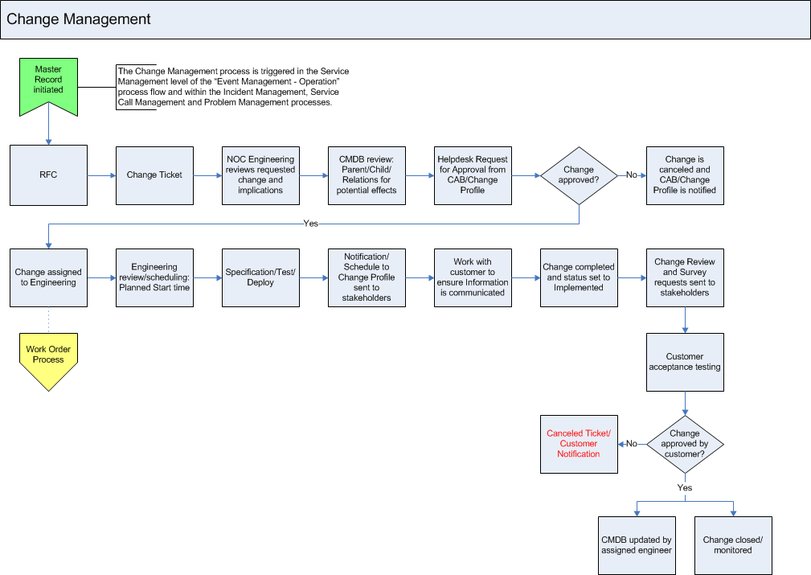
What to look for in a Managed Services Provider
Information Technology Infrastructure Library or ITIL
Documented set of processes to ensure IT meets the needs of the business
Process

Slide 14
What to look for in a Managed Services Provider
How many per shift?
Level 1
Level 2
Level 3
Length of experience?
What certifications are held?
Where are they located?

