Slide 1
Who is Being Served by Massachusetts Commonwealth Charter Schools October 2015
© 2015, Massachusetts Association of School Committees.

Slide 2
Key Findings
Commonwealth charter schools are publicly-funded schools governed by an independent Board with no connections to the local school committee. Commonwealth charters operate under a five-year charter granted by the Commonwealth’s Board of Elementary and Secondary Education. From 2009-10 through 2013-14, Commonwealth charter schools:
Educate Different Students with Disabilities than District Schools. At least 85 percent of charter school SWD receive special education services through full inclusion programs. Sixty-five percent of district school SWD are in full inclusion programs, 20 percent in partial inclusion, nine percent in substantially separate programs, and six percent in out-of-district placements.
Educate Fewer English Language Learners than District Schools. While charters are seeing growth in the ELLs enrolled, this is eclipsed by the increases seen in district schools. In Boston charter schools, 40 percent of the ELLs are enrolled in one charter school and the remaining 60 percent are enrolled in the other 18 charters in the city.
Educate Fewer Students Living in Poverty in Non-Urban Charters. The percentage of non-urban charters low-income students in non-urban charters is 25 to 50 percent below that of their sending districts. Some “high performing” charters may be successful as a result of enrolling smaller percentages of poor students.
Lose Parental Support. Parental choice applies to decisions to enroll and to withdraw a child. Many charter parents withdraw their child, most often after only one or two years at the school. Even students who have passed the Grade 10 MCAS do not necessarily stay in the school through to Grade 12. Male students leave in higher numbers than female students.
Have Serious Enrollment Problems. All urban charters and non-urban elementary and high school charters have enrollment losses by both number and percentage of students from their initial enrollment year through to the final academic year of the school. This is a more pronounced problem in urban charters, especially in high school.
Favor Female Enrollment. Commonwealth charter schools enroll a disproportionately higher percentage of female students at all levels, but most notably in grades 9-12. A substantial body of research indicates that female students academically outperform their male peers in all subjects. According to Department of Elementary and Secondary Education data, males are twice as likely to be enrolled in special education programs and to be suspended from school as females.
Fail to Fill Empty Seats. The Achievement Gap Act of 2010 requires charters to fill empty seats from waitlists. Enrollment data indicates that this is not happening. Many charters have higher number of students in their lower grades than their upper grades .
Notes:
Glenn, Changes from the previous version:
Reordered the bullets so that there is a better – and more logical – flow.
Put a present tense verb at the beginning of each bullet.
Any changes to the content is in red below.
LOSE PARENT CHOICE SUPPORT. It would appear that While some parents may be be choosing to enroll their child in a charter school, many of these same parents are subsequently choosing to remove their child prior to the completion of the school’s academic program. Parents exercise their choice in accepting an offer for their child to attend such charter school. Parents then exercise their choice by taking their child out of the charter school. Even students who have successfully taken and passed Grade 10 MCAS do not necessarily stay in the school until graduation. Males students leave charters at a higher rate than female students.
BACK FILLING EMPTY SEATS. Despite the statutory language of the 2010 Act to Narrow the Achievement Gaps that prohibits charters from filling empty seats of one grade cohort with students in lower grades, many of these schools appear to be doing just that. As a result, charters accept higher numbers of students into the initial grade and are always at their enrollment cap; thus, they get their full Chapter 70 aid allotment. Charters appear to build anticipated student attrition into their business model.

Slide 3
Recommendations
The Massachusetts Association of School Committees is committed to the education of all students, ages 3 through 21, in publicly-funded schools. MASC finds that false comparisons between the efficacy of charters over district schools raises serious questions about the data being used to advance a pro-charter agenda over a pro-public school agenda.
Based on the findings of this study, the MASC recommends the following legislative and regulatory changes.
Outcomes. Charter schools must be held to the same enrollment and outcomes standards as district schools.
Hold Harmless. District schools must be held harmless with regard to district, school and educator accountability when parents choose to withdraw their child from a charter school and enroll in a district school during or between academic years.
Charter Enrollment. Charter schools must make clear when reporting outcomes on state assessments the enrollment loss or gain within the grade level cohort of students tested.
English Language Learners. Charter schools that do not successfully serve the same percentage of English language learners as the sending district(s) may not be designated as a “proven provider.”
Students with Disabilities. Charter schools that do not successfully serve the same percentage of SWD in the categories of Specific Learning Disability, Communications Impairment and Autism as the sending district(s) may not be designated as a “proven provider.”
Students Living in Poverty. Charter schools that do not successfully serve the same percentage of low-income students as the sending district(s) may not be designated as a “proven provider.”
Proven Providers. The Commonwealth must develop a list of “proven providers” that meet all of the regulatory requirements. Providers that have not addressed each requirement may not be so designated.
District Enrollment. Superintendents must report annually to the Department the number of students enrolling in the district from charters, including: gender, disability status, ELL status, poverty status, and any learning gaps identified by district staff.
Notes:
Glenn, Changes from the previous version:
Reordered the bullets so that there is a better – and more logical – flow.
Put a present tense verb at the beginning of each bullet.
Any changes to the content is in red below.
LOSE PARENT CHOICE SUPPORT. It would appear that While some parents may be be choosing to enroll their child in a charter school, many of these same parents are subsequently choosing to remove their child prior to the completion of the school’s academic program. Parents exercise their choice in accepting an offer for their child to attend such charter school. Parents then exercise their choice by taking their child out of the charter school. Even students who have successfully taken and passed Grade 10 MCAS do not necessarily stay in the school until graduation. Males students leave charters at a higher rate than female students.
BACK FILLING EMPTY SEATS. Despite the statutory language of the 2010 Act to Narrow the Achievement Gaps that prohibits charters from filling empty seats of one grade cohort with students in lower grades, many of these schools appear to be doing just that. As a result, charters accept higher numbers of students into the initial grade and are always at their enrollment cap; thus, they get their full Chapter 70 aid allotment. Charters appear to build anticipated student attrition into their business model.

Slide 4
Charter School Landscape
KEY ELEMENTS
Distribution and governance of Commonwealth charter schools Requirements of An Act Relative to the Achievement Gap (2010) with regard to student demographic equity and filling vacant seats Identifying the lowest performing school districts for the purpose of raising the charter cap

Slide 5
Location of Commonwealth Charters
Commonwealth charter schools are publicly financed schools operating under a five-year charter granted by the Commonwealth's Board of Elementary and Secondary Education. These schools are organized around a core mission, curriculum, theme, or teaching method described in the application to BESE. The school’s Board of Trustees controls the budget and the employment of administrators, teachers and staff. The school must demonstrate good results within five years or risk being put on probation or losing its charter.
Governing Body: Board of Trustees, generally a self-appointed membership including founders.
Student Admission: If more applicants than seats, entry is by lottery; consideration given to siblings of current students.
Funding: Per pupil funding from the sending district(s); charters may also receive grant funding from foundations and contributions from benefactors.
Districts with Charters: Fifty-two of the 71 Commonwealth charters are located in urban districts. Each of the following public school districts has one Commonwealth charter school: Adams, Barnstable, Chelsea, Chicopee, Devens, East Hampton, Everett, Fitchburg, Framingham, Franklin, Foxborough, Greenfield, Hadley, Harwich, Haverhill, Lynn, Malden, Marlborough, Marblehead, Martha's Vineyard, Newburyport, Norwell, Plymouth, Salem, Saugus, Somerville, South Hadley, Tyngsborough.

Slide 6
An Act Relative to Closing the Achievement Gap
Student Enrollment and Retention Plans
Commonwealth Charter Schools must within their application include:
a statement of equal educational opportunity that charter schools shall be open to all students, on a space available basis, and shall not discriminate on the basis of race, color, national origin, creed, sex, ethnicity, sexual orientation, mental or physical disability, age, ancestry, athletic performance, special need, proficiency in the English language or academic achievement;
a student recruitment and retention plan, including deliberate, specific strategies the school will use to ensure the provision of equal educational opportunity and to attract, enroll and retain a student population that, when compared to students in similar grades in schools from which the charter school is expected to enroll students, contains a comparable academic and demographic profile. The plan must
include, but not be limited to, a detailed description of deliberate, specific strategies the school will use to maximize the number of students who successfully complete all school requirements and prevent students from dropping out. The student recruitment and retention plan shall be updated annually and shall include annual goals for: (i) recruitment activities; (ii) student retention activities; and (iii) student retention.
plans for disseminating successes and innovations of the charter school to other non-charter public schools.

Slide 7
Non-Discrimination
A section of the Achievement Gaps Act attempts to establish the same standards for districts and charter schools with regard to the demographics of the students served.
Non-Discrimination: “Charter schools shall be open to all students, on a space available basis, and shall not discriminate on the basis of race, color, national origin, creed, sex, gender identity, ethnicity, sexual orientation, mental or physical disability, age, ancestry, athletic performance, special need, or proficiency in the English language or a foreign language or academic achievement.” MGL Chapter 71, Section 89.
However, five years after the law’s enactment, based on actual enrollment data provided by charter schools to the Department of Elementary and Secondary Education, it appears that certain student subgroups are still advantaged over other groups.
English language learners
Students with disabilities
Students living in poverty
Males

Slide 8
Filling Vacated Seats
A section of the Achievement Gaps Act of 2010 requires charters to fill vacated seats with students from the waitlist or to recruit additional students and disallows the filling of vacated seats in upper grades with additional students in lower grades.
Filling Vacant Seats: When a student stops attending a charter school for any reason, the charter school shall fill the vacancy with the next available student on the waitlist for the grade in which the vacancy occurs and shall continue through the waitlist until a student fills the vacant seat. If there is no waitlist, a charter school shall publicize an open seat to the students of the sending district or districts and make attempts to fill said vacant seat. Charter schools shall attempt to fill vacant seats up to February 15, provided, however, that charter schools may but are not required to fill vacant after February 15. If a vacancy occurs after February 15, such vacancy shall remain with the grade cohort and shall be filled in the following September if it has not previously been filled. A vacancy occurring after February 15 shall not be filled by adding a student to a lower grade level. Charter schools shall attempt to fill vacant seats up to February 15, excluding seats in the last half of the grades offered by the charter school, and grades 10, 11 and 12. Within 30 days of a vacancy being filled, the charter school shall send the name of the student filling such vacancy to the department for the purposes of the department updating its waitlist. MGL Chapter 71, Section 89.
While some Commonwealth charter schools admit teach student cohort through a lottery, appear to be engaging in a post-lottery selection process in which students who may not “fit” their model leave and the seats are not filled from waitlists or additional recruitment.

Slide 9
Back Filling Seats
While well-intentioned, the 2010 legislation did not level the playing field between district schools and charter schools. District schools do not restrict enrollment to certain time frames: they enroll students throughout the academic year. Charter schools are allowed by statute to discriminate against parents wishing to enroll their child after February 15 or above a certain grade.
Few charters have consistent enrollment numbers across the grades served. As the adjacent table shows, charter schools are allowed by statute and regulation to leave vacant seats empty for at least half of the grades offered by the school.
All charters are allowed to close admissions to students in grades 10-12. The law allows charters not to fill vacant seats past the February 15 in all grades served.
This discriminatory exclusion allowance contributes to charter school claims of successful results with all students who “complete” their programs. Charters do not appear to acknowledge to parents, the public or the press that their “success” is often based on significant student attrition.
Grades Offered | Number of Charters | Required to Fill Vacancies | Not Required to Fill Vacancies
PK-12 (14 grades) | 3 | PK to Grade 5 | Grades 6-12
K-12 (13 grades) | 9 | K to Grade 5 | Grades 6-12
PK-8 (10 grades) | 8 | PK to Grade 3 | Grades 4-8
K-8 (9 grades) | 11 | K to Grade 4 | Grades 5-8
PK-6 (8 grades) | 1 | PK-Grade 3 | Grades 4-6
K-6 (7 grades) | 1 | K-Grade 3 | Grades 4-6
PK-5 (7 grades) | 1 | PK-Grade 2 | Grades 3-5
K-5 (6 grades) | 2 | K-Grade 2 | Grades 3-5
K-3 (4 grades) | 1 | K-Grade 1 | Grades 2-3
Grades 5-12 (8 grades) | 8 | Grades 5-8 | Grades 9-12
Grades 6-12 (7 grades) | 9 | Grades 6-9 | Grades 10-12
Grades 7-12 (6 grades) | 6 | Grades 7-9 | Grades 10-12
Grades 9-12 | 12 | Grade 9 | Grades 10-12

Slide 10
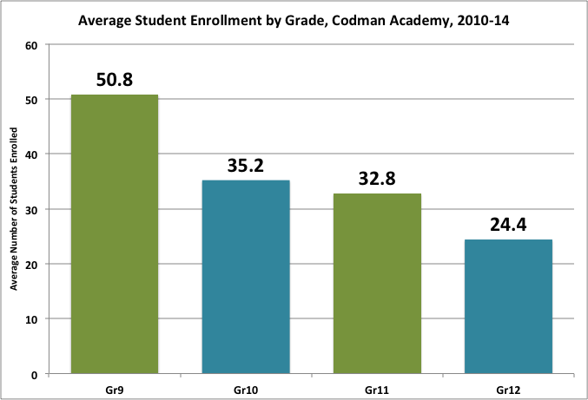
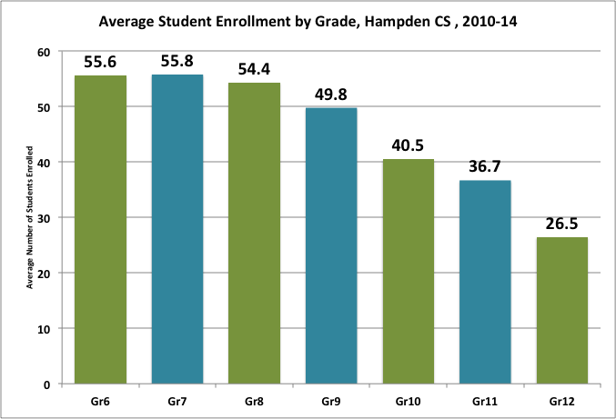
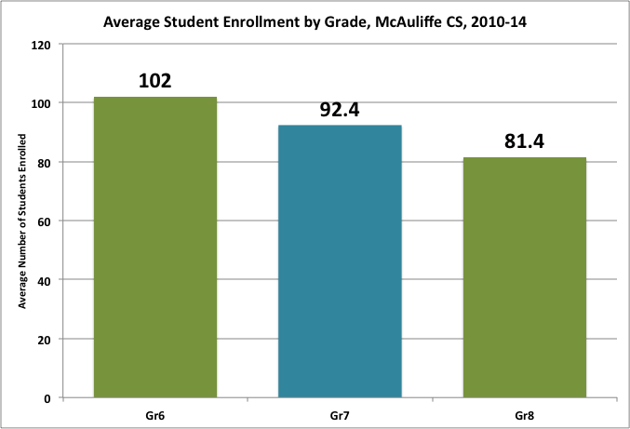
Enrollment Practices
Despite the intent of the Act to Close the Achievement Gaps, not all charters are filling empty seats vacated by students. Nor are all of them at the student enrollment cap approved by BESE.
Codman Academy, Boston Enrollment Cap: 345 Average Enrollment: 142 Highest Enrollment: 153 in 2013-14
Hampden CS of Science, Chicopee* Enrollment Cap: 560 Average Enrollment: 260 Highest Enrollment: 353 in 2013-14
McAuliffe CS, Framingham Enrollment Cap: 396 Average Enrollment: 276 Highest Enrollment: 345 in 2013-14
North Carolina
* Hampden CS of Science enrolled students in Grade 12 on in 2012-13 (23 students) and 2013-14 (30 students).
Notes:
Changed the focus of this slide to urban districts – going back to data on slide 23.
* I’m using DESE data, but I think that the neuro is wrong. The definition is: The capacity of the nervous system is limited or impaired with difficulties exhibited in one or more of the following areas: the use of memory, the control and use of cognitive functioning, sensory and motor skills, speech, language, organizational skills, information processing, affect, social skills, or basic life functions. The term includes students who have received a traumatic brain injury.
I think most of these kids could actually be in out-of-district placements. I’m going to ask DESE to check their numbers here.

Slide 11
An Act Relative to Closing the Achievement Gap
Charter Caps and Cap Lifts
No public school district's total charter school tuition payment to commonwealth charter schools shall exceed 9 per cent of the district's net school spending;
A public school district’s total charter tuition payment to commonwealth charter schools shall not exceed 18 per cent of the district’s net school spending if the school district is in the lowest 10 per cent of all statewide student performance scores released in the 2 consecutive school years before the date the charter school application is submitted.
BESE shall only approve an application for the establishment of a commonwealth charter school if an applicant, or a provider with which an applicant proposes to contract, has a record of operating at least 1 school or similar program that demonstrates academic success and organizational viability and serves student populations similar to those the proposed school seeks to serve, from the following categories of students, (i) eligible for free lunch; (ii) eligible for reduced price lunch; (iii) require special education; (iv) limited English-proficient of similar language proficiency level as measured by the Massachusetts English Proficiency Assessment examination; (v) sub-proficient, which shall mean students who have scored in the “needs improvement,” “warning” or “failing” categories on the mathematics or English language arts exams of the Massachusetts Comprehensive Assessment System for 2 of the past 3 years or as defined by the department using a similar measurement; (vi) who are designated as at risk of dropping out of school based on predictors determined by the department; (vii) who have dropped out of school; or (viii) other at-risk students who should be targeted to eliminate achievement gaps among different groups of students. For a district approaching its net school spending cap, the board shall give preference to applications from providers building networks of schools in more than 1 municipality.
Not less than 2 of the new commonwealth charters approved by the board in any year shall be granted for charter schools located in districts where overall student performance on the statewide assessment system is in the lowest 10 per cent statewide in the 2 years preceding the charter application.

Slide 12
Identifying the Lowest Performing School Districts
The BESE-approved method for identifying the lowest performing districts combines MCAS student performance by category (Advanced, Proficient, Needs Improvement, Failing/Warning) and the MCAS Student Growth percentile (SGP).
Status Metric: The percentage of students in each of the four performance categories is combined into a single metric for the school.
Growth Metric: The performance of each student is compared to “like” scoring students statewide to determine how much better or worse each student performed; the results of all students are combined into a district SGP.
In March 2014, the BESE adopted regulations that codified the 80-20 method that had been used for the previous two school years.
However, based on Board member discussion, the Commissioner was required to review other balanced percentages and bring his findings to the Board. This resulted in a regulatory change in June 2014 adopting a 75 percent achievement and 25 percent growth metric.
As a result six districts were no longer in the lowest 10 percent and eight new districts were added.
Student Growth Percentile measures how much district performance has improved from one year to the next relative to how students statewide with similar MCAS test score history performed.
Notes:
Glenn, I don’t know if you want to emphasize that the charter school association made a late effort to roll this regulation back to 100 percent status with no growth. Having a “growth” metric undercuts their claims of how wonderful they are and allows districts to demonstrate that they are doing better than charters. I could work this in if you like.

Slide 13
The Lowest Performing School Districts
As a result of the change from 100 percent achievement to a 75 percent achievement-25 percent growth split, six districts were no longer in the lowest 10 percent: Brockton, Fitchburg, Haverhill, Hawlemont, Provincetown, Somerville, and Worcester. The districts in ALL CAPITAL letters replaced them.
Lowest 10 Percent: 75 percent MCAS Achievement Scores and 25 percent MCAS Growth Scores
Adams-Cheshire | New Bedford
Athol-Royalston | North Adams
Boston | Orange
Chelsea | PALMER
CHICOPEE | Randolph
DENNIS-YARMOUTH | Salem
Everett | Southbridge
Fall River | SPENCER-EAST BROOKFIELD
Gardner | Springfield
GREENFIELD | TAUNTON
Holyoke | Ware
Lawrence | WAREHAM
Lowell | Webster
Lynn | Winchendon
Methuen

Slide 14
Proven Charter Provider Qualifications
Only “proven providers” may open charters in the “caplift” districts where new charters are not counted in the statutory cap of 72 Commonwealth charters and net school spending can rise to 18 percent.
Qualifications to Achieve Proven Provider Status: [603 CMR 1.04]
The applicant shall submit data demonstrating success in student academic performance and evidence of academic program success:
Proficiency levels and growth measures on the Massachusetts comprehensive assessment system or equivalent assessments for all students and for one or more targeted subgroups, which are similar to statewide averages in English Language Arts and mathematics for all students in Massachusetts in comparable grades, over no less than a three-year period for cohorts of students;
Student performance on other standardized tests over no less than a three-year period for cohorts of students, if available, which demonstrates student achievement levels that are similar to statewide averages in English Language Arts and mathematics for all students in Massachusetts in comparable grades;
Attendance, retention, and attrition data;
Graduation and dropout data, if applicable; and
In-school and out-of-school suspension rates.
Effective implementation of recruitment and retention plans, if applicable, and compliance with applicable laws and regulations.
Evidence to demonstrate that the successful school serves student population(s) similar to the population(s) to be served by the proposed charter, and that the program to be offered at the proposed charter is similar to, or represents a reasonable modification of the successful school.
Proven Provider is an annual determination and not a permanent designation by the Commissioner. Proven provider determinations for charter expansions take place at the time the Commissioner considers the request and not in bulk beforehand.
Hampden Charter School of Science and three school support organizations: Big Picture Learning, Building Excellent Schools, and EDWorks.
Communication from DESE on October 8, 2015
Notes:
Glenn, I don’t know if you want to emphasize that the charter school association made a late effort to roll this regulation back to 100 percent status with no growth. Having a “growth” metric undercuts their claims of how wonderful they are and allows districts to demonstrate that they are doing better than charters. I could work this in if you like.

Slide 15
Terminology
State Data: All enrollment and student outcomes data from all publicly funded Pre-kindergarten to Grade 12 and Ungraded as collected and reported by the Massachusetts Department of Elementary and Secondary Education (DESE).
District Data: All enrollment and student outcomes data from all Pre-kindergarten to Grade 12 and Ungraded public school districts as collected and reported by DESE.
Sending District Data: A subset of public school districts that reimbursed charter schools for at least 100 students in FY15 as report by DESE.
Urban Sending District: A subset of 21 Sending District Data representing Boston, Cambridge, Somerville and some of the Gateway Cities.
Non-Urban Sending District: A subset of the 18 Sending District Data representing suburban and rural districts and Barnstable. The five Martha’s Vineyard districts were combined into one which sent over 100 students to the charter school.
Commonwealth Charter Schools: All publicly funded charter schools independent of school districts during the time of this study 2009-10 to 2013-14.
Urban Charter: The 52 schools located in urban sending districts.
Non-Urban Charter: The 19 schools located in suburban or rural districts.
Enrollment Loss/Gain: Changes in the number of students within a graduation class from the initial enrollment to the final enrollment year for the cohort. For example, a middle school enrollment loss/gain would reflect changes with the same cohort of students from Grade 6 to Grade 8.
Graduation Year: The final year of enrollment for the school. For example, a K-4 school, the grade year would be Grade. 4.

Slide 16
Low Income Students
KEY FINDINGS
Non-urban charter school enrollment of students living in poverty is 25 to 50 percent lower than sending districts. Non-urban charter school claims of success may be the result of enrolling small percentages of students living in poverty. Urban charter school claims of success may be the result of enrolling percentages of low-income students that are half that of the sending district.

Slide 17
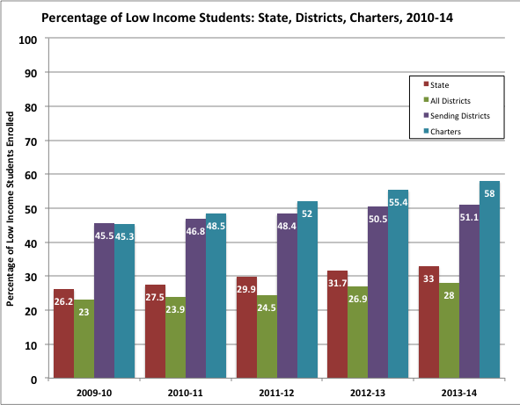
Students Living in Poverty
Charter schools celebrate their students’ performance on MCAS, often stating that their schools “outperform” district schools. However, connections between outcomes on standardized tests and family income have consistently proven to be reliable.
Statewide there was a five percent increase in the Low Income student population over the five years reviewed for this study. This increase applies to all public school districts charter sending districts.
Overall, charter schools saw a 13 percent increase in the enrollment of low income students over this period; however, most of this gain was in urban charters.
Student demographics suggest that, at least in part, charter student performance on state assessment may be connected to the family’s socioeconomic status.

Slide 18
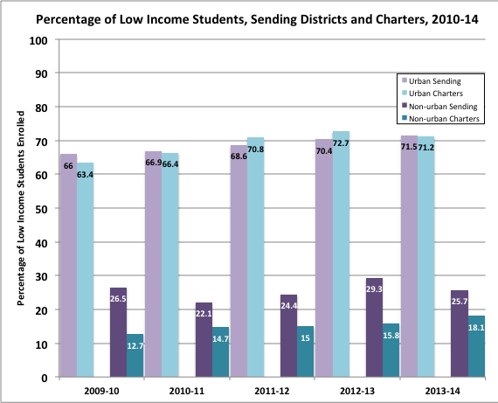
Sending Districts & Charters
Urban sending districts and urban charters enroll similarly high percentages of low income students. Non-urban districts enroll larger percentages of students living in poverty than the charters they host.
Urban Districts & Charters
Over the five years studied, the percentage of students living in poverty in urban sending districts has steadily increased from 66 percent on 2010 to 71.5 percent in 2014.
Urban charters have seen growth in enrollment from a low of 64 percent in 2010 to a high of 73 percent in 2013.
Non-Urban Districts & Charters
Non-urban sending districts have inconsistent enrollment of low-income students, with a low of 22 percent in 2011 and a high of 29 percent in 2013.
Non-urban charters have seen a small but steady percentage growth in enrollment from a low of 14 percent in 2010 to a high of 20 percent in 2014, but on average only between one-third and two-thirds of sending districts.
The percent of low-income students enrolled in non-urban charters is between 50 and 75 percent of sending districts.

Slide 19
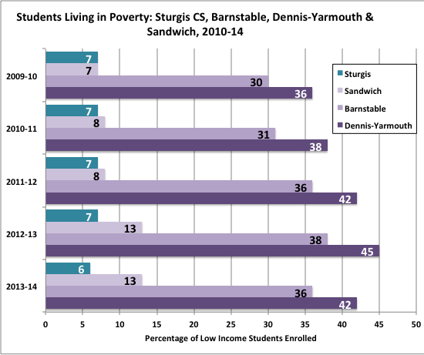
Sturgis Charter School Low Income Students
According to the Sturgis website, “U.S. News and World Report recently accounted the Best High Schools Ranking for 2015. Sturgis received a gold medal and is ranked #1 high school in MA, #6 charter school in US, and #32 high school in US.” It goes on, “Schools were awarded gold, silver or bronze medals based on their performance on state assessments and how well they prepare students for college.”
Sturgis Charter School Website
In FY14, Sandwich, Barnstable, and Dennis-Yarmouth sent the highest numbers of students to Sturgis Charter School.
Over the five years of this study, Barnstable’s poverty level is close to the state average. The Dennis-Yarmouth’s average is higher in all five years: Sandwich’s rate is lower.
The Sturgis charter school consistently has about seven percent of its students identified as low-income.
In FY14, Sturgis rate was half that of Sandwich, 17 percent of Barnstable and 14 percent of Dennis-Yarmouth.

Slide 20
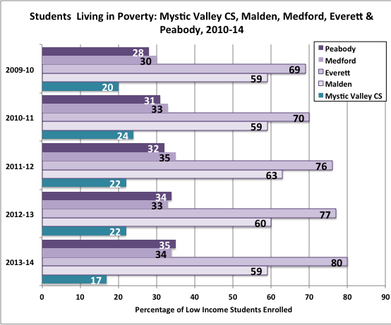
Mystic Valley CS Low Income Students
Mystic Valley Students Ace MCAS
“Mystic Valley Regional Charter School students once again scored at the top of all Massachusetts students on the most recent MCAS 10th Grade ELA exams. Ninety-nine percent of the Mystic Valley sophomores scored either Advanced or Proficient on the ELA portion of the exam. Not one member of the sophomore class received a Failing grade on any of the three MCAS test areas.
Mystic Valley Charter School Website
In FY14, Malden, Peabody, Everett and Medford sent the highest numbers of students to Mystic Valley Charter School.
On the five years studied, an average of 20 percent of Mystic Valley Charter School students are living in poverty.
During the same period, Peabody and Medford had an average poverty rate of 32.5 percent, Malden 60 percent and Everett 75 percent.
In FY 14, the poverty rate of students at Mystic Valley charter school is half that of Medford and Peabody, 29 percent of Malden’s, and 21 percent of Everett’s.

Slide 21
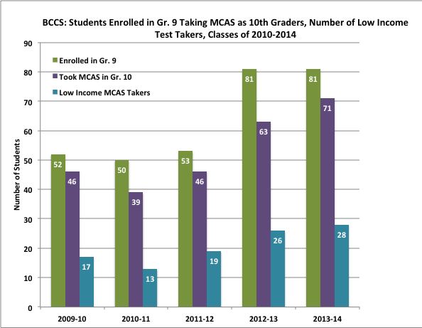
Boston Collegiate CS Low Income Students
Boston Collegiate Charter School is proud to announce its 2015 MCAS scores!
“Once again, our students outperformed state averages on both 10th grade MCAS exams: 97% of BCCS students scored Advanced or Proficient in Math, compared to 79% statewide, and, for the third consecutive year, 100% of BCCS students scored Advanced or Proficient in English Language Arts (ELA), compared to 91% statewide.”
Boston College Charter School Website
On average, 75 percent of students in the Boston public schools are identified as low-income while 43 percent of BCCS students are so identified.
Over the five years of this study,
317 students enrolled in grade 9.
265 students of those students took MCAS tests when they were in Grade 10.
103 of those test takers were low income, 39 percent of the test takers and 32 percent of the Grade 9 enrollment in the class.

Slide 22
English Language Learners
KEY FINDINGS
While charter schools are enrolling more English language learners, they are not doing so in the same percentage as district schools. Almost 40 percent of the ELL enrollment in the Boston charters is attributable to one school out of the 19 charters in the district. Non-urban charters enroll less than one-quarter the ELLs of sending districts. Over the five years since the Achievement Gap Act passed, two English language learners have taken the MCAS exams at Sturgis CS and none at Boston Collegiate CS.

Slide 23
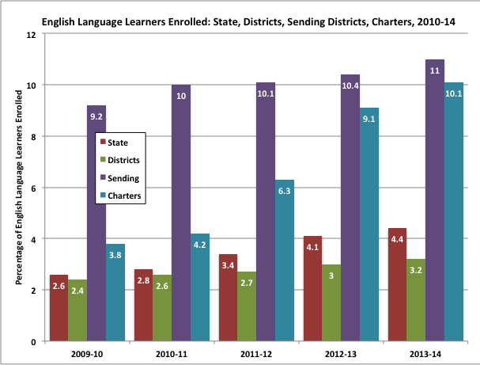
English Language Learners
Since 2009-10, Massachusetts has had a small but steady increase in the percentage of English Language Learners enrolled in public and charter schools.
Only four percent of all public school students are English language learners, most ELLs attend urban districts.
About 11 percent of the students in charter sending districts are ELLs.
Charter schools have seen steady growth in this population from a low of 3.8 percent in 2010 to 10 percent in 2014.
Much of the growth in ELL enrollment in charters is attributable to two schools: one in Boston and one in Lawrence.

Slide 24
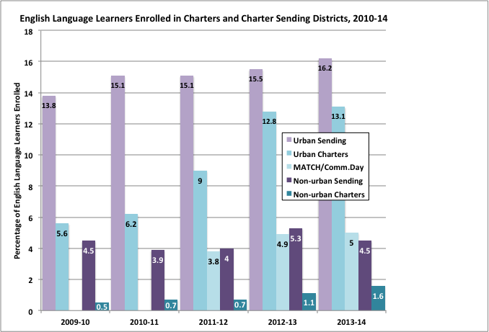
Sending Districts & Charters
Only about five percent of Massachusetts’ students are English language learners. The vast majority of these students attend urban public schools or urban charters.
Urban Districts & Charters
Over the five years studied, the percentage of English language learners in urban sending districts and urban charters has steadily risen.
However, from 2012 to 2014, about 40 percent of the ELL enrollment in charters is attributable to two out of the 52 urban charters: MATCH Community Day in Boston with an 82 percent ELL population and Community Day Gateway in Lawrence with a 79 percent ELL enrollment.
Non-Urban Districts & Charters
On average English language learners in non-urban sending districts comprise about five percent of all students enrolled.
Non-urban charters have seen little growth in their enrollment of ELLs.
For the most part, English Language Learners attend urban sending and charter schools and non-urban district schools.

Slide 25
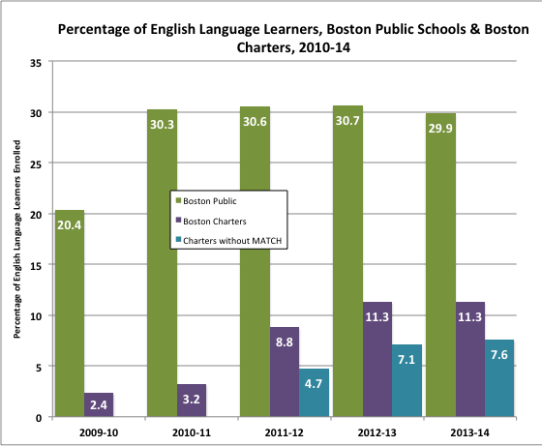
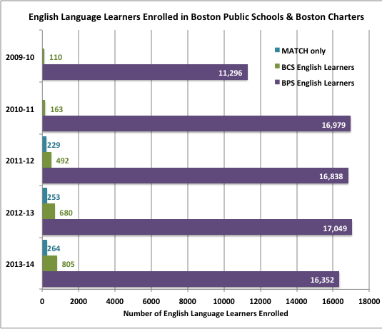
Boston’s English Language Learners
The danger of misinterpreting or representing data through the use of percentages over actual numbers is illustrated by the Boston data. In looking at the percentages for the last two academic years, it would appear that Boston charter schools have about one-third the number of ELLs as the Boston public schools. In fact, when the actual number of students is used, charters have about four percent of the ELLs as the public schools.
Over the last four years of this study, about 30 percent of the students attending the Boston public schools are English language learners, about 17,000 students per year.
Since 2011-12, 1900 ELLs have attended Boston charter schools. Of these, about 800, or 40 percent, attended MATCH Community Day charter school. The other 60 percent of ELLs attended one of the remaining 18 charter schools in Boston.

Slide 26
Students with Disabilities
KEY FINDINGS
District schools educate students in all 13 categories of disabilities. District schools provide special education services through full inclusion, partial inclusion and substantially separate programs as well as out-of-district placements. Students with moderate to severe disabilities are under-enrolled or not enrolled in charter schools.

Slide 27
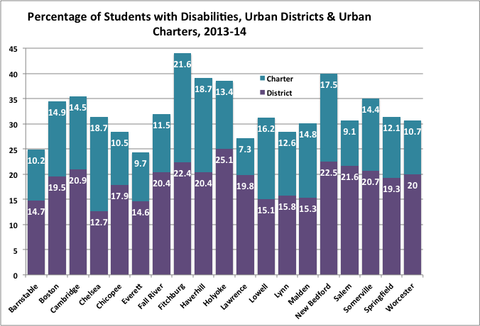
SWD in Urban Districts & Charters
Urban charter schools have lower percentages of students with disabilities from their host districts.
Lawrence and Salem charters have about one-third SWD as the host public school district.
Chicopee, Fall River, Holyoke and Worcester charters have about half the SWD as the host districts respectively.
Barnstable, Cambridge, Everett, Somerville and Springfield charters have about two-thirds the SWD as the host districts.
Boston, New Bedford, and Lynn charters have about three-quarters of the host district.
Chelsea, Fitchburg, Haverhill, Lowell and Malden have about the same or higher percentages of SWD as the host districts.

Slide 28
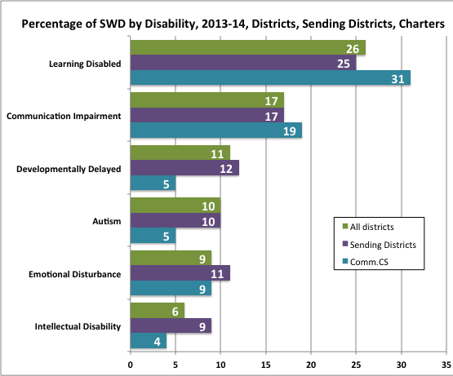
Students with Disabilities
Most SWD in charter schools have either a specific learning disability or a communications impairment. While these may be mild to severe disabilities depending on the students, given that charters provide services though Full Inclusion, an assumption can be made that most of these students have mild disabilities.
There are thirteen disability categories. Virtually all those in the blind, deaf, deaf-blind, neurological impairment or physical impairment are educated in public school district programs. About 10 percent of SWD have health issues – from ADD to asthma or a serious illness – and are equally represented in charters and districts.
One third of SWD in charter schools have specific learning disabilities, a slightly higher percentage that sending districts, and about 20 percent have a communication impairment, slightly higher than sending districts.
Districts have twice the percentage of autistic students, developmentally delayed students and students with intellectual disabilities.
Charters and districts report about the same percentage of students with emotional disturbances, with a slightly higher percentage in sending districts.

Slide 29
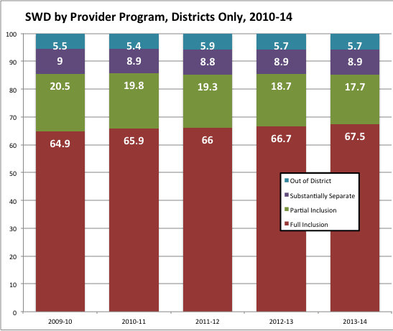
Students with Disabilities by Program
164,336 students with disabilities (SWD) enrolled in all publically funded schools in 2013-14.
SWD were 17 percent of the students educated in public school districts. In charter sending districts they were 19 percent of the total student population. SWD made up 13 percent of the total student population in charters
Public school districts provide a wide array of special education services to students with disabilities. Over the five years of this study, slightly less than six percent of SWD were educated in out-of-district placements.
Of the 94 percent who were educated in district schools, on average
66 percent were in Full Inclusion programs, meaning that their special education services were provided in the regular education classroom
19 percent were in Partial Inclusion programs, meaning that they leave the regular education classroom for some period of time, usually no more than 40 percent of their school time, to receive special education services.
9 percent were in Substantially Separate programs, meaning that most of their education and special education time was outside of a regular education classroom. Charter schools have no students in Substantially Separate Programs.
6 percent of SWD are in out-of-district placements where their special needs can be addressed.

Slide 30
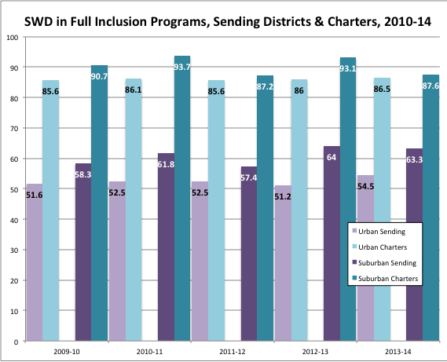
Full Inclusion Sending Districts & Charters
Charter schools do not educate the same population of Students with Disabilities as public school districts. Public school districts are educating students in all disability categories, and virtually all students with the severest special needs.
Full inclusion programs are the primary special education services in charter schools. Charter students appear to receive most, if not all, of their special education services in the regular education classroom.
On average
86 percent of SWD in urban charters, compared with 52 percent of SWD in urban sending districts, are enrolled in full inclusion program.
14 percent of SWD in urban charters are in Partial Inclusion programs.
90 percent of SWD in non-urban charters, compared with 61 percent of SWD in non-urban sending districts, are enrolled in such programs.
10 percent of SWD in non-urban charters are in Partial Inclusion programs.
Given that charter schools provide more than 85 percent of their SWD with special education services in the regular education classroom through Full Inclusion programs, an assumption can be made that charters have few SWD with moderate to severe special needs or SWD who must have services provided through Partial Inclusion or Substantially Separate services.

Slide 31
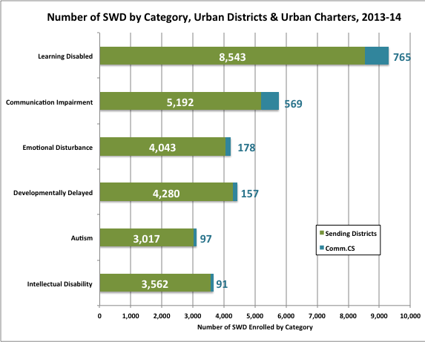
SWD in Urban Districts with Multiple Charters
Ninety-three percent of SWD attend district schools or are sent to out-of-district placements at district expense.
Nine districts host more than one Commonwealth charter school. These districts educate 29,408 students with disabilities while the charters in these districts educate 2,290.
Boston, Cambridge, Fall River, Holyoke, Lawrence, Lowell, New Bedford, Springfield and Worcester have more than one charter school.
The host districts educate 29,408 SWD and charters in these districts educate 2,290.
For both host districts and charters, students with specific learning disabilities followed by students with communication impairments are the largest groups.
District schools educate most students who are developmentally delayed, autistic or have emotional disturbances or intellectual disabilities.
Urban charters are not educating the same categories of students with disabilities as their sending districts.

Slide 32
Urban Districts Educate Students with Disabilities
Over 90 percent all SWD are educated by urban district schools, not by urban charter schools.
92 percent of the 9,308 students with specific learning disabilities are enrolled in District Schools
96.5 percent of the 4,437 developmentally delayed students are enrolled in District Schools
96 percent of the 4,221 emotionally impaired students are enrolled in District Schools
Specific Learning Disability is defined as
A disorder in one or more of the basic psychological processes involved in understanding or in using language, spoken or written, that may manifest itself in an imperfect ability to listen, think, speak, read, write, spell, or to do mathematical calculations, including conditions such as perceptual disabilities, brain injury, minimal brain dysfunction, dyslexia, and developmental aphasia. Disorders not included. The term does not include learning problems that are primarily the result of visual, hearing, or motor disabilities, of mental retardation, of emotional disturbance, or of environmental, cultural, or economic disadvantage.
Developmentally Delayed is defined as
The learning capacity of a young child (3-9 years old) is significantly limited, impaired, or delayed and is exhibited by difficulties in one or more of the following areas: receptive and/or expressive language; cognitive abilities; physical functioning; social, emotional, or adaptive functioning; and/or self-help skills.
Emotional Impairment is defined as
The student exhibits one or more of the following characteristics over a long period of time and to a marked degree that adversely affects educational performance: an inability to learn that cannot be explained by intellectual, sensory, or health factors; an inability to build or maintain satisfactory interpersonal relationships with peers and teachers; inappropriate types of behavior or feelings under normal circumstances; a general pervasive mood of unhappiness or depression; or a tendency to develop physical symptoms or fears associated with personal or school problems
North Carolina
Notes:
Changed the focus of this slide to urban districts – going back to data on slide 23.
* I’m using DESE data, but I think that the neuro is wrong. The definition is: The capacity of the nervous system is limited or impaired with difficulties exhibited in one or more of the following areas: the use of memory, the control and use of cognitive functioning, sensory and motor skills, speech, language, organizational skills, information processing, affect, social skills, or basic life functions. The term includes students who have received a traumatic brain injury.
I think most of these kids could actually be in out-of-district placements. I’m going to ask DESE to check their numbers here.

Slide 33
Gender Enrollment & Parental Choice
KEY FINDINGS
All urban charters and non-urban elementary and high school charters have enrollment losses in both the number and percentage of students from the initial enrollment year through the final year of the academic program. This is a more significant problem in urban charters, especially at the high school level. Compared with district schools, Commonwealth charter schools serve a disproportionately higher percentage of female students at all grades spans, with urban charters most likely to enroll and retain a higher percentage of female students. Parents exercise their choice in accepting an offer to enroll their child in a charter school. Subsequently, parents exercise their choice by taking their child out of the charter school prior to the completion of the school’s academic program. Even students who have successfully taken and passed Grade 10 MCAS do not stay in the school through to graduation. Male students are more likely to leave charter schools than female students.
Notes:
I added the fourth bullet.
I think the title of this section is unwieldy and will try to think of a more succinct one.

Slide 34
Academic Performance by Gender
Female students outperform their male peers. In a meta-analysis looking at 369 samples from 308 studies conducted between 1914 and 2011, an American Psychological Association reports that, “Despite the stereotype that boys do better in math and science, girls have made higher grades than boys throughout their school years for nearly a century.”
The authors found that while boys “typically score higher on math and science tests, females have the advantage on school grades regardless of the material.”
Therefore, schools that enroll higher percentages of female students should, on average, have better results than those with higher percentages of male students.
Voyer, D. and Voyer, S.D. (2014).!Gender differences in scholastic achievement: A meta-analysis. American Psychological Association, Psychological Bulletin. 2014, 140(4), 1748-1204.Retrieved on May 11, 2015 at http://www.apa.org/pubs/journals/releases/bul8a0036620.pdf.

Slide 35
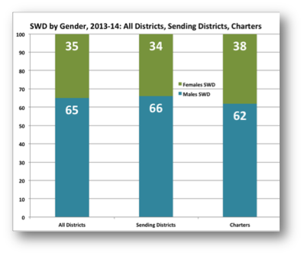
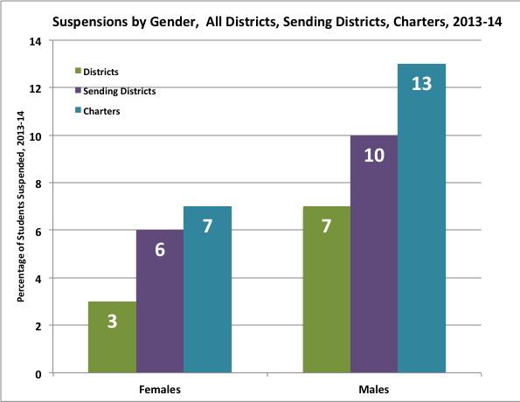
Students with Academic Challenges
On average, male students require more academic support than females. Two metrics that illustrate this are the percentage of students with disabilities and those suspended from school.
Approximately two-thirds of all SWD are male; the percentage of male SWD is slightly lower in charter schools.
Approximately twice the percentage of males are suspended from school as females. Charter schools suspend twice the percentage of males as do all district schools.

Slide 36
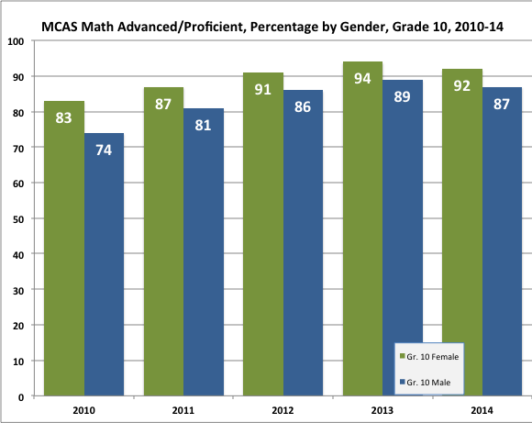
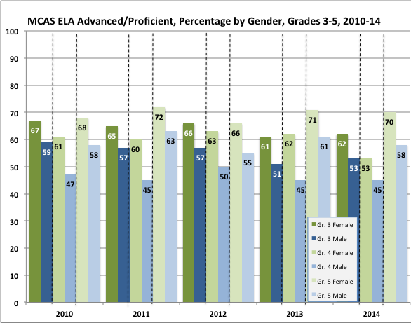
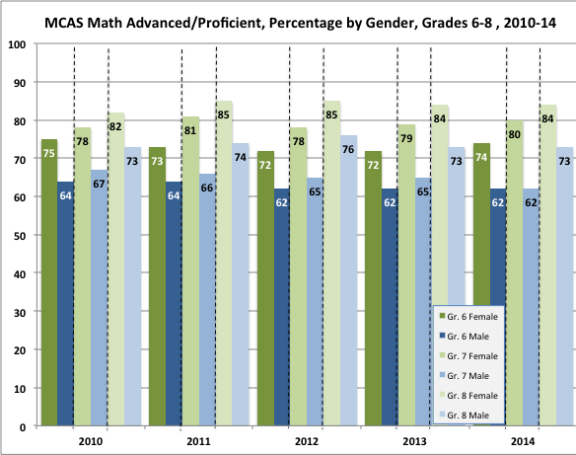
MCAS English Language Arts Performance
Over the past five administrations of MCAS, females consistently outperform males in every grade in ELA, often outscoring males by 10 percentage points or more. Over 80 percent of females score in the top two MCAS categories beginning in Grade 7. Over 80 percent of males score Advanced or Proficient only in Grade 10 and only from 2011 to 2014, while over 90 percent of females score about 240 from 2012 to 2014.
Gr.6 Gr.7 Gr.8
Gr.6 Gr. 47Gr. 8
Gr.6 Gr. 7 Gr. 8
Gr.3 Gr. 4 Gr. 5
Gr.3 Gr. 4 Gr. 5
Gr.3 Gr. 4 Gr. 5
Gr.6 Gr.7 Gr.8
Gr.6 Gr. 7 Gr. 8
Gr.3 Gr. 4 Gr. 5
Gr.3 Gr. 4 Gr. 5

Slide 37
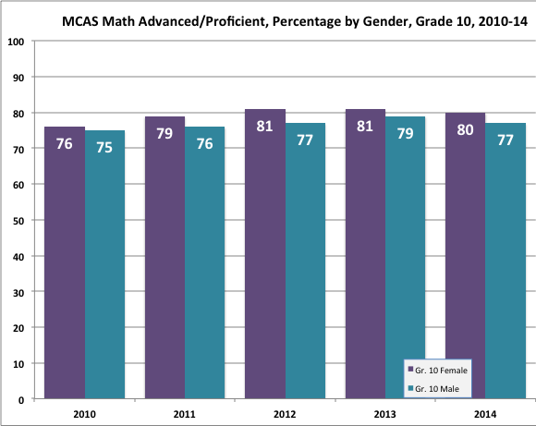
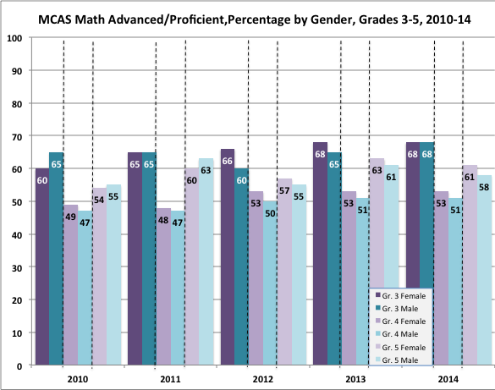
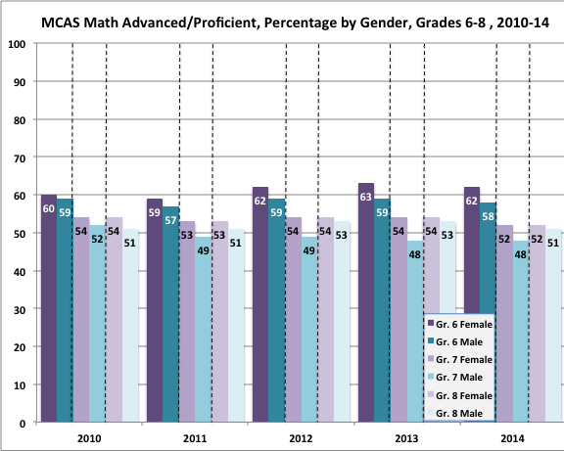
MCAS Mathematics Performance
On the 2010 to 2014 MCAS administrations, females outperformed males in every grade, with five exceptions out of 35 test administrations: Grade 3 in 2010, 2011 and 2014 and Grade 5 in 2010 and 2011. Third and sixth graders have consistently performed better than the other elementary and middle grades.
Gr.3 Gr. 4 Gr. 5
Gr.3 Gr. 4 Gr. 5
Gr.3 Gr. 4 Gr. 5
Gr.6 Gr.7 Gr.8
Gr.6 Gr.7Gr.8
Gr.6 Gr.7 Gr.8
Gr.3 Gr. 4 Gr. 5
Gr.3 Gr. 4 Gr. 5
Gr.6 Gr.7 Gr.8
Gr.6 Gr.7 Gr.8

Slide 38
Enrollment by Gender: Elementary Schools
In 2013-14, 352,649 students enrolled in all public school kindergarten through Grade 4: 181,165 males and 171,484 females. Of these, 10,050 – 2.85 percent – were enrolled in a Commonwealth charter school; of those, 56.7 percent were enrolled in urban charters and 43.3 percent in non-urban charters.
District K-4 enrollment by gender was relatively consistent with 51.5 percent of students male and 48.5 percent of students female.
Urban charters enrolled higher percentages of females than males in this grade span. With slightly more males in kindergarten and grade 3; slightly fewer in grades 1 and 2; and 4.6 percent more females than males in grade 4.
Non-urban charter schools enrolled more females in all grades: less than half a percentage point in grade 3; 13 percent in grade 2, and between 3 and 5 percent in K and grades 1 and 4.
Elementary Charters enroll a higher percentage of female students than district schools in all grades K-4.
Percentage of Female Enrollment: 2013-14
 | District Schools | Urban Charters | Non-Urban Charters
K | 47.9 | 49.7 | 51.4
Gr.1 | 48.6 | 50.2 | 51.9
Gr.2 | 48.6 | 50.3 | 56.5
Gr.3 | 48.7 | 49.6 | 50.2
Gr.4 | 48.9 | 52.3 | 52.4
Percentage of Male Enrollment: 2013-14
 | District Schools | Urban Charters | Non-Urban Charters
K | 52.1 | 50.3 | 48.6
Gr.1 | 51.4 | 49.8 | 48.1
Gr.2 | 51.4 | 49.7 | 43.5
Gr.3 | 51.3 | 50.4 | 49.8
Gr.4 | 51.2 | 47.7 | 47.6
Notes:
Added red box.

Slide 39
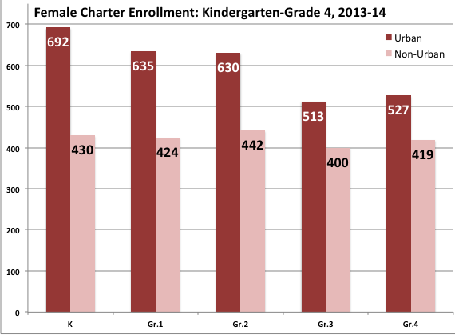
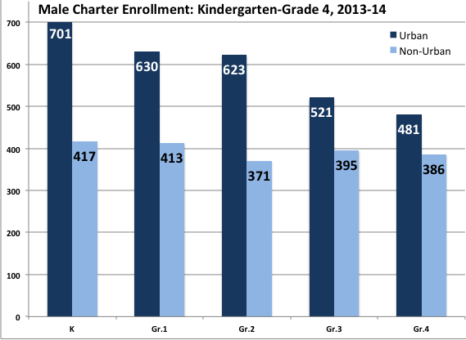
Enrollment Loss: Elementary Schools
Urban elementary charters enroll more students than non-urban charters. Of the 2,240 kindergarteners enrolled in 2013-14, 1,393, or 62 percent, were in urban charters. In 2013-14, the grade 4 enrollment is 84 percent of K enrollment: An enrollment loss of 16 percent.
In both urban and non-urban charters, female enrollment loss is less than that for males. While relatively flat at non-urban charters, the urban female grade 4 enrollment is 76 percent of the K enrollment: An enrollment loss of 24 percent.
However, one out of every three male students leave urban charters: An enrollment loss of 34 percent.
This data suggest that in the elementary grades, urban parents choose to enroll their child in a Commonwealth charter school, but over time at least one out of four are choosing to take their child out of the school – especially for male students in urban charters.
Parents of at least three out of every ten students are choosing to withdraw their child from elementary charter schools.
Notes:
Added red box.
Inserted “urban” before “parents” in first line of last paragraph on the right side of the slide.

Slide 40
Enrollment by Gender: Middle Schools
In 2013-14, 286,293 students were enrolled in all public school grades 5 through 8: 146,015 males and 140,278 females. Of these, 13,285 – 4.6 percent – were enrolled in a Commonwealth charter school; of these, 50.3 percent were enrolled in urban charters and 49.7 percent in non-urban charters. In all grades, district schools enrolled about 3 percent more males than females.
District Grades 5-8 enrollment by gender was relatively consistent with 51.4 percent of students male and 48.8 percent of students female.
Urban charters had about a 3 percent higher male enrollment in grade 5. In grades 6-8, the female enrollment was higher by 5.8 percent, 6.6 percent and 3.8 percent respectively.
Non-urban charters consistently enrolled more females, with the smallest gap in grade 5, the highest in grade 7 at 5.2 percent, and about 3 percent in
Middle School Charters enroll a higher percentage of female students than district schools in all grades 5-8.
Percentage of Female Enrollment: 2013-14
 | District Schools | Urban Charters | Non-Urban Charters
Gr.5 | 48.8 | 48.6 | 50.3
Gr.6 | 48.8 | 52.9 | 51.6
Gr.7 | 48.8 | 53.3 | 52.6
Gr.8 | 49 | 51.9 | 51.2
Percentage of Male Enrollment: 2013-14
 | District Schools | Urban Charters | Non-Urban Charters
Gr.5 | 52.1 | 51.4 | 49.7
Gr.6 | 51.2 | 47.1 | 48.4
Gr.7 | 51.2 | 46.7 | 47.4
Gr.8 | 51 | 48.8 | 48.1

Slide 41
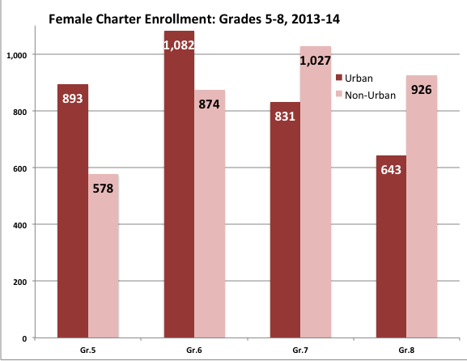
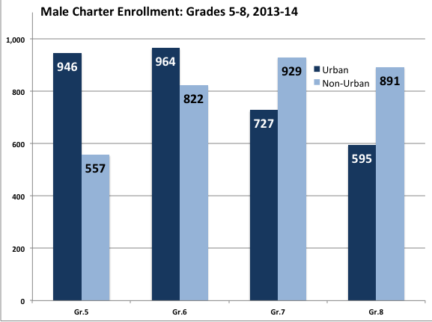
Enrollment Loss: Middle Schools
Of the 8,237 students enrolled in the middle grades in 2013-14, 81 percent, were in urban charters. Due to charter grade configurations, grade 6 has peak enrollment.
For every ten females enrolled in grade 6 in an urban charter school, slightly more than four are gone by grade 8: An enrollment loss of 41 percent.
For every ten males in grade 6 in an urban charter, slightly fewer than four are gone by grade 8: An enrollment loss of 38 percent.
Non-urban charters show enrollment growth over grades 6-7 with a slight decline in grade 8. This suggests that vacant seats may be filled. Both the male and female grade 8 enrollment is approximately 106 percent of grade 6.
It would appear that over the course of the middle grades, urban parents are choosing to remove their sons and daughters from charter schools, but female students in higher numbers.
Parents of four out of ten middle school students are choosing to withdraw their children from middle school charters.
Charter Middle Schools may begin in either Grade 5 or Grade 6. Grade 5 is included here for completeness but Grade 6 numbers are used as they are attributable to more schools.
Notes:
Added red box
Changed the last sentence of last paragraph on left changed “children” to “sons and daughters” and added “in almost equal numbers.”

Slide 42
Enrollment by Gender: High Schools
In 2013-14, 287,478 students were enrolled in grades 9 through 12 in all publicly funded high schools: 141,851 females and 145,627 males. Of these, 8,330 (2.9 percent) were enrolled in a Commonwealth charter school; of these, 31.8 percent were enrolled in urban charters and 69.2 percent in non-urban charters. Seven out of every students enrolled in a charter high school were in a non-urban school.
District Grades 9-12 enrollment by gender was relatively consistent with 50.8 percent of students male and 49.2 percent of students female.
Urban charters have a significantly higher female enrollment in all grades. The grade 9 differential is 5.4 percent, grade 10 is 12.4 percent, grade 11 at 13 percent and grade 12 at 11.8 percent.
Non-urban charters enrolled more females in grades 9, 10 and 12, with a difference of 3.6 percent, 4.0 percent and 2.8 percent respectively. In grade 11, 5.8 percent more males were enrolled.
High School Charters enroll a higher percentage of female students than district schools in all grades 9-12.
Non-Urban Charter High Schools enroll nearly twice as many students as urban charter high schools.
Percentage of Female Enrollment: 2013-14
 | District Schools | Urban Charters | Non-Urban Charters
Gr.9 | 48.7 | 52.7 | 51.8
Gr.10 | 49.1 | 56.2 | 52
Gr.11 | 49.5 | 56.5 | 47.1
Gr.12 | 49.5 | 55.9 | 51.4
Percentage of Male Enrollment: 2013-14
 | District Schools | Urban Charters | Non-Urban Charters
Gr.9 | 51.3 | 47.3 | 48.2
Gr.10 | 50.9 | 43.8 | 48
Gr.11 | 50.5 | 43.5 | 52.9
Gr.12 | 50.4 | 44.1 | 48.6
Notes:
Added red box.

Slide 43
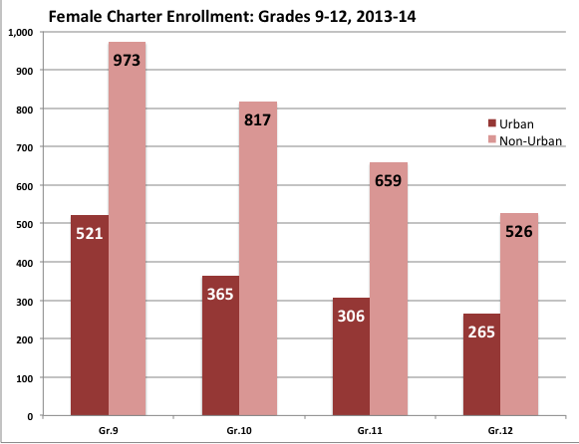
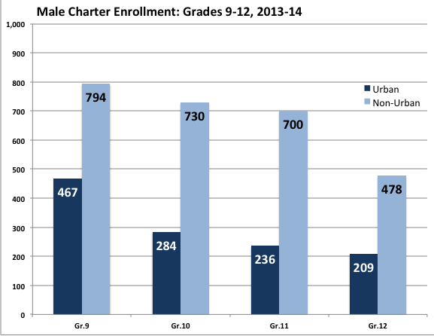
Enrollment Loss: High Schools
All charter high schools enroll significantly more females and males and have an average decline in enrollment from grade 9 to grade 12 of 50 percent.
Urban charters enroll fewer students than their non-urban counterparts and have higher enrollment losses.
Female enrollment loss from grade 9 to grade 12 is 49 percent and male enrollment loss is 52 percent. For every ten students enrolled in an urban charter in grade 9, five have left by grade 12, with four leaving between grades 9 and 10.
In non-urban charters, female enrollment loss is 46 percent and male enrollment loss is 40 percent. For every ten students enrolled in grade 9, more than four leave by grade 12 with an average decline in enrollment of about 20 percent each year.
It would appear that parents are choosing to remove their sons and daughters from these schools in even higher percentages than those making that choice in elementary or middle school charters, but is greater numbers in non urban schools due to their higher initial enrollment numbers.
Parents of five out of ten students are choosing to withdraw their child from urban charter high schools
Parents of more than four out of ten students are choosing to withdraw their child from non-urban charter high schools.
Notes:
Added red box.

Slide 44
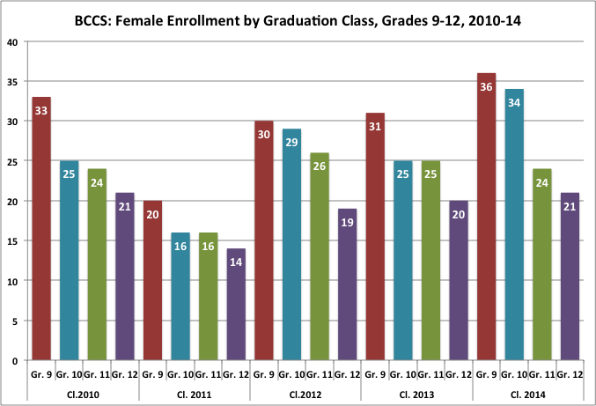
Female Enrollment: Boston Collegiate
Over five graduation classes, on average 63.3 percent of the females enrolled in grade 9 at BCCS were enrolled in grade 12: 150 females enrolled in grade 9 in the five year period and 95 enrolled in grade 12. One out of every three females enrolled in grade 9 left prior to grade 12.
Boston Collegiate Charter School has female enrollment loss from Grade 9 through Grade 12.
For each of the graduating classes, the story is similar:
Class of 2010: 63.6 percent of grade 9 students were enrolled in Graded 12.
Class of 2011: 70 percent of grade 9 students were enrolled in Graded 12.
Class of 2012: 63.3 percent of grade 9 students were enrolled in Graded 12.
Class of 2013: 64.5 percent of grade 9 students were enrolled in Graded 12.
Class of 2014: 58.3 percent of grade 9 students were enrolled in Graded 12.

Slide 45
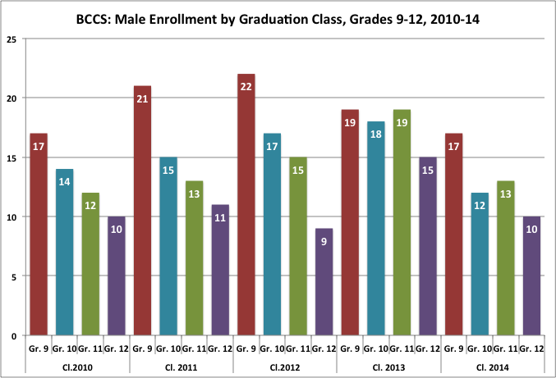
Male Retention: Boston Collegiate
Over five graduation classes, on average 57.3 percent of the males enrolled in grade 9 at BCCS were enrolled in grade 12: 96 males enrolled in grade 9 over the five years, while only 55 were enrolled in grade 12 in the same period. Two out of every five males enrolled in grade 9 left prior to grade 12.
Boston Collegiate Charter School has male enrollment loss from Grade 9 through Grade 12.
Class of 2010: 58.8 percent of grade 9 students were enrolled in Graded 12.
Class of 2011: 52.4 percent of grade 9 students were still enrolled in Graded 12.
Class of 2012:. 39.9 percent of grade 9 students were still enrolled in Graded 12.
Class of 2013: 78.9 percent of grade 9 students were still enrolled in Graded 12.
Class of 2014: 58.8 percent of grade 9 students were still enrolled in Graded 12.

Slide 46
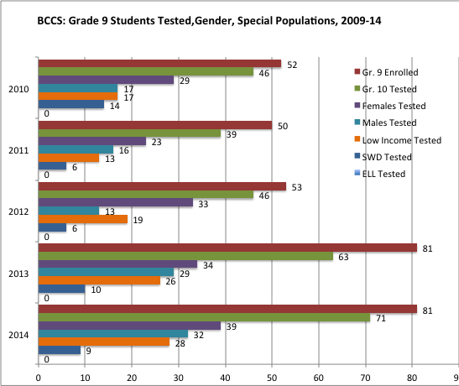
Who is taking MCAS tests at BCCS?
Boston Collegiate Charter School claim to being the best in the Commonwealth on MCAS is based on a skewed student testing pattern where six out of ten test takers are female, lower percentage of low-income students as BPS, and no English language learners took the tests.
From 2010 to 2014,
317 students enrolled in grade 9.
265 students took MCAS tests.
158 were female, 60 percent.
107 were male, 40 percent.
103 were low income, 39 percent.
45 were students with disabilities, 17 percent.
Zero were English language learners.

Slide 47
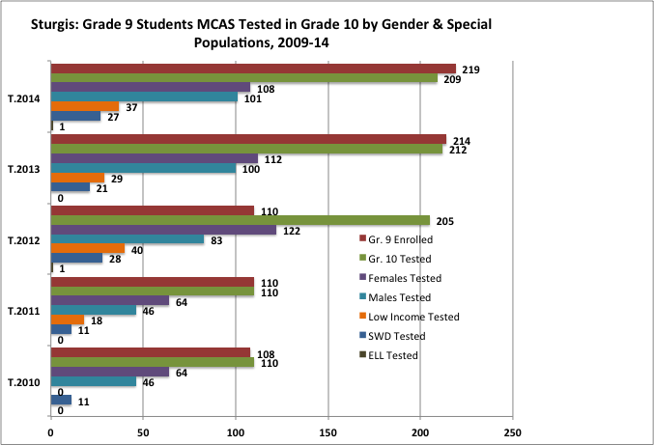
Who is taking MCAS tests at Sturgis?
Sturgis Charter School claims to being the best in the Commonwealth on MCAS is based on a skewed student testing pattern where almost six out of ten test takers are female, only two English language learners took the test in five years, and students with disabilities and those living in poverty are well below the statewide averages and those of the primary sending districts.
671 students enrolled in grade 9.
846 students took MCAS tests.*
470 were female, 56 percent.
376 were male, 44 percent.
124 were low income, 15 percent.
98 were students with disabilities, 12 percent.
2 were English language learners. .002 percent.
* The Sturgis charter allowed for a doubling of enrollment beginning in 2011-12 resulting in higher numbers of students tested in Grade 10 than enrolled in Grade 9.

Slide 48
Research Questions & Methodology

Slide 49
Research Questions
How should we determine the success of charter schools that claim high rates of academic success for their enrolled students?
What is the impact of An Act to Close the Achievement Gap on charter school subgroup enrollment pattern compared with the public school districts sending students to charter schools?
The enrollment data related to three subgroups – students with disabilities (SWD) , students living in poverty, and English language learners (ELL) – will form the basis of the study.
What categories of students with disabilities are enrolled in charter schools compared with public school districts sending students to charter schools?
How do the percentage and number of students living in poverty compare between charter schools and sending districts?
How do the percentage and number of ELLs compare between charter schools and sending districts?
How do the percentage and number of SWD, students living in poverty, ELLs compare between Boston charter schools and the Boston public schools?
Are there other enrollment trends that policy makers should be cognizant of when considering amending or enacting legislation and/or regulations?

Slide 50
Methodology
This is a longitudinal designed study using data gathered from charter schools and public school districts and reported annually by the Massachusetts Department of Elementary and Secondary Education. The initial year is 2009-10, the year that an Act to Close the Achievement Gap, is the initial year through to the 2013-14 academic year, the last for which complete data including state assessment results are available.
The independent variable is the academic year. The dependent variables are the student enrollment data in each academic year by charter schools, sending districts, all districts and the state and student subgroups: Students with disabilities, students living in poverty, English language learners and gender.
Trend Study
A type of longitudinal study in which data are collected at two or more points in time from different samples of the same population.
Check, J. and Schutt, R.K.(2012). Research methods in education. Thousand Oaks: Sage.

Slide 51
Charter Sending Districts
Urban | Non-Urban
Attleboro* | Barnstable*
Boston | Billerica
Brockton* | Chelmsford
Cambridge | Dennis-Yarmouth
Chelsea* | Dracut
Chicopee* | Foxborough
Everett* | Framingham
Fall River* | Haverhill*
Fitchburg* | Mansfield
Holyoke* | Marblehead
Lawrence* | Marlborough
Lowell* | Martha’s Vineyard**
Lynn* | Medford
Malden* | Melrose
New Bedford* | Norton
Pittsfield* | Randolph
Revere* | Saugus
Salem* | Sandwich
Somerville
Springfield*
Worcester*
Districts that sent more than 100 students to a charter school in 2014-15 were included as sending districts for this report.
Source: Massachusetts Department of Elementary and Secondary Education, Office of School Finance, FY15 Charter Tuition Payments and Reimbursement for Sending District (Q4).
* Gateway Cities as defined in MGL, Chapter 23A, Section 3A: Population between 35,000 and 250,000, median household income below the state average, rate of educational attainment of bachelor’s degree is below the state average.
** Martha’s Vineyard is counted as one sending district number using aggregated data from the five districts sending students to the charter school.

Slide 52
Resources
Cohodes, S.R., Setren, ElM., Walters, C.R., Angrist, J.D. and Pathak, P.A. (2013). ˆCharter school demand an effectiveness: A Boston Update. Boston: The Boston Foundation. Available online at http://economics.mit.edu/files/9248
Commonwealth of Massachusetts Office of the State Auditor (2014). The department of elementary and secondary education’s oversight of charter schools: For the period July 1, 2009 through June 30 2013. Available online at http://www.mass.gov/auditor/docs/audits/2014/201351533c.pdf
Massachusetts Department of Elementary and Secondary Education, Summary of MCAS Test Results for 2010-13.http://www.doe.mass.edu/mcas
Massachusetts Department of Elementary and Secondary Education, 2014 MCAS results posted at School and District Profiles
Massachusetts Department of Elementary and Secondary Education (2013). Report on charter school waitlists .Available online at http://www.doe.mass.edu/charter/enrollment/fy2014Waitlist.pdf
Massachusetts Department of Elementary and Secondary Education (2000). Special education definitions and related links. Available online at file:// Volumes/NO percent20NAME/MASC.Charters percent20 percent5B3 percent5D/MASC.Charters/SPED/DESE percent20SWD percent20Definitions.Links.webarchivee
Voyer, D. and Voyer, S.D. (2014).!Gender differences in scholastic achievement: A meta-analysis. American Psychological Association, Psychological Bulletin. 2014, 140(4), 1748-1204.Retrieved on May 11, 2015 at http://www.apa.org/pubs/journals/releases/bul8a0036620.pdf.
Recommended citation: Skinner, K.J. (2015). Who is being served by Massachusetts Commonwealth charter schools. Boston: Massachusetts Association of School Committees. Available online at _________.
Notes:
More to be added.

