Slide 1
Less Testing, More Learning
November 6 2015
MASS/MASC Conference

Slide 2
Goal
Provide a sense of what other states are doing and thinking about in relation to state accountability systems

Slide 3
Developments in Education
Standardized testing has done little to close achievement gaps by race, income, & language
Common Core Standards focus more deeply on critical thinking and deeper learning
New research on the importance of building skills and dispositions of an effective learner
Notes:
ADD A PICTURE OF SOMEONE TAKING A PAPER AND PENCIL TEST
Increasing concerns about the impact of too much standardized testing taking away from learning time, testing that does not further learning, and that narrows the curriculum
MA still has some of the widest gaps in the nation
Dispositions (e.g., perseverance, self-direction, communication, collaboration, creativity)

Slide 4
What Does the Community Say About What’s Important to Learn?

Slide 5
And What Our High Schools Should Look Like?

Slide 6
CCSSO Accountability Advisory Committee (2013)
Three recommendations:
Accountability systems should include a broad range of indicators that better assess readiness for college, career, and citizenship
Districts and schools should have flexibility to establish some priority outcomes for which they will be held accountable
Accountability systems should permit flexible testing approaches.

Slide 7
A Progression of Assessments – Linda Darling-Hammond

Slide 8
Three different models of education accountability systems

Slide 9
Performance assessment for competency education - PACE
New Hampshire

Slide 10
Performance Assessments for Competency Education
GOAL: Create a state accountability system with performance assessments as a primary determinant of student and school progress that can eventually be expanded statewide
PACE reflects the belief that most students are better able to demonstrate their competency through multiple assessment measures that approximate real-world demonstrations of competency
Notes:
Driving test example

Slide 11
Building Assessment Literacy
Year-long institutes for district teams on performance assessments
Statewide, CCSS-aligned competencies and dispositions
Task bank of common performance assessments
Volunteer districts for PACE pilot
Notes:
ADD PICTURE OF PEOPLE WORKING TOGETHER OR TALKING AROUND A TABLE

Slide 12
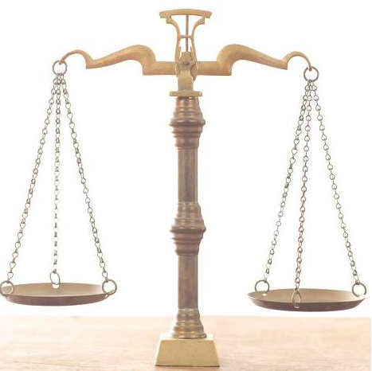
Comparability
Need to ensure comparable “annual determinations” of proficiency
How to accomplish this?
Provide lots of local flexibility, but require certain “common” performance assessments to both calibrate local scoring and evaluate comparability
Adapted from Scott Marion slide, Center for Assessment, 2015
Notes:
ADD A PICTURE OF A BALANCE SCALE (THE ONES WITH PLATES ON EITHER SIDE AND YOU TRY TO PUT EQUAL WEIGHTS ON EACH PLATE TO BALANCE THEM? DOESN’T HAVE TO BE EXACTLY EQUAL, THOUGH).

Slide 13
PACE: What Does It Look Like?

Slide 14
Task Validation and Calibration Sessions
Regional teams give feedback on tasks using protocols to ensure alignment, fairness, validity
Field testing
Scoring sessions across districts
Goal: Make consistent evidence-
based evaluations of student work
Notes:
ADD PICTURE OF STUDENT OR STUDENTS WORKING ON OR PRESENTING A PROJECT

Slide 15
New York Performance Standards consortium
New York
Consortium of 28 schools pioneering an accountability system based on performance assessment

Slide 16
NYPSC Accountability System
“Developed an assessment system that leads to quality teaching, that enhances rather than compromises our students' education”
Graduation level performance-based tasks/rubrics aligned to NY Learning Standards
Analytic literary essay
Social studies research paper
Original science experiment
Application of higher level mathematics
Notes:
Note the emphasis on preparation of students for real world experiences

Slide 17
Comparability and Reliability
Cross-School Scoring Sessions
Teachers from Consortium schools
Experts in various disciplines (such as writers, scientists, historians)
Performance Assessment Review Board
External board periodically reviews student work and the process by which it is graded

Slide 18
NYPSC Outcomes
Indicator Rates | NYPSC Schools | NYC City-Wide
Suspension | 5% | 11%
Dropout | 10% | 19%
Graduation | 69% | 59%
College acceptance | 91% | 63%

Slide 19
California Office to Reform Education - core
California
School Quality Improvement System

Slide 20
What is CORE?
Nonprofit with 10 member school districts, enrolling >1 million students, seeking to improve student achievement by fostering collaboration and learning
Received a federal waiver to create a new accountability system based on multiple indicators

Slide 21
School Quality Indicators
Academic Domain | Social-Emotional & Culture Domain
Smarter Balance proficiency rate | Chronic absenteeism (<90%)
Academic growth rate (using SB) | Student/staff/parent culture surveys
% of 8th graders on track to graduate | Suspension & expulsion rates
4-year cohort graduation rate | Self-assessment on social-emotional skills
 | SPED disproportionality rates

Slide 22
Summing up: what does it all mean?

Slide 23
What’s Most Important to Assess?
The business of schools is to invent tasks, activities, and assignments that the students find engaging and that bring them into profound interactions with content and processes they will need to master to be judged well educated.
Schlechty, P.C. (2001) Shaking up the schoolhouse. San Francisco: Jossey-Bass

Slide 24
Looking Forward (cont.)
Since assessment drives curriculum and instruction, we need state accountability systems that assess what is most important for our graduates to know and be able to do for their future
Use standardized tests as diagnostics for literacy and numeracy, as well
as for comparability
Notes:
ADD IN PICTURE OF STUDENT PRESENTING

Slide 25
Contact Information
Center for Collaborative Education
Email: dfrench@ccebos.org
Phone: (617) 421-0134 X227
www.ccebos.org
@cceboston
www.facebook.com/centerforcollaborativeed

