Slide 1
Planning for Success
Advancing district planning practices
MASS/MASC Joint Conference
November 5, 2014
Carrie Conaway, Associate Commissioner Planning & Research
Kevin Hutchinson, Superintendent, North Andover
Lori Likis, Principal Consultant, Creative Coaching

Slide 2
Agenda
Welcome to our session
Improvement planning in your districts today
The Planning for Success process and the School Committee’s and Superintendent’s roles
Barriers to advancing planning practices
Benefits to advancing planning practices
  Superintendent Kevin Hutchinson, North Andover
Closing
2
Notes:
Offer a sign in sheet with names/email addresses for follow up or to distribute more information
5 min for welcome and agenda

Slide 3
What is
Planning for Success?
The purpose and spirit of this work
Notes:
Origin of project:
to streamline and simplify the district planning process
to provide resources that will help districts and schools advance their planning practices, for those interested in doing so
Not another state mandate
Our goal: to help districts and schools build coherence in their work by tightening connections among existing systems
We collaborated with:
-- MASS and MASC – thanks to reps of those orgs who offered input into the design of the Planning for Success model and our resources. Planning for Success is aligned with the New Superintendent Induction Program and the District Governance Project.
-- with principals, hosting a workshop at MSSAA this summer for feedback, and working with Ed Eval’s principal cabinet
-- with teachers, working with Ed Eval’s teacher cabinet

Slide 4
Sharing with colleagues
What does your district planning process look like today?
How do your School Committee and Superintendent work together to monitor implementation and progress?
On a scale of 1-5—with 1 (not at all) and 5 (very)—how valued do you think improvement planning is in your district? Why?
Notes:
Ask them to talk in groups of 4-5. This could be 10-15 little clusters, if we have 50-75 participants.
Ask people to hold up fingers (1-5) that reflect their rating.
Allow 10 min for conversation followed by whole group share out of 5 min – for 15 minutes total

Slide 5
What are the essential elements of improvement planning?
A structure to support the district planning process

Slide 6
MA Planning and Implementation Framework

Slide 7
Improvement planning elements
    1. Mission, Vision, Core Values
    2. Data Analysis and Theory of Action
    3. Strategic Objectives and Initiatives, including:
    a. Professional development
    b. Teacher induction and mentoring activities
    4. Outcomes (SMART goals)
District Plan
(3 years)

Slide 8
The district plan
The district’s official roadmap for improvement
A multi-year academic improvement plan
  District vision, strategy, planned outcomes for students
Should be the heart of coherence for district work
  Aligned to budget, Educator Evaluation System, school improvement plans

Slide 9
What are the essential elements of implementation planning?

Slide 10
Implementation planning elements
    Implementation Benchmarks
      Process benchmarks: what, when, who
      Early evidence of change benchmarks: measuring impact during implementation
    Resources
District Action Plan
(annual)

Slide 11
What process supports the successful creation and implementation of improvement plans?

Slide 12
The district planning process three phases
Notes:
Turn and talk
Which phase(s) are areas of strength for your district today?
Which phase(s) might you want to improve?
Whole group discussion w/ Q&A on this slide (10 min):

Slide 13
What roles do the Superintendent and School Committee play in the improvement planning process?

Slide 14
The Superintendent’s role
Leads the development of the District Plan
Engages the community in developing core values, mission, and vision
Ensures data, research, and best practices are used to adapt practice to achieve improvement
Uses data to create focused, measurable district goals
Organizes high-quality PD aligned with district goals
Develops budget aligned with vision, mission, and goals
Builds consensus in community around critical decisions
Supports administrators and teams in developing and attaining improvement goals
Notes:
From the Educator Evaluation Rubric for Superintendents

Slide 15
The School Committee’s role
Responsible for approving district goals
Evaluates Superintendent annually on at least 2 goals: professional practice, student learning
  2-4 district improvement goals also recommended
Best positioned to safeguard district focus on improvement by monitoring goal coherence
  District plan
  Superintendent evaluation goals
  Budget goals
  School improvement goals
  School Committee goals

Slide 16
What are some of the barriers to and benefits of advancing your district’s planning practices?

Slide 17
Key barriers
Number and alignment of district goals
Compliance vs. improvement mindset
Culture and resistance to change
Perceived risk of public monitoring
Notes:
Whole group discussion of this slide (10 min)
Under compliance and improvement mindset cite that:
Creating a plan is a technical issue
Planning is an adaptive process
Under culture and resistance to change, cite:
Difficult conversations
Community engagement
Important but not urgent: we don’t have time

Slide 18
Key benefits in practice…
Superintendent Kevin Hutchinson
North Andover Public Schools

Slide 19
North Andover background
New Superintendent Induction Program (NSIP)
Entry plan process
Connecting to the Instructional Core
Developing focused Strategic Plan

Slide 20
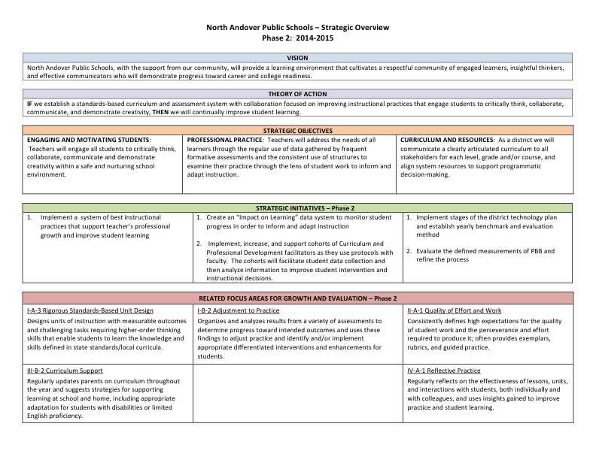
Strategic plan overview

Slide 21
Strategic plan highlights/adaptations
Vision and theory of action
Strategic objectives
Strategic initiatives
Professional growth and evaluation focus areas

Slide 22
Advancing our collective leadership practice
School Committee discussions
Desired improvements in articulation of action and benchmarks
Involvement with Planning for Success pilot
Sustainability

Slide 23
Planning for Success Resources
Planning process guidelines and frameworks
  MA Planning and Implementation Framework
  The District Planning Process
  The School Improvement Planning Process
  The Educator Evaluation Series
Implementation tools and protocols, developed with our pilot districts
Best practices in planning, from successful districts and schools
http://www.doe.mass.edu/research/success/

Slide 24
“A goal without a plan is just a wish.”
-- Antoine de Saint-Exupery

Slide 25
Interested in exploring a pilot project with us?
Associate Commissioner Carrie Conaway email: CConaway@doe.mass.edu

