Slide 1
Using Student & Staff Feedback in Educator Evaluation
November 5, 2014
MASC/MASS Joint Conference

Slide 2
Two Separate Ratings
Summative
Performance Rating
Student
Impact Rating

Slide 3
Summative Performance Rating
Summative
Performance Rating
Rating reflects:
Performance based on Standards and Indicators of Effective Practice
Progress toward educator goals

Slide 4
Multiple Pieces of Evidence
Summative
Performance Rating
Rating reflects:
Performance based on Standards and Indicators of Effective Practice
Progress toward educator goals
Multiple Measures
Observations & Artifacts
Student / Staff Feedback

Slide 5
How can educators collect feedback?
Student / Staff Feedback
603 CMR 35.07. Evidence used in educator evaluation shall include:
Student feedback collected by the district starting in 2013–14*
Staff feedback (with respect to administrators) collected by the district, starting in 2013–14*
* Amended to 2014-15

Slide 6
How can educators collect feedback?
District/School Wide
  A common instrument
  (i.e. surveys)
Educator Specific
  Individual surveys
  Written narratives
  Focus groups/interviews
A Combination
  Depending on educator role
Student / Staff Feedback

Slide 7
Principles of Effective Feedback
Meaningful
Aligned to one or more performance Standards
Actionable
Information is useful – educators know what to do in response to what students say
Accessible
All students have the opportunity to give feedback
Students understand what is being asked
Aligned to content
Information is timely

Slide 8
Research shows
student perception data, combined with observations and multiple measures of student achievement, results in:
(a) a stronger predictor of teacher impact on student learning,
(b) diagnostic feedback an educator can use to improve,
and (c) a more reliable picture of educator effectiveness.

Slide 9
Public Access
Individual educator-level survey data not subject to public records requests.
  Protected personnel information under the ed eval regulations.
Aggregate survey data may be subject to disclosure if it cannot be linked to an individual educator.

Slide 10
Selecting Feedback Instruments
District Wide Instruments
Districts identify common feedback collection tools for specific educator roles.
Ensures fairness (in terms of establishing common survey administration protocols, and quality of feedback, for example) across educator groups.
Allows for district-wide (and possibly school-wide) aggregation of data that can inform professional development, goal-setting and school- and district-wide improvement planning.

Slide 11
Selecting Feedback Instruments
District Wide Instruments
Districts identify common feedback collection tools for specific educator roles.
May demand a greater logistical or financial burden to accurately and efficiently analyze and report back data.
Requires appropriate storage and management of confidential educator data.
May be more difficult to tailor feedback to educators’ individual needs, which may in turn result in less educator buy-in.

Slide 12
Selecting Feedback Instruments
Educator-determined instruments
Individual educators consult with their evaluators to decide which feedback collection tools to use, as they do with other forms of evidence (e.g., artifacts of practice).
Capitalizes on existing practices by individual educators accustomed to soliciting and applying feedback to their practice.
Lightest lift for a district; work is distributed across evaluators and educators.
High degree of individualization for educators, which may result in the process feeling more authentic/empowering and promote better targeted feedback.

Slide 13
Selecting Feedback Instruments
Educator-determined instruments
Individual educators consult with their evaluators to decide which feedback collection tools to use, as they do with other forms of evidence (e.g., artifacts of practice).
Precludes systematic collection of feedback data at the district level, which could inform school- or district-wide improvement planning.
May be challenging to ensure fairness across educator groups with regard to the type and/or quality of feedback.

Slide 14
Barnstable Vision
Barnstable is part of pilot project
  Staff were involved in survey question reviews last year
  Using Panorama Education for this year
    Current thinking: student and staff
  Winter/spring launch
  Using short form
  Forming a task force to:
    Implement survey
    Review results
    Determine future plans

Slide 15
Barnstable Vision (cont.)
We also have used K-12 Insight for other survey purposes in our district so we may use this resource in the future (adopt or adapt survey questions)
We can be flexible in how much it contributes to the summative performance rating.
  We have not had any discussions but will be soliciting the opinions of other districts.
Bargaining
  We are not bargaining yet as it is too soon, we will have those discussions next year.

Slide 16
Staff & Student Feedback
What’s Available from ESE?
Notes:
Districts can look to ESE for resources and support around the identification and implementation of Staff and Student Feedback.

Slide 17
ESE Model Surveys
Optional
Grade spans:
  3-5 and 6-12
Aligned to observable practices:
  Standard I: Curriculum, Planning & Assessment
  Standard II: Teaching All Students
Long form and short form
To be used formatively:
  Step 1: self-assessment
  Step 2: goal-setting

Slide 18
ESE Model Feedback Surveys
ESE Model Student Surveys (Grades 3-5) | ESE Model Student Surveys (Grades 6-12) | ESE Model Staff Surveys | ESE Model Discussion Prompts (Grades K-2)
Long Form Short Form Administration Protocol | Long Form Short Form Administration Protocol | Long Form Short Form Administration Protocol | Discussion Prompts Administration Protocol
Aligned to MA Standards and Indicators of effective practice
Vertically aligned (Grades 3-5 and 6-12)
Freely available to all districts.
May be adapted to meet local needs.

Slide 19
ESE Model Feedback Surveys
Aligned to MA Standards and Indicators of effective practice
Student Survey Example
I use evidence to explain my thinking when I write, answer questions, and talk about my work.
Aligned to Standard I, Indicator A: Curriculum & Planning
Staff Survey Example
The principal/administrator of our school works with educators to ensure all students (ELL, SPED etc.) are able to access knowledge.
Aligned to Standard I, Indicator B: Instruction
Notes:
The Model Surveys are aligned to the Massachusetts Standards and Indicators for effective teaching and administrative leadership. Here you can see a student survey item that taps into a teacher’s practice related to Standard I:A, Curriculum and Planning, and a staff survey item that reflects a school leader’s practice under Standard I.B: Instruction.

Slide 20
ESE Model Feedback Surveys
Vertically aligned (Grades 3-5 and 6-12)
  Developmentally-appropriate language
  BUT cover the same constructs
Notes:
Also, the student surveys for students in grades 3-5 and 6-12 are vertically aligned, meaning that although they include language that is developmentally appropriate for those age groups, the items on each survey are quite similar and cover the same constructs. This vertical alignment underscores the importance of common practices associated with effective teaching across grade levels.

Slide 21

ESE Supports & Resources
  Quick Reference Guide: Student & Staff Feedback
  Model Feedback Surveys & K-2 Discussion Prompts
  Guidance (Part VIII of the ESE Model System)
  Considerations for collective bargaining
  Item Bank for customizing model surveys
Notes:
You’ll also find quick reference guides, K-2 Discussion Prompts, Specific Guidance, Considerations for Collective Bargaining, and an item bank for customizing model surveys.

Slide 22
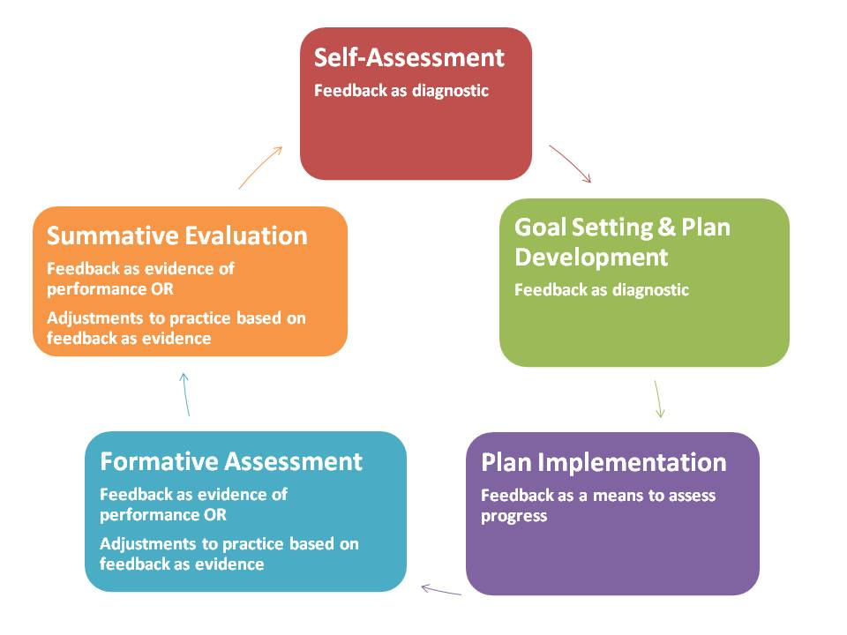
Where does feedback live in the evaluation cycle?
Notes:
Student feedback can be gathered at multiple points in the 5-step evaluation cycle and considered formatively, summatively, or both. For example, feedback can be an excellent source of formative or diagnostic evidence to consider during steps 1 and 2 of the cycle, Self-Assessment and Goal Setting & Plan Development, particularly as it sheds light on specific aspects of practice on which an educator might focus. Feedback can also be an appropriate and important piece of evidence that educators and evaluators consider during steps 4 and 5 of the cycle, Formative Assessment/Evaluation and Summative Evaluation, particularly as it relates to aspects of practice that are less readily “observable” through classroom observations or artifacts such as student work samples.

Slide 23
Questions
Ron Noble – rnoble@doe.mass.edu

