Slide 1
District-Determined Measures
November 5, 2014
MASC/MASS Joint Conference

Slide 2
Introduction

Slide 3
Two Separate Ratings
Exemplary
Proficient
Needs Improvement
Unsatisfactory
High
Moderate
Low
Summative
Performance Rating
Student
Impact
Rating

Slide 4
Intersection of practice and outcomes
Summative Rating
Exemplary | Self-Directed Growth Plan
Proficient
1-yr Self-Directed Growth Plan | 2-yr Self-Directed Growth Plan
Needs Improvement | Directed Growth Plan
Unsatisfactory | Improvement Plan
Low | Moderate | High
Student Impact Rating

Slide 5
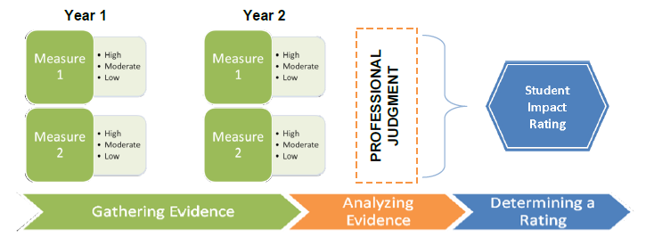
Student Impact Rating
Notes:
Measures are either DDMs or SGPs (if available). DDMs can take many different forms (e.g., pre-/post-tests, portfolio assessments, performance assessments, indirect measures).
A Student Impact Rating is only arrived at after considering: multiple years of data collected from multiple measures each year, each of which includes multiple students and then applying professional judgment to consider the learning context and the quality of the measures.

Slide 6
What is a DDM?
District-Determined
Measure of Student Growth
Aligned to Frameworks
Comparable Across District
District-Determined Measures are NOT measures of educator impact.
Notes:
Regulatory “Measures of student learning, growth, and achievement related to the Massachusetts Curriculum Frameworks, Massachusetts Vocational Technical Education Frameworks, or other relevant frameworks, that are comparable across grade or subject level district-wide. These measures may include, but shall not be limited to: portfolios, approved commercial assessments and district-developed pre- and post-unit and course assessments, and capstone projects.”
DDMs must be “comparable across schools, grades, and subject matter district-wide.” (603 CMR 35.09(2)a)
Type 1: Comparable within a grade, subject, or course across schools within a district
Identical measures are recommended
Type 2: Comparable across grade or subject level district-wide
Impact Ratings should have a consistent meaning across educators; therefore, DDMs should not have significantly different levels of rigor

Slide 7
Student Impact Rating
Example: Middle School Music Teacher
Year 1
Year 2
Music Terminology DDM
Low
Band Performance DDM
High
Music Composition DDM
High
Music Terminology DDM
Low
Band Performance DDM
High
Music Composition DDM
High

Slide 8
Major Shifts
From…
What teachers do - - - > what students do
Students’ proficiency - - - > students’ growth
Assessments within - - - > Assessments across

Slide 9
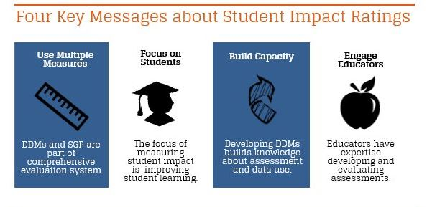
Key Messages for Stakeholders

Slide 10
Identifying DDMs –
Key Questions
Is the measure aligned to content?
  Does it assess what the educators intend to teach and what’s most important for students to learn?
Is the measure informative?
  Do the results tell educators whether students are making the desired progress, falling short, or excelling?
  Do the results provide valuable information to schools and districts about their educators?
See Technical Guide B for more about these key questions:
http://www.doe.mass.edu/edeval/ddm/TechnicalGuideB.pdf

Slide 11
Meaningful Conversations
Does the DDM help different educators in the same role discuss issues of key content?
Does the DDM highlight areas of strengths between different educators?

Slide 12
State of the Commonwealth
304 Plans reviewed by ESE
97 | Ready for full implementation (2 measures per educator, no extension requests)
101 | Ready to implement in most areas (few extension requests)
67 | Ready to implement with more than half of educators
26 | Ready to implement with less than half of educators
13 | Ready to implement with few educators (extensions requested for most areas)
33 | Requested blanket extensions
265
72

Slide 13
In Practice…
Lessons from Wakefield
Dr. Stephen Zrike, Superintendent
Dr. Kim Smith, Assistant Superintendent

Slide 14
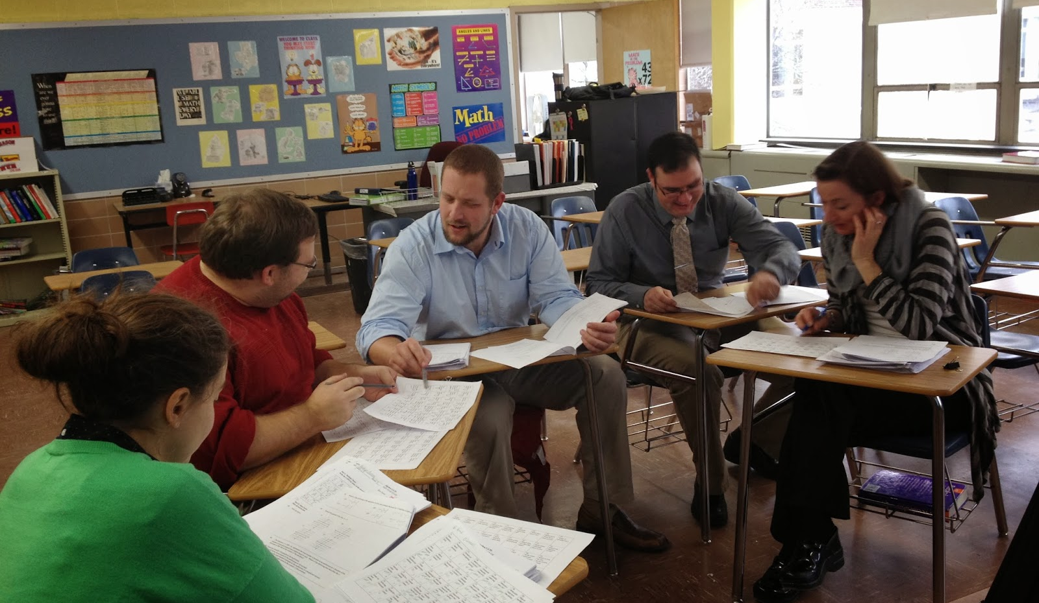
DDMs as an opportunity…
to foster student growth and achievement

Slide 15
An Opportunity for Wakefield Public Schools
Ongoing, just in time data collection, analysis and ACTION
Emphasis on growth
Educator influenced
Focus on student learning
Inclusive of all grade levels and content areas
Moving from data poor to data rich

Slide 16
Big Idea
We can raise student achievement with the ongoing collaboration and collective inquiry of educators, expressly focused on student learning and growth, as measured by common assessments
------------------------------------------------------------
DDMs are common interim assessments designed for this purpose

Slide 17
Structures and Systems of Support
Mechanism for collaboration: Professional Learning Communities (PLCs)
Time: Consistent job-embedded collaboration
Professional Development: Investing in adult development
Coaching Model: Providing teams with continuous support in meeting objectives
Communication/Clarity: Communicate clear expectations and provide oversight to obtain desired outcomes

Slide 18
Professional Learning Community (PLC) structure
A culture of professional collaboration with student performance data as centerpiece of discussion
Educators develop strategic response to students’ needs in order to ensure high levels of learning for all students.
DuFour, DuFour, & Eaker

Slide 19
Professional Development
Provides opportunity for educators to:
understand PLC framework
learn how to work with data and practice specific data protocols
establish team norms and student learning goals

Slide 20
Consistent, Job-embedded Time
Budget-neutral redesign of school schedules at middle school and high school to facilitate grade level/content area educator teams to meet 1-3 times per 6-day cycle
Currently working on plan for implementing 1x5 in K-4 schools

Slide 21
Clear Expectations & Oversight
Provide a self-assessment rubric as a guide for teams to strive for exemplary performance
Principal is a regular presence at meetings providing guidance and support
Implement a reporting mechanism for teams to complete on a regular basis
District-wide steering committee

Slide 22
Launch Coaching Model
Coaches (K-4), Coordinators (5-12), and Directors (K-12) bring knowledge of:
Common Core/MA State Standards
Best practices in data synthesis & analysis
Have time to assist busy teachers with:
planning and details between meetings
accessing materials and resources to support their work

Slide 23
Key to success? Buy-in
“State regulation says we have to do this”
will not inspire excitement, work ethic, and results from our teachers
A goal that reads “8th grade students will improve MCAS ELA scores by 25% by May of 2015”
will not elicit passionate and tenacious effort from our teachers

Slide 24
Teacher-driven student learning goals
Allowing grade level/content area teacher teams to examine student performance data, discuss their hopes and dreams for their students, and target a specific area of student learning and growth that they believe is essential to achieving these hopes and dreams
This is what will inspire sustained interest and resolute effort from teachers!

Slide 25
Provide “expert” support
Principals, coaches, coordinators, & directors take the role of “expert” coaches
help PLC teams shape and refine their student learning goals and action plans
oversee and support PLC team work over the course of the year

Slide 26
District-wide Steering Committee
Establish a district-wide committee of educators (teachers and administrators) to share ideas, experiences, and feedback on a monthly basis
Process each new aspect of the Educator Evaluation system and provide recommendations for implementation
Include teacher union leadership to ensure voice and perspective in regard to the teachers’ contract

Slide 27
District-developed Educator Resource Manual
Develop and provide educators with a district-developed resource
culling the vast amount of information and materials available at the state level to a manageable, user-friendly, and clear manual for local educators
providing a unique opportunity to “message” the Educator Evaluation system to match the values and context of the district

Slide 28
Setting Parameters

Slide 29
What are Parameters?
In the psychometric community the process is called “standard setting”.
Parameters support the critical conversation about what type of learning we expect, and what is above and below this expectation.
This is not a “last step” when creating an assessment.

Slide 30
Some Things Considered
Moderate growth is a range, not a point
Rigorous definition of low (all teachers will have some students who demonstrate low growth)
Focus on comparability across the scale.
Include a high enough “ceiling” so even high ability students can demonstrate growth

Slide 31
Some Approaches
Normative
  Set Percentage of Students as High, Moderate, Low
Historical Normative
  Based on historical or national percentages.
Qualitative
  Professional judgment, using current assessment
Embedded
  Predetermining parameters, and having scoring match

Slide 32
Normative: Determining a certain percentage of students that will be rated as high, moderate, and low. Making determinations of high, moderate, and low after results have been collected.
Advantages | Considerations
Straight forward Comparable standard across district Does not require existing data | Assumes identical growth in each measure Prevents identification of systemic improvement Cannot be used to identify impact for singletons Educators do not know parameters
Example: All students growth scores are converted to z-scores and rank ordered. Scores one standard deviation below the mean are determined to be low growth, while scores one standard deviation above are determined to be high growth

Slide 33
Historical Normative: Determining ratings that would have defined a certain percentage of students as high, moderate, and low.
Advantages | Considerations
Based on objective standards Can produce comparable standard across district Parameters are set before year | Requires historical or national pre-existing data Comparability across district cannot be assumed May not be straight forward Easier with commercial assessments
Example: In Easthampton, Using Fountas and Pinnell’s data, a team of educators determine that roughly 50% of students grow between 4 and 6 levels. They determine that growth 3 or less levels is low growth, growing more than 6 levels is high growth.

Slide 34
Qualitative: Setting parameters of high, moderate, and low based on the assessment and using professional judgment.
Advantages | Considerations
Parameters based on professional judgment Educators intimately involved in the process Parameters are set before year | Comparability across district cannot be assumed Time intensive
Example: In Chelsea, A team of educators looked at the level of growth they would expect to see from students on the assessments that they built. If the pre-test score was 0-5, they expected 4 points of growth, a 6-9 fall score 2 points of growth, and for pre-test scores of 10-12 a perfect score. They then aggregated. They determined a high overall rating was 80% or more reaching targeted growth, while low was less than a third of students reaching target.

Slide 35
Embedded: Developing scoring guides that are designed with high, moderate, and low.
Advantages | Considerations
Parameters based on professional judgment Educators intimately involved in the process Parameters are set before year | Comparability across district cannot be assumed Time intensive
Example: Determining beforehand that no movement is low growth, one point is moderate growth, and two points is high growth. Then writing the rubric.

Slide 36
Resources: http://www.doe.mass.edu/edeval/ddm/
Implementation Briefs
Technical Guide B
Webinar Series
Commissioner’s Memoranda
Educator Evaluation Newsletter
Technical Assistance and Networking Sessions
Using Current Assessments in DDMs (Curriculum Summit)
Example Assessments
Other ESE documents (Technical Guide A, Part VII, Regulations)

Slide 37
Questions
Ron Noble – rnoble@doe.mass.edu

