Slide 1
SUBSTANCE USE DISORDERS:
IDENTIFICATION & TRENDS
Dr. Romas Buivydas
VP, Clinical Development

Slide 2
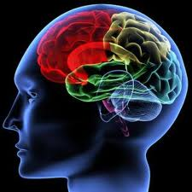
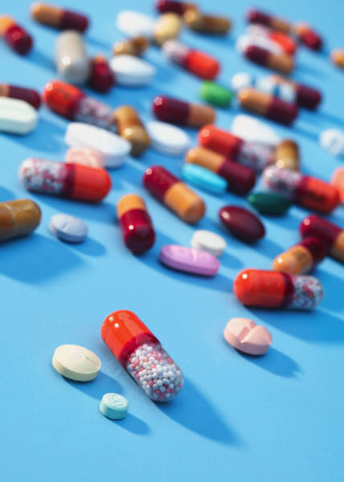
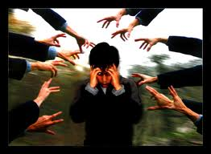
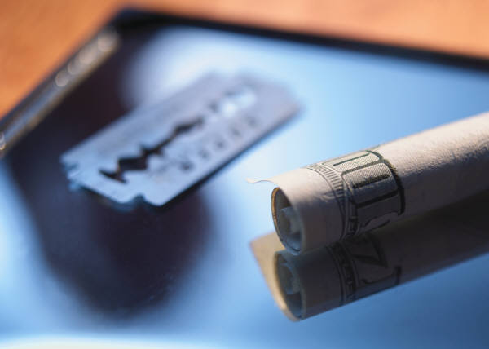
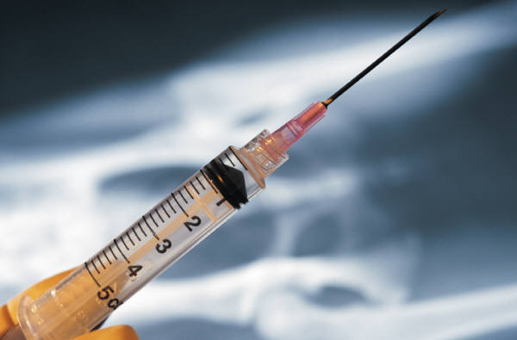
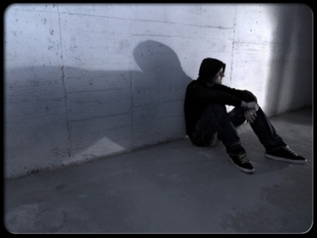
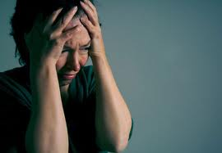
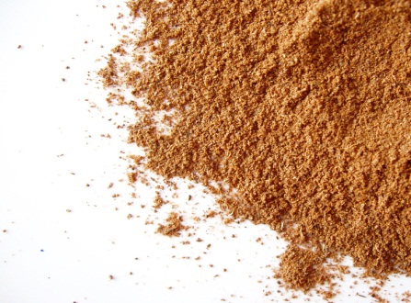
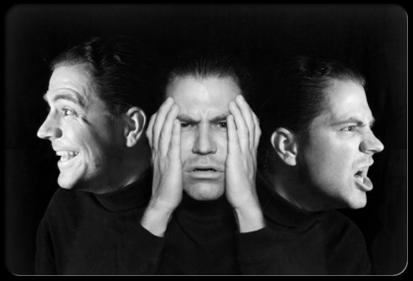
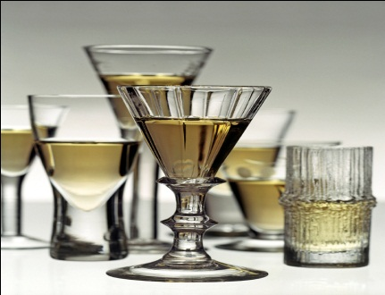
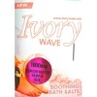
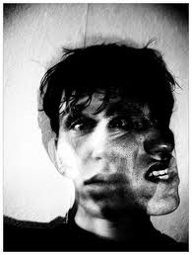
SUBSTANCE USE DISORDERS: IDENTIFICATION & TRENDS
Dr. Romas Buivydas
VP, Clinical Development
SPECTRUM HEALTH SYSTEMS, INC.

Slide 3
ALCOHOL
DESIRED EFFECTS OF USE
Euphoria
Decreased social anxiety
Decreased sexual inhibition
Sedation

Slide 4
ALCOHOL INTOXICATION
SIGNS AND SYMPTOMS SEEN WITH VARIOUS LEVELS OF BLOOD ALCOHOL CONCENTRATION (BAC)
20 - 99 mg%: loss of muscular coordination
100 - 199 mg%: neurological impairment, ataxia (impaired gait), prolonged reaction time, mental impairment, poor/impaired coordination
200 - 299 mg%: nausea, vomiting, ataxia
300 - 399 mg%: hypothermia, dysarthria (disturbance of speech), amnesia, stupor
400 - > mg%: coma
* Degree of impairment can depend on an individual’s degree of tolerance

Slide 5
ALCOHOL METABOLISM RATES
Alcohol is metabolized at a rate of:
1/3 ounce alcohol per hour
(3 beers in one hour = BAC of 50 mg% or .05)

Slide 6
MINOR WITHDRAWAL
TIME
STARTS IN 6+ HOURS AFTER THE LAST USE OF ALCOHOL
SYMPTOMS
Tremulousness
Insomnia
Nausea
Anorexia
Anxiety
Weakness

Slide 7
The Latest Drug Trends
Alcoholic Energy Drinks
Alcoholic Whipped Cream

Slide 8
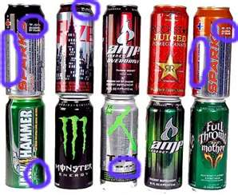
Alcoholic Energy Drinks
Alcohol Energy Drinks (AEDs) are pre-packaged beverages containing alcohol, caffeine, and various other stimulants such as ginseng, guarana, and taurine.
AEDs are not currently FDA regulated. The FDA limits beverages to 65 mg of caffeine. Some AEDs contain as much as 300 mg of caffeine—a dangerous amount of the stimulant, especially when combined with alcohol.
AEDs are sold under such brand names as Spark, Charge, Tilt, Joose, Four Loko, Liquid Charge, Rock Star 21, PINK Spirits and various others
Packaging of AEDs can make them very difficult to distinguish from regular (non-alcoholic) energy drinks-very similar packaging styles.
Many states require retailers to separate AEDs from regular, non-alcoholic energy drinks in their displays and provide training on this matter to state licensees.
To distinguish from regular energy drinks (no alcohol) check for the standard nutrition label- alcohol energy drinks DO NOT have a nutrition label, but list the amount of alcohol by volume (abv) instead.

Slide 9
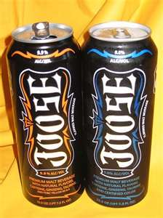
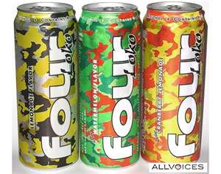
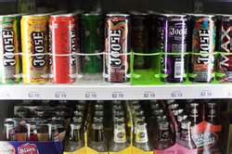
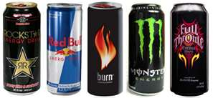
Some AEDs have as much as 12% alcohol content.
Some brands of AEDs are served in 23.5 oz. containers that may actually contain the equivalent of between 3 and 5 beers, as well as up to 8 cups of coffee.
The combination of energy drinks (stimulants) and alcohol (depressant) can lead to serious health effects:
dehydration which can also cause the effects of alcohol to be extended up to 24 hours
stimulants mask the effects of alcohol so individuals are unaware of the amount of alcohol they have consumed
after the effects of stimulants wear off, the effects of the depressant remains which can potentially lead to respiratory depression, vomiting while sleeping (which could result in asphyxiation/death), and other alarming medical concerns.
A 16 year old died in the VA Beach area as the result of a car accident in which his friend was charged with a DUI from drinking an Alcohol Energy Drink - a growing trend nationwide.

Slide 10
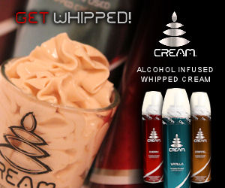
Alcoholic Whipped Cream
This product is sold in aerosol cans with packaging similar to non-alcoholic whipped cream products.
It is sold currently in over 10 states, primarily in liquor/alcohol stores where consumers must be 21 years of age & provide valid ID to purchase.
The average cost of these products is about $13 per canister
It is also known as “whipahol” and sold under several brand names such as Get Whipped, Cream, and Whipped Lightning.
The average alcohol by volume content is about 15%, though the Whipped Lightning brand contains 16-18% alcohol by volume (equal to 3-4 beers). This is also comparable in content to such drinks as Bacardi Mojito and Bailey’s Irish Crème.
The product is sold in a variety of popular flavors ranging from simple raspberry, orange & cherry to more exotic flavors such as white chocolate raspberry, caramel pecan, German chocolate, tropical passion, spiced vanilla, hazelnut espresso and cinnamon-used to help mask flavor of alcohol content.

Slide 11
SEDATIVES/HYPNOTICS
BARBITURATES and BENZODIAZEPINES are the two major (Xanax), and chlorazepate (Tranxene). A few sedatives-hypnotics do not fit either category. These include: methaqualone (Quaalude).
DESIRED EFFECTS WHEN USED
Decrease anxiety
Induce sleep categories of sedatives-hypnotics. The drugs in each of these groups are similar in chemical structure or effect. Some well – known barbiturates are secobarbital (Seconal) and pentobarbital (Nembutal). Well- known benzodiazepines include: diazepam (Valium), chlordiazepoxide (Librium), alprazolam
Offset effects of other drug classes

Slide 12
SEDATIVES/HYPNOTICS
INTOXICATION
Decrease in anxiety
Sedation
Occasional elation secondary to depression of inhibitions and judgment
Pupils are midpoint and slowly reactive
Hiccups can be seen in long term benzodiazepine use

Slide 13
SEDATIVES/HYPNOTICS
BENZODIAZEPINE OVERDOSE
Sedation with decrease in level of consciousness
Decrease in respiratory rate
Hypotension (low blood pressure)
Decrease in temperature
Gastric (stomach) paralysis
Respiratory compromise
Pulmonary edema (fluid in the lungs)

Slide 14
SEDATIVES/HYPNOTICS
BENZODIAZEPINE WITHDRAWAL
Mood changes
Negative, dysphoria (anxious, depressed), ruminative
Sleep changes
Insomnia, alterations of sleep - wake cycle
Physical changes
Increase in pulse rate and in blood pressure, increase reflexes, tremors, restless, nausea, seizures, pupils are dilated, exaggerated blink reflex (especially barbiturates), metallic taste
Perception changes
Illusions, hallucinations, depersonalization, sensory hyperactivity ( lights brighter, noise louder, etc.)

Slide 15
SEDATIVES/HYPNOTICS
SPECIAL CASES
ROHYPNOL (“Rufies”)
One of the first “date rape” drugs
Benzodiazepine class
Dissolves easily in carbonated drinks
Significant amnesia for up to 12 hours when used

Slide 16
OPIOIDS
DESIRED EFFECTS OF USE
“The Rush”
Sedation
Euphoria
Analgesia

Slide 17
OPIOIDS
Sometimes referred to as narcotics
Are prescribed because of their effective analgesic or pain relieving properties.
Opioids act by attaching to opioid receptors found in the brain, spinal cord and gastrointestinal tract.
Opioid drugs can also affect regions of the brain that mediate what we perceive as pleasure.
This results in an initial euphoria.

Slide 18
PRESCRIPTION OPIOIDS
Some examples:
Morphine
Codeine
Oxycontin
Vicodin
Dilaudid
Demerol

Slide 19
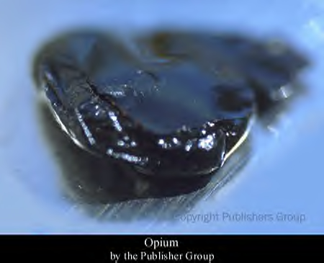

Slide 20
OPIOIDS
MORPHINE – a naturally occurring opiate
HEROIN
Heroin does not occur naturally, but is a semi - synthetic opioid
Morphine is isolated from the crude opium and then reacted with acetic anhydride, a chemical also used in the production of aspirin. The purity of the extracted morphine determines in large part the quality of the resulting heroin. Most black market heroin is highly impure due to contaminants left after refinement of opium into morphine when then remain in the final product.

Slide 21
OPIOIDS
HEROIN USE - URINE DRUG SCREEN SHOWS
Free morphine
Morphine Glucuronide
Free codeine
6 - Monoacetylmorphine
Only seen with heroin use
POPPY SEEDS IF EATEN IN QUANTITY CAN SHOW UP AS A POSITIVE URINE DRUG SCREEN FOR MORPHINE AND CODEINE

Slide 22
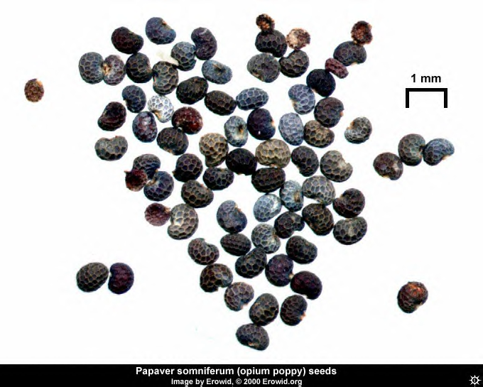

Slide 23
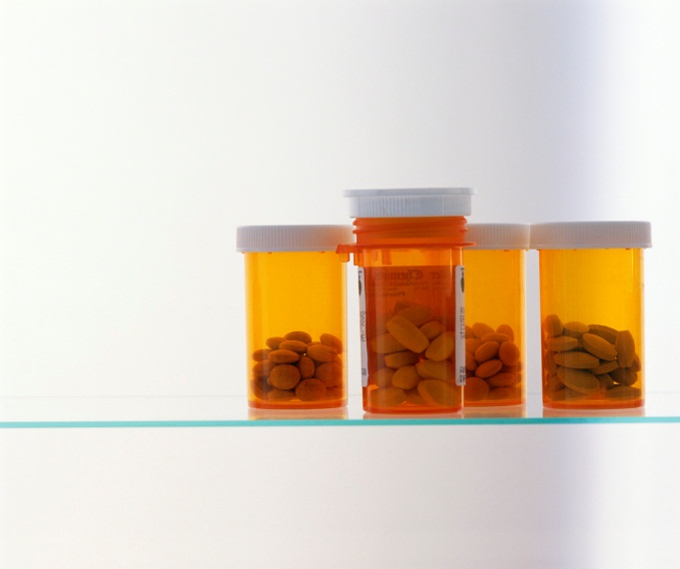
OPIOID INTOXICATION
MOST COMMON
Miosis (contraction of the pupil)
Nodding
Hypotension
Depressed respiration
Bradycardia (low heart rate)
Euphoria
Floating feeling

Slide 24
OPIOIDS OVERDOSE
Classic triad seen in overdose
Miosis (small pupils)
Coma
Respiratory depression
Pulmonary edema
Seizures
Demerol, Darvon, Talwin

Slide 25
WITHDRAWAL – EARLY PHASE
Lacrimation (eyes water)
Yawning
Rhinorrhea (runny nose)
Sweating

Slide 26
WITHDRAWAL - LATE PHASE
Increase in all previous signs and symptoms
Increase in heart rate
Increase in blood pressure
Nausea and vomiting
Diarrhea
Abdominal cramps
Labile mood
Depression
Muscle spasm
Weakness
Bone pain

Slide 27
STIMULANTS
DESIRED EFFECTS
Increased alertness
Feeling of well being
Euphoria
Increased energy
Decrease in appetite/weight loss
Heightened sexuality

Slide 28
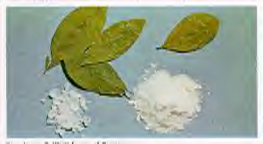
STIMULANTS
COCAINE LEAVES AND POWDER

Slide 29
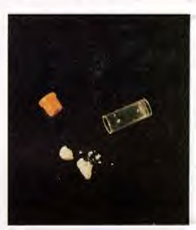
STIMULANTS
CRACK VIAL AND ROCKS

Slide 30
STIMULANTS
INTOXICATION
Pupils dilated
Increase in heart rate (30-50%)
Increase in blood pressure (15-20%)
Nausea / vomiting
Confusion
Tremors
Weight loss
Chest pain / arrhythmia
Electrocardiogram abnormalities (QRS and QT intervals are prolonged)

Slide 31
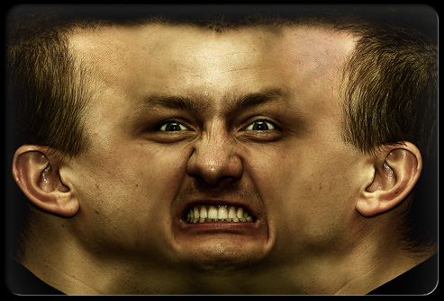
STIMULANTS
INTOXICATION
Headache (most common neurologic complaint)
Seizures (can occur after only one use of cocaine, usually need more than one time use for amphetamines to cause seizures)
Renal failure secondary to rhabdomyolysis and myoglobinuria (muscle cells in the urine)
Priapism (painful penile erection)
Psychotic behaviors

Slide 32
METHAMPHETAMINE
In 1997 in the West, Southwest, and South, meth was only an emerging drug
Meth popular in San Francisco with young users who combine it with heroin (“meth speedball”), or combine it with coffee in affluent areas (“biker’s coffee”)
Perceived harmfulness of meth among youth has declined steadily
Stimulant use is cyclic and happens in outbreaks in US (Fenway Institute, 2006)
Meth currently is most prevalent controlled synthetic substance clandestinely manufactured in US

Slide 33
METHAMPHETAMINE
Commonly sold in ¼ g = “a good weekend” for 1st time users
1/16 oz. = “teenager”
1/8 oz. = “8-ball”
1 g every 2-3 hrs for chronic meth addicts

Slide 34
Before Source: Nebraska State Patrol

Slide 35
After Source: Nebraska State Patrol

Slide 36
STIMULANTS
MDMA
Methylenedioxymethamphetamine
Developed as an appetite depressant
“Ecstasy”
Damages serotonin transmission sites
* Ecstasy is in the methamphetamine class of drugs – many of the features detailed in the next slides pertain to methamphetamines in general.

Slide 37
STIMULANTS
Ritalin
Adderall (amphetamine based)

Slide 38
STIMULANTS
Enhance brain activity
Cause an increase in alertness, attention and energy that is accompanied by increases in blood pressure, heart rate and respirations.

Slide 39
STIMULANTS
MDMA
Users report
Nausea
Jaw clenching and teeth grinding
Increase in pulse rate
Tremors
Blurred vision
Anxiety
Altered time perception
Decreased libido
Increase in social interactions
Tics
Decrease in sleep
Paranoia

Slide 40
STIMULANTS
MACE AND NUTMEG
Contain Amphetamine (MDA)
With use see
Projectile vomiting
Blinding headaches
Localized and persistent kidney pain
Localized and persistent joint pain

Slide 41
HALLUCINOGENS
The subjective experience of hallucinogen intoxication is heavily determined by the set (expectations for the experience and personality of the use) and setting of the user.

Slide 42
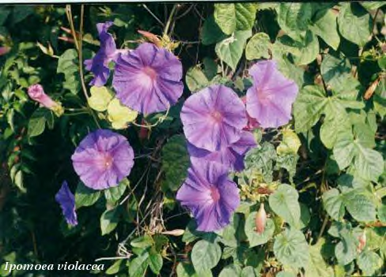
HALLUCINOGENS
MORNING GLORY- LSD DERIVATIVES

Slide 43
HALLUCINOGENS
DESIRED EFFECTS OF USE
Modification of perception
Hallucinations
Distortions (trails)
Insight
Synesthesia (cross over or mixing of the senses “smell a sound”)
Onset in 60 minutes with peak in 2 - 4 hours

Slide 44
HALLUCINOGENS
COMMON PROBLEMS
Rapid tolerance ( 3 - 4 days for LSD )
Depersonalization
Confusion
Acute anxiety and panic
Depression
Flashbacks
Temporary psychosis
Loss of coordination
Increase in pulse rate and temperature
Dilated pupils
Nausea and vomiting 30 - 120 minutes after mescaline use
Increase in cortisol and prolactin hormone levels

Slide 45
HALLUCINOGENS
COMMON PROBLEMS
Flashbacks
Same with marijuana, LSD, psilocybin, mescaline, PCP and MDMA use
15 - 77% of users report brief flashbacks
Taper off over time
Benzodiazepines can be used (better than Haldol) to treat problematic flashbacks

Slide 46
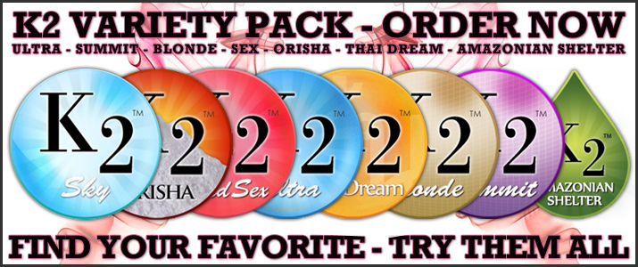
K2/Spice products are a mixture of herbal/spice plant products sprayed with potent psychotropic drugs, often
contaminated with unidentified toxic substances which
contribute to various adverse health effects (also
cause hallucinogenic effects similar to effects of PCP.
Marketed under variety of names including K2, Spice, Pep Spice, Spice Silver, Spice Gold, Spice Diamond,
Smoke, Sence, Skunk, Yucatan Fire, Genie & Zohai
Sold in variety of colors/flavors- usually sold in foil packaging

Slide 47
Status of K2/Spice
Police in Indianola, Iowa report 18 yr old smoking K2 resulting in severe anxiety attack-stated was “going to hell” and went home and shot & killed his self.
K2/Spice is labeled by users as the “stealth” marijuana.
Dr. Anthony Scalzo (professor of toxicology at St. Louis University) indicates nearly 30 cases in past month involving teenagers experiencing hallucinations, severe agitation, elevated heart rate/blood pressure, vomiting and tremors/seizures as result of smoking K2.
Scalzo states that what makes K2 (and other Spice derivatives) so dangerous is that its side effects suggest that it also affects the user’s cardiovascular system, as well as the central nervous system.
One sign of use that parents should look for is dried herbal residue in their children’s rooms, as well as the foil packets in trash.
Check out advertising at http://www.dutchincense.com/

Slide 48
CANNABINOIDS
Work in the hippocampus
Highly correlated with alcohol use in the adolescent

Slide 49
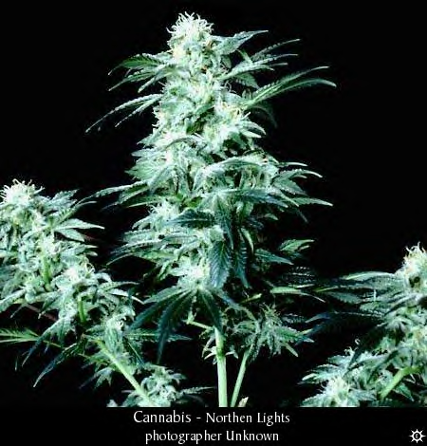
CANNABINOIDS

Slide 50
CANNABINOIDS
DESIRED EFFECT OF USE
Sense of well being
Euphoria
Modified level of consciousness
Altered perceptions
Altered time sense
Sexual disinhibition

Slide 51
CANNABINOIDS
COMMON PROBLEMS
Decrease vigilance
Decrease motor coordination
Decrease strength
Increase pulse rate (not blood pressure or temperature
Galactorrhea (breast milk production) in 20% of female users
Decrease testosterone
Decrease in sperm count and motility
Interference with macrophage antigen processing (killer cells are unable to process foreign bodies – impaired immune system)

Slide 52
CANNABINOIDS
COMMON PROBLEMS
Inability to learn
Acute panic
Delirium
Depersonalization
Paranoia
Hallucinations
Flashbacks

Slide 53
DISSOCIATIVE ANESTHETICS
KETAMINE (Club drug: “K”, “Special K”, “Vitamin K”
FDA class III
Shorter acting than PCP
Oral or IV and hard to smoke
The effects of a ketamine “high” usually last an hour but it can last for 4 – 6 hours and 24 – 48 hours are generally required before the user will feel completely “normal” again. Effects of chronic use of ketamine may take from several months to two years to wear off completely. Low doses (25 – 100mg) produce psychedelic effects quickly. Large doses can produce vomiting and convulsions and may lead to oxygen starvation to the brain and muscles; one gram can cause death. Flashbacks may even occur one year after use.

Slide 54
INHALANTS/SOLVENTS
DESIRED EFFECTS OF USE
Euphoria
Excitement
Altered perceptions
“A cheap high”

Slide 55
INHALANTS/SOLVENTS
INDICATIONS OF USE
Chemical odor
Paint stains
Hidden containers (whiteout, glue)
Drunk
Dizzy
Gait impairment
Slurred speech
Red running nose and eyes

Slide 56
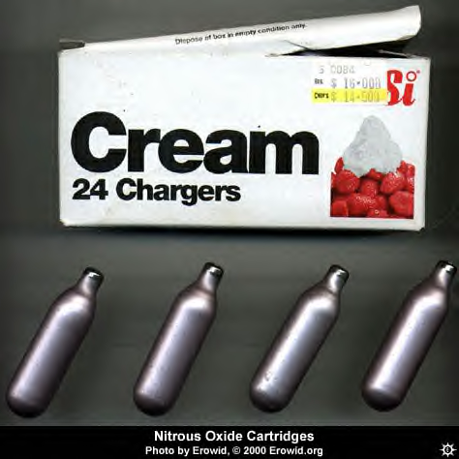
INHALANTS/SOLVENTS

Slide 57
INHALANTS/SOLVENTS
COMMON PROBLEMS
Nervous system
Ototoxicity (impaired hearing) - dimethyl benzene (toluene)
Peripheral neuropathy - hexane (glue), ketones and toluene
Multiple sclerosis-like syndrome - nitrous oxide
Vertical nystagmus
Slurred speech
Impaired judgment
Lack of coordination

Slide 58
DXM - DEXTROMETHORPHAN
ROBITUSSIN, CORICIDIN COUGH & COLD
Accessible and cheap
Drunk, high and tripping at the same time
Mega –dosing
Drink entire bottle or ingest 10 – 40 pills
Risk of acetaminophen (Tylenol) toxicity
Risk of toxicity
Olney’s Brain lesions
Learning and memory impairment
Visual perception impairment

Slide 59
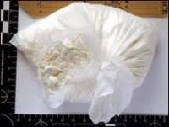
BATH SALTS
Bath Salts are a synthetic product that contains hallucinogenic, mind-altering chemicals similar in structure to those also found in cocaine and ecstasy, depending on which brand or form is purchased.
It is being sold as a bath salt, or plant food in some cases, labeled “for novelty use only” and/or “not for human consumption” in order to by- pass FDA regulations-not being sold as food or drug product.
It is most often sold in either 250mg or 500mg packets depending on brand or form purchased.
Though Ivory Wave is the most popular form/brand of this product, it (or similar products) is also sold under other names such as Vanilla Sky, Fly, Snow, Ivory, Charge, Ivory Coast, Purple Wave, Cristalius, Magic, and Ocean Blue. There are also competitors with similar products made of the same chemical compounds identified as Columbian Salts and Bolivian Salts.

Slide 60
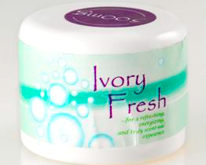
BATH SALTS
The drugs identified in these products most often are MDPV (methylenedioxypyrovalerone) usually referred to as pyrovalerone, a powerful psychoactive chemical similar to Ritalin which acts as a stimulant that inhibits re-uptake of dopamine & norepinephrine while having minimal effects on serotonin levels. Tests have also identified most versions of these products as containing Lidocaine which is frequently used by dentists for anesthesia. Many versions may also contain similar components to the drug MDMA (aka ecstasy).
It appears to be purposely designed in a way that will mimic the effects of cocaine/crack or ecstasy and is most often used by snorting.
It is sold most frequently on-line, though also in some tobacco/smoke shops as a novelty item “not for human consumption” for about $30 for a small package. Many websites sell it in bulk (50-100 packets) for a discount rate. (Bath salts being sold in smoke shops should raise questions about its content with most people)

Slide 61
The Latest Trends
Krokodil (desmorphine)
Tampons
Molly (MDMA)
N-Bombs (25I-BOMe)
Syrup (codeine + promethazine)

Slide 62
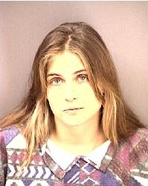
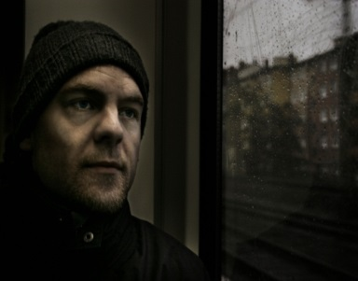
WRAP UP
62

