Slide 1
PARCC – A Two Year Test Drive
MASS/MASC Joint Conference
November 6, 2014
Notes:
Welcome to this session about the PARCC Practice tests. This is one of a dozen presentations that will be given in Massachusetts in the fall of 2014.
Notes to Presenter:
You can customize this opening slide to show the location and date of your specific presentation.

Slide 2
Agenda
Comments from Deputy Commissioner Jeff Wulfson
The Two-Year Test Drive of PARCC
Results of 2014-15 assessment choice
Public reporting and accountability in 2015
A District Perspective: Revere and Burlington

Slide 3
The Massachusetts Story: K-12
The 1993 Massachusetts Education Reform Act established high standards and equitable school funding regardless of a student’s zip code
The Massachusetts Curriculum Frameworks for ELA and Math have been revised 4 times since 1995
The 2011 Frameworks incorporate the Common Core State Standards
Today, Massachusetts K-12 students outperform all other states and rank right near the top internationally
High school graduation rates are at all-time high and drop-out rates are the lowest in decades
Notes:
Massachusetts has been working to improve public education for more than two decades now, beginning with the landmark Massachusetts Education Reform Act in 1993. That was the legislation that stipulated, among other things, that Massachusetts public school districts’ curriculum and instruction would be guided by standards in the Massachusetts Curriculum Frameworks and that all students who attend public schools must participate in statewide assessments.
Massachusetts math and ELA standards and frameworks adopted by the Board of Elementary and Secondary Education in 2010 incorporated the Common Core State Standards. These new frameworks superseded those adopted in 2000 and 2001, which had supplements in 2004.
Historically, the Massachusetts Curriculum Frameworks have received positive reviews from independent reviewers. But it is really what Massachusetts educators have done to make the standards important in their classrooms that matters. On national and international measures of math and reading such as the National Assessment of Educational Progress (NAEP) and PISA (the international Program for Student Assessment), as well as on the SATs, Massachusetts students perform extremely well.
In addition, we can be proud of increasing high school graduation rates and decreasing dropout rates.

Slide 4
Improve Student Success
MA legacy of rigorous standards and assessments
#1 nationally and top tier internationally
Lessons learned: What we must improve
1 in 3 HS graduates who enroll in public higher education require non-credit bearing remedial courses thereby greatly diminishing the likelihood of earning a college diploma
Historic agreement between K-12 and Higher Education
Enroll directly in credit bearing freshman courses
Assessment that reflects the world our children live in
More comprehensive and authentic assessments

Slide 5
PARCC: Ready to Assess College and Career Readiness in Massachusetts
Our schools have been transitioning to new college- and career-ready academic standards since 2010
New standards require a new assessment system
We’re “test driving” PARCC
Could replace MCAS for ELA and math in 2016 for grades 3-8 and for grade 10 after 2019
Emphasizes the problem-solving and thinking skills needed for success in college and the workplace
Computer-based (with a paper/pencil option)
A smoother transition to college with historic placement agreement between K-12 and higher education
Notes:
Schools across the Commonwealth have been making the transition to curriculum and instruction aligned to the 2011 standards since 2010, when the Board first adopted the Common Core State Standards.
Since statewide assessments are based on standards, our assessment system has to change eventually. We have been making incremental changes with MCAS over the past two years, at the same time that PARCC assessments were under development.
PARCC has developed computer-based assessments that have not been developed for MCAS, with the aim of creating s smoother transition from high school to college and careers.

Slide 6
What Does PARCC Look Like?
It includes 2 parts in English language arts
and 2 parts in math.
 |  | English Language Arts | Mathematics
Part 1 | Performance-Based Assessment (hand-scored) Late March—early April | Writing effectively Analyzing print and video texts | Solving multi-step problems Using abstract reasoning
Part 2 | End-of-Year Assessment (computer-scored) May | Reading comprehension | Understanding major grade-level appropriate math concepts
Notes:
PARCC assessments in math and ELA/literacy have 2 parts.
Part I consists of Performance-Based Assessments in late March or April. In math, these include solving multi-step problems; in ELA , the assessments include writing at all grade levels to respond to multiple texts, some of which may be multimedia.
Part II consists of an end-of-year assessment in May that is computer-scored.

Slide 7
Where Are We on the PARCC “Test Drive”?
2013
BESE votes on 2-year “test drive”
March-June 2014
PBA and EOY field tests
June-Oct 1, 2014
Districts choose PARCC or MCAS
Spring 2015
Operational PARCC and MCAS testing
Fall 2015
BESE votes whether to adopt PARCC
2016
PARCC is implemented or transition begins to another “next-gen” assessment
Today
Notes:
Right now we are in the middle of this calendar: districts have made their choice whether to give MCAS or PARCC in the spring of 2015.

Slide 8
Yr 2: 2015 Operational Test
Test Drive: Yr 1: 2014 Field Test
2014 Field Test: About 15% of students in grades 3-11 “tested the test” – assessing test items and online/paper test delivery
2015 PARCC Operational Test: All students within a district that selects PARCC in grades 3-8 and possibly some in grades 9 & 11 will take the new assessments
Each school will administer PARCC either online OR on paper in both English Language Arts and Mathematics
Students in grades 5, 8, and high school will also continue to take the MCAS Science and Technology/Engineering tests.

Slide 9
What did 37,000 Students Say about Taking PARCC Online?
The majority of students expressed a preference for the online tests over paper-and-pencil tests (74% ELA, 56% Math)
All or most test questions asked students about things they had learned in school this year (87% in ELA, 70% in math)
28% reported that the ELA test was more difficult than their school work; 61% of students reported that the math test was more difficult
83% (Math) to 94% (ELA) of students responded that they had enough time!
Two out of three students took one or more practice tests on a computer or tablet to get ready

Slide 10
What did 37,000 Students Say about Taking PARCC Online?
Approximately 87% use a computer or tablet on at least a weekly basis at home
Approximately 60% use a computer or tablet on at least a weekly basis in school
The vast majority (87%) of students taking the ELA PBA found it “easy to type answers;” for math, 58% founding typing “easy” – but 41% found it “hard”
Almost half of students (46%) reported a technology problem during the math test, compared to 31% in ELA
Students overwhelmingly found it easy to navigate and use the embedded “accessibility tools”

Slide 11
371 Online PARCC Field Test Administrator Survey Highlights
81% had never before administered a computer based test
Most students were able to complete the test without needing the additional time allotted (sessions were 40-80 minutes)
29% said none of the students in their class needed additional time; 44% said less than 1/3rd needed additional time; 28% said about half to the majority needed the additional time
48% said the training did not prepare them to solve basic problems related to technology; 46% agreed that the training was adequate

Slide 12
MCAS/PARCC Choice for Spring 2015
Public School Districts and Charters
Grades | Number of Districts (serving grades 3–8, or high school students) | MCAS |  | PARCC
 |  | # | % | # | %
Grades 3–8 | 362 | 165 | 46% | 197 | 54%
Grade 9 and/or 11 | 295 | n/a | n/a | 71 | 24%
Notes:
This chart show that 54% of districts have chosen to administer PARCC and 46% MCAS in grades 3-8 in 2015. ESE’s goal was to have 50% of districts select PARCC.
24% of districts will also administer PARCC high school assessments in 2015.
The advantage of the Massachusetts policy of providing choice to districts is in part that we will gain information on student performance on the two types of assessments.

Slide 13
PARCC Mode of Administration
Grades | Number of Public School Districts Administering PARCC | Districts Administering Paper-Based Tests |  | Districts Administering Computer-Based Tests |  | Districts Administering Both Computer- and Paper-Based Tests
 |  | # | % | # | % | # | %
Grades 3–8 | 197 | 58 | 29% | 99 | 50% | 40 | 20%
Grade 8 Algebra I | 63 | 15 | 24% | 32 | 51% | 16 | 25%
Grade 9 and/or 11 | 71 | 15 | 21% | 52 | 73% | 4 | 6%
Notes:
And here is the breakdown of PARCC districts choosing the computer-based version versus the paper/pencil version.

Slide 14
Demographics of MCAS and PARCC Cohorts
Group based on 2013-14 Enrollment in Grades 3-8 | MCAS N = 194,054 |  | PARCC N = 232,529
 | # of Students | % of MCAS | # of Students | % of PARCC
African American | 9,969 | 5.1% | 25,874 | 11.1%
Asian | 13,108 | 6.8% | 13,201 | 5.7%
Hispanic | 30,750 | 15.8% | 40,676 | 17.5%
White | 134,017 | 69.1% | 144,812 | 62.3%
Low Income | 66,811 | 34.4% | 98,101 | 42.2%
LEP | 12,750 | 6.6% | 18,815 | 8.1%
Students w/Disabilities | 32,927 | 17.0% | 40,453 | 17.4%

Slide 15
Breakdown of PARCC Mode by Income
Grades 3-8 only; poverty defined as districts with 40% or more students eligible for free or reduced lunch
Notes:
District that selected PARCC had the option of administering the tests online or with paper—on a school by school basis.
One concern is that online testing could exacerbate the digital divide.
We see here that 60% of wealthy districts have decided to administer PARCC only online, while 22% have selected to paper option only. For high poverty districts, only 38% are exclusively administering the online tests.

Slide 16
Public Reporting on PARCC
The Department will use a representative sample to link PARCC results to MCAS results
Achievement and growth (where available) will be reported at the student, school, district, and state levels
A large representative sample will allow the Department to identify PARCC scaled scores that are similarly difficult to achieve to calculate a Composite Performance Index, Needs Improvement, and Advanced cut scores under “hold-harmless”

Slide 17
“Hold harmless” approach for schools administering PARCC
Will data be reported for a school that administers PARCC?
Yes, ESE will report assessment and accountability data for all schools, whether they administer MCAS or PARCC
Using a representative sample, ESE will use “equipercentile linking” to compare and publish achievement levels and CPI scores based upon 2015 MCAS and PARCC results for each school
ESE will calculate reliable student growth percentiles (SGPs) for schools that administer PARCC

Slide 18
Linking Student Achievement Results

Slide 19
Calculating Growth Percentiles with PARCC

Slide 20
“Hold harmless” approach for schools administering PARCC
Will accountability reporting be different in 2015?
Yes, but only for schools that administer PARCC. Their level will stay the same or improve from 2014, but cannot decline. Protocols will be followed that ensure PARCC 2015 results do not disadvantage school accountability classifications in 2016, 2017, and 2018 as well
Schools administering MCAS will be classified into a level as usual, and will not be held harmless

Slide 21
“Hold harmless” approach for schools administering PARCC
What will hold harmless look like in practice?
Below are three hypothetical examples of 2015 accountability determinations for schools that participate in PARCC in spring 2015

Slide 22
Resources and Questions
Email questions to: parcc@doe.mass.edu
Additional resources:
www.parcconline.org
www.doe.mass.edu/parcc
www.mass.edu/currentinit/parcc.asp

Slide 34
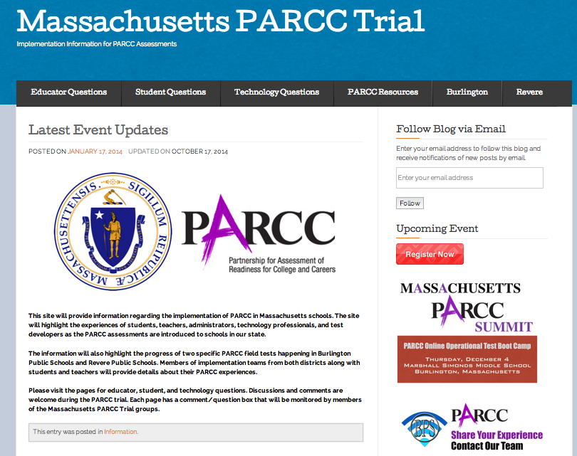
massparcctrial.org/

