Slide 1
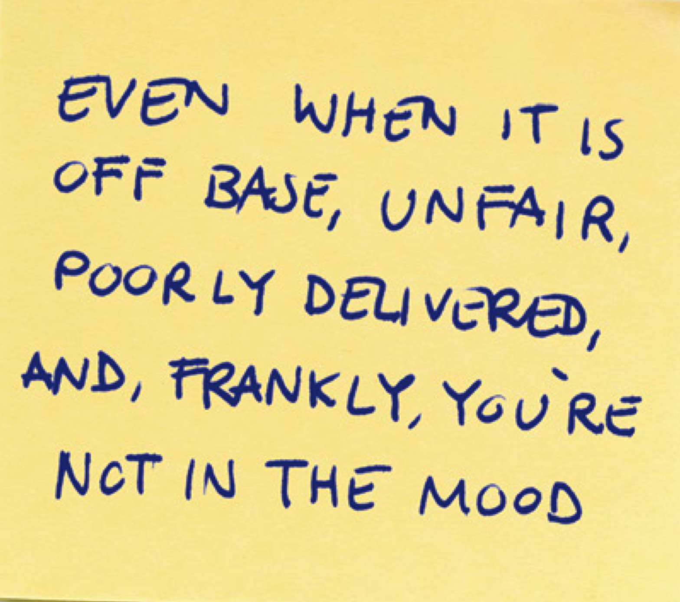
MASC MASS Joint Conference
How to Receive Feedback Well
MASC MASS Joint Conference
November 6, 2014
Douglas Stone
of Triad Consulting

Slide 2
There are No Perfect Feedback Systems
Some systems are better than others, but every system has tradeoffs
Whatever the system, it will succeed or fail based on the quality of the feedback conversations that givers and receivers engage in

Slide 3
We Had it Backwards
Learning to give feedback more skillfully, clearly, and often is useful
But it’s the receiver who is in charge
The receiver decides whether and how to use the information and whether and how to change

Slide 4
What’s So Hard?
2 Core Human Needs:
The need to learn and grow, and
The need to be accepted, respected and loved,
just the way you are now

Slide 5
What Is
"Feedback”?
I wish you’d give me more feedback
What exactly do you want?
Appreciation
I see you. I value you. I thank you.
Coaching
Skills Coaching: Here’s how you can improve
Evaluation
Here’s how you’re doing and where you stand compared
to others, or against expectations
Notes:
- Why is it important to have all three?

Slide 6

In Pairs
Think of a time in your life when you received coaching or advice, and did not take it
Why didn‘t you take it?

Slide 7
3 Triggers We Use to Disqualify Feedback
TRUTH Triggers
You’re wrong! That’s not true!
RELATIONSHIP Triggers
      Who are you to tell me?!
IDENTITY Triggers
      AAARRGGHH!! Too upsetting to hear

Slide 8
Managing Truth Triggers

Slide 9
“I don’t like the way
those pants look on you”

Slide 10
“Those pants don’t do you justice—you are so much better than those pants”
“I don’t like those particular pants, at this moment. Oh wait, now they look pretty good…”
“I don’t like the way those kinds of pants look on you”
“You’re not as fit anymore and those pants are no longer flattering”
“You’ve never had any taste. This is the kind of thing people mock you for, behind your back”
“I’ve asked you not to wear those in the past. You don’t care what I want. You’re humiliating and selfish”
“I want a divorce”

Slide 11
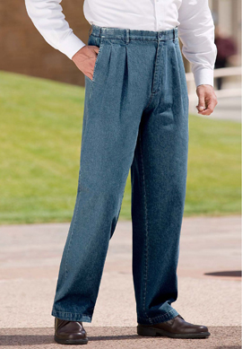

Slide 12
Can You Pass the “Label” Test?
When they say, “be more _______”
professional
appropriate
engaged
politically savvy
proactive
of a team player
athletic
What do they mean?

Slide 13
Getting Under the Label
Coming from?
Going to?
Data and observations?
Expectations?
Interpretations?
Implicit rules?
Advice or coaching?
Consequences?
Label

Slide 14
Our Blind Spots
Everyone has blind spots
  Facial expressions
  Body language
  Tone of voice
  Patterns of behavior
  Impact on others

Slide 15
A Loud Internal Voice Blocks Feedback
That’s totally wrong and stupid!! ☹
Thanks for the feedback ☺

Slide 16
Re-Direct Your Internal Voice Toward Curiosity
First understand the feedback, by digging under labels
You can ask yourself what’s wrong with the feedback, but also ask what might be right?
And experiment: create a behavioral change to test whether the feedback is helpful, even if you doubt that it’s “true”

Slide 17
Managing Relationship Triggers

Slide 18
Louie Brings Kim Roses
Kim: Listen. Try not to take this the wrong way, okay, but if we’re going to be married for the next 30 years, I need you to know that red roses are not my thing. I really don’t like red roses.
Louie: Okay, well, can I critique how you told me that? It’s not that big a deal. I just think that you should have thanked me for the flowers first, then said the thing about the roses.
Kim: I’ve told you before that I don’t like red roses. Remember?
Louie: But still, I was thinking of you, so I bought you flowers.
Kim: If you were thinking of me, you wouldn’t have gotten me red roses.
Louie: Oh, come on, Kim, I brought you flowers. That’s a nice thing! You say thank you. It’s called being polite.

Slide 19
Louis Brings Kim Roses
Kim: You know what would be polite? If when I told you things, you actually listened!
Louie: Hang on, all I’m asking for here is a tiny bit of gratitude. So maybe they’re not your favorite kind of flowers!
Kim: No, I didn’t say ‘not my favorite,’ I said don’t bring me red roses!
Louie: What is wrong with you?! Are you allergic to saying thank you to people?!
Kim: How do you expect someone to thank you for giving them something they specifically told you they don’t want!?
Louie: You know what’s a better question? How you get given red roses and turn around and act like this?!

Slide 20
Switchtracking
Kim’s: you don’t listen
Louis’: you are unappreciative
Notes:
We Triggers create a second topic, shifting the conversation from their feedback for us, to our feedback to them.
Often neither giver nor receiver realizes there are two different topics. Each hears the conversation through their own topic filter.

Slide 21
Relationship Triggers Create
Switchtrack Conversations
You have two separate but important issues to discuss:
1. How and when the feedback
was offered
2. The actual content of the
feedback
Give each topic its OWN TRACK
Notes:
We Triggers create a second topic, shifting the conversation from their feedback for us, to our feedback to them.
Often neither giver nor receiver realizes there are two different topics. Each hears the conversation through their own topic filter.

Slide 22
Relationship Preparation is KEY
Questions for Giver and Receiver to Discuss
What feedback have you gotten in the past that was helpful to you? Why?
What feedback have you received that was not helpful. Why not?
How do you often react to feedback in the moment?
What would you like to learn (specific skills, tools, goals, perspectives?)
What are you NOT working on at the moment?
What advice do you have for me for how to help you?
Do you want more Evaluation? Coaching? Appreciation?
What’s your baseline? Positive sustain? Negative recovery?
And remember: feedback is a relationship, not a meeting

Slide 23
Managing Identity Triggers

Slide 24
The “50-40-10” Formula
    Neuroscientists and psychologists estimate that, regarding our response to stress and to feedback, about:
    50% is “wired in;”
    10% is based on the “situation;” and
    40% is based on “how we tell the story” about what the situation or feedback mean to us

Slide 25
We Are All Wired Differently
    Baseline
    Swing
    Sustain/Recovery

Slide 26
Physiological Sustain/Recovery
Positive sustain:
How long does positive feedback buoy your spirits?
Dopamine & seratonin circuit
Negative recovery:
How far do you swing?
How long does it take for you to recover from negative feedback?
Referred to as “resilience”; individuals can differ by up to 3000%

Slide 27
Sustain/Recovery Combinations
 | No big deal | Love feedback
 | Hate feedback | Hopeful, but fearful
Quick
Negative RECOVERY
Slow
Short
Long
Positive SUSTAIN
Notes:
Quick recovery + long sustain = low risk, high reward → love feedback!
Quick recovery + short sustain = low risk, low reward → no big deal
Slow recovery + long sustain = high risk, high reward → hopeful, but fearful
Slow recovery + short sustain = high risk, low reward → hate feedback!

Slide 28
How We Tell the Story Matters Too:
Identity Triggers Cause Distortions
PAST | Google Bias 129,045 reasons why I’m a terrible person.
PRESENT | One Thing is Everything I’m completely incompetent.
FUTURE | Doom Zoom It’s hopeless, I’ll never get better, I’m going to die alone.

Slide 29
Feedback Containment Chart
What is
this feedback about?
What’s isn’t
it about?

Slide 30
And Mindset Impacts Story
FIXED
MINDSET
This is how I am
and always will be
GROWTH
MINDSET
I can learn and improve

Slide 31
Triad Consulting Group
Harvard Square
50 Church Street, 3rd Floor
Cambridge, MA 02138
USA
617-547-1728
www.triadconsultinggroup.com
Handling
Difficult Conversations

