Slide 1
Teaching Forward
Effective Technology Integration in Schools
Traci Jansen
Wilmington Public Schools
Jennifer Judkins
Lynnfield Public Schools
Jennifer Scheffer
Burlington Public Schools

Slide 2
Jennifer Judkins
Google Education Trainer &
District Tech Integration Specialist
Lynnfield Public Schools
judkinsj@lynnfield.k12.ma.us teachingforward.net
@jennjudkins https://plus.google.com/+JenniferJudkins

Slide 3
Traci Jansen
Google Educator &
Elementary Tech Integration Specialist
Wilmington Public Schools
traci.jansen@wpsk12.com TechFocus
@tbjansen +TraciJansen

Slide 4
Jenn Scheffer
Google Educator &
Digital Learning Coach
Burlington Public Schools
jscheffer@bpsk12.org
BHS Help Desk
@jlscheffer
+Jennifer Scheffer

Slide 5
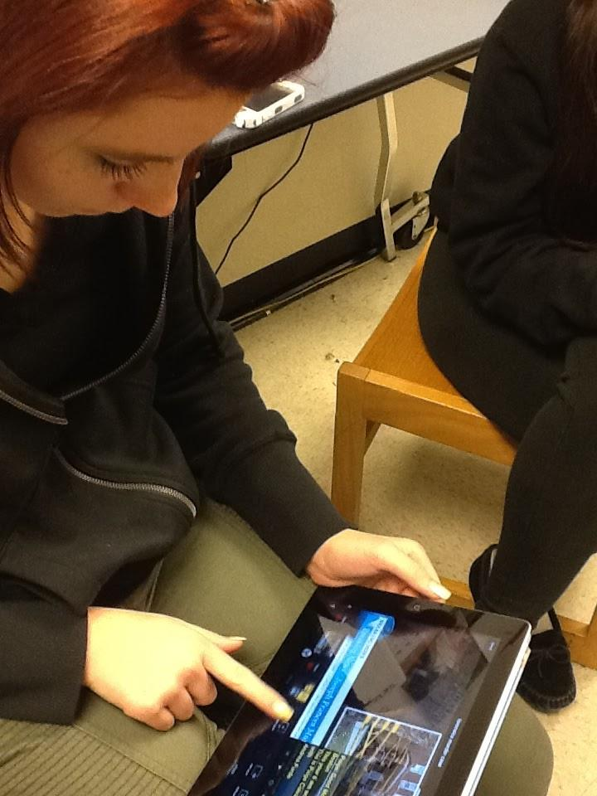
Considerations
Infrastructure readiness
On-going Teacher Training & Classroom Support
Device Selection
Format - 1:1, carts
Access - What content do you allow/restrict

Slide 6
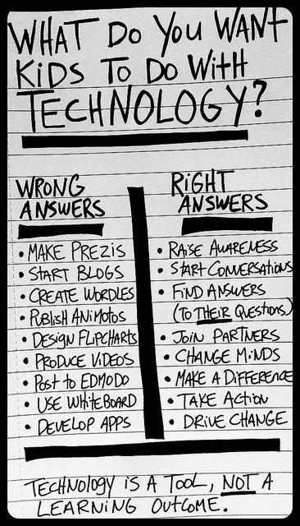
Embedding 21st Century Skills
Communication & collaboration
Creativity & innovation
Critical thinking, problem solving & decision making
Digital citizenship
Research & information fluency
Technology operations & concepts

Slide 7
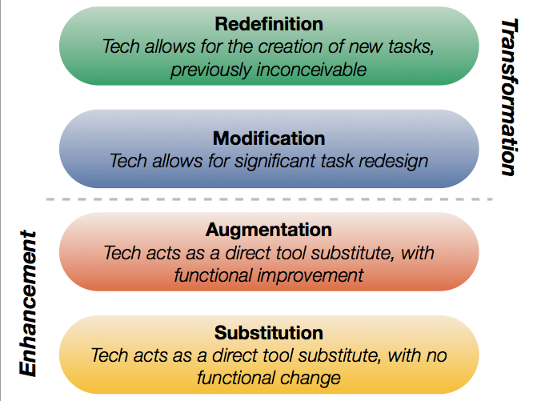
SAMR Model of Tech Integration

Slide 8
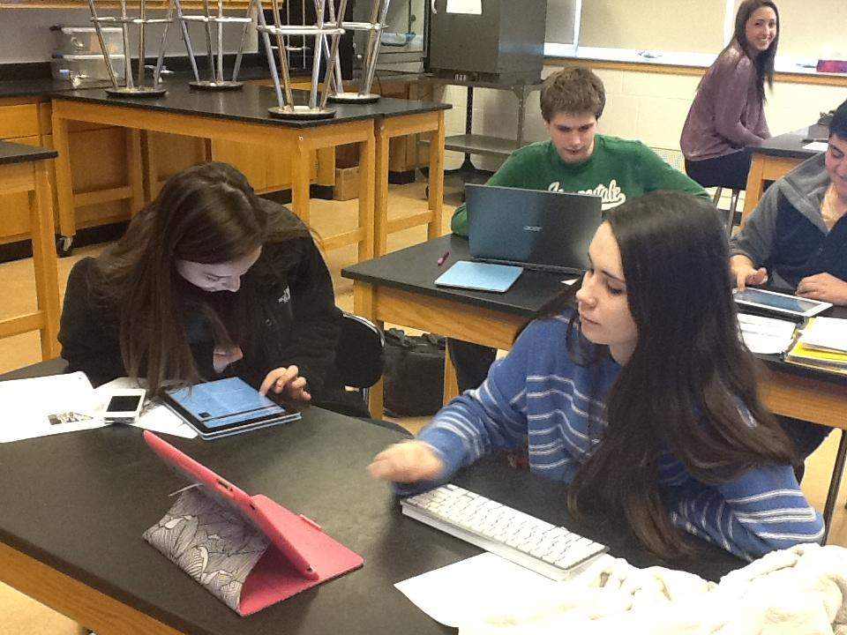
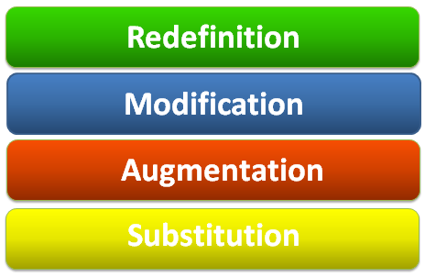
Substitution
Research
Note-taking
Digital work submission

Slide 9
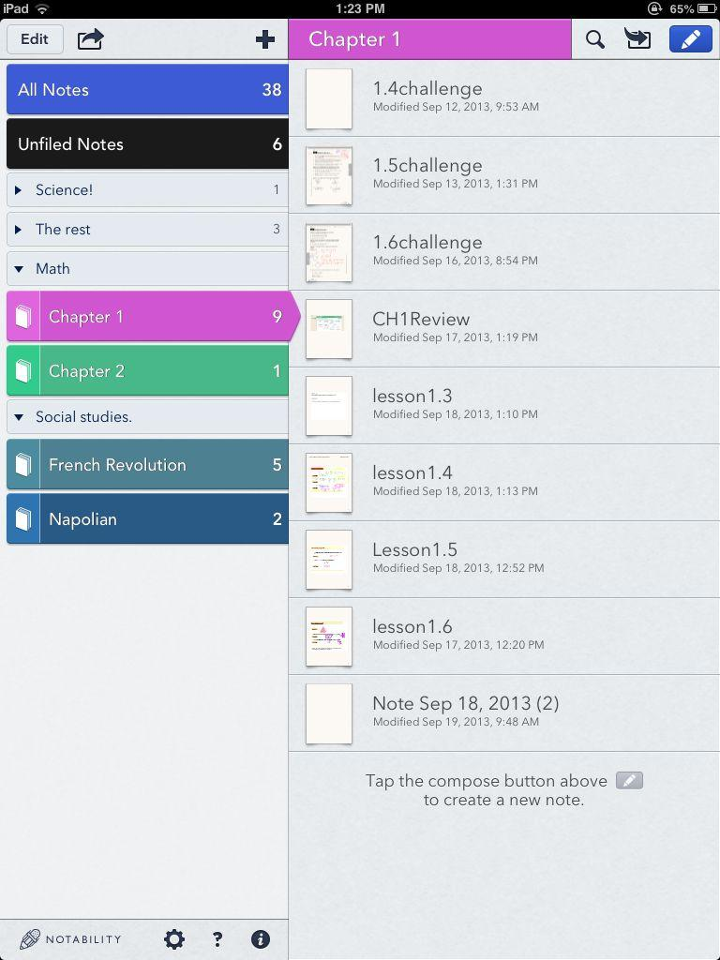
Digital Note Taking & Annotation

Slide 10
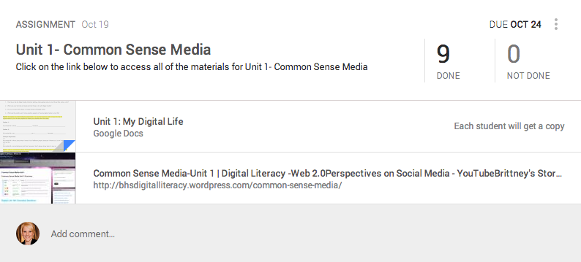
Augmentation
Google Classroom

Slide 11
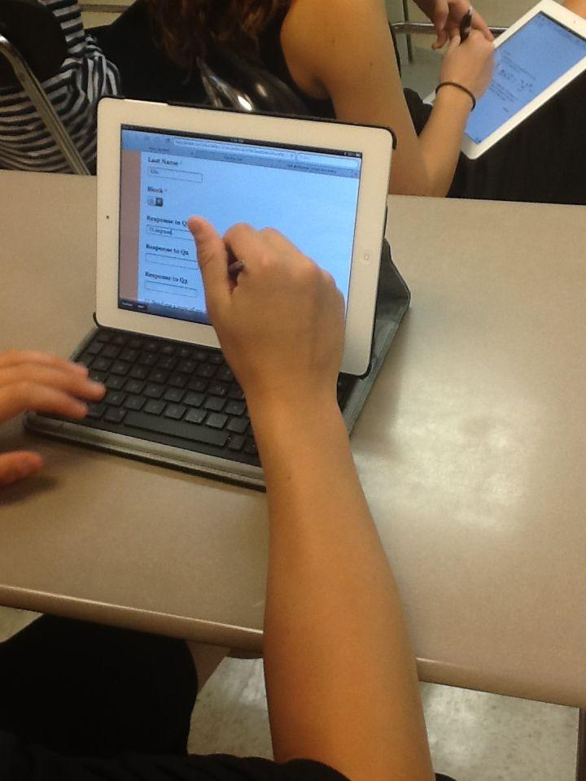
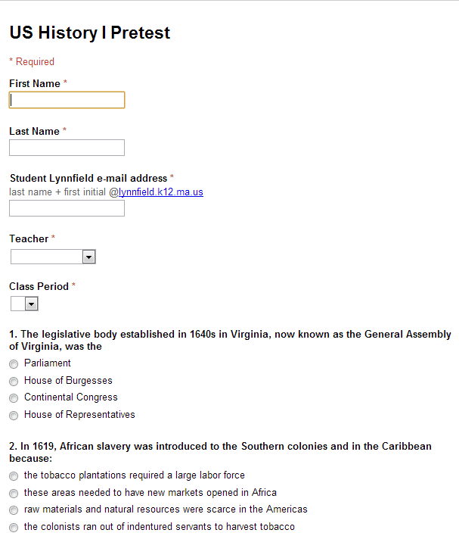
Paperless Assessment & Auto-Grading

Slide 12
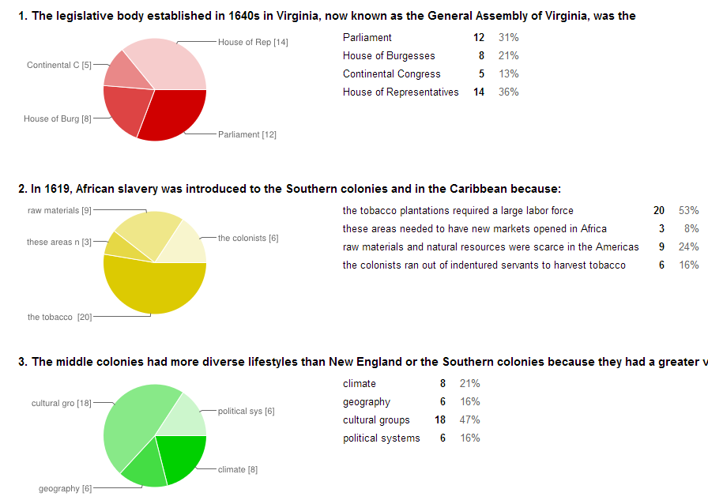

Slide 13
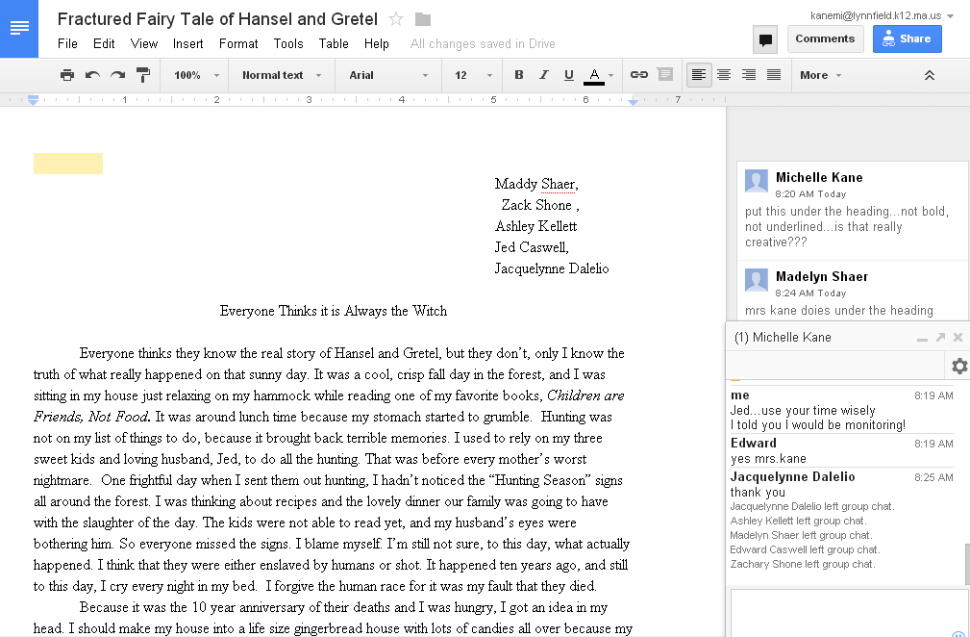
Modification
Built-in chat for immediate teacher feedback
Multiple simultaneous editor - group writing

Slide 14
Modification
Student Presentation Projects
Click to view:
http://goo.gl/R74b58 http://goo.gl/QVpK8r

Slide 15
Redefinition
Newscast
Communication & presentation skills

Slide 16
Redefinition
Animal research project grade 4
Click link to view examples:
http://goo.gl/EtkPai
Notes:
eachers embed links to extend learning
In-text discussion questions

Slide 17
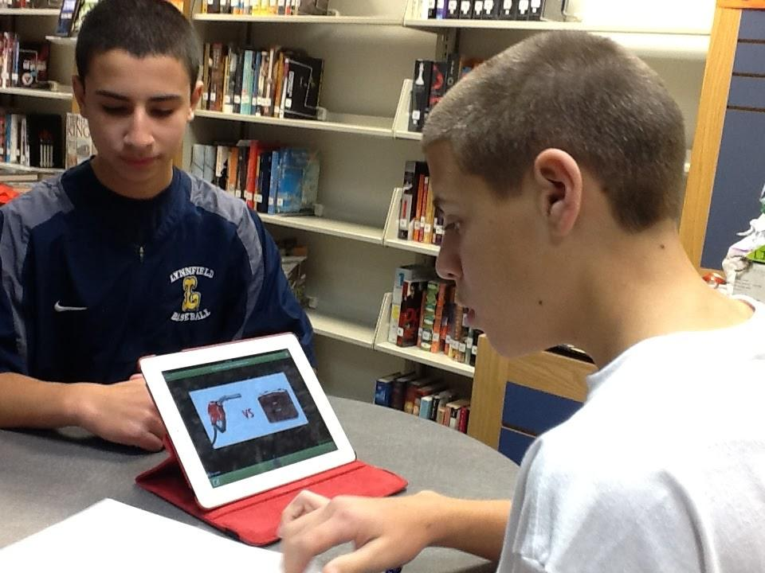
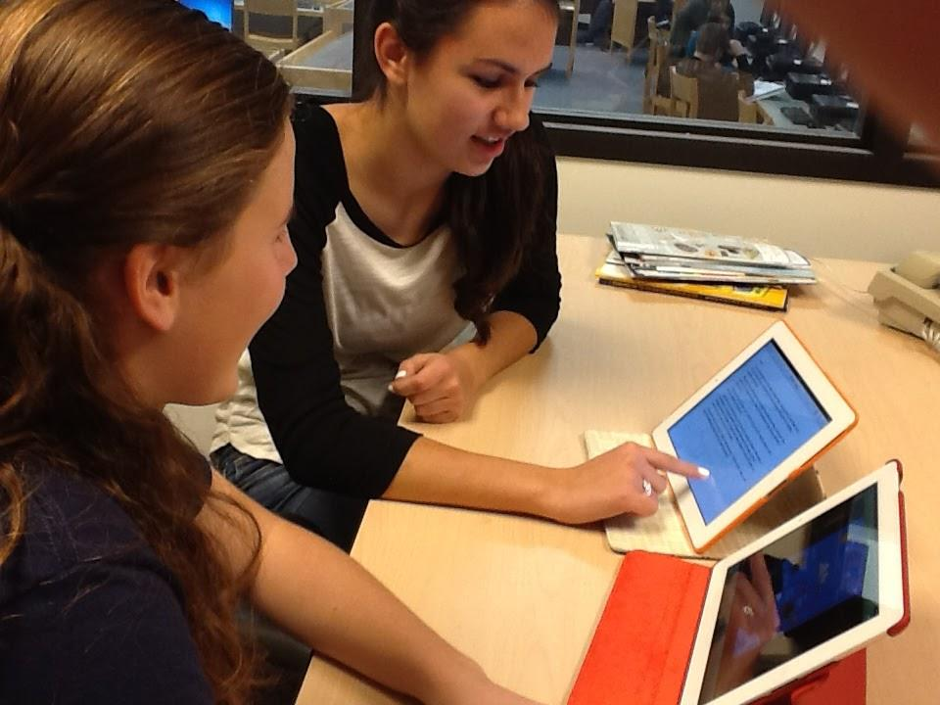
Redefinition
Narrated Slideshows
Real-time collaboration on script writing w/ Google Docs

Slide 18
Student Help Desk Video Call

Slide 19
Redefinition
Augmented Reality in the Classroom

Slide 20
Redefinition
Maker Spaces

Slide 21
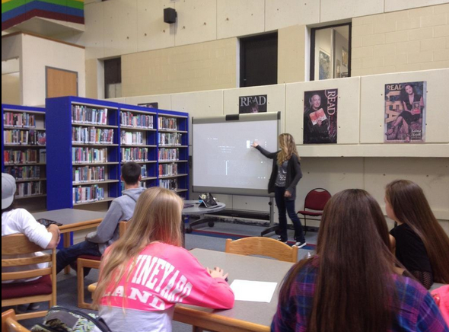
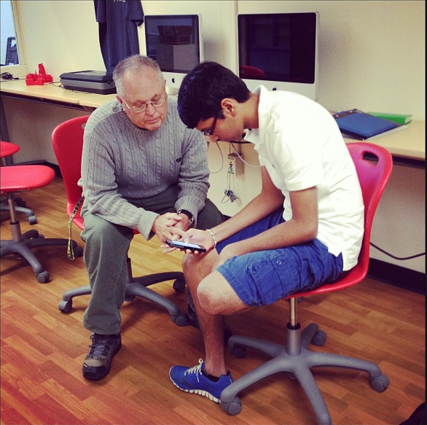
Students as Technology Leaders
Bbhshelpdesk.com
lhshelpdesk.com
#techteamMA

Slide 22
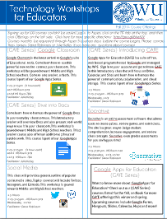
Teacher Leaders &
Professional Development
Technology Vertical Team Technology Trainers
#wpsk12

Slide 23
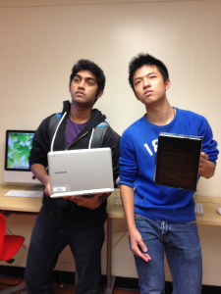
The Great Device Debate
iPad vs. Chromebook (student perspective)

