Slide 1
State of Early Education in Massachusetts Presentation to the Massachusetts School Committees and School Superintendents Associations Joint Conference November 14, 2014
Thomas L. Weber, Commissioner

Slide 2
A Commonwealth of Communities
APPENDIX

Slide 3
Why Early Education Matters
Massachusetts students continue to lead their peers on national and international measures of student achievement.
There are still persistent achievement gaps that disproportionally affect certain students.
Vocabulary gaps can be seen early
Statewide MCAS results for third-graders (Sept. 2014):
32% scored below proficient in Mathematics
43% scored below proficient in English-Language Arts
Access to high-quality early education is essential to closing achievement gaps.
Investment in early ed yields:
Benefits to government and society
Benefits to workforce and families
Positive return in savings on education, crime and welfare spending; increased taxes on earnings
Notes:
Data show that 3/4 of children who struggle with reading in 3rd Grade will continue to struggle academically through their educational careers.

Slide 4
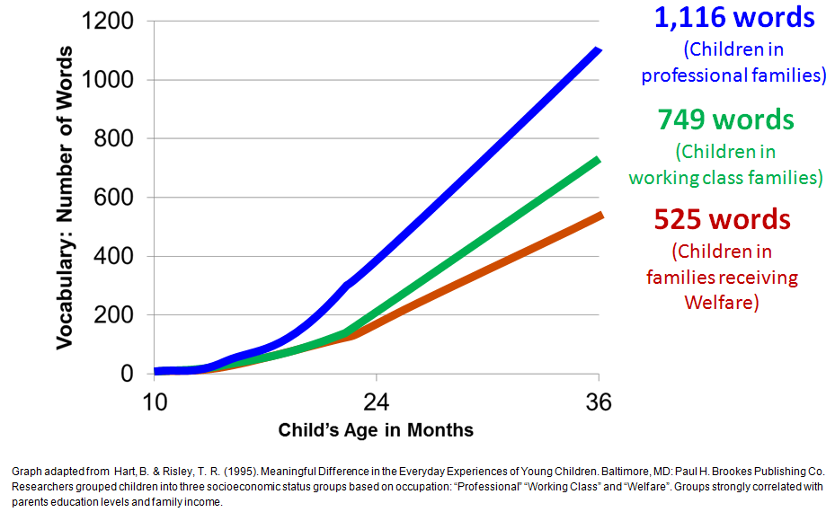
The Achievement Gap Begins Early
Vocabulary gaps by household occupational status can be seen early:
Statewide MCAS results for third-graders (Sept. 2014):
32% scored below proficient in Mathematics
43% scored below proficient in English-Language Arts
Notes:
MCAS Score Levels:
Advanced
Proficient
Needs Improvement
Warning/Failing
New York Times recently highlighted new Stanford research findings -- language gap evident as early as 18 months in children who are from lower-income homes

Slide 5
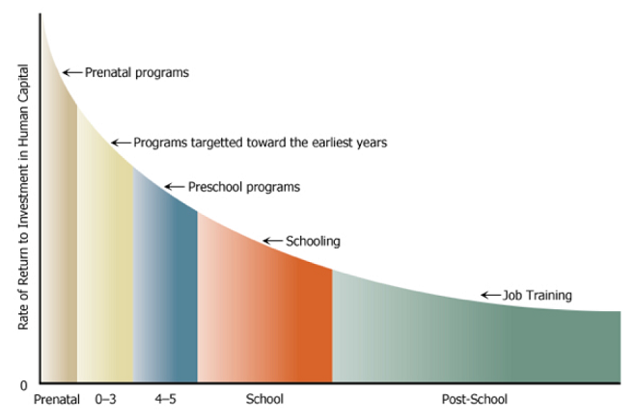
Investing Early Makes Economic Sense
Research suggests greater ROI the earlier the investment
Investment in early ed yields positive return in savings on education, crime and welfare spending; increased taxes on earnings*
Investment of $15K/child returned total public benefit of $195K/child*
Graph Source: Heckman, James (2008) “Schools, Skills, and Synapses” Available online at: https://heckman.uchicago.edu/sites/heckman2013.uchicago.edu/files/uploads/Heckman_2008_Schools%20skills%20and%20synapses.pdf
*From “Lifetime Effects: The High/Scope Perry Preschool Study Through Age 40 (pp. 194–215), by Lawrence J. Schweinhart, Jeanne Montie, Zongping Xiang, W. Steven Barnett, Clive R. Belfield, & Milagros Nores, 2005, Ypsilanti, MI: High/Scope Press. © 2005 by High/Scope ® Educational Research Foundation. Available at: http://www.highscope.org/file/Research/PerryProject/specialsummary_rev2011_02_2.pdf
Notes:
The earliest years of a child's life are the most formative in terms of their overall growth and development making it an opportune time for supporting their learning.
It's much harder and more costly to play a game of catch up later.

Slide 6
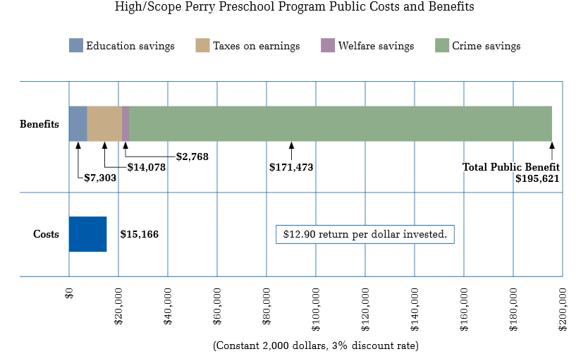
Quantifying the Value
From “Lifetime Effects: The High/Scope Perry Preschool
Study Through Age 40 (pp. 194–215), by Lawrence J. Schweinhart, Jeanne Montie, Zongping Xiang, W. Steven Barnett, Clive R. Belfield, & Milagros Nores, 2005, Ypsilanti, MI: High/Scope Press. © 2005 by High/Scope ® Educational Research Foundation. Available at: http://www.highscope.org/file/Research/PerryProject/specialsummary_rev2011_02_2.pdf

Slide 7
A Bold Step
The Commonwealth established the Massachusetts Department of Early Education and Care in 2005
First agency of its kind in the nation
Department was created to develop a more effective and coordinated early education and care system
Merged the Office of Child Care Services with the Early Learning Services division of the (former) Department of Education (now the Department of Elementary and Secondary Education)

Slide 8
The Department of Early Education and Care
We license programs, provide financial assistance, and much more!
quality
family engagement
licensing/ investigations
mental health
infants/toddlers
safety/ BRC
workforce
subsidies/waitlist/ I&R
UPK
Notes:
Some misconceptions about EEC/EEC programs:
They are still called “day cares”
We give out child care ‘vouchers’ [instead of ‘subsides’; public doesn’t understand the difference between vouchers and contracts, or how either works]
That we “inspect” programs; public thinks this is just safety/compliance related and doesn’t understand what licensing is, what QRIS is, and what QRIS means for quality improvement
We oversee public preschool classes – public doesn’t understand our jurisdiction, and that public preschool programs are overseen by the public school district, we administer the federal special education preschool funding but ESE still mostly monitors the compliance of this funding, not EEC

Slide 9
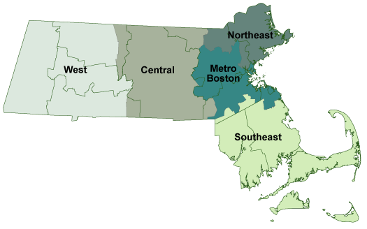
EEC Licensed Programs
Total programs* statewide: 10,078 (July 2014)
2,386
1,824
1,903
2,287
Program Setting | Children
Family Child Care | 51,357
Small Group and School Age | 246
Large Group and School Age | 171,255
Total licensed capacity | 222,858
1,718
*Includes family child care and group/school age child care only. Does not include Residential programs or placement agencies.

Slide 10
We Can’t Do It Without Our Partners!
Central to these connections is EEC’s partnership with families and communities…
Key EEC Stakeholders
EEC Board
Legislature
EEC Advisory Council
Public School Districts
Provider Working Team
MADCA MAP MASSCAP YMCAs
SEIU 509
Head Start SCO Mass HS Ass’n
GovernorEOE, ESE DHE
CCR&RsCFCEs EPS
…as EEC recognizes and values that families are their child’s first teacher.
Notes:
This graphic is not meant to be all-inclusive. We know that there are unaffiliated, independent providers not represented by some of the membership organizations shown here

Slide 11
Budget Funding
Total amounts are adjusted for prior appropriations continued into the next fiscal year.
Federal Supplements:
$23.97M CCDF through ARRA – supported access and quality
$50M Early Learning Challenge for system quality (2012-15)
Potential $60M Preschool Expansion Grant
Notes:
The majority of EEC’s funding is actually federally-sourced through revenue claiming ($416.7M).

Slide 12
Funding for Early Education
The majority of EEC’s funding is actually federally-sourced through revenue claiming ($416.7M).
EEC’s total budget for FY15 is $535M.
Line Item | Descriptor | FY2015 GAA
3000-1000 | Administration | $ 13,365,851
3000-1050 | EEC Assessment | $ 385,000
3000-2000 | Access Management | $ 6,503,861
3000-3050 | Supportive Care | $ 79,730,057
3000-4040 | Birth Through Pre-school expansion | $ 15,000,000
3000-4050 | DTA Related Child Care | $ 133,477,330
3000-4060 | *Income Eligible Child Care | $ 241,894,678
3000-5000 | Grants to Head Start | $ 9,100,000
3000-5025 | K1 Classroom Grant Program | $ 1,000,000
3000-5075 | UPK | $ 7,500,000
3000-6075 | Mental Health | $ 750,000
3000-7040 | EEC Contingency Contract Retained Revenue | $ 200,000
3000-7050 | Services for Infants and Parents | $ 18,464,890
3000-7070 | Reach Out and Read | $ 700,000
1599-0042 | CBC Reimbursement Rate Reserve | $ 6,573,571
 |  | $ 534,645,238
*DOES NOT INCLUDE FY14 PAC
An estimated $33M in Ch. 70 state funding supports approximately 20K children in public preschool classrooms

Slide 13
Formal Programs: Who EEC Serves
Infant | Toddler | Preschool | School Age*
0 - 14 mos | 15 - 32 mos | 33 mos – 4 yrs, 11mo | 5-13 yo (up to 16 yo if child has special needs)
*School Age children may be served in a before or after school program, or a summer program, or both

Slide 14
Universe of Children Birth to Age 16

Slide 15
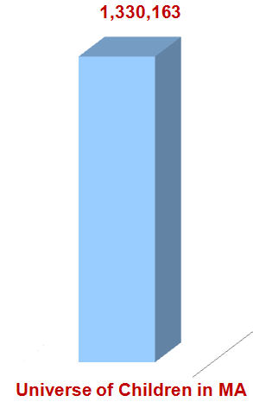
Reach of Current Subsidy System
Children Enrolled in Early Education Program through EEC subsidy:
Current Monthly Caseload
We can account for at least another 70,000 children 0-Gr.12 who are supported through public (state and federal dollars.
Notes:
Transitional Child Care (subsidies for DTA involved families) held steady from 15,847 in FY10 to 15,882 in FY14 (average number of children served monthly.)
Supportive Child Care (subsidies for DCF involved families) increased slightly from 6,158 in FY10 to 6,180 in FY14 (average number of children served monthly.)
Income Eligible Child Care (subsidies for low-income families) increased from 29,118 in FY10 to 30,629 in FY14 (average number of children served monthly.)
In addition, EEC served 3,083 new children in FY14 through $15M waitlist remediation funding. EEC expects to serve an additional 2,500 with this same amount in FY15.

Slide 16
Other Children Served Through Publicly Funded Early Education
We can account for at least another 70,000 children birth to grade 12 who are supported through public (state and federal dollars.
Public School District PreK (2.9 – 5 years old): 28,189*(1)
Early Head Start, Head Start (0-5 years old): 14,000**
Afterschool/Out of School Time Quality (K- Gr.12): 11,300*** (State grant through ESE, funds may support partnerships with EEC-licensed programs)
21st Century Community Learning Centers (K- Gr.12): 17,000**** (State grant through ESE, funds may support partnerships with EEC-licensed programs)
(1) Funding sources include Ch.70 state and local aid, EEC’s Inclusive Preschool Grant ($9M), and the federal Individuals with Disabilities Education Act (IDEA) grant ($7M)
*2013-14 Enrollment By Grade Report (District), Department of Elementary and Secondary Education
**Office of Head Start Program Information Report, and Massachusetts Head Start State Supplemental Funding Grant Report
***Report to the Legislature on After-School and Out-of-School Time Quality Enhancement Grants: 2013
****21st Century Community Learning Centers Program Fiscal Year 2013 Year End Report
Notes:
Private-pay: 96,694 (source: Strategies for Children)
Limitations of this data:
It is not all inclusive of funding for school district operated/license exempt afterschool/out of school time programs. There may be local funding or other state funding (e.g., EOPPS) that supports ASOST.
The ASOST and 21st Century grants allow for partnerships with EEC licensed programs, therefore those counts may include children already accounted for in EEC’s count of subsidized children in school age programs
The ASOST grant serves up to grade 12

Slide 17
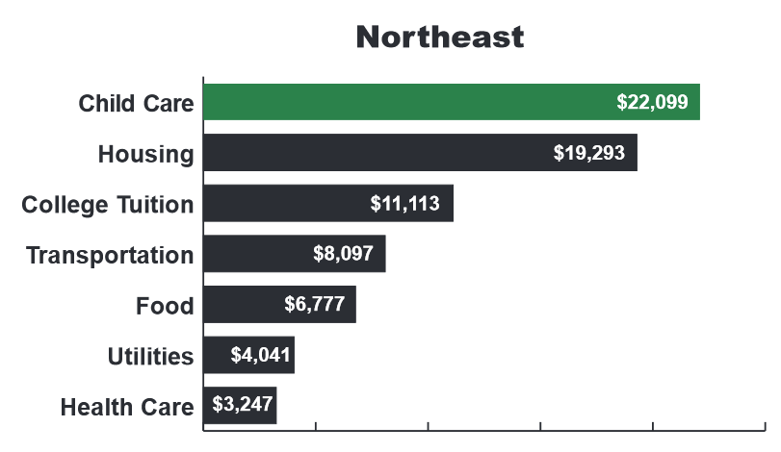
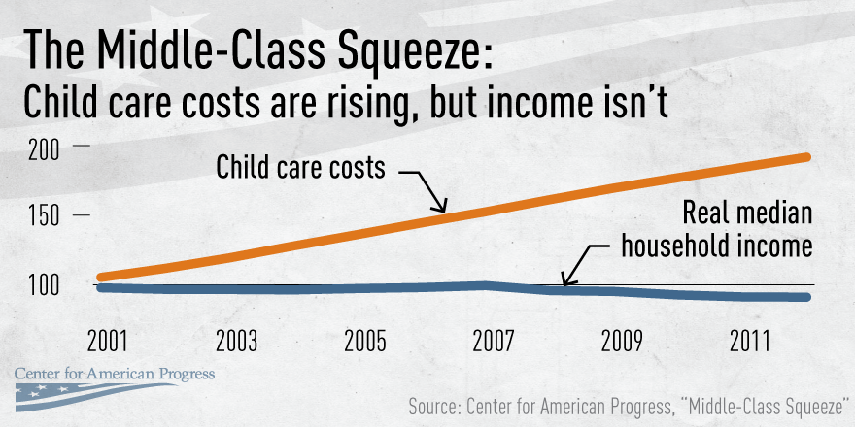
Affordability of Child Care
The high cost of child care is not just a challenge for low-income families.
Center-Based Care Costs for Two Children
MA: 6th least affordable state center-based care
Avg annual cost $12,176 for 4-yo center-based care is 44.1% of the median income for a single-mother family

Slide 18
Other Options For PreK Are Limited
Early/Head Start (mostly federally-funded)
$15,130 or less household income for family of two
Ages 0-5 years old
Not available in all communities
Public school districts
May charge (if not special needs)
Not available in all districts
Not always full day or full year
Community based programs that fundraise and offer own scholarships or sliding fee scale.
Waitlist:
PreK (0-5): 16,616
School Age: 11,841
Total: 28,457

Slide 19
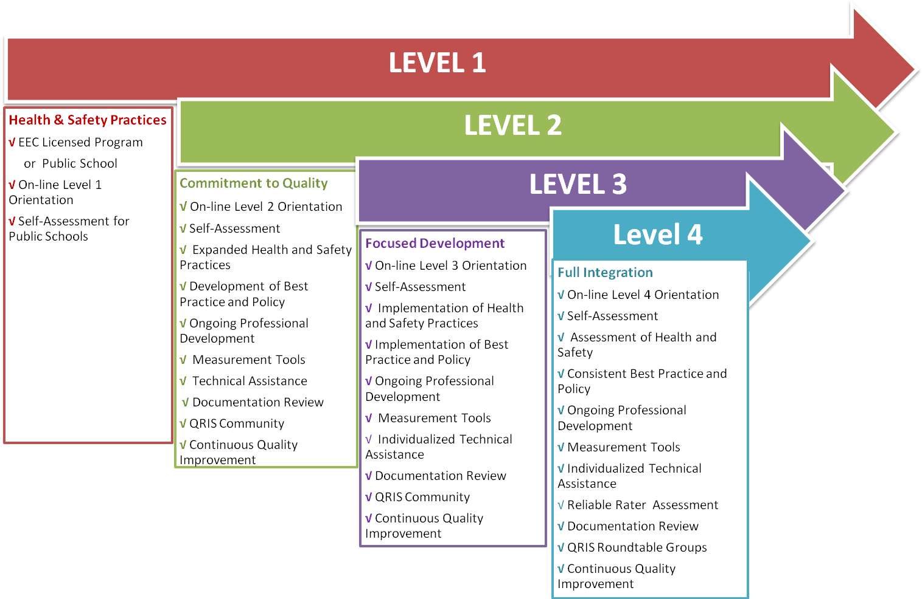
Moving to Higher Levels of Quality
As programs meet higher standards in each category, they progress upward in overall level in the QRIS.

Slide 20
Moving Towards Higher Education/Qualifications
Accreditation, UPK and QRIS all have requirements on minimum number of educators who must possess a college degree
EEC Scholarship supports about 3 courses/year per student
6-7 years for Associate’s Degree
13 years for a Bachelor’s Degree
However still unequal compensation structure
Family child care provider median salary: $25,001 - $27,500*
Center-based educator median salary: $22,501 - $25,000*
Public school educator avg. starting salary in MA: $40,462**
Est. 30% of the early educator workforce attrits annually.
Salaries/ benefits = most significant operation costs for programs
Notes:
The ECE Scholarship was initially earmarked for up to $4M, the earmark was removed and scholarship has been included in the general line financial aid line item for the Office of Student Financial Assistance.
Current appropriation is $3.2M. Each year the demand for the scholarship exceeds the supply.
UPK – classroom must have at least one educator with a BA
QRIS
Level 2 = 50% of classrooms in the program must have at least one educator with a BA degree
Level 3 = 75% of classrooms in the program must have at least one educator with a BA degree
Level 4 = 100% of classrooms in the program must have at least one educator with a BA degree
NAEYC requires (http://www.naeyc.org/academy/pursuing/edquals/candidacy)
75% of teachers have CDA or equivalent or are working towards associate's or higher in ECE or unrelated associate's or higher with 3+ years of experience in NAEYC accredited program or experience outside of NAEYC program and 30 contact hours
Administrator has bachelor's degree and at least 9 credit-bearing hours of specialized college-level course work in administration, leadership, or management AND at least 24 credit-bearing hours of specialized college-level course work in early childhood education, child development, elementary education or early childhood special education that addresses child development and learning from birth through kindergarten,

Slide 21
Notable Accomplishments
Creation of EEC (FY05)
Early Childhood Educators Scholarship program launched (FY06)
Universal Pre-Kindergarten (UPK) Program launched (FY07)
Professional Development Calendar posted online (FY08)
Workforce Task Force Review and Report (FY08)
Updates to program licensing regulations (FY10)
Professional Qualifications Registry established (FY10)
Guidelines and Standards for early education and care* (FY10-14)
Quality Rating and Improvement System (QRIS) launched (FY11)
“Brain Building in Progress” Campaign launched (FY11)
$50 million federal Early Learning Challenge (ELC) Grant award (2012-2015)
Enhancements to background records checks (BRC) (FY13)
Rate increases for subsidized providers of early education and care (FY14, FY15)
Capital fund for early education and care facilities (FY14)
Initial design of a differential licensing model (FY14)
NGA Birth to Third Grade Strategy with ESE and DHE (FY14)
Legislative commission review on EEC administration and operations (FY14)
Notes:
*includes Infants/Toddlers, ELA and Math PreK, STE PreK, and Dual Language Learners

Slide 22
Challenges
Increasing Access - Income Eligible, Supportive
Improving Affordability
Supporting Quality Agenda
Workforce Development
Compensation
Infrastructure
Information Technology
Cross-Sector Alignment
Staffing, including high licensor caseloads
273:1 for family child care providers
90:1 for center-based providers
Notes:
The Commonwealth’s FY14 program to licensor ratios will be 273:1 for family child care providers and 90:1 for center-based providers.
According to Child Care Aware and other nationally recognized accrediting bodies for early education and care programs, the recommended ratios are 75:1 for family child care providers and 50:1 for center-based providers.
Under IT mention:
Preparation for 2016 CCDF Block Grant requirements
Require visits reports/investigations online
Require more frequent program visits
Require background checks
See slides in Appendix for full list of IT challenges, Quality challenges, and Access challenges

Slide 23
Partnerships: Current and Potential
Race to the Top – Early Learning Challenge
MKEA
Birth to 8 Strategy
NGA
Early Educators’ Fellowship
*Early Literacy Expert Panel
*K1 Classroom Grant
*Preschool Expansion Grant

Slide 24
K1 Classroom Grant Program
$1M in FY2015 Budget
For grants to cities, towns, regional school districts and educational collaboratives to provide educational opportunities on a voluntary basis to 4-year-olds in the district through the creation of Pre-Kindergarten classrooms
ESE and EEC to jointly develop application guidelines and approve requests for funding
Quality standards on teacher qualifications, curriculum, ideal class size, and best practices
Preference to be given to innovative, collaborative proposals jointly proposed by school districts, private providers, human service agencies, and local/regional non-profits that ensure Pre-K classrooms have appropriate wrap-around child care and human services;
Preference may be given to Gateway Cities, level 3 and level 4 schools

Slide 25
Early Literacy Expert Panel
Source: Nonie K. Lesaux, PhD, Harvard Graduate School of Education. Presentation to the EEC and ESE Boards, January 27, 2014

Slide 26
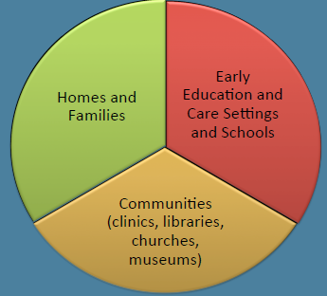
Early Literacy Expert Panel
Source: Nonie K. Lesaux, PhD, Harvard Graduate School of Education. Presentation to the EEC and ESE Boards, January 27, 2014

Slide 27
Preschool Expansion Grant
New grant program jointly administered by U.S. Departments of Education (ED) and Health and Human Services (HHS)
Program supports State and local efforts to build, develop, and expand High-Quality Preschool Programs so that more children from low- and moderate-income families enter kindergarten ready to succeed in school and in life.
Request for $60M total awarded over four years annual ($15M per year)
$14,250,000 to expand PreK
$750,000 to enhance statewide quality and accountability structures across the state.
Notes:
The states eligible to apply for a Preschool Development Grants--Expansion Grant are Arkansas, California, Colorado, Connecticut, Delaware, District Of Columbia, Florida, Georgia, Illinois, Iowa, Kansas, Kentucky, Louisiana, Maine, Maryland, Massachusetts, Michigan, Minnesota, Nebraska, New Jersey, New Mexico, New York, North Carolina, Ohio, Oklahoma, Oregon, Pennsylvania, Rhode Island, South Carolina, Tennessee, Texas, Vermont, Virginia, Washington, West Virginia, and Wisconsin.

Slide 28
The Expansion Partnership Model
High-quality preschool programming for eligible 4 year-olds
Model: partnership between LEA and EEC-licensed providers.
Local school district is lead grantee
EEC-licensed subgrantees to provide services
Five High Need Commonwealth communities
Boston
Holyoke
Lawrence
Lowell
Springfield
Together, these communities are home to 15.38% of the four-year olds in the Commonwealth

Slide 29
Opportunities
How can EEC better support the work of public preschools and elementary schools?
What is working well and what can be improved?
Where are there additional untapped opportunities to collaborate for improved child and family outcomes?
Notes:
Suggested by Strategies for Children: What is working? What would you change? What does the ideal since the look like?

