Slide 1
_{State Ethics}
^{Commission}
Conflict of Interest Seminar-
School Districts

Slide 2
THE COMMISSION
◆ is a five-member, independent, non-partisan agency.
◆ provides advice, education and enforcement of M.G.L. 268A and 268B.
◆ has jurisdiction over all state, county and municipal employees, including volunteers, paid
or unpaid, full-time, part-time, intermittent or
specials.

Slide 3
THE DIVISIONS
◆ Public Education Division:
Seminars, Website, Media.
◆ Legal Division:
Free, confidential, guidance, oral or written.
Statements of Financial Interests.
◆ Enforcement Division:
Investigates 900-1200 complaints a year. Complainant identity kept confidential. Anonymous complaints accepted.

Slide 4
Website
www.mass.gov/ethics
    Educational materials
    Formal Legal Opinions
    Enforcement Decisions
    Disclosure Forms
    Links to the Online Training Program and Summary of the Conflict of Interest Law for Municipal Employees

Slide 5
Obtaining Legal Advice
Speak to the Attorney of the Day
    Advice is Confidential
    Advice can be given by telephone (617-371-9500), email, or letter.
    Online request for advice, www.mass.gov/ethics.
    No third party or past conduct advice given.
    Disclosure forms available on the website.

Slide 6


Slide 7
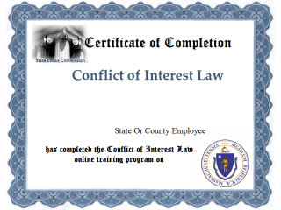

Slide 9
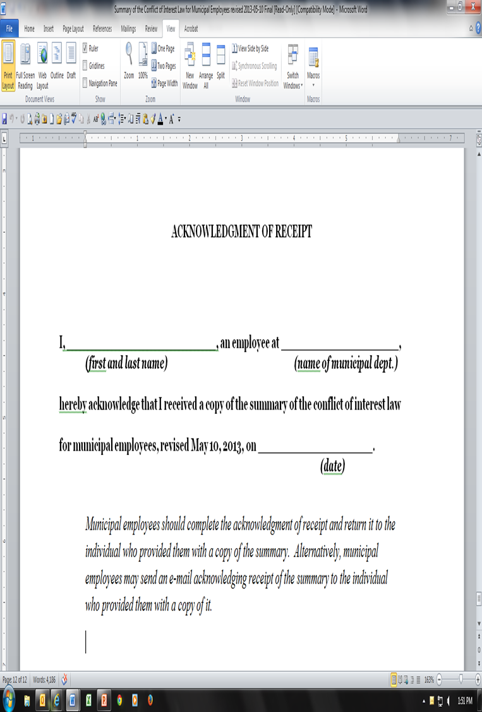

Slide 10
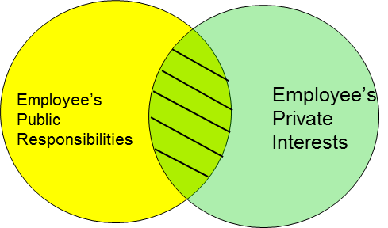
CONFLICTS 101
Professional Life Personal Life
Focus of the Conflict of Interest Law

Slide 11
Conflict of Interest Law: Gifts
School Employees may not accept:
Bribes
Gifts, Gratuities or Any Item of Value Worth $50 or more and that is given because of an official act or because of official position.

Slide 12
Conflict of Interest Law: Gifts
GIFTS THAT MAY BE PROHIBITED
Meals
Event Tickets [Advisory 04-01]
Free Travel or Expense Reimbursements
Gift Certificates
Floral Arrangements/Fruit Baskets
Lottery Tickets
Gifts offered through sales promotions

Slide 13
Conflict of Interest Law: Gifts
Gifts worth less than $50 are not prohibited, but a written disclosure may be required to dispel an appearance of a conflict interest.
Amounts can be Aggregated.

Slide 14
Regulatory Exemption: Gifts
Class Gifts to Teachers
Gift Cards to Reimburse or pay for classroom supplies
Passes to School Events
Unsolicited Perishable Items

Slide 15
Regulatory Exemption: Gifts
Travel Expense Payment or Reimbursement for Events that Serve a Legitimate Public Purpose
Incidental Hospitality at Events that Serve a Legitimate Public Purpose
School Dept. employees, including supervisory employees can advocate for their children
Fee based Services Available to the Public

Slide 16
Regulatory Exemption: Gifts
Gifts of Nominal Value are allowed
A gift without retail value, such as a plate of cookies or other homemade food items, hand-picked flowers, handmade gifts, or other items worth less than $10, need not be disclosed, because a reasonable person would not think that a teacher would unduly show favor to the giver.
Teacher FAQs available on the website

Slide 17
NEPOTISM
A public employee may not in general participate in particular matters in which he, his immediate family, a partner, a business organization with which he has certain affiliations or someone with whom he is negotiating prospective employment has a financial interest.
Hiring, Supervising and Personnel Matters
Budgets
Contracts
Negotiating for Employment

Slide 18
IMMEDIATE FAMILY
BOTH SETS OF PARENTS
YOU
YOUR SPOUSE
SIBLINGS
SIBLINGS
YOUR CHILDREN

Slide 19
Regulatory Exemption
930 CMR 6.09: Exemption for School Committee Members
School Committee members may participate in
general school fees that will affect their child if
the school committee member first files a
disclosure of the financial interest with the city or
town clerk.

Slide 20
CODE OF CONDUCT
A school department employee shall not knowingly:
 Act in a manner such that a reasonable person might
conclude that he or she might act with bias.
 One-step written disclosure to dispel appearance of conflict.
 Secure unwarranted privileges for his/herself or others.
 Use school resources for private or personal use.
 Disclose confidential information.

Slide 21
POLITICAL ACTIVITY
    SOLICITING CAMPAIGN SUPPORT FROM COLLEAGUES, SUBORDINATES OR CONSTITUENTS
    CAMPAIGN ACTIVITIES IN PUBLIC BUILDINGS
    CANNOT USE MUNICIPAL RESOURCES FOR POLITICAL PURPOSES
Advisory 11-1: Public Employee Political Activity

Slide 22
JOB RECOMMENDATIONS
Advisory 13-1: Making and Receiving Recommendations for
Employment
Explains how the conflict of interest law applies to elected and appointed public employees in connection with making and receiving job recommendations.

Slide 23
PRIVATE COMMERCIAL RELATIONSHIPS
Advisory 14-1: Public Employees’ Private Business
Relationships And Other Private Dealings
With Those Over Whom They Have
Official Authority Or With Whom They
Have Official Dealings

Slide 24
SEEKING NEW EMPLOYMENT
Advisory 15-1: Avoiding Conflicts of Interest While Seeking
a New Job and After Leaving Public
Employment
Explains how the conflict law applies to public employees
when seeking new employment with those with whom the
public employee has had official dealings, and after the
public employee leaves public employment.

Slide 25
Divided Loyalties
School Dept. employees may not act on the behalf of, or be paid by third parties in connection with matters of direct and substantial interest to the municipality.
Law applies less restrictively to special municipal employees

Slide 26
Regulatory Exemption
930 CMR 6.03: Exemption to Permit School Department
Employees Who Are Parents to Advocate
for Their Children
    A public employee may advocate for their children
    provided that they follow established procedures and do
    not seek special consideration for their child.
    Persons holding supervisory positions with a school
    department or agency related to education must disclose,
    but the disclosure may omit identifying information to the
    extent necessary to protect a student's privacy rights.

Slide 27
Divided Loyalties
Exceptions to the rule:
Disciplinary/Personnel issues if uncompensated.
Family members if appointing authority approves.
Testimony/Sworn Statements.
Can Apply for Gas, Plumbing, Electrical or Septic Permits.

Slide 28
FINANCIAL INTERESTS IN
CONTRACTS
Unless an exemption applies, a public employee may not have a financial interest in a public contract
  Applies to Teachers Involved in:
    Tutoring
    Coaching
  Law applies less restrictively to special municipal employees
Teacher FAQs available on the website

Slide 29
REVOLVING DOOR PROVISIONS
 THE FOREVER BAN
 THE ONE YEAR COOLING OFF PERIOD
A former municipal employee is prohibited from receiving compensation from or representing a third party in any particular matter in which he participated as a municipal employee.
A former municipal employee is prohibited for one year from appearing personally on behalf of a third party if, within two years prior to his last day of employment, the matter was under his official responsibility.

Slide 30
REVOLVING DOOR PROVISIONS
 THE FOREVER BAN
A former municipal employee is prohibited from receiving compensation from or representing a third party in any particular matter in which he participated as a municipal employee.
Partners in the firm may also be restricted in matters where the former municipal employee is restricted under the Forever Ban.

Slide 31
Quick Tips
When in doubt …..
If a bell goes off or a flag goes up ….
Visit us on the Web at
DON’T
CALL
617/371-9500
888/485-4766
www.mass.gov/ethics

